Slide 1


Friendship
Paving the Way Team

Slide 2
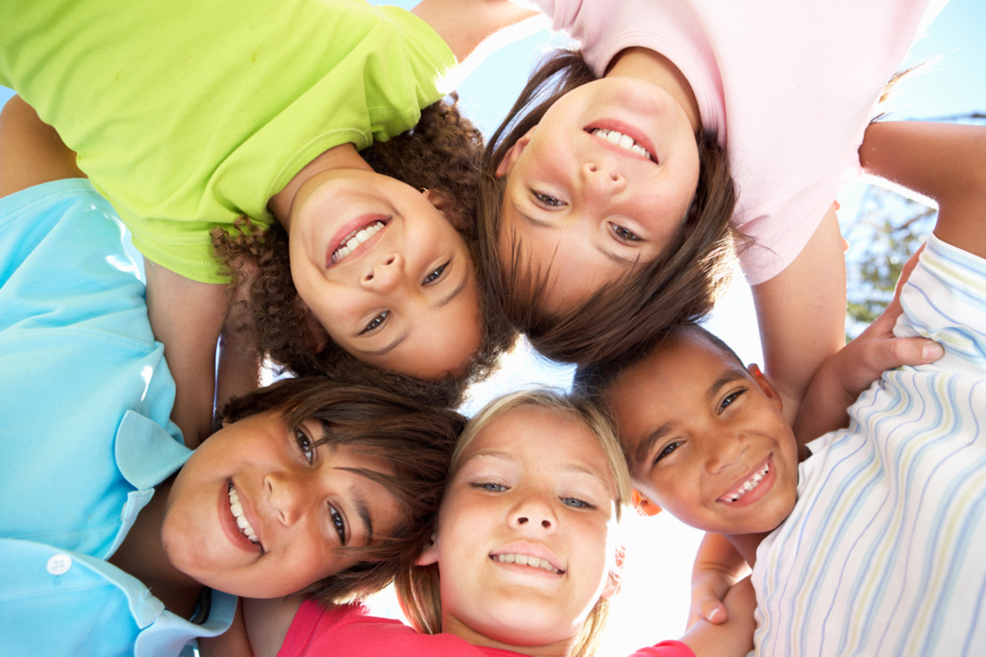

What is a friend?
What is self esteem?
A friend is a person someone likes or knows, they spend time together. They help each other when they are in trouble or are hurt. Friends are people that we can look up to and trust.

Slide 3
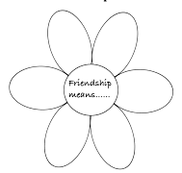

What makes a good friend?
Talk about the characteristics that make a good friend?
Activities
What is self esteem?
Using these templates, write the qualities you look for in a friend on the petals or the fingers. You may want to think about somebody who is a good friend to you. You can then colour and decorate.
Friendship flower
Friendship hand

Slide 4
Words you could have used:
fun
sharing
respectful
honest
trustworthy
loyal
listens
forgiving
helpful
kind

Slide 5
Let’s watch this fun video
What is self esteem?
Let’s watch this fun video
Let’s learn a bit more about friendship!
Please press ctrl + click:
Video on building friendships and relationships

Slide 6
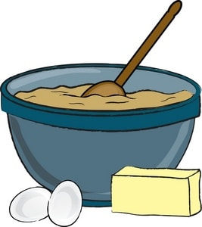
Activity time! Complete your own recipe
What is self esteem?
Let’s watch this fun video

Slide 7

How to be a make friends
Lets think how to be a friend magnet:
Smile/be cheerful
Compliment at least one person each day
Be kind online
Be a good sport about losing a game
Let people know you are interested in them
Be yourself
Share feelings, plans and ideas
Start conversations
Look for common interests

Slide 8
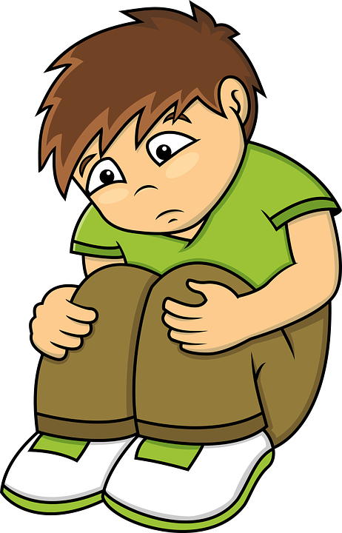
When friendships become tricky
Having friends can be really fun but we can all sometimes find it tricky to make friends or struggle when we fall out with them.
Lets talk about how this makes us feel.

Slide 9
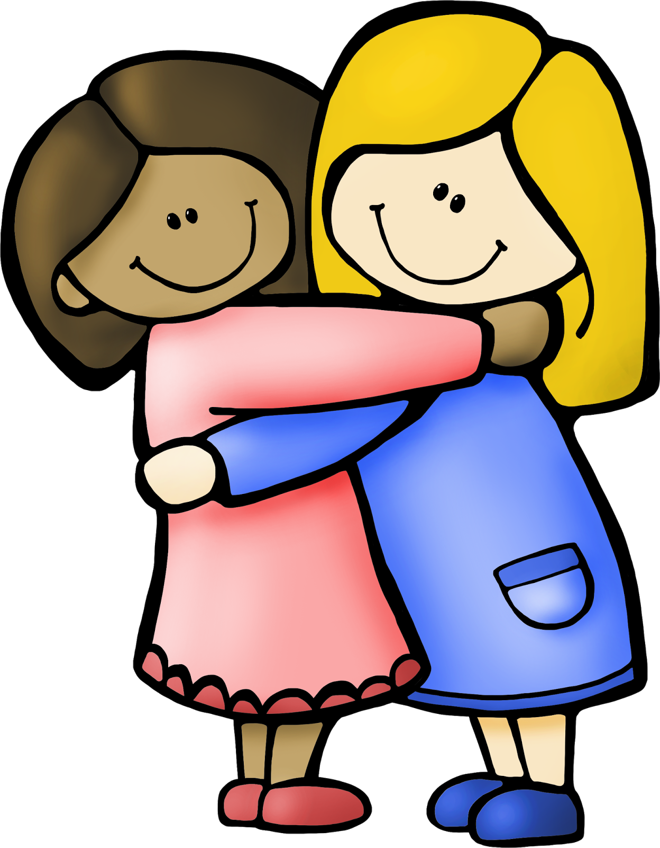
What can help
Stop and take some time out calmly to think about the situation
Talk to your friend about how you feel, listen to how they are feeling
Say sorry if you need to and accept others apologies
Talk to a trusted adult about what has happened
Ask for help, we all need it sometimes
This Photo by Unknown Author is licensed under CC BY-NC

Slide 10

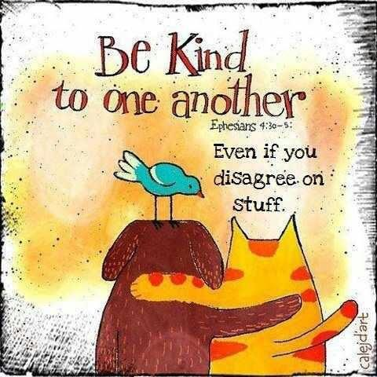
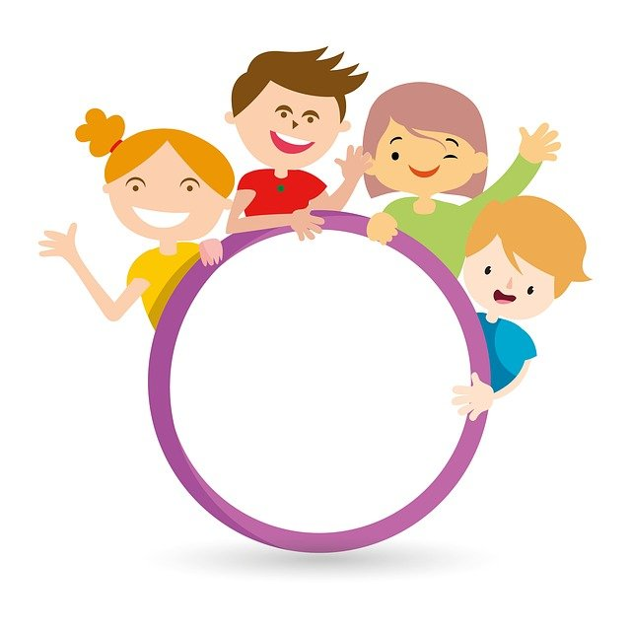

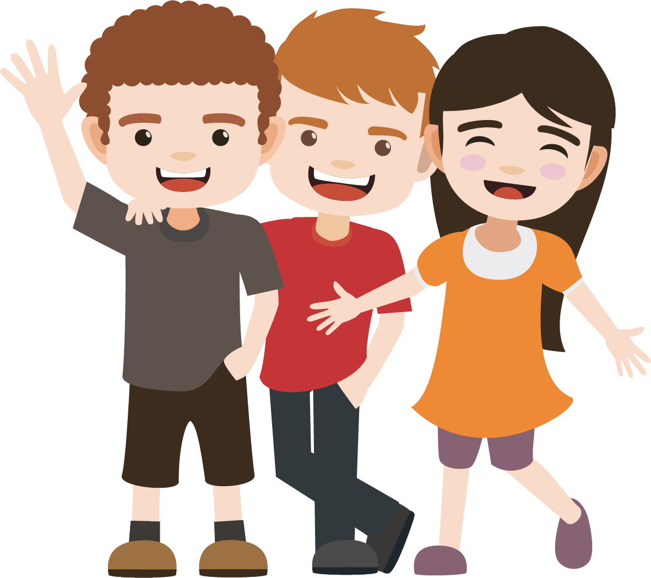
Celebrate the good times!
This Photo by Unknown Author is licensed under CC BY-NC

