Slide 1
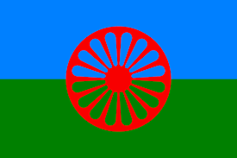

Gypsy, Roma and
Traveller People
An assembly prepared by the Traveller Education Service – Cognus Ltd
Notes:
Today we are going to find out about Travellers. The flag you can see at the top of the picture is the Romani flag which is often used as a symbol for Travellers.

Slide 2



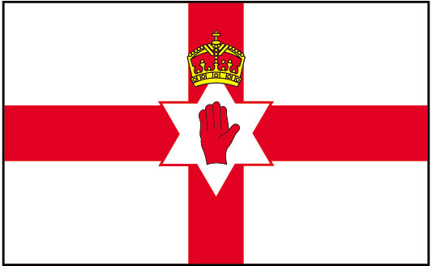

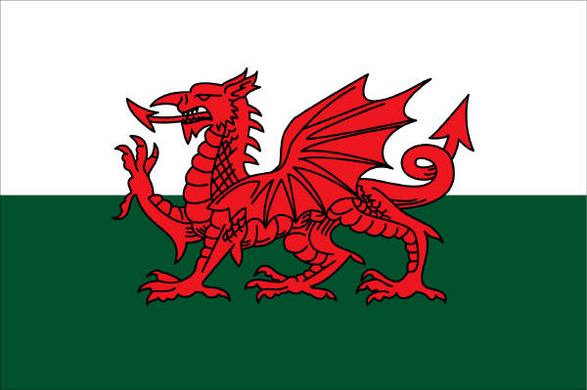
Gypsy, Roma and Traveller People
Traveller Communities
Let’s think about the word “British“.
It can include lots of different types of people...
Even though they are all very different, they are all still British.
That is the same for Travellers.
The word "Traveller" can describe people from different groups.
BRITISH
England
Scotland
Wales
Northern Ireland
Catholic
Christian
Hindu
Other faith
House
Flat
Caravan

Slide 3
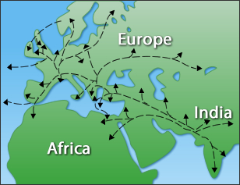

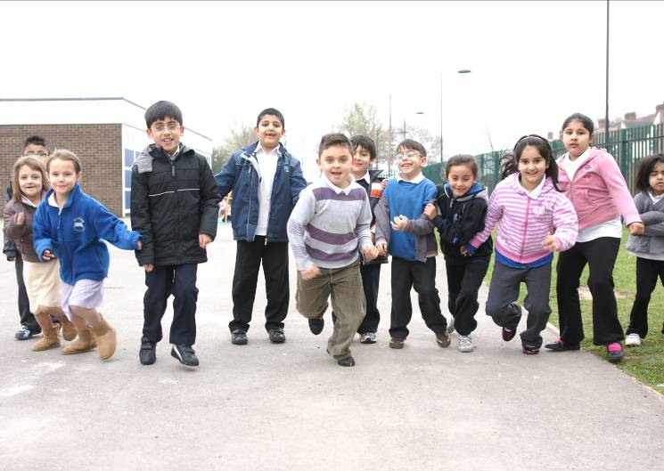
Gypsy, Roma and Traveller People
Romany / English Gypsies
Originally from the India.
In Britain since 1514.
‘The Travelling Egyptians’
Roma
Originally from the India.
Moved to Britain more recently.
Notes:
Gypsies originally came from the India. They travelled across Asia and Europe and eventually arrived in Britain in 1514 (the time of Henry VIII).
When they arrived in Europe people thought they were from Egypt and called them ‘The Travelling Egyptians’.
Roma also came from India originally like Gypsies, but they only moved to the UK more recently from Central and Eastern Europe. Many of them had leave their homes as they were in danger there.

Slide 4

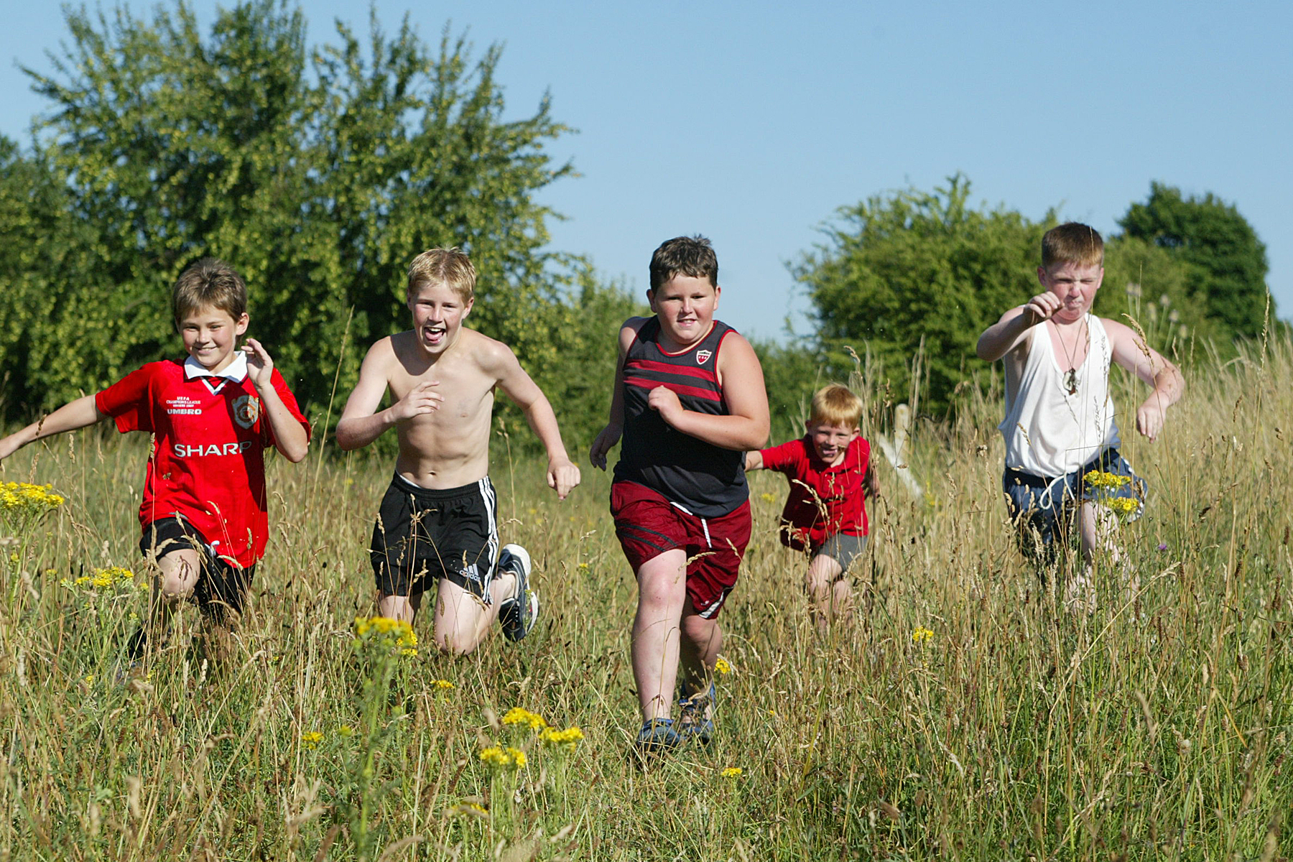
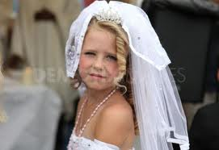
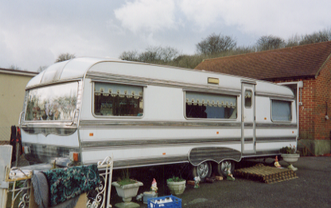
Gypsy, Roma and Traveller People
Irish Travellers
In Britain since 1850’s.
Speak Cant or Gammon.
Usually Catholic.
Scottish Travellers
Called Scottish Travellers, Scottish Gypsies or Nawkens or Nachins.
Can also speak Cant.
Known for their story-telling and songs.
Notes:
Irish Travellers are first recorded as arriving in Britain in the 1850’s.
They speak a language called Cant or Gammon.
They are also usually Catholic.
Although there is a large Irish Traveller community living permanently in the UK, some travel from or back to Ireland for part of the year.
Scottish Gypsy Travellers are made up of a range of different groups. They call themselves Scottish Travellers, Scottish Gypsies or
Nawkens or Nachins.
Like Irish Travellers, many also speak Cant.
Scottish Travellers are known for their story-telling and songs.

Slide 5
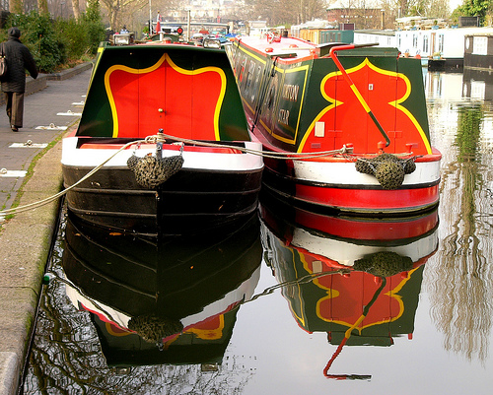
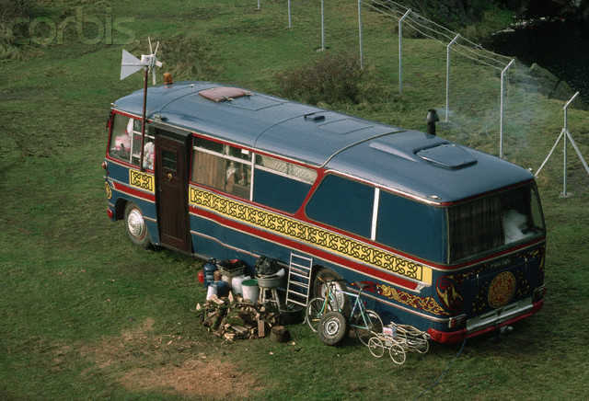
Gypsy, Roma and Traveller People
Some of the other Traveller groups are:
Boat People / Bargees
Bargee families live on the their boats.
New Travellers
New Travellers choose to live away from the hustle and bustle of towns and cities.
Notes:
Hundreds of years ago, the canals of Great Britain were used to transport goods between major cities and this led to the creation of a new way of life.
Although the canals are rarely used for transporting goods now, some people prefer this quieter, simpler way of living.
It began in the 1970's for various reasons. Many wanted a change from city life and a life style that would offer different experiences.
Since then their children have been brought up that way and now it is their tradition.

Slide 6
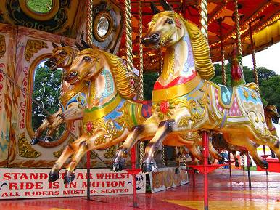
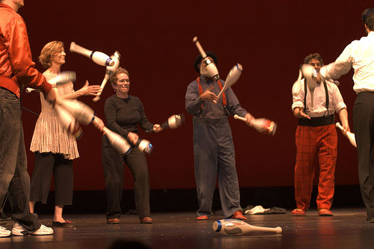
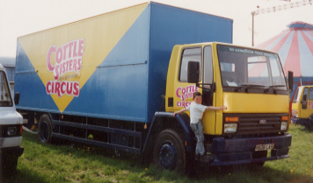
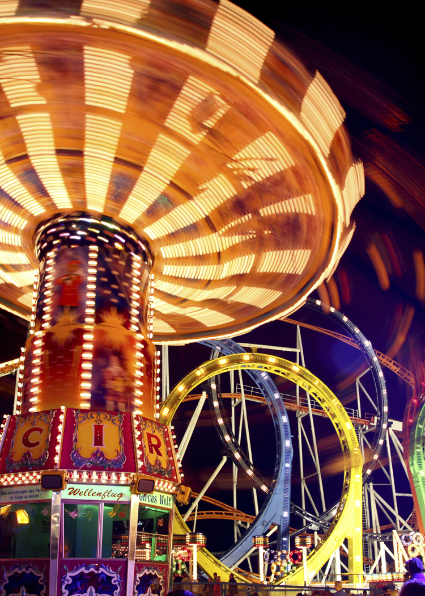
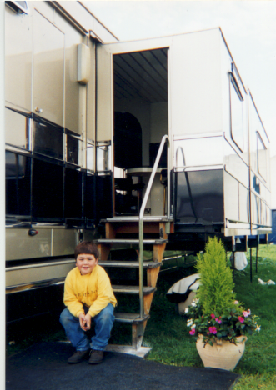
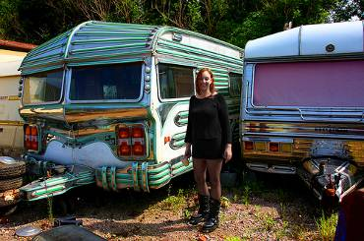
Gypsy, Roma and Traveller People
Fairground (Showmen) / Circus
Fairground (or Showmen) and Circus families travel with their circus or rides.
The families move from place to place on a weekly basis.
They have a winter ground
for the "off-season“.
Notes:
Fairground (or Showmen) and Circus families travel with their circus or rides from about March to around October.
The families move from place to place on a weekly basis, often following routes and visiting fairs or locations which their families have visited for generations.
Families tend to have a family owned winter ground, which they will stay on during the "off-season“.

Slide 7
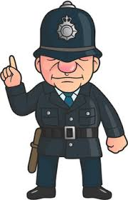
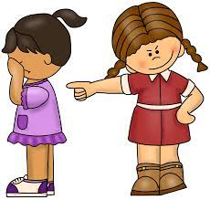


Gypsy, Roma and Traveller People
Traveller Names
We know that there are different types of Travellers with different names but it is important to know that there are some names that we must never use for Travellers.
pikey
The word ‘pikey’ is a mean and offensive word for Travellers.
In the eyes of the law using it can even be seen as a racist offence because Travellers are recognised as Ethnic Minority groups protected by the Race Relations Act.

Slide 8
Gypsy, Roma and Traveller People
Traveller Names
Some Travellers have their own distinct language but all groups use specific terms to identify non-Travellers for example:
Gypsies / Romany – Gorgios
Irish Travellers – Country folk
Fairground – Flatties
If a Traveller calls you one of these names, they are not being rude or unkind, it is just the word they use to talk about people who are different from them.

Slide 9
Gypsy, Roma and Traveller People
Traveller Talk
We know that different Travellers can sometimes speak different languages. Some of their words are used in English today.
Do you recognise any of the following words that have come
from Romany, Cant or Gammon?
cushti gavver mush
Cushti = Good Gavver = Policeman Mush = Man
Notes:
Sanskrit is of a form of language used in Northern India in the ninth century and therefore gives us a clue when the Gypsy people first left that area and began to travel the world.
In addition to the Asian words are others that originate in 'Cant' which was the language of the road used by the 'sturdy beggars' of Elizabethan England.
'Mort' meaning woman and 'kenna' for a house are examples of Cant words. Also mixed into modern day Romany Pookering are occasional words and expressions drawn from Cockney rhyming slang and other local dialects.
Some Romany words have also moved in the opposite direction and are used locally by non Travellers, these include 'cushti' meaning 'good', chavvie when used by Gypsies means 'son' or 'child' but is now used by many non Gypsies to mean 'mates'. 'Wonga' comes from the Romany 'Vonga' meaning money.

Slide 10
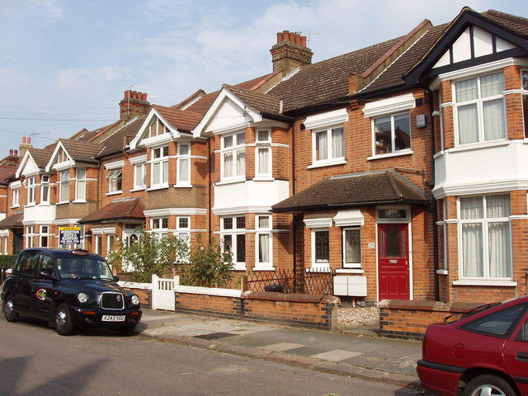
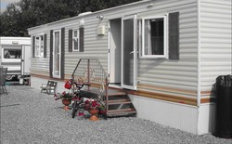
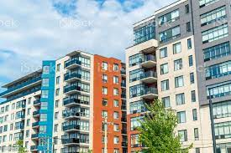
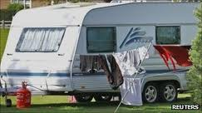
Gypsy, Roma and Traveller People
Where do they live?
Travellers can live in lots of different places, just
like you and me.
They might live in…
…a trailer
…a house
…a flat
…a caravan

Slide 11

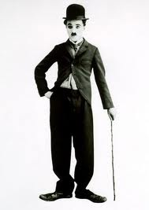
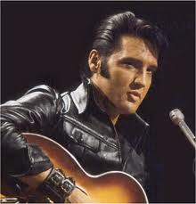

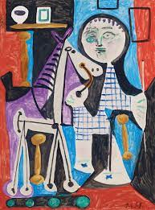
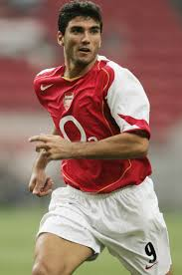
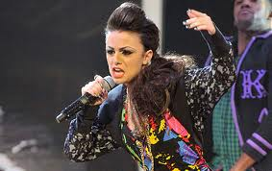
Gypsy, Roma and Traveller People
Did you know?
There are lots of very successful and famous people who were part of Gypsy or Traveller families.
Do you recognise any of them ?
Sport
Entertainment
Art
Notes:
Tyson Fury is a British professional boxer of Irish Traveller heritage. He is a two-time world heavyweight champion.
Billy Joe Saunders is a British professional boxer. He has held world championships in two weight classes, including the WBO super-middleweight title since 2019, and previously the WBO middleweight title from 2015 to 2018. Saunders is the first boxer from the Travelling community to become a two-weight world champion.
José Antonio Reyes, the Spain and former Arsenal forward was born into a Gypsy clan in Utrera, a small town south-east of Seville.
One of the most famous painters, sculptors, painters and graphic artists of the 20th century, Pablo Picasso was a Roma. Elvis Presly and Charlie Chaplin were also both from Roma origins.
Popstar sensation Cher Lloyd rose to fame through the series X-Factor, and wowed audiences with her singing skills. While not winning the series, she went on to have top ten hits. Cher is from a Romani background, and has spoken with pride of her Gypsy heritage.

Slide 12

Gypsy, Roma and Traveller People
What have you learned about
Travellers today?
An assembly prepared by the Traveller Education Service – Cognus Ltd
Notes:
So now you know a little bit more about Travellers, who they are and how they live.
I hope you have enjoyed this assembly and learned something new.
Thank you for listening.

