Slide 1
Notes – supporting a successful transition
To support a successful transition to secondary school it is really important for the young person to have information on the new school such as
what the entrance looks like
where the toilets are
rules and expectations etc.
Perhaps taking the photos could even be a job you could give some current Year 7s?

Slide 2
XXXXX High School:
Transition to Secondary School Visuals

Slide 3
Welcome message from current Year 7s

Slide 4
School entrance and reception

Slide 5
Key staff

Slide 6
Where do I go at break/lunch time?

Slide 7
Where do I get my lunch?

Slide 8
What toilets can I use?

Slide 9
Where can I go if I have a problem?

Slide 10
School rules/consequences
Example:
Rule | Consequence

Slide 11
School uniform, school bag, planner etc.

Slide 12
Tips on keeping organised

Slide 13
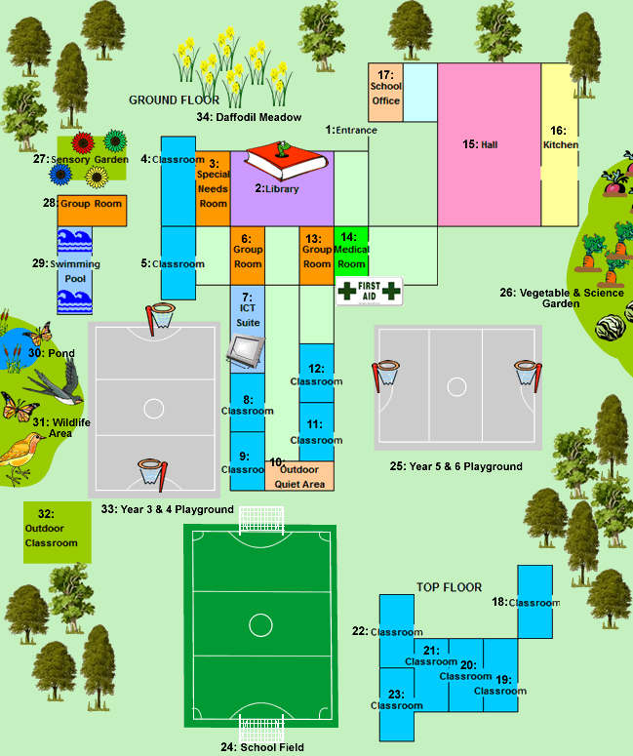
Map of the school
Example: colour coded if possible.

Slide 14
Key vocab
e.g.
Detention
form tutor

Slide 15
If I need some ‘calm down’ time, I can...
Example:

Slide 16
Daily checklist

Slide 17
Final positive message

