Slide 1
Self Esteem
Paving the Way Team
Notes:
Sarah to open

Slide 2
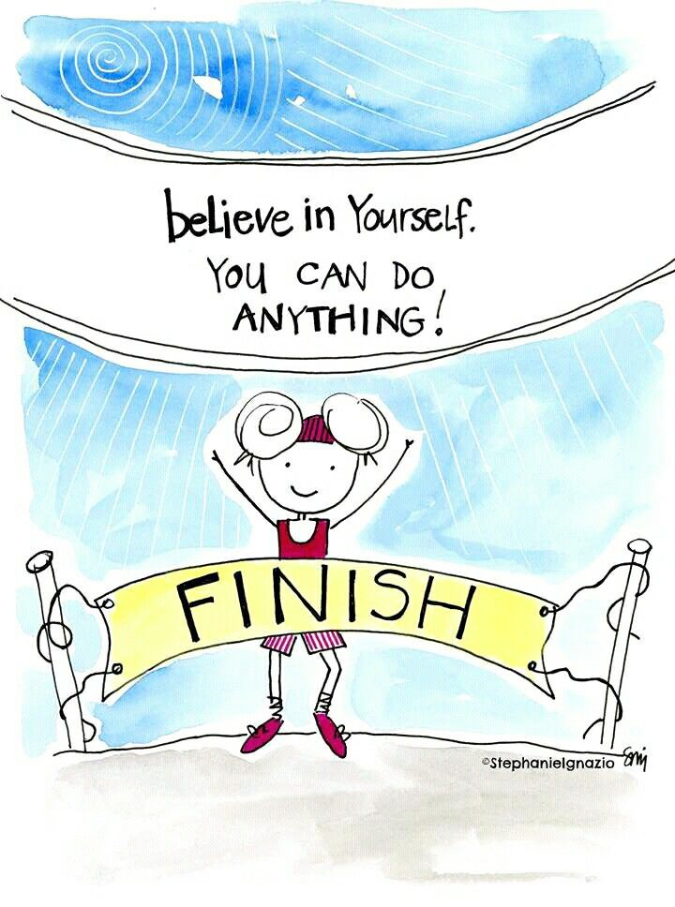
What is self esteem?
What is self esteem?
Believing in yourself!
Trying new things!
Trying again!
Finding something you are good at!
Being kind to others!
Positive thinking!
Accepting yourself!
Notes:
Ann to deliver

Slide 3
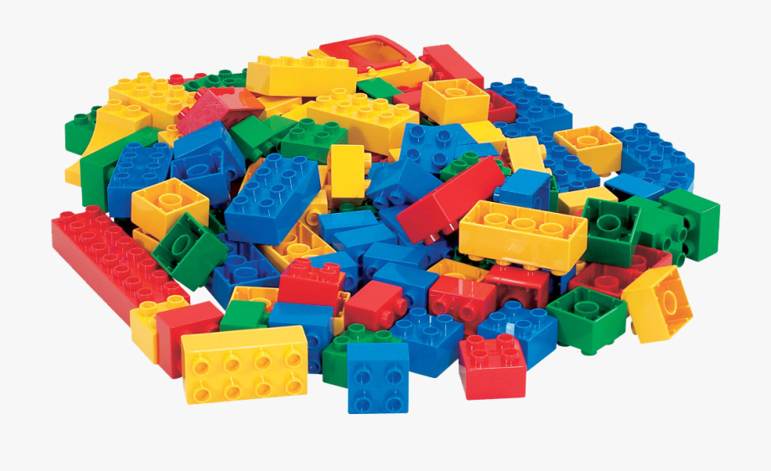
Let’s play a game
What is self esteem?
Find items in your home that spell SELF ESTEEM
You have 2 minutes .. Time’s ticking!
Notes:
Ann introduces the game. Kemi to feedback the game
Pictures of examples – Egg, Envelope, Teabag, Toothbrush, Teddy Bear, Sweet, Sock, Shoe, Mug, Mouse (not a real one), Lollipop, Lego, Lentils, Easter Egg

Slide 4
Let’s watch this fun video
What is self esteem?
Let’s watch this fun video
Let’s learn a bit more about self esteem and confidence!
https://youtu.be/pdjaxS4ME2A
Notes:
https://youtu.be/pdjaxS4ME2A - 7 minutes video – Kemi to deliver

Slide 5
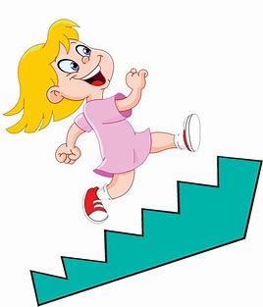
Activity time!
What is self esteem?
Let’s watch this fun video
Let’s think about something that is tricky for you
For example: “I hate eating in the lunch hall”, or “I am worried about my new class or school”
What steps would you need to make to make this less tricky for you?
Notes:
Kemi to do
10 minutes for activity - 6 year old example, who are you going to play in playground

Slide 6
Example
What is self esteem?
Let’s watch this fun video
I’m worried about eating in the lunch hall. What can I do??
6) Yay! I made it! Now I can go and play!
5) What else do I need to help me? For example, ear defenders, a special toy, something that smells nice
4) What else is worrying me about the lunch hall? For example, Noise or smell?
3) Decide who I am sitting next to
2) Find out what I’m having for lunch
1) Tell my parents/carers and teacher so they can help me
Notes:
Kemi to feedback 1& 2, Ann to feedback 3 & 4, Sarah to feedback 5& 6
*If children don’t provide examples, we can think of a problem, and make a step plan*
For some of you you may need more steps, and for some of you you may need less steps. That is okay, and it is not a race, just do what feels the most comfortable for you. If you ever need help remember, always speak to an adult you know first!

Slide 7
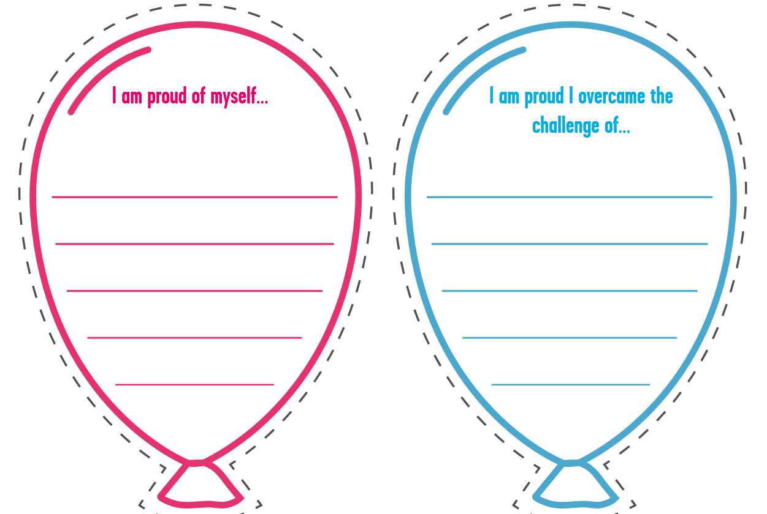
Balloons!
Notes:
Sarah to deliver
Draw balloons – If no child is speaking, speak to each other and think of examples

Slide 8
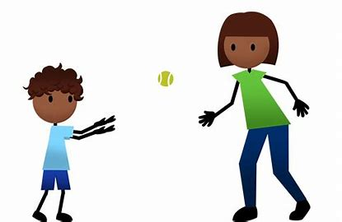
Catch the complement!
Giving and receiving complements is important for self esteem
Think about something nice someone has said about you, and enjoy and believe it!
With a group of friends and family, take turns to throw a ball (virtually if you are away from them), and give them each a complement.
Notes:
Ann to introduce
Explanation of the game – With a group of friends and family, take turns to throw a ball (virtually if you are away from them), and give them each a complement.

Slide 9
Goodbye from the Paving the Way Team!
Well done for completing the self esteem workshop!
Write down, or speak about some things you have learnt
Notes:
Kemi to deliver
*What did you learn?
*Is there anything you’d like to speak about next time?

