Slide 1
Transitions workshop
Paving the Way Team

Slide 2
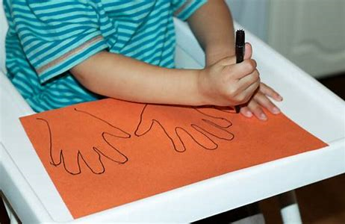
Game!
Draw around your hand like this

Slide 3
5,4,3,2,1 game
Think about and write down..
FIVE things you can see
FOUR things you can hear
THREE things you can touch
TWO things you can smell
ONE thing you can taste

Slide 4
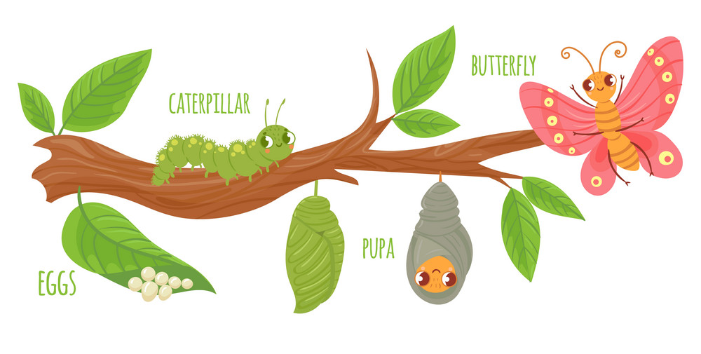
What is a transition?
What is self esteem?
A transition is …
Going through a change
Just as a caterpillar transitions into a butterfly, we can all go through transitions everyday!

Slide 5
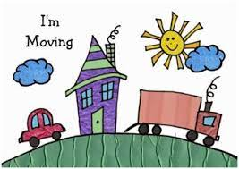
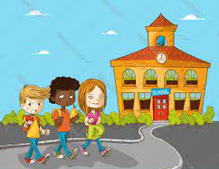
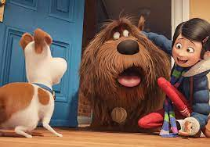
What kinds of transitions can you think about?
What other transitions can you think of?
Moving house
Going into school
Getting a new pet
Starting secondary/high school

Slide 6
Let’s watch this fun video
What is self esteem?
Let’s watch this fun video
Let’s learn a bit more about transitions!
https://open.online.clickview.co.uk/share?shareCode=cf5245be

Slide 7
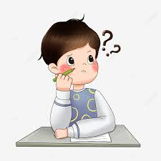
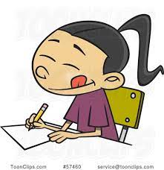
Activity time!
What is self esteem?
Let’s watch this fun video
Think of a transition each and write it down
Write down your worries and concerns about this transition
For example: Playtime
My worries might be “I don’t know who I am going to play with at playtime”

Slide 8
Growth mindset!
It can be difficult to have a lot of worries about a transition, and it can make you avoid doing things
Having a growth mindset and thinking of the word “yet” when you have a worry about a transition can help you think more positively and make a plan

Slide 9
Example
“I am not sure I can get into school tomorrow!”
What could I do?

Slide 10
The fear ladder
If your worries seem really big and tricky, using the fear ladder can help you to face your fears in small steps

Slide 11
“I am not sure I can get into school tomorrow!” Is there something that worries you about this?
Tell someone, or write down your worries
Think about your journey to school
Is your uniform uncomfortable?
Do you forget things?
Have you done your homework?
Is it too noisy when you get to school?
Is there something that worries you on your journey? (for example, a noisy dog, a strong smell)
Are you worried you will be alone?
Are you worried about what is going to happen in the day?

Slide 12
The Fear Ladder
What is self esteem?
Let’s watch this fun video
“I am not sure I can get into school tomorrow” Should we make a plan?
6) Yay! I made it! Now think about ways to reward yourself!
5) Highlight the areas in the day that you will enjoy
4) Think about your “yet”. For example, I don’t know the answers to my Maths test yet, but I will!
3) Highlight the areas that bother you
1) Tell my parents/carers and teacher so they can help me
2) Ask for a timetable so you can see what you have planned for the next day

Slide 13
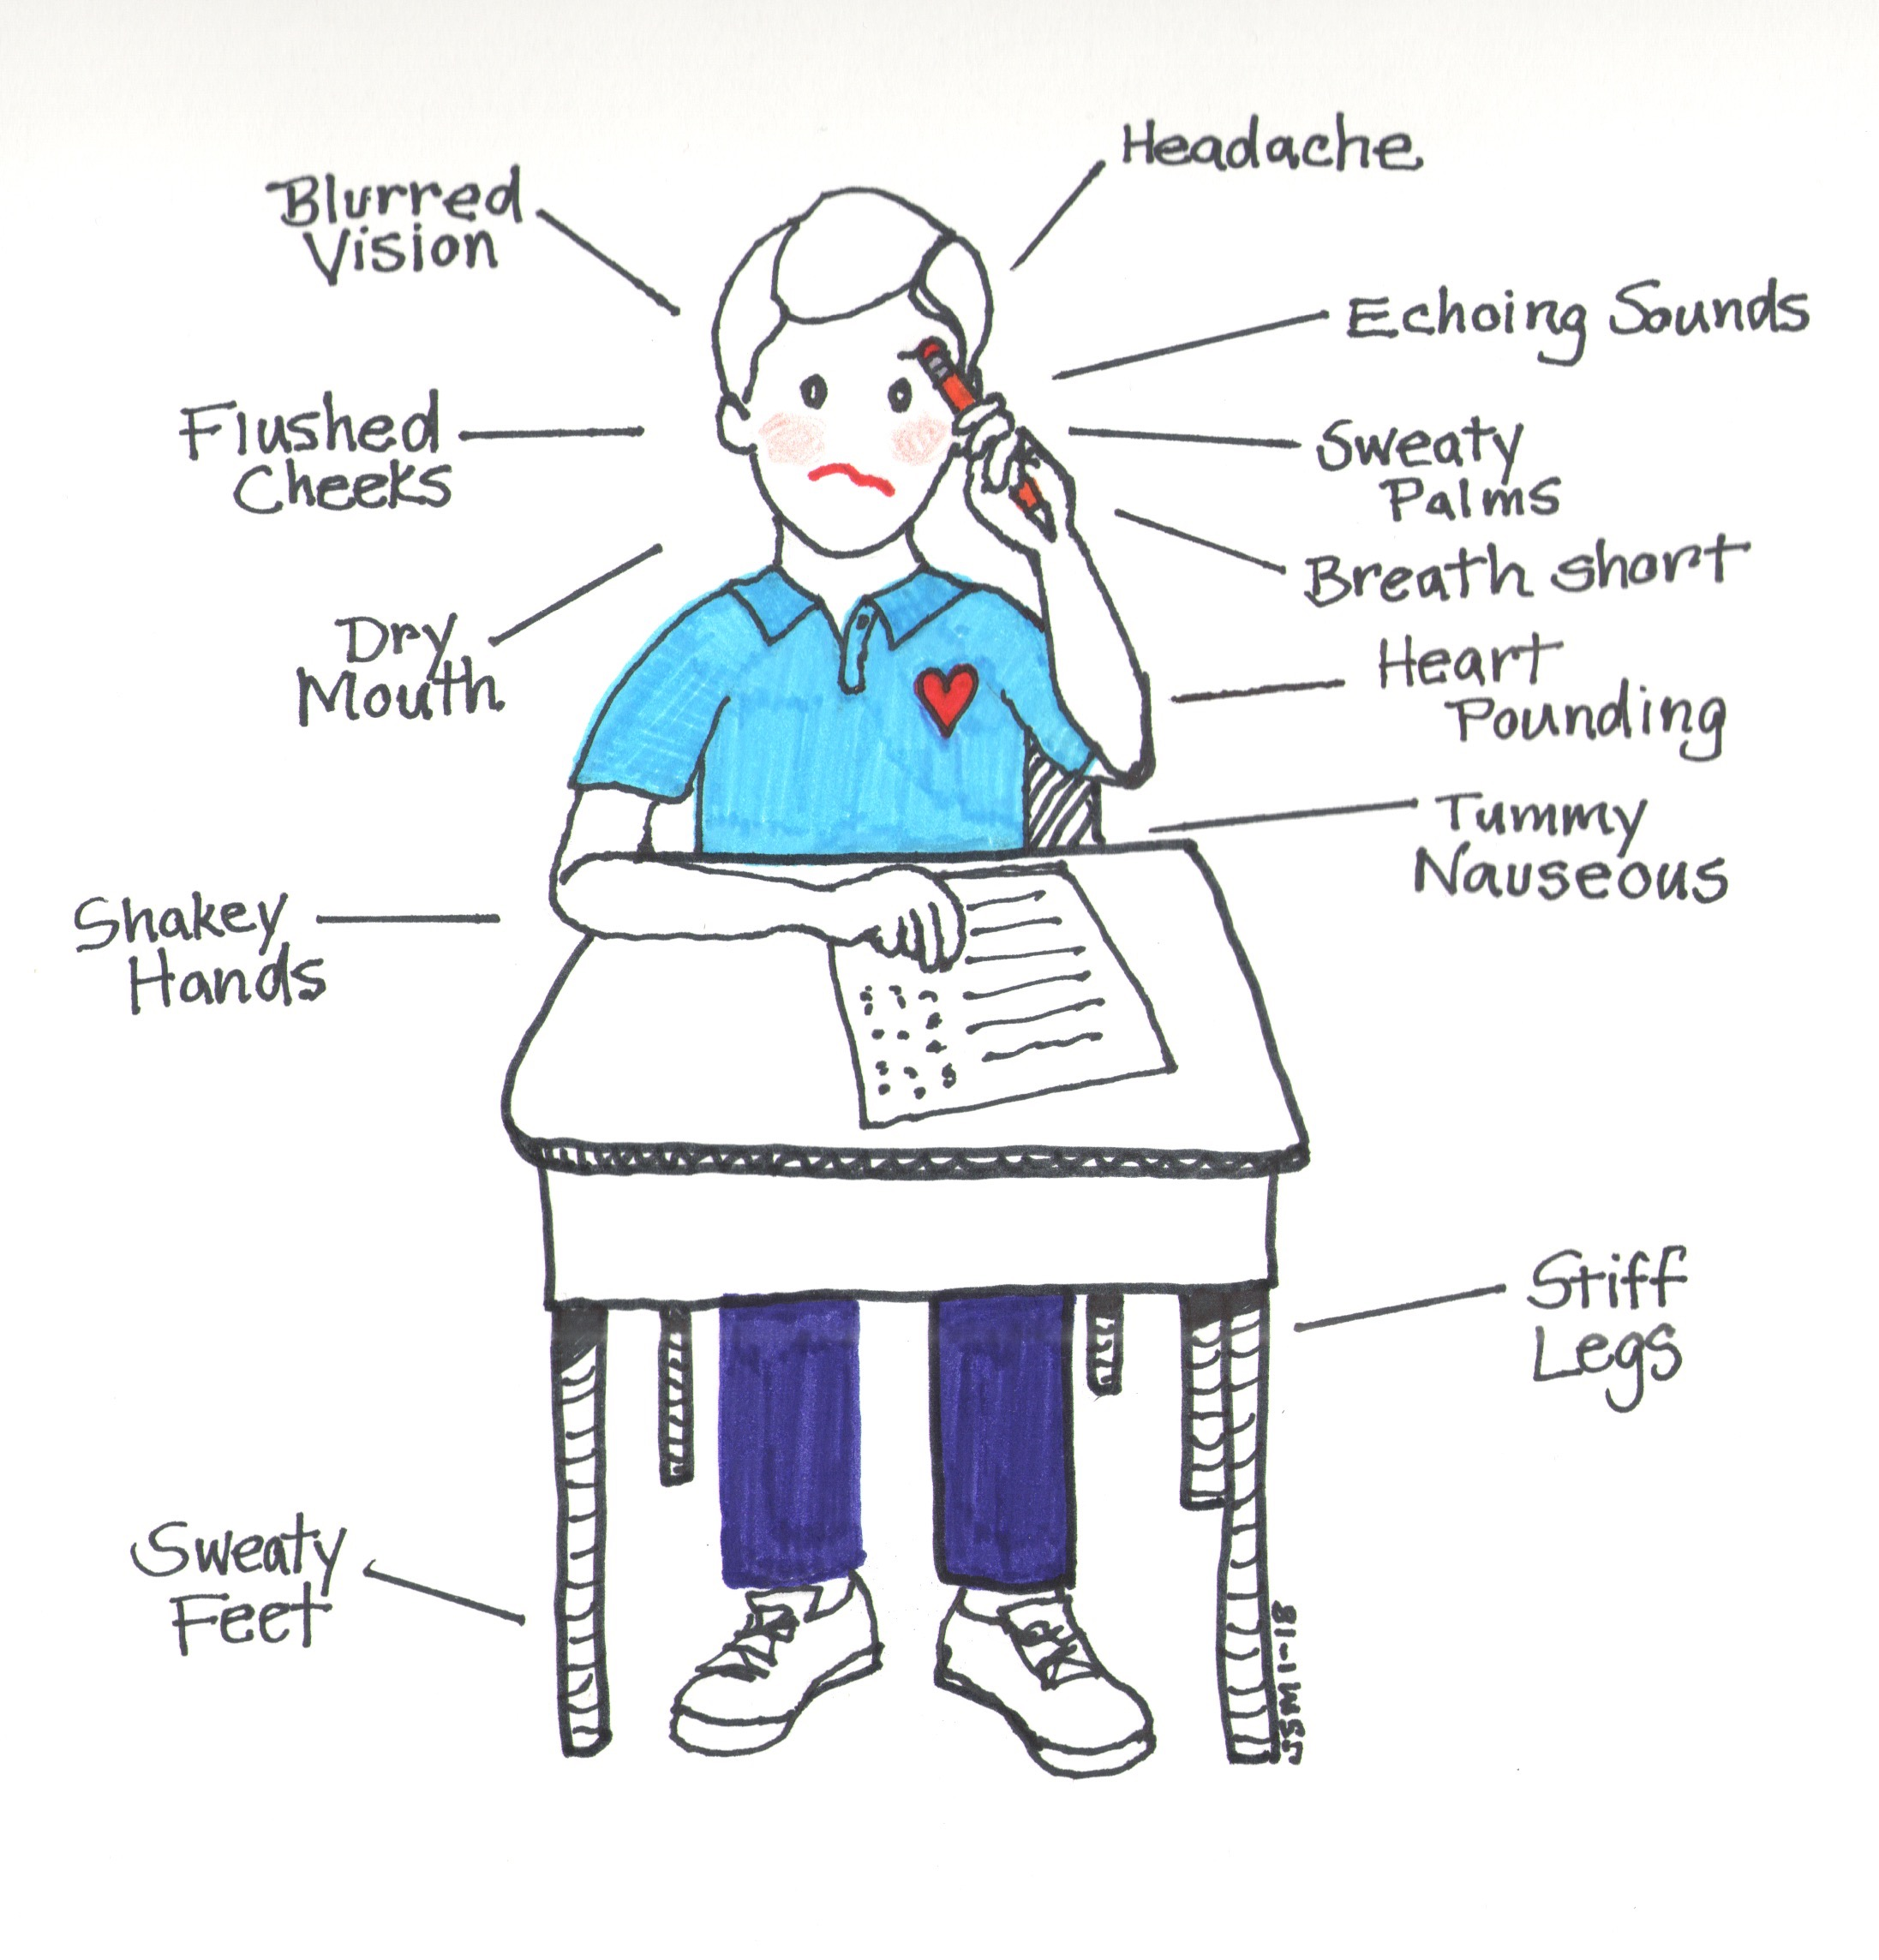
How do these worries make you feel?
Here are some examples of some things that some people might feel when they are worried. Can you think of any more?
Everyone feels differently when they are worried or anxious. This is okay
Try and recognise how you feel
It might be helpful for you to draw a picture like this

Slide 14
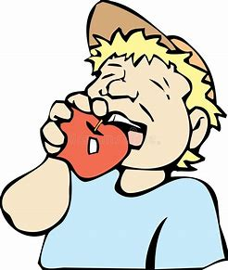
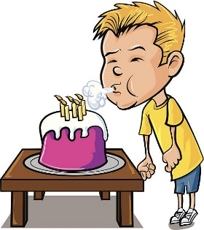
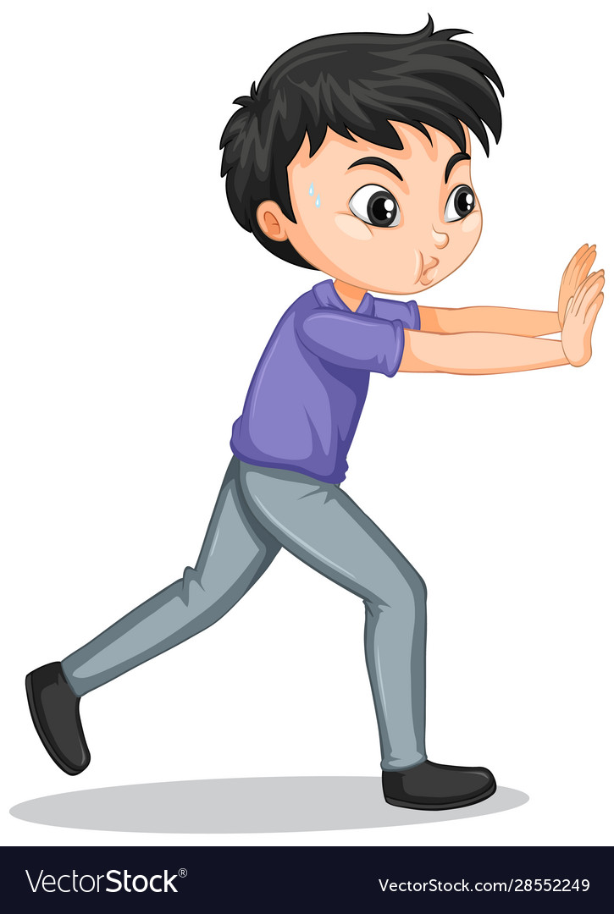
Let’s learn some cool skills to help
Smell the Strawberry, blow out the candle
Eat something crunchy
Hand massage
Push the wall

Slide 15
Try this fun activity!
Write about how it made you feel. Was it funny? Did it make you laugh? Did you do it with someone else?

