Slide 1

Safeguarding children, young people
All School Staff Safeguarding Training
Hayley Cameron: Education Safeguarding Manager
Stephen Welding: Esafety Adviser/Prevent Trainer
Gill Bush: Education Lead, MASH
Mick Bradshaw: Outdoor Education Adviser

Slide 2

Setting the scene - agenda
What’s new in KCSIE 2021
Key safeguarding issues
Managing disclosures, how to report
Sexual Violence and Sexual Harassment
Record keeping principles
Insight into the CFCS/MASH processes

Slide 3

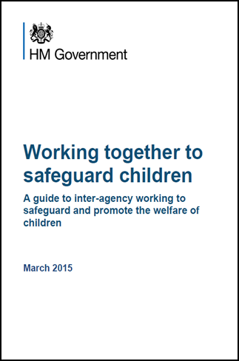


Legislation, Guidance and Procedure
July 2018
September 2021
Notes:
Read Keeping children safe in education (50 pages)

Slide 4
Introduction to the School Safeguarding Documents
School Safeguarding Policy
School Child protection/safeguarding young people and vulnerable adults – Procedure
Keeping Children Safe in Education September 2021 DfE
Staff Code of Conduct and Social Media policy
All staff are expected to read and understand PART 1

Slide 5
KCSIE 2021 – Para 324
Safeguarding and promoting the welfare of children is everyone’s responsibility. Everyone who comes into contact with children and their families has a role to play. In order to fulfil this responsibility effectively, all practitioners should make sure their approach is child-centred. This means that they should consider, at all times, what is in the best interests of the child.

Slide 6


Slide 7
KCSIE 2021
No single practitioner can have a full picture of a child’s needs and circumstances. If children and families are to receive the right help at the right time, everyone who comes into contact with them has a role to play in identifying concerns, sharing information and taking prompt action.

Slide 8
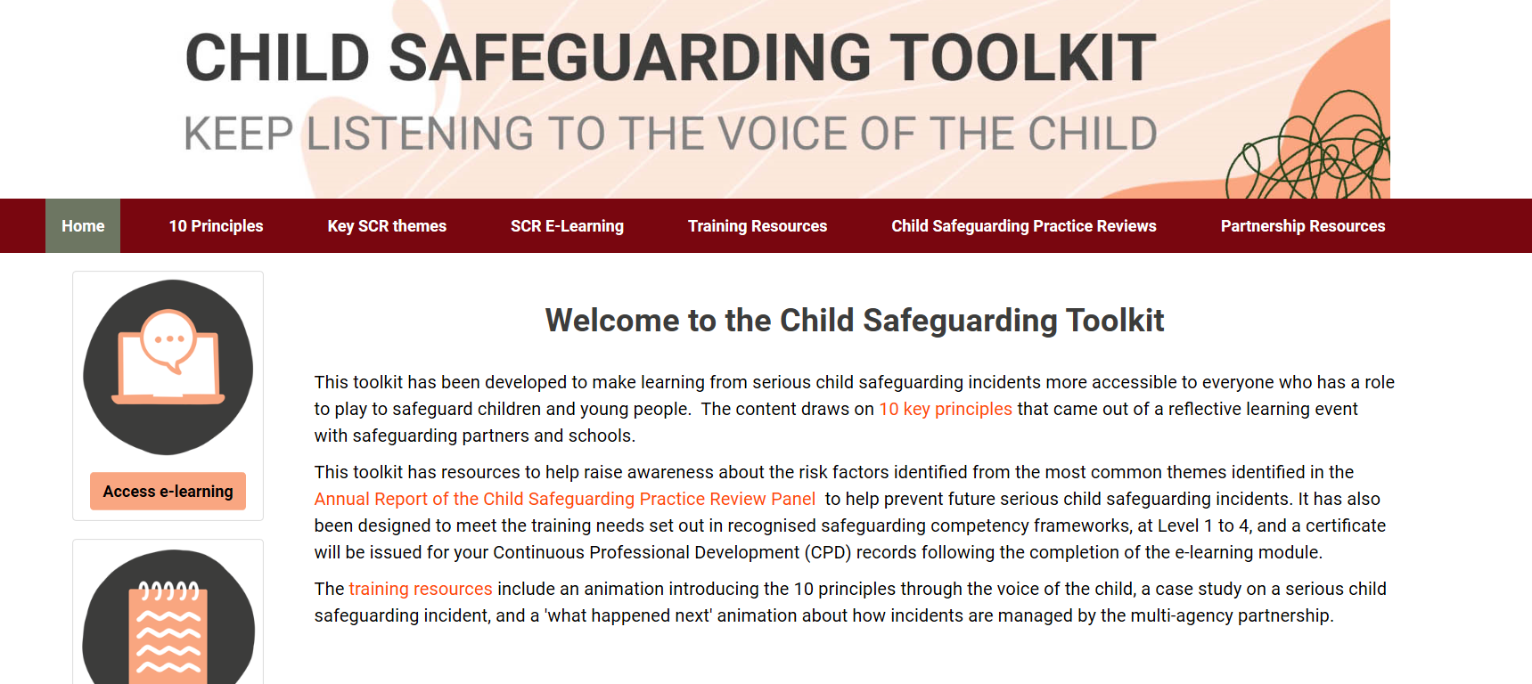
www.childsafeguardingtoolkit.org.uk

Slide 9
KCSIE 2021 – Safeguarding Definition
Safeguarding and promoting the welfare of children is defined for the purposes of this guidance as:
protecting children from maltreatment;
preventing the impairment of children’s mental and physical health or development;
ensuring that children grow up in circumstances consistent with the provision of safe and effective care; and
taking action to enable all children to have the best outcomes.

Slide 10
What all staff should know
What to do if a child says they are being abused or neglected
Manage confidentiality appropriately
Identify early help needs
How to follow school referral processes
Be aware of referral processes for social care.
That all concerns/discussions and decisions made and the reasons for those decisions are accurately recorded in writing
QUESTION: are you secure in your knowledge and understanding

Slide 11
What all staff should know -
The child protection policy, which should amongst other things also include the policy and procedures to deal with peer on peer abuse;
The behaviour policy (which should include measures to prevent bullying, including cyberbullying, prejudice-based and discriminatory bullying)
The staff behaviour policy (sometimes called a code of conduct)
The safeguarding response to children who go missing from education
The role of the designated safeguarding lead (including the identity of the designated safeguarding lead and any deputies).

Slide 12

Every Child Matters – 5 Principles
Being healthy
Staying Safe
Enjoying and achieving
Making a positive contribution
Achieving economic wellbeing

Slide 13
What is Physical Abuse?
Physical abuse is defined as hitting, shaking, throwing, poisoning, burning, scalding, drowning, suffocating or otherwise causing physical harm to a child.
Physical harm may also be caused when a parent or carer feigns the symptoms of, or deliberately causes, ill-heath to a child whom they are looking after.

Slide 14
Chastisement
If a child discloses that they have been smacked by their Parent/Carer :-
Use TED to get some context on what has taken place.
Things you need to consider – Before you call CFCS/MASH
Is there a visible mark or is the child in pain or discomfort.
Did the child say that an implement was used?
Was it with an open hand or clenched fist?
Where on the body was it?
What was the child doing to cause the chastisement?
How often does this happen? And when was the last time?
Has the child disclosed chastisement before or a sibling of the child
Have parents ever been spoken to about chastising their children
How does the child feel about going home that day?
Do not contact parents until you have received advice from CFCS

Slide 15

T.E.D.
T – Tell me what you mean by that
E – Explain what you mean by that
D – Describe what you mean by that

Slide 16
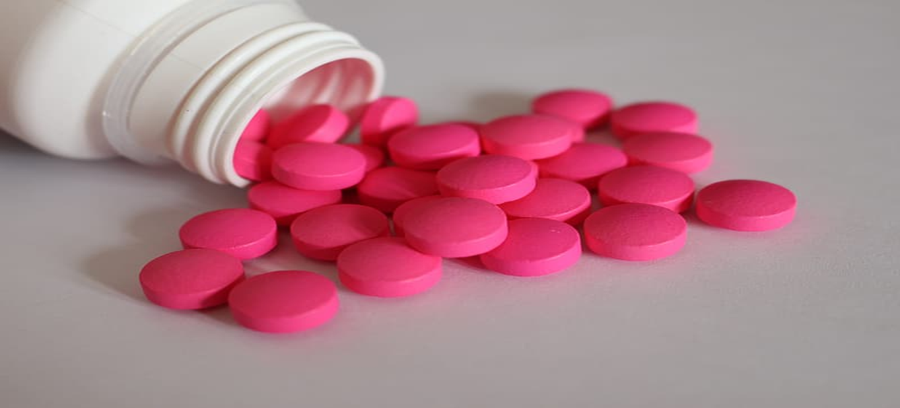


Slide 17
What to look out for:- Child Abuse, Neglect
Significant changes in children’s behaviour
Deterioration in children’s general well-being
Unexplained bruising, marks or signs of possible abuse or neglect
Children’s comments which give cause for concern
Any reason to suspect neglect or abuse outside the setting

Slide 18
Working with parents/carers
Sutton works with families on a consent model – Families will always be informed about any referral received. Either by letter, phone call or in extreme cases in person.
Always consider discussing a concern with parents unless:-
Your told not to by Social Care.
Allegations against the parents ie Chastisement, Sexual Abuse, Fabricated illness, Honour based abuse, Prevent
Or if you believe talking to the parents would place the child at greater risk.. In these cases contact CFCS/MASH for advice
However - Do not delay referral where it is not possible to contact parents/carers

Slide 19
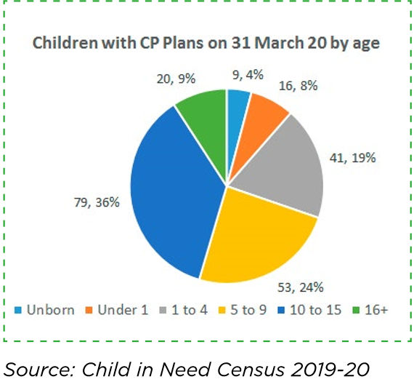

Slide 20
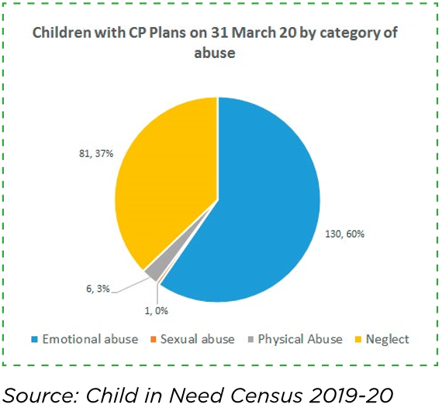

Slide 21
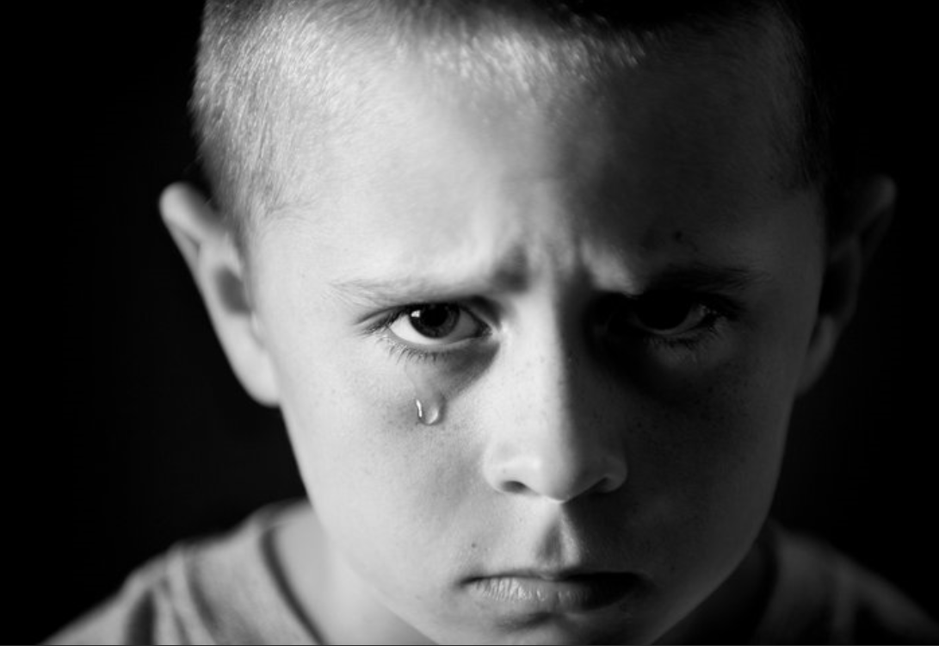
Neglect and Abuse
NEGLECT
EMOTIONAL ABUSE
PHYSICAL ABUSE
SEXUAL ABUSE

Slide 22






Always assume ‘it could happen here’
For every child we know about, there are likely to be 8 more not getting the help they need
1 online offence against a child every 16 minutes
Notes:
[Please note, this slide may look like the images are on top of each other when you’re working through the presentation, but it will show correctly when you’re presenting the slide show.]
Ask staff: where do you think there are children at risk of or suffering harm?
Click to colour the map. Sadly, there are children at risk of or suffering significant harm across the country
In the most recent statistics, there were 51,510 child protection plans in England
This means 51,510 children had been assessed as being at risk of or suffering significant harm
[If you used the pre-training activity] Ask staff for their answers to the first question in the pre-training activity, about the number of safeguarding reports at your school over the last school year. Share the answer and highlight how this shows that it can, and does, happen here
Click again to bring up the stick figure
Ask staff: for every child we know about who’s at risk of or suffering harm, how many other children do you think there are who we don’t yet know about?
Take some suggestions
Click to bring up the stick figures
For every child we know about, it’s been estimated that there are a further 8 who aren’t getting the help they need
Click again to bring up the final statistic. Put this into context – in the last 16 minutes, an online offence has been committed against a child. This might be related to abusive images of children or grooming, for example. By the time you’ve finished today’s safeguarding INSET, another 10 offences will have happened
[If you used the pre-training activity] Point out that this is the answer to the second question in the pre-training activity
Sources:
GOV.UK, Characteristics of children in need. https://explore-education-statistics.service.gov.uk/find-statistics/characteristics-of-children-in-need/2020
NSPCC, Estimated 90 cybercrimes recorded a day against children. https://www.nspcc.org.uk/about-us/news-opinion/2020/cybercrimes-against-children/
NSPCC, How safe are our children? (2013) https://learning.nspcc.org.uk/research-resources/how-safe-are-our-children

Slide 23
Key Safeguarding Issues in Education settings
Children and the Court System
Children Missing Education
Child Sexual Exploitation
Peer on peer abuse
Upskirting
FGM
Self-harm
Homelessness
Domestic violence
Honour based abuse
Radicalisation & extremism
Cyber bullying and social media
Children with family members in prison
Child Criminal Exploitation – County lines

Slide 24

Key safeguarding issues –
Child abuse
Self Harm
Domestic Violence and Impact on Children
Child Sexual Exploitation (CSE)
Child Criminal Exploitation (CCE)
Children Missing Education (CME)

Slide 25
Child Abuse
Child abuse is the range of ways in which people significantly harm children or young people
Inflicting harm or failing to prevent harm
Children or young people may be sexually abused in a family or in an institutional or community setting, by those known to them or, more rarely, by a stranger
They may be abused by an adult or adults, or by another child or children
Neglectful behaviours may include: missing medical appointments, lack of food/appropriate clothing, prioritising adult need rather than children’s, poor attendance at school.

Slide 26
How common is child sexual abuse?
1 in 20 children in the UK
1 in 3 children did not tell anyone
Over 90% of sexually abused children were abused by someone they knew
450,000 abused in the UK last year
50,000 reported to police
Sources:
Radford, L. et al (2011) Child abuse and neglect in the UK today
Jütte, S. et al (2014) How safe are our children? 2014. London: NSPCC
Office of the English Children’s Commissioner 2015

Slide 27
Child Sexual Abuse
Sabah was sexually abused between the ages of seven and 13 by four members of her family and a teacher. She was raped for the first time when she was nine.
“Child sexual abuse does not discriminate.” said Sabah. “The teacher was white – the family members who abused me were brown.
“This is not a race or colour issue. It is about as a society tackling all predators of child sex abuse.
“All my abusers had one thing in common – they had the entire community thinking they were good people.
Independent Inquiry into Child Sex Abuse looking at barriers faced by ethnic minority communities in reporting child sexual abuse.

Slide 28
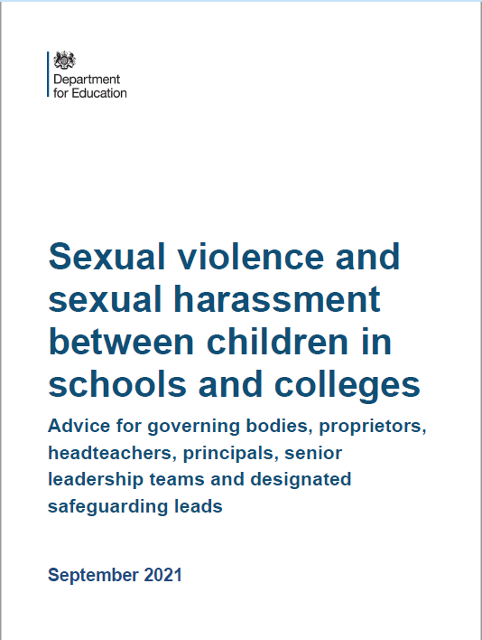
Sexual Violence & Sexual Harassment Sept 2021

Slide 29
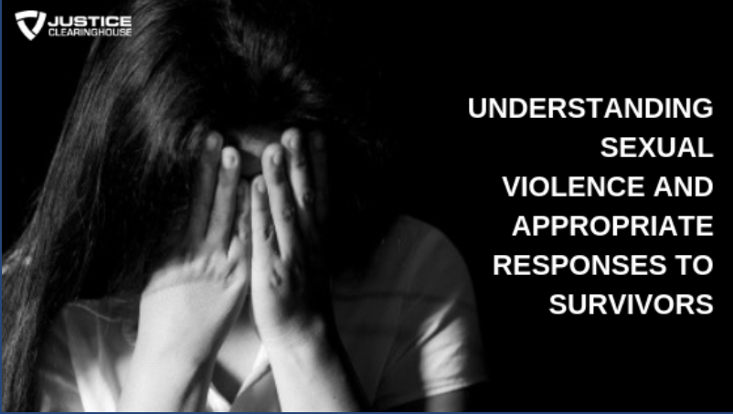
Sexual Violence & Sexual Harassment Sept 2021
Sexual violence and sexual abuse can happen anywhere, and all staff working with children are advised to maintain an attitude of ‘it could happen here’. Schools and colleges should be aware of, and respond appropriately to all reports and concerns, including those outside the school or college, and or online.

Slide 30
Sexual Violence & Sexual Harassment
When referring to sexual violence we are referring to sexual violence offences under the Sexual Offences Act 2003 as described below:
Rape
Assault by penetration
Sexual Assault
Sexual harassment is likely to: violate a child’s dignity, and/or make them feel intimidated, degraded or humiliated and/or create a hostile, offensive or sexualised environment.
Sexual Comments/Remarks/Sexual Jokes
deliberately brushing against someone, interfering with someone’s clothes
Upskirting, Sharing sexual images, online sexual bullying

Slide 31
Sexual assault – Section 3 SOA 2003
(1) A person (A) commits an offence if—
(2) He/she intentionally touches another person (B),
(3) the touching is sexual,
(4) (B) does not consent to the touching, and
(5) (A) does not reasonably believe that (B) consents.

Slide 32


“Consent”
A person consents if he/she agrees by choice, and has the freedom and capacity to make that choice.

Slide 33
Breakdown of Up-skirting Law
Operates equipment or records an image under another person’s Clothing.
With the intention of viewing, or enabling another person to view their genitals or buttocks (with or without underwear).
The purpose of the act is to obtain sexual gratification or to cause the person humiliation, alarm or distress.
Maximum of 2 years imprisonment
In some cases you may be put onto the Sex Offenders Register.

Slide 34
KCSIE 2021 – para 18
It is clear in this new guidance that incidents of sexual violence and sexual harassment should be taken seriously. Paragraph 18 says:-
'All staff should be able to reassure victims that they are being taken seriously and that they will be supported and kept safe. A victim should never be given the impression that they are creating a problem by reporting abuse, sexual violence or sexual harassment. Nor should a victim ever be made to feel ashamed for making a report.'

Slide 35
KCSIE 2021 – para 24
Paragraph 24 says, 'All staff should be aware that technology is a significant component in many safeguarding and wellbeing issues. Children are at risk of abuse online as well as face to face. In many cases abuse will take place concurrently via online channels and in daily life. Children can also abuse their peers online, this can take the form of abusive, harassing, and misogynistic messages, the non-consensual sharing of indecent images, especially around chat groups, and the sharing of abusive images and pornography, to those who do not want to receive such content.'

Slide 36
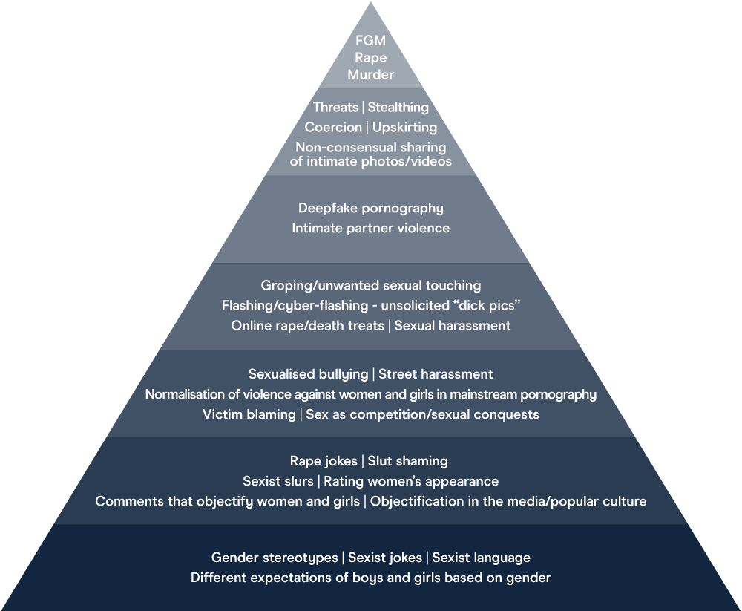
What the lower end of the continuum might look like in our school
Calling a girl a ‘slut’ or a ‘bitch’
Flicking bra straps
Lifting up skirts
Unwelcome looks and comments about appearance
Comments about how boys and girls should behave
Different expectations about which toys boys and girls should play with
Boys saying girls are ‘gross’
Image adapted from Bold Voices
Notes:
Remind staff that, today, you’re going to be focusing more on the lower end of this continuum
Click to bring up the examples on the slide
These ‘small’ behaviours contribute to the 'bigger', more violent issues, as you’ve already touched on
The things at the lower level of the pyramid can and do happen in schools across the country, and staff have probably seen them too
These behaviours normalise a culture where women are treated like objects or where we control and police their sexuality. This low-level harassment and sexism contribute to a culture where the behaviours at the top of the pyramid become accepted
By dealing with the issues at the lower levels of the pyramid, we can help stop escalation to the higher levels of the pyramid. That’s why it’s so important that our school challenges sexual harassment and violence at all levels of the continuum
Note the categorisation in this pyramid differs from the categorisation in Keeping Children Safe in Education in some places. The pyramid is being used here to illustrate the escalation of behaviours rather than as a reflection of statutory guidance
Emphasise that staff should assume sexual harassment is happening in your school, even if there are no specific reports of it – as Ofsted recommended in its review of sexual abuse in schools and colleges
Sources
Bold Voices, https://www.boldvoices.co.uk/
EqualiTeach, https://equaliteach.co.uk/
GOV.UK – Ofsted, Review of sexual abuse in schools and colleges. https://www.gov.uk/government/publications/review-of-sexual-abuse-in-schools-and-colleges/review-of-sexual-abuse-in-schools-and-colleges

Slide 37
Peer on Peer Abuse (Part 5 KCSIE 2021)
All Staff should be aware of the importance of :
Making clear that sexual violence and sexual harassment is not acceptable, will never be tolerated and is not an inevitable part of growing up.
Not tolerating or dismissing sexual violence or sexual harassment as “BANTER”, “PART OF GROWING UP”, “JUST HAVING A LAUGH” or “BOYS WILL BE BOYS”
Challenging behaviours (potentially criminal in nature), such as grabbing bottoms, breasts and genitalia, flicking bras and lifting up skirts.
Dismissing or tolerating such behaviours risks normalising them.
www.everyoneinvited.com

Slide 38
Communities at risk of FGM
FGM is practised in at least 28 African countries, in the Middle East and Asia.
In the UK, FGM tends to occur in areas with large populations of FGM practising communities. These include London, Cardiff, Manchester, Sheffield, Northampton, Birmingham, Oxford, Crawley, Reading, Slough and Milton Keynes.
However, FGM can happen anywhere in the UK (NHS Choices, 2013).
It is a criminal act in the UK and should be reported to the police if staff/volunteers become aware of the procedure taking place.
If a member of staff/volunteer becomes aware that it may be taking place then it is a referral to CFCS.
Notes:
How prevalent is FGM?
FGM is usually carried out on girls between infancy and age 15, with the majority of cases occurring between the ages of 5 and 8 years (HM Government, 2011). Because of the hidden nature of the crime, it is difficult to estimate FGM's prevalence, but a study based on 2001 census data in England and Wales estimated that 23,000 girls under the age of 15 could be at risk of FGM each year; and nearly 66,000 women are living with its consequences (Dorkenoo et al, 2007). FGM could be even more prevalent than these figures suggest due to population growth and immigration from practising countries since 2001 (HM Government, 2011).

Slide 39
There are an estimated 137,000 women and girls affected by FGM in England and Wales
FGM is usually performed by someone with no medical training. Girls are given no anaesthetic, no antiseptic treatment and are often forcibly restrained.
The age at which FGM is carried out varies. It may be carried out when a girl is new-born, during childhood or adolescence, just before marriage or during pregnancy.
Signs a teacher or school may notice
A family arranging a long break abroad during the summer holidays.
Unexpected, repeated or prolonged absence from school.
Academic work suffering.
A child may ask a teacher or another adult for help if she suspects FGM is going to happen or she may run away from home or miss school.

Slide 40
High Risk Time
This procedure often takes place in the summer, as the recovery period after FGM can be 6 to 9 weeks. Staff (in particular Heads of School and Office staff) should be alert to the possibility of FGM as a reason why a girl in a high risk group is absent from school or where the family request an ‘authorised absence’ for just before or just after the summer school holidays.

Slide 41

FGM Guidance for Schools
nationalfgmcentre.org.uk

Slide 42

Holistic Approach

Slide 43
BREAST IRONING
Keeping Children Safe in Education (2021) mentions Breast Ironing, under so-called 'Honour-based Abuse’.
Breast Ironing is practiced in some African countries, notably Cameroon. Girls aged between 9 and 15 have hot pestles, stones or other implements rubbed on their developing breast to stop them growing further

Slide 44
Self harm
Self-harm is a serious public health problem and is the reason behind many admissions to accident and emergency departments every year.
Sutton has a multi-agency self-harm protocol (Nov 17)
Self-harm and suicidal threats by a child/young person put them at risk of significant harm, and should always be taken seriously and responded to without delay.
Self-harming is NOT attention seeking behaviour, it is attention NEEDING behaviour.
Self-harm is a way of coping with difficult or overwhelming situations or emotional states.

Slide 45
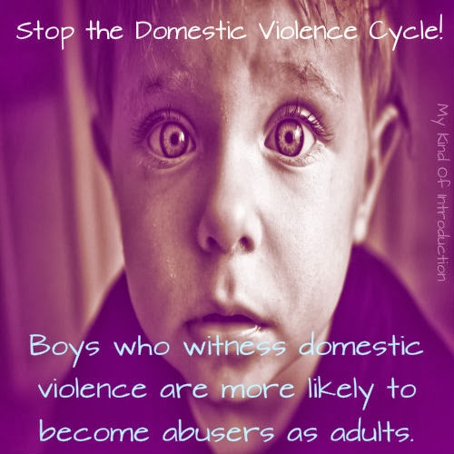
Domestic Abuse
This Photo by Unknown Author is licensed under CC BY

Slide 46
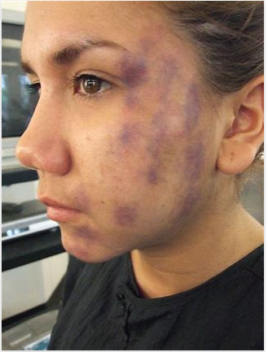
Domestic Abuse in Sutton – Lockdown
There has been a significant increase in the number of reported cases of Domestic abuse nationally.
Sutton has seen a significant rise in Domestic abuse cases since the lockdown was imposed.
From March to June 2020 the police recorded more than a quarter of a million domestic abuse-related offences, a 7% increase the same period in 2019 and an 18% increase from in 2018. The number of offences has been increasing in recent years
Sutton Crime Prevention and Community Safety Strategy 2017-20

Slide 47

Police - Domestic Incident
Police Definition :-
Any incident or pattern of incidents of controlling, coercive or threatening behaviour, violence or abuse between those aged 16 or over who are or have been intimate partners or family members regardless of gender or sexuality.
This can encompass, but is not limited to, the following types of abuse:
•psychological
•physical
•sexual
•financial
•emotional

Slide 48
Social Care – Domestic incident
Threats and intimidation - threatening to hurt you or members of your family
Physical abuse - hitting, shoving, kicking, strangling or slapping, hair pulling, throwing things, choking or smothering, even when it doesn't leave physical marks
Sexual abuse - performing sexual acts or having sex with you when you don't want to. This can include the use of threats, intimidation, coercive behaviour or physical force, although it is still sexual abuse even without using these insults by name calling or criticism of your appearance or identity,
Criticism and put-downs - being blamed for every argument or problem.
Forced isolation from your friends or family
Controlling behaviour - telling you what to do or wear, or using manipulation or coercion. Following you or checking up on your mobile phone, post or internet use
Financial abuse - preventing you from getting or keeping a job, taking your money away or withholding the family income

Slide 49
Domestic Abuse in Sutton – MARAC 2020- 2021
Our Multi Agency Risk Assessment Conferences continue virtually on a monthly basis. Over the past 12 months,
164 new cases
60 repeat incidents were referred
224 cases in total
220 children living in the households. highlighting the clear link between Domestic Abuse and Child Protection.
27% were repeat victims, slightly higher than the previous 12 month period
65% of referrals to MARAC were received from agencies aside from the Police, which is a really positive indication that a wide range of professionals have been identifying and referring on high risk domestic abuse cases.
MPS Crime Reporting Information System

Slide 50

Domestic Abuse in Sutton – MARAC 2020- 2021
In Sutton, there are at least 250 known perpetrators causing high risk to victims, and of these, many are repeat offenders.
Often, perpetrators of domestic abuse have more than one
victim.
1 in 4 perpetrators are repeat offenders and some have as many as six different victims.

Slide 51
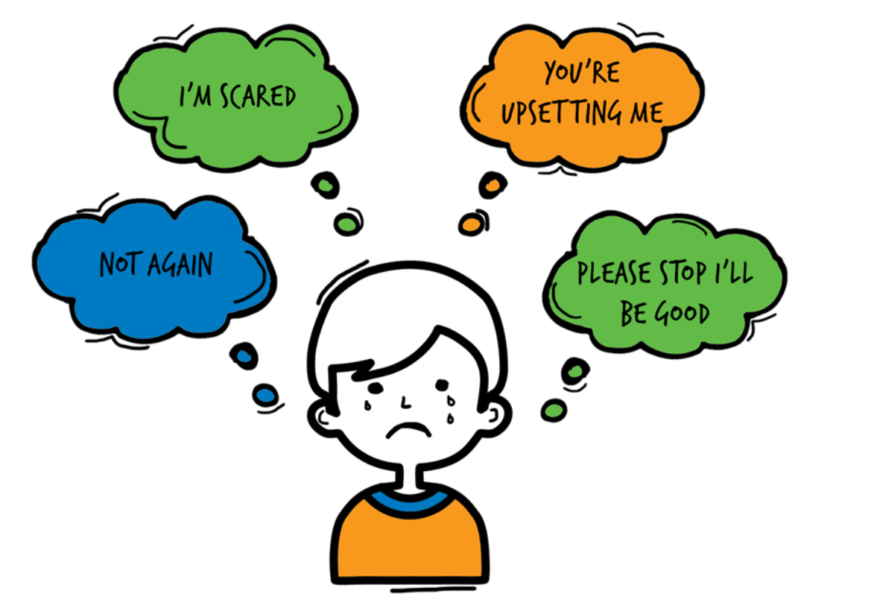
Domestic Abuse
Children living with domestic violence and abuse are over-represented among those children referred to Children Social Care, abuse and neglect represent about two thirds of cases seen at child protection conferences.
The risks of harm to children exposed to domestic violence and abuse have now been recognised. Children who live/experience DA feel:
75% of all CP cases in Sutton, Domestic Abuse is present

Slide 52
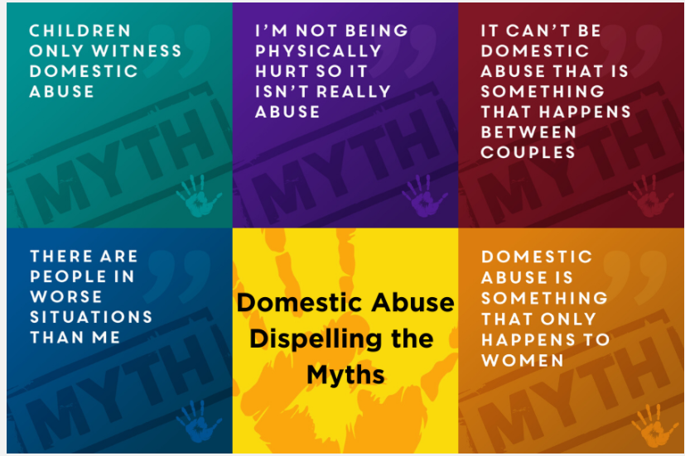
DA – Dispelling the Myths

Slide 53
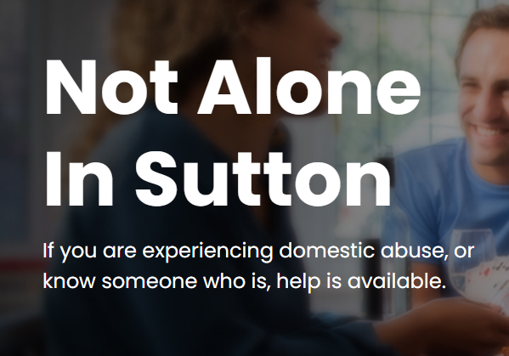
Not alone in Sutton -
A website full of useful information about domestic abuse, including what to do if someone is affected by domestic abuse:
​www.notaloneinsutton.org.uk

Slide 54
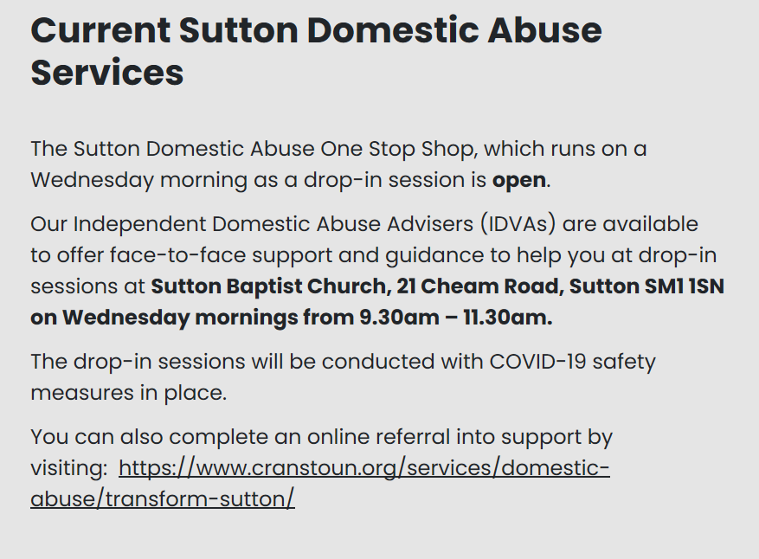

Slide 55

Bromley & Croydon Women’s Aid
Bromley & Croydon Women’s Aid
For any enquiries, you can email info@bcwa.org.uk or call 0208 3139303.
They are open Monday to Friday, from 9.00am to 4.30pm. This applies to all types of information, including
Notes:
Remind staff that, today, you’re going to be focusing more on the lower end of this continuum
Click to bring up the examples on the slide
These ‘small’ behaviours contribute to the 'bigger', more violent issues, as you’ve already touched on
The things at the lower level of the pyramid can and do happen in schools across the country, and staff have probably seen them too
These behaviours normalise a culture where women are treated like objects or where we control and police their sexuality. This low-level harassment and sexism contribute to a culture where the behaviours at the top of the pyramid become accepted
By dealing with the issues at the lower levels of the pyramid, we can help stop escalation to the higher levels of the pyramid. That’s why it’s so important that our school challenges sexual harassment and violence at all levels of the continuum
Note the categorisation in this pyramid differs from the categorisation in Keeping Children Safe in Education in some places. The pyramid is being used here to illustrate the escalation of behaviours rather than as a reflection of statutory guidance
Emphasise that staff should assume sexual harassment is happening in your school, even if there are no specific reports of it – as Ofsted recommended in its review of sexual abuse in schools and colleges
Sources
Bold Voices, https://www.boldvoices.co.uk/
EqualiTeach, https://equaliteach.co.uk/
GOV.UK – Ofsted, Review of sexual abuse in schools and colleges. https://www.gov.uk/government/publications/review-of-sexual-abuse-in-schools-and-colleges/review-of-sexual-abuse-in-schools-and-colleges

Slide 56
Operation Encompass - National Police Strategy
Operation Encompass operates in the majority of police forces across England. It helps police and schools work together to provide emotional and practical help to children. The system ensures that when police are called to an incident of domestic abuse, where there are children in the household who have experienced the domestic incident, the police will inform the key adult (usually the designated safeguarding lead) in school before the child or children arrive at school the following day. This ensures that the school has up to date relevant information about the child’s circumstances and can enable support to be given to the child according to their needs.

Slide 57
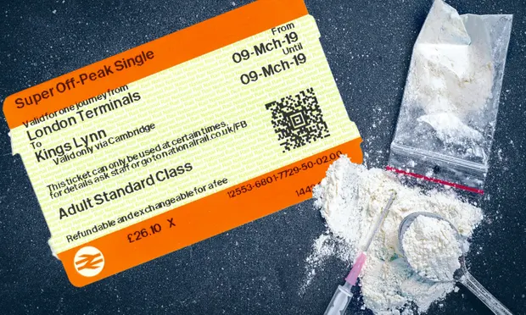
COUNTY LINES
A drug distribution system in which criminal networks exploit thousands of children and vulnerable adults to funnel hard drugs from cities to towns and rural regions across the country, often using the public transport network to move their illicit wares. The youngsters transporting the drugs are recruited by ruthless criminal organisations, who target them with a mixture of financial rewards and threats, often finding recruits outside schools or the pupil referral units to which they have been sent after being excluded from mainstream schools.

Slide 58
Change - Contextual Safeguarding
‘Contextual Safeguarding’ has been replaced with
‘assessment of risk outside the home’.

Slide 59
Assessment of risk outside the home
Contextual Safeguarding is one approach to understanding, and responding to, young people’s experiences of significant harm beyond their families.
Peer relationships and extra-familial contexts are critical to engage with in response to harm beyond family homes – and that Contextual Safeguarding is one such approach being developed to address this.

Slide 60
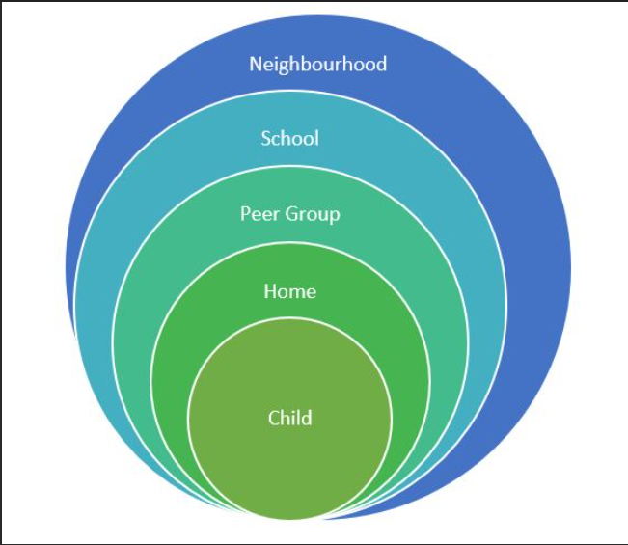
Assessment of risk outside the home

Slide 61
Common behavioural signs to look out for, Whatever the issue
Difficulty concentrating and not doing as well at school
Becoming withdrawn
Mood or Behaviour changes
Tiredness
Mental Health needs
Self Harming
Risk taking behaviour
Using Drugs or Alcohol

Slide 62
Responding to a Child who discloses – you should NEVER
Investigate or seek to prove or disprove possible abuse
Make promises about confidentiality or keeping ‘ secrets’
Assume that someone else will take the necessary action
Jump to conclusions, be dismissive or react with shock, anger, horror
Speculate or accuse anyone
Suggest or probe for information
Confront another person (adult or child) allegedly involved
Offer opinions about what is being said or the persons allegedly involved
Forget to record what you have been told
Fail to pass this information on to the correct person

Slide 63
T.E.D.
T – Tell me what you mean by that
E – Explain what you mean by that
D – Describe what you mean by that

Slide 64
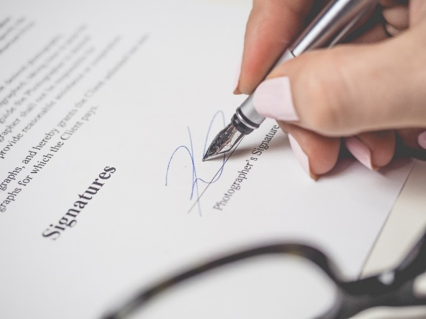
Record Keeping- Principles
Records should be:
Accurate
Based on fact
Record what the child actually said
Jargon free
Abbreviation free
Inclusive of relevant information
Write in permanent ink (Not pencil)
Sign, Date, Time and print your full name
Your current position within the Company
Don’t cross out mistakes, put a line through and correct it.

Slide 65

Poor Practice
Failure to act soon enough
Poor record keeping
Failure to listen to the child
Failure to re-assess
Sharing too slowly
Lack of challenge to inaction

Slide 66
Managing allegations: we all have a responsibility to report
Where it is alleged that a member of staff has:
Behaved in a way that has harmed a child, or may have harmed a child;
Possibly committed a criminal offence against or related to a child;
Behaved towards a child or children in a way that indicates he or she may pose a risk of harm to children; or
Behaved or may have behaved in a way that indicates they may not be suitable to work with children.
The Head Teacher/Chair of Governors will contact the Local Authority Designated Officer (LADO) who has overall responsibility for oversight of the procedures for dealing with allegations.
The LADO will provide advice and guidance, in addition to liaising with the police and other agencies, and monitoring the progress of cases to ensure that they are dealt with as quickly as possible consistent with a thorough and fair process.

Slide 67
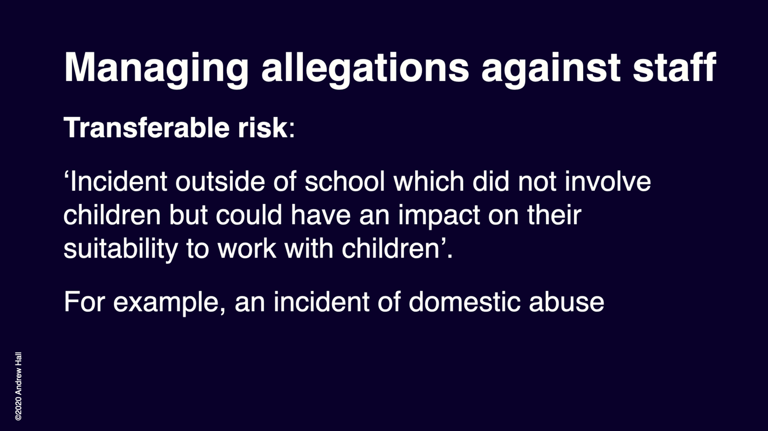
Transferable Risk

Slide 68
The term – ‘low level concern’
'The term ‘low-level’ concern does not mean that it is insignificant, it means that the behaviour towards a child does not meet the threshold of harm. A low-level concern is any concern – no matter how small, and even if no more than causing a sense of unease or a ‘nagging doubt’ - that an adult working in or on behalf of the school or college may have acted in a way that:
is inconsistent with the staff code of conduct, including inappropriate conduct outside of work.
does not meet the allegations threshold or is otherwise not considered serious enough to consider a referral to the LADO.

Slide 69
Examples of ‘low-level’ concerns
being over friendly with children;
having favourites;
taking photographs of children on their mobile phone;
engaging with a child on a one-to-one basis in a secluded area or behind a closed door.
using inappropriate sexualised, intimidating or offensive language.
This means that 'governing bodies and proprietors should set out their low-level concerns policy within their staff code of conduct and safeguarding policies'
(paragraph 413).

Slide 70
Whistle blowing
If any staff member feels unable to raise an issue with their employer, or feels that their genuine concerns are not being addressed, other whistleblowing channels are open to them.
General guidance on whistleblowing can be found at:
The ‘NSPCC what you can do to report abuse dedicated helpline’ is available as an alternative route for staff who do not feel able to raise concerns regarding child protection failures internally or have concerns about the way a concern is being handled by their school or college.
Staff can call 0800 028 0285 line is available from 8.00am – 8.00pm Monday – Friday and email help@nspcc.org.uk

Slide 71
Information Sharing
Early sharing of information is the key to providing effective early help where there are emerging problems. At the other end of the continuum, sharing information can be essential to putting in place effective child protection services.
Serious Case Reviews (SCRs) have shown how poor information sharing has contributed to the deaths or serious injuries of children.
Fears about sharing information cannot be allowed to stand in the way of the need to promote the welfare and protect the safety of children.

Slide 72

Information Sharing
DPA and UK GDPR do not prevent the sharing of information for the purposes of keeping children safe and promoting their welfare. If in any doubt about sharing information, staff should speak to the designated safeguarding lead or a deputy. Fears about sharing information must not be allowed to stand in the way of the need to safeguard and promote the welfare of children.
KCSIE 2021

Slide 73
At a glance reminders (All Safeguarding concerns)
Always remember the child and look beyond their behaviour and consider why they are behaving like this.
Always listen to what the child is telling you.
Make a record of what the child has said (as soon as possible)
Don’t dismiss what a child tells you.
Be professionally curious if the situation doesn’t look or feel right to you then it probably isn’t right.
If in doubt always seek advice and support.
Share information with the School/Organisation Designated Safeguarding Lead.
Always share with your manager if you have a concern regarding a colleague’s behaviour towards a child.

Slide 74
Key messages for all staff
REMEMBER ‘it could happen here’
Always act in the best interest of the child

Slide 75


Don’t hold onto the RISK

Slide 76
Safeguarding contacts Sutton
childrensfirstcontactservice@sutton.gov.uk
Tel: 020 8770 6001
Emergency Duty Team (Out of Hours)
Tel: 020 8770 5000x9
suttonlscp@sutton.gov.uk
lado@Sutton.gov.uk
0208 770 4532

Slide 77
Safeguarding contacts Croydon
Single Point of Contact (SPOC)
Phone: 0208 255 2888
Monday to Friday, 9am to 5pm
Emergency Duty Team
Telephone: 0208 726 6000
Email: SSD-EMERGENCY-DUTY-TEAM@croydon.gov.uk
Monday to Friday, 5pm to 9am
Weekends and bank holidays, 24 hours
Contact the LADO
Telephone: 020 8255 2889
Email: LADO@croydon.gov.uk

Slide 78
Safeguarding contacts Merton
MASH: 020 8545 4226/4227
mash@merton.gov.uk
Emergency Duty Team
Out of hours: 020 8770 5000
LADO: John Shelley
Email: lado@merton.gov.uk
Tel: 020 8545 3187

Slide 79
Sutton -Cognus Safeguarding Team
hayley.cameron@cognus.org.uk
stephen.welding@cognus.org.uk
gillian.bush@cognus.org.uk
mick.bradshaw@cognus.org.uk
Jan.capon@cognus.org.uk - Early Years Adviser
Nick.Banham@cognus.org.uk – Early Years Adviser

Slide 80
Thank You for Listening
Hayley Cameron: Education Safeguarding Manager
Stephen Welding: Esafety Adviser/Prevent Trainer
Gill Bush: Education Lead, MASH
Mick Bradshaw: Outdoor Education Adviser

