Slide 1
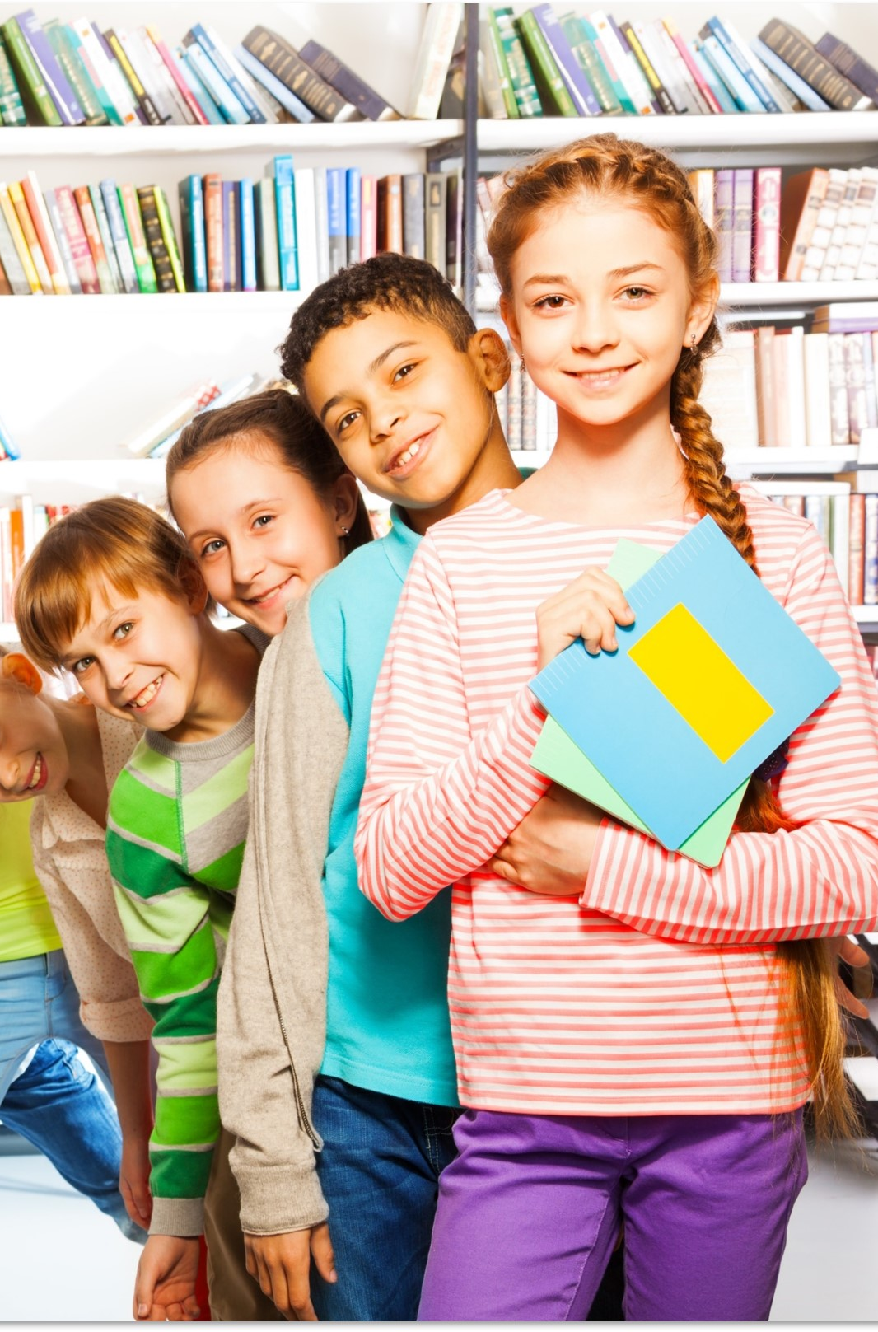
Understanding Emotions workshop
Paving the Way Team
Notes:
Ann to deliver

Slide 2
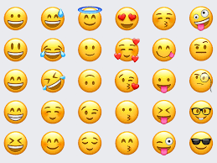
Emoji game
Have a look at the pictures of emojis on the next slides
Write down and act what emoji you think this is
Discuss with your parent(s)/carer(s) a time when you felt this emotion and what you did

Slide 8
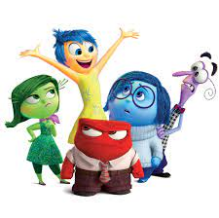
What are emotions?
What is self esteem?
Emotions are…
How you feel!
Emotions can change all the time!
Have a think… what might cause a change in your emotions?

Slide 9
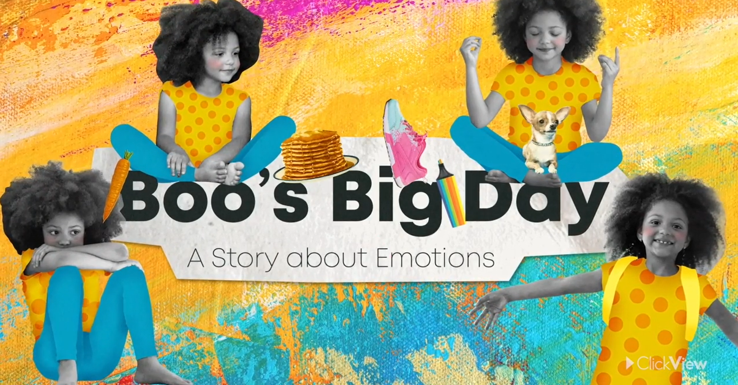
Video
Let’s learn more about emotions!
Boo's Big Day: A Story about Emotions - This... - ClickView
We will have a quiz about this video..

Slide 10
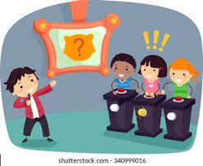
Quiz
There will be 10 questions
Write your answers down on a piece of paper
We will tell you the answers once all 10 questions have been asked
Good luck!

Slide 11
Quiz Questions!
1. When Boo was sitting by the window and breathing in the fresh air, what emotion did she feel?
2. Who made Boo’s pancakes?
3. What colour is Boo’s T-shirt?
4. When Boo remembered she had a sports carnival, what did her stomach feel like?
5. Think of an emotion that begins with ‘E’.
6. What happened to Boo’s trousers when she lost the race?
7. What emotion did Boo feel when she ripped her trousers?
8. What fruit did the teacher use in the Maths lesson?
9. Guess how many emotions that Boo experienced in the video?
10. What emotion are you feeling right now?

Slide 12
Quiz Answers!
1. When Boo was sitting by the window and breathing in the fresh air, what emotion did she feel? Calm
2. Who made Boo’s pancakes? Her dad
3. What colour is Boo’s T-shirt? Orange/yellow
4. When Boo remembered she had a sports carnival, what did her stomach feel like? She had butterflies/was excited
5. Think of an emotion that begins with ‘E’. Excited/embarrassed/elated
6. What happened to Boo’s trousers when she lost the race? She ripped them
7. What emotion did Boo feel when she ripped her trousers? Embarrassed
8. What fruit did the teacher use in the Maths lesson? Bananas
9. Guess how many emotions that Boo experienced in the video? 15! Calm, happy, excited, nervous, embarrassed, sad, loved, confident, guilty, sorry, disappointed, jealous, scared, angry, grateful
10. What emotion are you feeling right now?

Slide 13
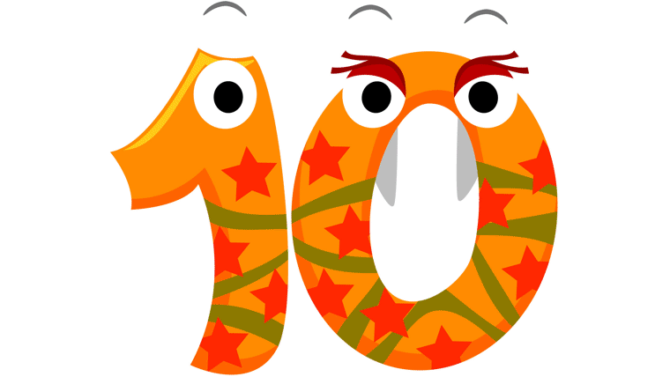
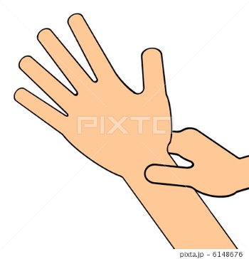
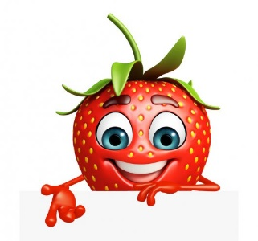
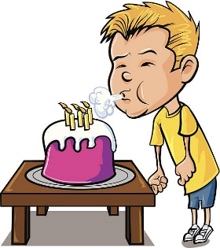
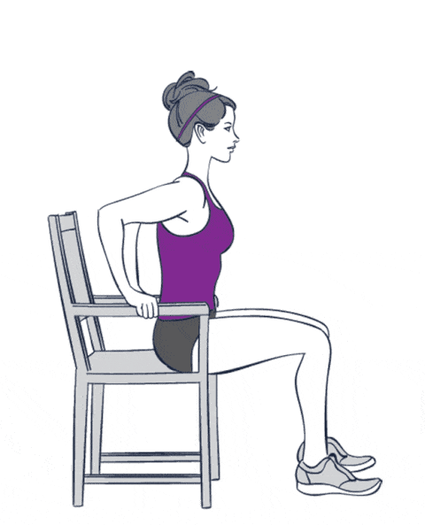
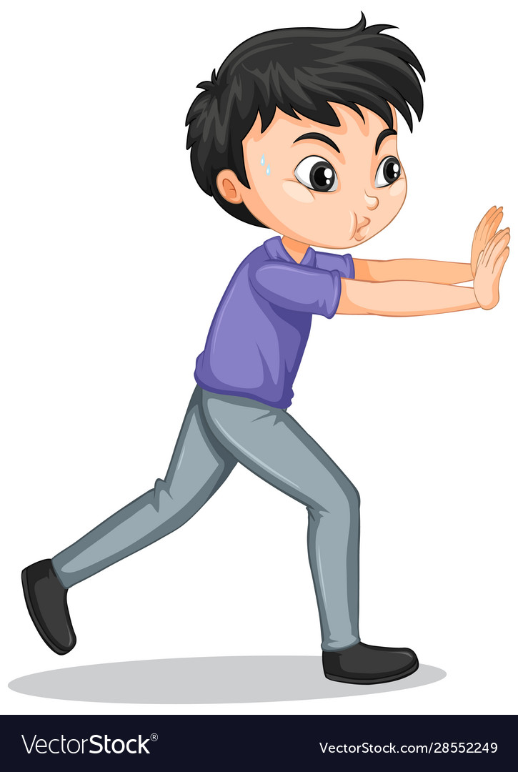
Here are some skills to help you with your emotions
Count backwards from 10
Smell the Strawberry, blow out the candle
Hand massage
Chair push ups
Push the wall

Slide 14
Time to relax
https://youtu.be/UEuFi9PxKuo

Slide 15
Well done for completing this workshop!
Have a look on our website for more workshops that you might enjoy!
Well done!

