Slide 1
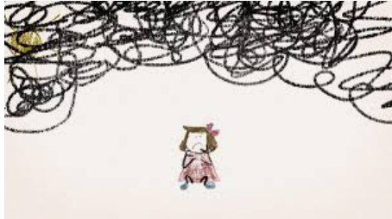
Peer on Peer Abuse
Haley Cameron:
Safeguarding Manager, Cognus
Steve Welding:
Esafety/Prevent trainer, Cognus

Slide 2
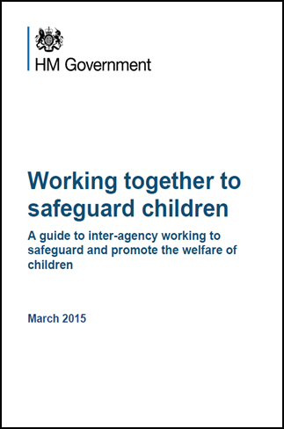
Legislation, Guidance and Procedure
July 2018
September 2021
Notes:
Read Keeping children safe in education (50 pages)

Slide 3
Sexual Violence & Sexual Harassment Sept 2021
Sexual violence and sexual abuse can happen anywhere, and all staff working with children are advised to maintain an attitude of ‘it could happen here’. Schools and colleges should be aware of, and respond appropriately to all reports and concerns, including those outside the school or college, and or online.

Slide 4
Definitions
Peer-on-Peer ABUSE
Any kind of abuse between peers, but has come to refer to sexual abuse.
Sexual Violence and Sexual Harassment
Specifically sexual abuse across a spectrum of behaviours
Harmful Sexual Behaviour
Developmentally inappropriate sexual behaviour displayed by children which may be harmful or abusive.

Slide 5
Peer on peer abuse
Peer on peer/ child on child abuse Children can abuse other children (often referred to as peer on peer abuse) and it can take many forms.
It can happen both inside and outside of school/college and online. It is important that all staff recognise the indicators and signs of peer on peer abuse and know how to identify it and respond to reports.
This can include (but is not limited to): bullying (including cyberbullying, prejudice-based and discriminatory bullying); abuse within intimate partner relationships; physical abuse such as hitting, kicking, shaking, biting, hair pulling, or otherwise causing physical harm; sexual violence and sexual harassment; consensual and non-consensual sharing of nude and semi-nude images and/or videos; causing someone to engage in sexual activity without consent, such as forcing someone to strip, touch themselves sexually, or to engage in sexual activity with a third party;
upskirting and initiation/hazing type violence and rituals. Addressing inappropriate behaviour (even if it appears to be relatively innocuous) can be an important intervention that helps prevent problematic, abusive and/or violent behaviour in the future.

Slide 6
Sexual Violence & Sexual Harassment
When referring to sexual violence we are referring to sexual violence offences under the Sexual Offences Act 2003 as described below:
Rape
Assault by penetration
Sexual Assault
Sexual harassment is likely to: violate a child’s dignity, and/or make them feel intimidated, degraded or humiliated and/or create a hostile, offensive or sexualised environment.
Sexual Comments/Remarks/Sexual Jokes
deliberately brushing against someone, interfering with someone’s clothes
Upskirting, Sharing sexual images, online sexual bullying

Slide 7
Sexual violence and sexual harassment – Sept 2021
Sexual violence and sexual harassment can occur between two children of any age and sex from primary through to secondary stage and into colleges.
It can occur through a group of children sexually assaulting or sexually harassing a single child or group of children.
Sexual violence and sexual harassment exist on a continuum and may overlap; they can occur online and face to face (both physically and verbally) and are never acceptable.
As set out in Part one of Keeping children safe in education (KCSIE), all staff working with children are advised to maintain an attitude of ‘it could happen here’.
Source - Sexual violence and sexual harassment between children in schools and colleges (DofE Sept 21)

Slide 8
Sexual violence and sexual harassment
In the year ending March 2019, the police recorded 73,260 sexual offences where there are data to identify the victim was a child. Around one-quarter (27%) of these were rape offences. These totals are likely to be a significant under-representation of the true number of offences against young people in this age group.
Police recorded crime data (England and Wales) for year ending March 2020 indicated that 51.9% of female victims and 62.4% of male victims of sexual offences were aged between 5 and 19.

Slide 9
Sexual violence and sexual harassment
NSPCC’s how safe are our children report 2020 found that girls are particularly vulnerable to sexual abuse, accounting for around 90% of victims of recorded rape offences against 13- to 15-year-olds in England, Wales and Scotland.
The Women and Equalities committee (WEC) state that a number of large-scale surveys found that girls are consistently reporting high levels of sexual harassment and sexual violence in schools and colleges.

Slide 10
Sexual violence and sexual harassment
Girlguiding's Girls' 2021 Survey found that 67% of girls and young women aged 13-18 surveyed have experienced sexual harassment at school from another student, and that 29% first experienced sexual harassment when they were just 11-13 years old.
Almost a quarter (24%) of female students and 4% of male students at mixed-sex schools have been subjected to unwanted physical touching of a sexual nature while at school.12
Source - Girlguiding’s Girls’ Attitude Survey 2018
NEU and UKfeminista Report It's Just Everywhere

Slide 11
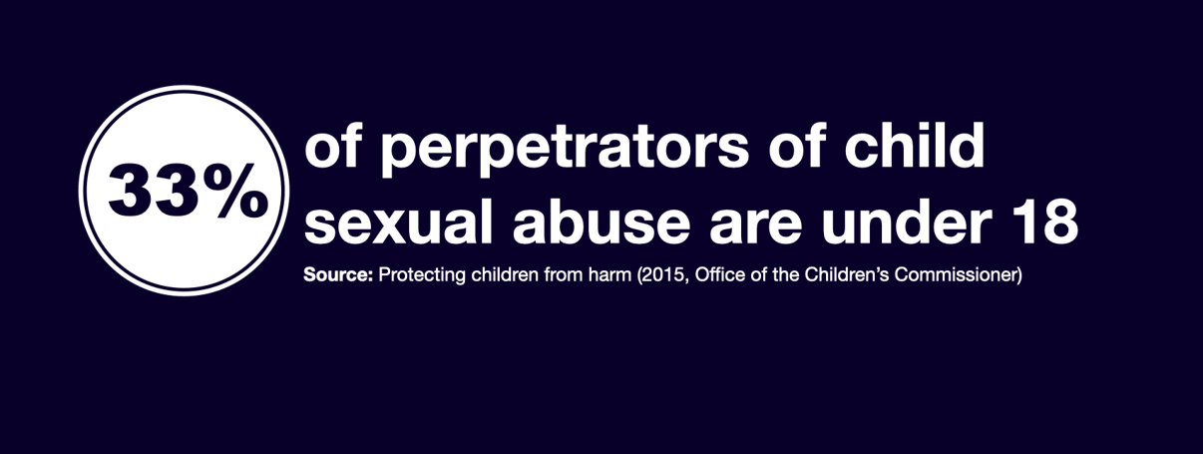
Sexual violence and sexual harassment

Slide 12
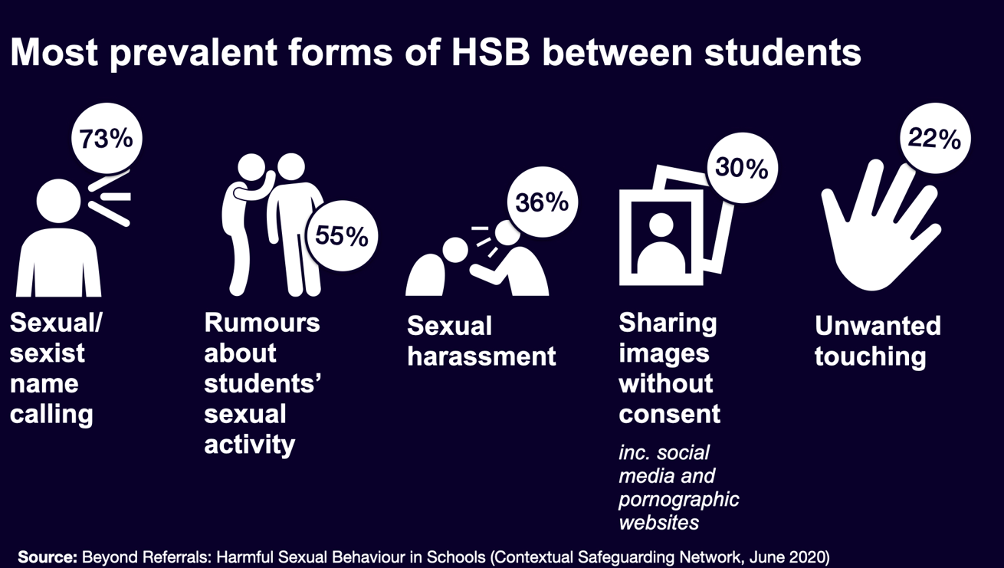
Harmful Sexual Behaviours in Schools

Slide 13
Sexual violence and sexual harassment

Slide 14
Sexual violence and sexual harassment

Slide 15
Sexual violence and sexual harassment
Ofsted’s Review of sexual abuse in schools and colleges revealed how prevalent sexual harassment and online sexual abuse is for children and young people and that, the issues are so widespread that they need addressing for all children and young people.
Nationally collected statistics show that there has been a sharp increase in reporting of child sexual abuse to the police in recent years. Figures that include all child sexual abuse cases show that the police recorded over 83,000 child sexual abuse offences (including obscene publications) in the year ending March 2020.

Slide 16
Sexual assault – Section 3 SOA 2003
(1) A person (A) commits an offence if—
(2) He/she intentionally touches another person (B),
(3) the touching is sexual,
(4) (B) does not consent to the touching, and
(5) (A) does not reasonably believe that (B) consents.

Slide 17
“Consent”
A person consents if he/she agrees by choice, and has the freedom and capacity to make that choice.

Slide 18
Consent under 13’s
Under-13’s can’t consent to sexual activity
Age of consent is 16
Sexual intercourse without consent is rape
Making and sharing sexual images of under 18’s is illegal

Slide 19
Peer on Peer Abuse (part 5 KCSIE 2021
All staff should be aware of the importance of:-
The starting point regarding any report should always be that there is a zero tolerance approach to sexual violence and sexual harassment and it is never acceptable and it will not be tolerated.
It is especially important not to pass off any sexual violence or sexual harassment as “banter”, “just having a laugh”, “part of growing up” or “boys being boys” as this can lead to a culture of unacceptable behaviours and an unsafe environment for children.
Dismissing or tolerating such behaviours risks normalising them.

Slide 20
Harmful Sexual Behaviours - HSB
Examples include:
Touching the genitals of other young people
Forcing other into sexual activity
Exposing themselves or masturbating in public
Sexually explicit talk to or touching of younger children

Slide 21
HSB – A continuum of behaviours
It is vital for professionals to distinguish normal from abnormal sexual behaviours. A child’s sexual behaviour should be considered abnormal if it:
Occurs at a frequency greater than would be developmentally expected.
Interferes with the child’s development
Occurs with coercion, intimidation, or force
Is associated with emotional distress
Occurs between children of divergent ages or developmental abilities
Repeatedly recurs in secrecy after intervention by caregivers.

Slide 22
Continuum of Sexual Behaviour in Children

Slide 23
Immediate response
Children may well not directly verbalise their abuse to adults:
May be shown in behaviour.
Information may come from a friend: or
An overheard conversation.

Slide 24
Immediate response
Listening carefully to the child
Reflecting back, using the child’s language
Being non-judgmental,
Clear about boundaries
Give information about how the report will be progressed.
Don’t ask leading questions
Only prompt the child where necessary using open questions, like, where, when, what etc.
Source: KCSIE (2021)

Slide 25
Immediate response
How the report is dealt with, will affect whether others will come forward in the future.
A child is likely to report to someone they trust – it could be anyone
Victim must not feel like they’re a nuisance for reporting their concerns.
They need to feel listened to and be taken seriously
A written report is essential: record only the facts as reported.
Source: KCSIE (2021)

Slide 26
Next Steps
Report to the school’s Designated Safeguarding Lead (DSL)
DSL will review the report; and then carry out a risk and needs assessment
Source: KCSIE (2021)

Slide 27
Designated Safeguarding Lead will consider:
Wishes of the victim
Nature of the alleged incident
Ages of the children involved
Developmental stages of the children involved
Any power imbalance between the children
Whether this is a one-off, or a sustained pattern of behaviour
Any on-going risks to others, children or staff
Any potential links to sexual abuse or exploitation
Source KCSIE (2021)

Slide 28
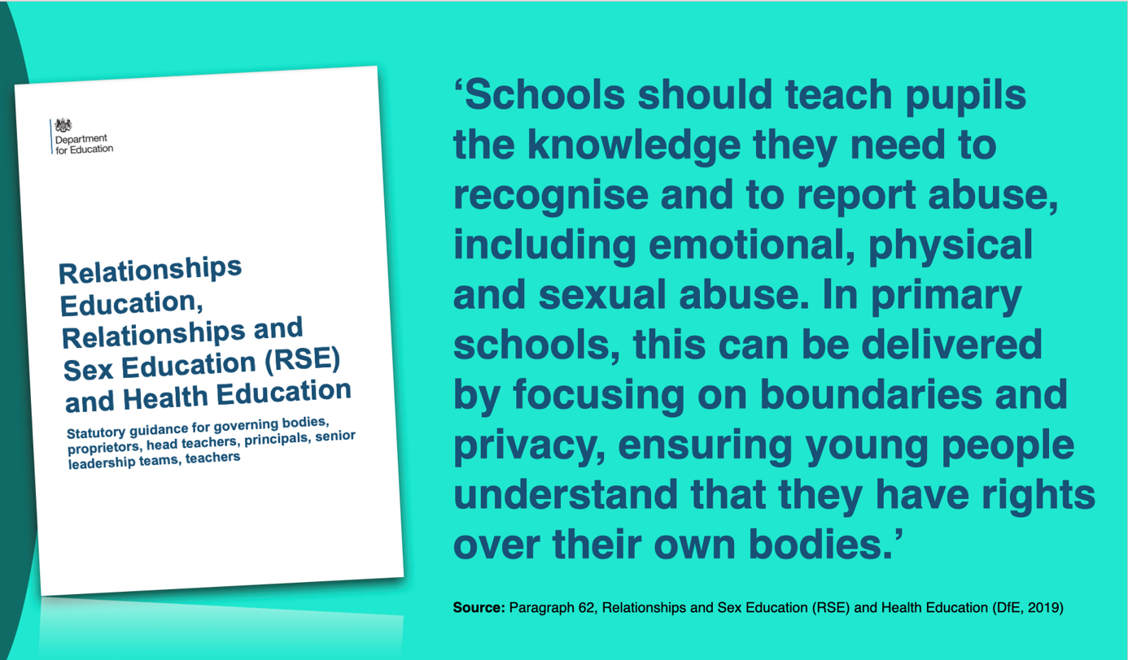

Slide 29
Relationships Education & Relationships & Sex Education
Caring Friendships - Pupils should know…. how to recognise who to trust and who not to trust, how to judge when a friendship is making them feel unhappy or uncomfortable.
Respectful relationships - Pupils should know …. The importance of permission-seeking and giving in relationships with friends, peers and adults.
Online relationships – Pupils should know …. That the same principles apply to online relationships as to face-to-face relationships, including the importance of respect for other online.
Being safe – Pupils should know …. That each person’s body belongs to them, and the differences between appropriate and inappropriate or unsafe physical, and other contact.
Source – Relationships & Sex Education (RSE) & Health Education (DfE 2019)

Slide 30
At a glance reminders (All Safeguarding concerns)
Always remember the child and look beyond their behaviour and consider why they are behaving like this.
Always listen to what the child is telling you.
Make a record of what the child has said (as soon as possible)
Don’t dismiss what a child tells you.
Be professionally curious if the situation doesn’t look or feel right to you then it probably isn’t right.
If in doubt always seek advice and support.
Share information with the School/Organisation Designated Safeguarding Lead.
Always share with your manager if you have a concern regarding a colleague’s behaviour towards a child.

Slide 31
Key messages for all staff
REMEMBER ‘it could happen here’
Always act in the best interest of the child

Slide 32
Legislation, Guidance and Procedure
July 2018
September 2021
Notes:
Read Keeping children safe in education (50 pages)

Slide 33
Peer on Peer Abuse
Haley Cameron:
Safeguarding Manager, Cognus
Steve Welding:
Esafety/Prevent trainer, Cognus

