Slide 1
Safeguarding children, young people Children Missing Education - CME Gill Bush: Education Safeguarding Lead, CFCS Louise Blay: CME Officer
Hayley Cameron: Education Safeguarding Manager
Stephen Welding: Esafety Adviser/Prevent Trainer
Mick Bradshaw: Outdoor Education Adviser

Slide 2
Children Missing Education - CME
Section 436A of the Education Act 1996
All children, regardless of their circumstances, are entitled to an efficient, full time education which is suitable to their age, ability, aptitude and any special
educational needs they may have.
This is a 24 page document which details and highlights the risks of children of statutory school age not being in suitable education.

Slide 3
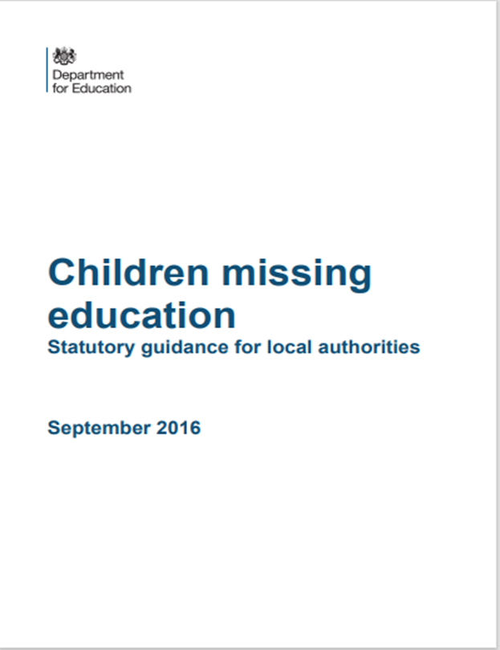
Who are Children Missing Education ?
Children missing education are children of compulsory school age who are not registered pupils at a school and are not receiving suitable education otherwise than at a school. Children missing education are at significant risk of
Underachieving
Being victims of harm/crime
Exploitation or radicalisation

Slide 4
Children that are NOT CME
Children who are ON a school roll are not CME.
If a child of Statutory School Age is ON a school roll and they are not attending School, this is NOT CME.
It is however an attendance issue and is still a concern.
It should be dealt with in conversation with the Designated Safeguarding Lead of the school and possibly Children Social Care (CFCS) depending on circumstances, but it is NOT a referral to CME.

Slide 5
When can a child be off rolled by the School ?
As we have stated CME is a child not on a school roll and not receiving suitable education, to understand fully CME we need to be aware that once a child is on a school roll they can only be removed when certain circumstances apply. These are details in Children Missing Education 2016. Examples are :
Death.
Imprisonment
Permanently Excluded.
Written notification from parent that child will be Elective Home Educated. ehe@cognus.org.uk
Children who have moved location and no longer live within a reasonable distance from the school and parent has stated too far to travel.
Children no longer living in UK and proof of this has been obtained.
Children who have been continually absent from school for a period of not less than 20 school days and school have failed to ascertain where the pupil is after reasonable enquiries and there is not reasonable grounds to believe that they cant attend due to sickness or other unavoidable cause.
Children who have been continually absent from school for a period of 10 days after immediately following the expiry of a period of leave granted and as above. school have failed to ascertain where the pupil is after reasonable enquiries and there is not reasonable grounds to believe that they cant attend due to sickness or other unavoidable cause.
The above is just an example of when a child can off rolled by a school but having been off rolled, if they are then no longer receiving a suitable education as a result and are still believed to be in UK then the child then becomes CME and a referral has to then be sent to cme@cognus.org.uk.

Slide 6
Examples of Children who are CME
Children who have moved to a new local authority and as yet have no new school.
Children who have not been seen or heard from, including after home visits and enquiries with the local authority.
Children moved abroad with no confirmation being received.
Children new to the Borough who have not applied for a school place or notified us of any other type of education.
Children excluded who have not accepted alternative provision i.e. Limes College.

Slide 7
So, what does CME do ?
CME accepts the risks and will either track the child using Council Tax, Schools to Schools database, Health enquiries or will pass onto the new local authority – (CME to CME), or in some cases take action by referring onto to Social Care, Police or School Attendance.
How do we do this?
We hold regular CME Meetings for decision making purposes with attendees including, Head of Service Peter Gasparelli, CME Officers, Safeguarding Team, Attendance Service, Travellers, Admissions. We will then make a decision on next steps which may include referring on for a Multi Agency decision jointly with Children Social Care.

Slide 8
What can you do?
A CME Form must be completed by anyone concerned that a child is ‘Missing Education’. The form is then emailed to cme@cognus.org.uk
For more information, visit the Cognus Website using the link below where you will find the CME referral form.
https://www.cognus.org.uk/services-for-professionals/safeguarding/children-missing-education/

Slide 13
Thank You for Listening Any Q uestions
Gill Bush: Education Safeguarding Lead, CFCS
Louise Blay: CME Officer
Hayley Cameron: Education Safeguarding Manager
Stephen Welding: Esafety Adviser/Prevent Trainer
Mick Bradshaw: Outdoor Education Adviser

