Slide 1
Professional Curiosity (Disguised Compliance)
Hayley Cameron: Education Safeguarding Manager
Stephen Welding: Esafety Adviser/Prevent Trainer
Gill Bush: Education Lead, CFCS
Mick Bradshaw: Outdoor Education Adviser

Slide 2
Professional Curiosity
Professional curiosity is the
capacity and communication
skill to explore and understand what is happening within a
family rather than making
assumptions or accepting
things at face value.
Walsall safeguarding Board

Slide 3
Professional curiosity
Professional curiosity is key to safeguarding children and adults – be interested in the individuals you are working with and fully
explore rather than making assumptions. Be aware of your own values affecting judgements.
Walsall safeguarding Board

Slide 4
“Think outside the Box”
Be self aware in your practice,
Professional curiosity can require
practitioners to think ‘outside the box’,
beyond their usual professional role, and consider families’ circumstances
holistically.
Curious professionals engage with
individuals and families through visits,
conversations, observations and asking
relevant questions to gather historical
and current information
Walsall safeguarding Board

Slide 5
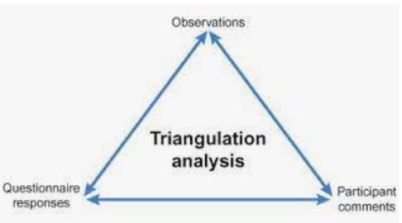
Professional Curiosity
Triangulate information you receive.
Seek independent confirmation of
individuals’ accounts and weigh up
details from a range of sources and practitioners.
Focus on the need, voice and “lived
experience” of the person or family. Ask relevant questions and be ‘brave’. Be prepared to have difficult conversations.
Walsall safeguarding Board

Slide 6
Those difficult questions!!
Professionals need to enquire about
the significant people in families’ lives
that influence them. This may be someone
who provides care, or supports the family or
individual – for example, another family
member, a friend, someone from the
community or father of any children and so
on. Professionals need to be brave and have
what are often difficult or awkward
conversations about the issues affecting
families. These could be domestic abuse,
inadequate housing, self-neglect, social
isolation, mental health, drugs and alcohol, or
issues between a person and carer
Walsall safeguarding Board

Slide 7
Bichard report - 2004
“For those agencies whose job it is to protect children and vulnerable people, the harsh reality is that if a sufficiently devious person is determined to seek out opportunities to work their evil, no one can guarantee that they will be stopped. Our task is to make it as difficult as possible for them to succeed...”
Bichard Report, 2004, p 12, para 79

Slide 8
Definition of disguised compliance
“Disguised compliance involves parents giving the appearance of co-operating with child welfare agencies to avoid raising suspicions and allay concerns. Published case reviews highlight that professionals sometimes delay or avoid interventions due to parental disguised compliance.”
Walsall safeguarding Board

Slide 9
Disguised Compliance
Families can develop skilful strategies to keep professionals at 'arms length'. Disguised compliance occurs when parents want to draw the professional's attention away from allegations of harm and unsafe parenting with the aim of minimising or avoiding agency interventions in family life.
Walsall safeguarding Board

Slide 10
Indicators of Disguised Compliance
Parents put little effort into making any changes
There is limited improvement despite significant input
Parents align with certain professionals
Parents only engage with part of the plan
Child’s view conflicts with that of the parents view
Cases begin to drift and lack focus
Significant issues may be missed
The risk to the child may increase
Cases may be closed too early
CHILD REMAINS AT RISK OF HARM

Slide 11
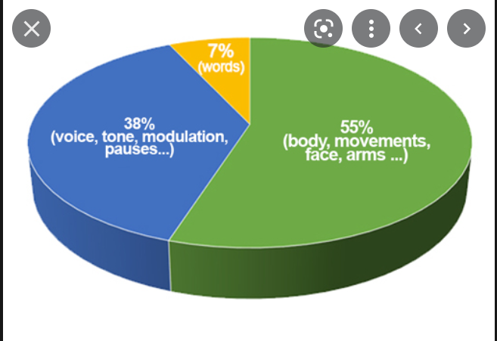
Non Verbal Communication

Slide 12
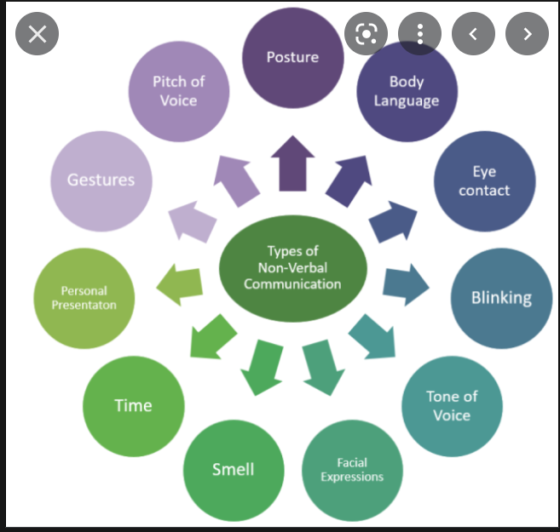

Slide 13
Learning from Safeguarding Practice reviews
Establish the facts and gather evidence
Build Chronologies
Record the child’s perspective
Identify the outcomes
Use staff supervision to challenge beliefs

Slide 14
Why is all of this important?
It is important for children to receive the right help at the right time to address safeguarding risks, prevent issues escalating and to promote children’s welfare. Research and Safeguarding Practice Reviews have repeatedly shown the dangers of failing to take effective action.
Examples of poor practice include:
▪ failing to act on and refer the early signs of abuse and neglect
▪ poor record keeping
▪ failing to listen to the views of the child
▪ failing to re-assess concerns when situations do not improve
▪ not sharing information with the right people within and between agencies
▪ sharing information too slowly
▪ a lack of challenge to those who appear not to be taking action.

Slide 15
SO WHY ARE WE HERE TODAY??
We can all make a difference to a child’s life.
We can all help a child to achieve.
We can all listen to what a child is telling us.
We can all be “there” for the child.
We can provide the best support for the child.
We all know “right from wrong”.
WE ALL HAVE TO BE PROFESSIONALLY CURIOUS

Slide 16
Summary - Establish the facts
Use in-depth assessments to gather evidence about what is actually happening.
Observe what is being said but also remember to look for non-verbal cues e.g. body language and parent/child interactions.
Keep detailed records and build up a chronology - this will help with looking for patterns of non-compliance.
Look at previous records to identify patterns of behaviour/engagement. Remember that previous history is the best predictor of future behaviour.
Talk to other professionals. What are their experiences of the family? Coordinate information across families for a fuller picture of what life is like for the child.
Avoid being over optimistic about a parent’s ability or motivation to change. Hampshire Safeguarding Authority

Slide 17
Thank You for Listening
Please visit www.Cognus.org.uk where you will find more bitesize training packages.
Hayley Cameron: Education Safeguarding Manager
Stephen Welding: E safety Adviser/Prevent Trainer
Gill Bush: Education Lead, CFCS
Mick Bradshaw: Outdoor Education Adviser

