Slide 1
Safeguarding children, young people All School Staff Safeguarding Training
Hayley Cameron: Education Safeguarding Manager
Stephen Welding: Esafety Adviser/Prevent Trainer
Gill Bush: Education Lead, MASH
Mick Bradshaw: Outdoor Education Adviser

Slide 2
Setting the scene - agenda
Key Guidance and Policies
What’s new in KCSIE 2022
Key safeguarding issues – in Sutton
Safeguarding refresher
Managing disclosures, how to report
Record keeping principles
Insight into the CFCS processes

Slide 3
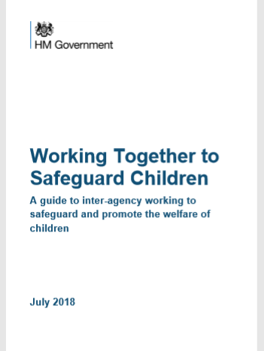
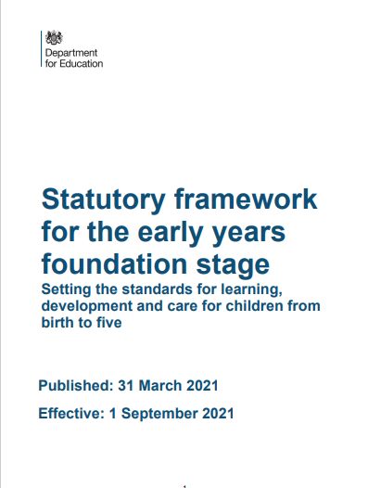
Legislation, Guidance and Procedure
Notes:
Read Keeping children safe in education (50 pages)

Slide 4
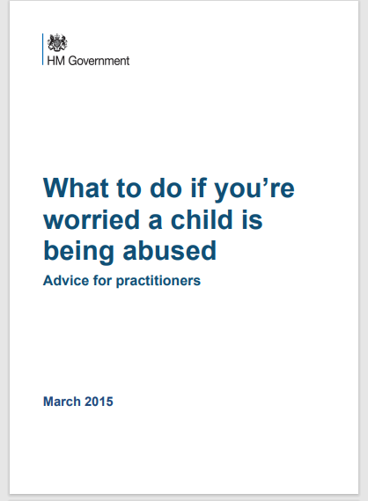
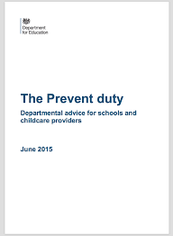
Key Guidance and Legislation

Slide 5
Introduction to the School Safeguarding Documents
School Safeguarding Policy
School Child protection/safeguarding young people and vulnerable adults – Procedure
Staff Code of Conduct and Social Media policy
Keeping Children Safe in Education September 2022 DfE
All staff are expected to read and understand PART 1 of the KCSIE document

Slide 6
Ofsted - School inspection handbook
Safeguarding
262. All schools should have a culture of safeguarding. This means they should have effective arrangements to:
◼ always act in the best interests of children, pupils and students to protect them online and offline
◼ identify children, pupils and students who may need early help, and who are at risk of harm or have been harmed. This can include, but is not limited to, neglect, abuse (including by their peers), grooming or exploitation
◼ secure the help that children, pupils and students need, and if required, referring in a timely way to those who have the expertise to help
◼ manage safe recruitment and allegations about adults who may be a risk to children, pupils, students and vulnerable adults.

Slide 7
KCSIE 2022 – What is in it?
Part one: Safeguarding information for all staff. What school and college staff should know and do
Part two: The management of safeguarding. The responsibility of governing bodies, proprietors and management committees
Part three: Safer recruitment, Recruitment and selection process
Part four: Allegations made against/Concerns raised in relation to teachers, including supply teachers, other staff, volunteers and contractors
Part five: Child on child sexual violence and sexual harassment
Responding to reports of sexual violence and sexual harassment

Slide 8
KCSIE 2022 – What is in it?
Annex A: Safeguarding information for school and college staff
Annex B: Further information. Additional advice and support
Annex C: Role of the designated safeguarding lead
Annex D: Host families - homestay during exchange visits
Annex E: Statutory guidance - Regulated activity (children) - Supervision of activity with children which is regulated activity when unsupervised.
Annex F: Table of substantive changes from September 2022

Slide 9
Policy & Procedures
Pupil's health & safety
Attendance
Behaviour
Child protection/Safeguarding
Meeting the needs of children with medical needs
Intimate care and emotional well-being
Providing first aid
Physical intervention/reasonable force
Risk assessments for educational trips/visits
E-safety and associated issues
Staff Code of Conduct
Acceptable Use Policies – Staff/students/parents
Lockdown/Evacuation

Slide 10
Key education personnel
Safeguarding Governor
Head teacher, head of school, manager
Designated Safeguarding Lead (and Deputies)
LA Safeguarding Lead
CFCS Education Safeguarding Lead
Designated Teacher for Looked After Children (LAC)
Designated Teacher for pupils with SEND
Designated Officer(s)/ Local Authority (LADO)

Slide 11
Wider safeguarding agenda
Safer recruitment
DBS
Regulated activity
Disqualification (Childcare Act)
Allegations against staff
Premises and the school
environment

Slide 12
Sutton Local Safeguarding Children’s Partnership (LSCP)
The “Go To” place for Safeguarding Advice
www.suttonlscp.org.uk

Slide 13
SO WHY ARE WE HERE TODAY??
We can all make a difference to a child’s life.
We can all help a child to achieve.
We can all listen to what a child is telling us.
We can all be “there” for the child.
We can provide the best support for the child.
We all know “right from wrong”.
We must all report any worry or a concern.
WE ALL HAVE TO BE PROFESSIONALY CURIOUS
It’s Safeguarding

Slide 14
KCSIE 2022 – Safeguarding Definition
Safeguarding and promoting the welfare of children is defined for the purposes of this guidance as:
protecting children from maltreatment;
preventing the impairment of children’s mental and physical health or development;
ensuring that children grow up in circumstances consistent with the provision of safe and effective care; and
taking action to enable all children to have the best outcomes.

Slide 15
KCSIE 2022
Safeguarding and promoting the welfare of children is everyone’s responsibility.
Everyone who comes into contact with children and their families has a role to play. In order to fulfil this responsibility effectively, all practitioners should make sure their approach is child-centred. This means that they should consider, at all times, what is in the best interest of the child.

Slide 16
KCSIE 2022
No single practitioner can have a full picture of a child’s needs and circumstances. If children and families are to receive the right help at the right time, everyone who comes into contact with them has a role to play in identifying concerns, sharing information and taking prompt action.

Slide 17
KCSIE 2022 – New paragraph inserted
All staff should be aware that children may not feel ready or know how to tell someone that they are being abused, exploited, or neglected, and/or they may not recognise their experiences as harmful. For example, children may feel embarrassed, humiliated, or being threatened. This could be due to their vulnerability, disability and/or sexual orientation or language barriers. This should not prevent staff from having a professional curiosity and speaking to the DSL if they have concerns about a child. It is also important that staff determine how best to build trusted relationships with children and young people which facilitate communication

Slide 18
What all staff should know
What to do if a child says they are being abused or neglected
Manage confidentiality appropriately
Identify early help needs
How to follow school referral processes
Be aware of referral processes for social care.
That all concerns/discussions and decisions made and the reasons for those decisions are accurately recorded in writing
QUESTION: are you secure in your knowledge and understanding

Slide 19
What all staff should know – KCSIE 2022
All staff should be aware of systems within their school or college which support safeguarding, and these should be explained to them as part of staff induction. This should include the:
child protection policy (which should amongst other things also include the policy and procedures to deal with child-on-child abuse)
behaviour policy (which should include measures to prevent bullying, including cyberbullying, prejudice-based and discriminatory bullying)
staff behaviour policy (sometimes called a code of conduct) should amongst other things, include low- level concerns, allegations against staff and whistleblowing
safeguarding response to children who go missing from education.
The role of the designated safeguarding lead (including the identity of the designated safeguarding lead and any deputies).

Slide 20
KCSIE 2022 – Part 1
14. All staff should receive appropriate safeguarding and child protection training (including online safety) at induction. The training should be regularly updated. In addition, all staff should receive safeguarding and child protection (including online safety) updates (for example, via email, e-bulletins, and staff meetings), as required, and at least annually, to continue to provide them with relevant skills and knowledge to safeguard children effectively.

Slide 21
KCSIE 2022 – Part 2
128. Governing bodies and proprietors should ensure that children are taught about how to keep themselves and others safe, including online. It should be recognised that effective education will be tailored to the specific needs and vulnerabilities of individual children, including children who are victims of abuse, and children with special educational needs or disabilities.

Slide 22
KCSIE 2022 – Part 2
140. governing bodies and proprietors should be doing all that they reasonably can to limit children’s exposure to the those risks from the school’s or college’s IT system. As part of this process, governing bodies and proprietors should ensure their school or college has appropriate
filters and monitoring systems in place and regularly review their effectiveness.

Slide 23
Strip searches in Schools
A strip search is a search involving the removal of more than outer clothing. Strip searches on school premises can only be carried out by police officers under the Police and Criminal Evidence Act 1984 (PACE) Code A and in accordance with the Police and Criminal Evidence Act 1984 (PACE) Code C.
While the decision to undertake the strip search itself and its conduct are police matters, school staff retain a duty of care to the pupil(s) involved and should advocate for pupil wellbeing at all times.

Slide 24
Strip searches in Schools
A strip search is a search involving the removal of more than outer clothing. Outer clothing includes shoes and socks.
Strip searching can be highly distressing for the pupil involved, as well as for staff and other pupils affected, especially if undertaken on school premises. PACE Code C states that a strip search may take place only if it is considered necessary to remove an item related to a criminal offence, and the officer reasonably considers the pupil might have concealed such an item. Strip searches should not be routinely carried out if there
is no reason to consider that such items are concealed.

Slide 25
Strip searches in Schools
Except in cases of urgency where there is risk of serious harm to the pupil or others, whenever a strip search involves exposure of intimate body parts there must be at least two people present other than the pupil, one of which must be the appropriate adult.
The role of the appropriate adult is to safeguard the rights, entitlements and welfare of children and vulnerable adults in police custody. This adult must not be a police officer or otherwise associated with the police. Examples of an appropriate adult include, but are not limited to, a parent, relative, social worker, teacher or, if the person is in the care of a local authority or voluntary organisation, a person representing that authority or organisation. Note that an appropriate adult is not required when a pupil is eighteen or above.

Slide 26
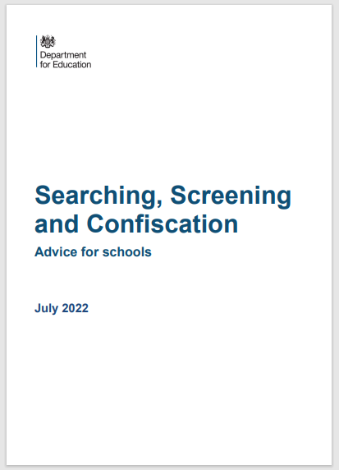
Searching in Schools – Revised July 2022
It is important that SLT/DSL liaise with the School police teams when a student is believed to be in possession of drugs or prohibited articles. Be aware of your obligation to the student and do not be afraid to challenge the police if you believe things are not being done correctly or in the best interest of the child.

Slide 27
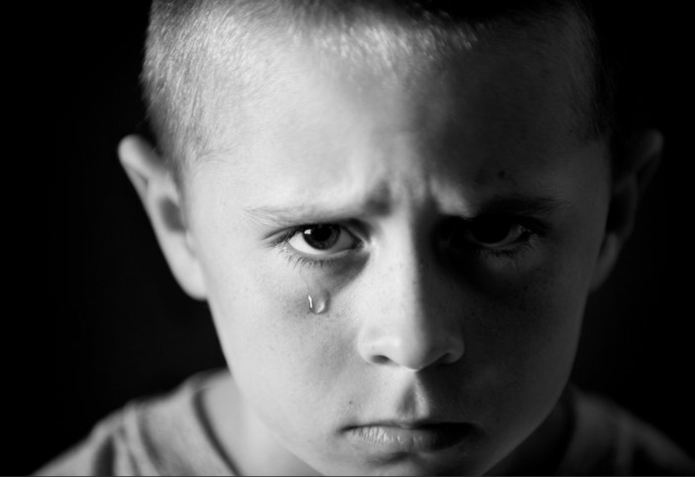
Neglect and Abuse
NEGLECT
EMOTIONAL ABUSE
PHYSICAL ABUSE
SEXUAL ABUSE

Slide 29
Key safeguarding issues – Sutton
Child abuse
Self Harm
Mental Health issues
Domestic abuse that Impact on Children
Child Sexual Exploitation (CSE)
Child Criminal Exploitation (CCE)
Children Missing Education (CME)

Slide 30
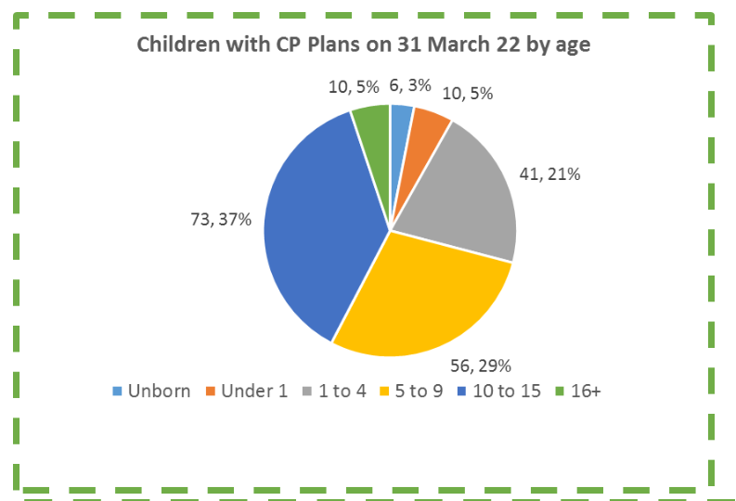

Slide 31
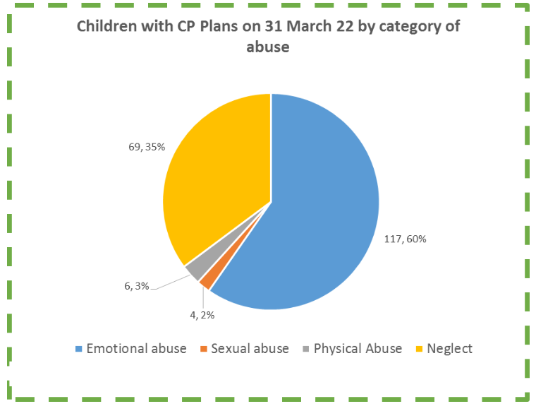

Slide 32
Key Safeguarding Issues in Education settings
Children and the Court System
Children Missing Education
Child Sexual Exploitation
Child on Child abuse
Upskirting
FGM
Self-harm
Mental Health
Homelessness
Domestic violence
Honour based abuse
Radicalisation & extremism
Cyber bullying and social media
Children with family members in prison
Child Criminal Exploitation – County lines

Slide 33
Child Abuse
Child abuse is the range of ways in which people significantly harm children or young people
Inflicting harm or failing to prevent harm
Children or young people may be sexually abused in a family or in an institutional or community setting, by those known to them or, more rarely, by a stranger
They may be abused by an adult or adults, or by another child or children
Neglectful behaviours may include: missing medical appointments, lack of food/inappropriate clothing, prioritising adult need rather than children’s, poor attendance at school.

Slide 34
Crime and Sentencing Act 2022 (New)
New sentencing powers related to child abuse that have come into effect in England and Wales as part of the Police, Crime and Sentencing Act 2022. Changes include: the maximum sentence for causing or allowing a child’s death has increased from 14 years to life; and the maximum penalty for causing serious harm to a child has increased from 10 to 14 years.
Tony’s Law
Tony Hudgell was attacked by his birth parents when he was a baby and left with life-changing injuries.
He suffered multiple fractures, was left deaf in one ear and had to have both his legs amputated.

Slide 35
How common is child sexual abuse?
1 in 20 children in the UK
1 in 3 children did not tell anyone
Over 90% of sexually abused children were abused by someone they knew
450,000 abused in the UK last year
50,000 reported to police
Sources:
Radford, L. et al (2011) Child abuse and neglect in the UK today
Jütte, S. et al (2014) How safe are our children? 2014. London: NSPCC
Office of the English Children’s Commissioner 2015

Slide 36
Child Sexual Abuse
Sabah was sexually abused between the ages of seven and 13 by four members of her family and a teacher. She was raped for the first time when she was nine.
“Child sexual abuse does not discriminate.” said Sabah. “The teacher was white – the family members who abused me were brown.
“This is not a race or colour issue. It is about as a society tackling all predators of child sex abuse.
“All my abusers had one thing in common – they had the entire community thinking they were good people.
Independent Inquiry into Child Sex Abuse looking at barriers faced by ethnic minority communities in reporting child sexual abuse.

Slide 37
Child-on-child sexual violence and sexual harassment (Part 5 KCSIE 2022)
All Staff should be aware of the importance of :
making clear that there is a zero-tolerance approach to sexual violence and
sexual harassment, that it is never acceptable, and it will not be tolerated
It should never be passed off as “banter”, “just having a laugh”, “a part of growing up” or “boys being boys”
Failure to do so can lead to a culture of unacceptable behaviour, an unsafe environment and in worst case scenarios a culture that normalises abuse, leading to children accepting it as normal and not coming forward to report it.
Dismissing or tolerating such behaviours risks normalising them

Slide 38
Sexual assault
(1) A person (A) commits an offence if—
(2) He/she intentionally touches another person (B),
(3) the touching is sexual,
(4) (B) does not consent to the touching, and
(5) (A) does not reasonably believe that (B) consents.

Slide 39
“Consent”
A person consents if he/she agrees by choice, and has the freedom and capacity to make that choice.

Slide 40
NO Consent - under 13’s
Under-13’s can’t consent to sexual activity
Age of consent is 16
Sexual intercourse without consent is rape
Making and sharing sexual images of under 18’s is illegal

Slide 41
Communities at risk of FGM
FGM is practised in at least 28 African countries, in the Middle East and Asia.
In the UK, FGM tends to occur in areas with large populations of FGM practising communities. These include London, Cardiff, Manchester, Sheffield, Northampton, Birmingham, Oxford, Crawley, Reading, Slough and Milton Keynes.
However, FGM can happen anywhere in the UK (NHS Choices, 2013).
It is a criminal act in the UK and should be reported to the police if staff/volunteers become aware of the procedure taking place.
If a member of staff/volunteer becomes aware that it may be taking place then it is a referral to CFCS.
Notes:
How prevalent is FGM?
FGM is usually carried out on girls between infancy and age 15, with the majority of cases occurring between the ages of 5 and 8 years (HM Government, 2011). Because of the hidden nature of the crime, it is difficult to estimate FGM's prevalence, but a study based on 2001 census data in England and Wales estimated that 23,000 girls under the age of 15 could be at risk of FGM each year; and nearly 66,000 women are living with its consequences (Dorkenoo et al, 2007). FGM could be even more prevalent than these figures suggest due to population growth and immigration from practising countries since 2001 (HM Government, 2011).

Slide 42
FGM Guidance for Schools
nationalfgmcentre.org.uk

Slide 43
Holistic Approach

Slide 44
'Honour-based Abuse’ – KCSIE 2022
Along with FGM, Keeping Children Safe in Education (2022) mentions Breast Ironing and Forced marriage, under so-called 'Honour-based Abuse’.
Breast Ironing is practiced in some African countries, notably Cameroon. Girls aged between 9 and 15 have hot pestles, stones or other implements rubbed on their developing breast to stop them growing further.
Forcing a person into a marriage is a crime in England and Wales. A forced marriage is one entered into without the full and free consent of one or both parties and where violence, threats or any other form of coercion is used to cause a person to enter into a marriage

Slide 45
Legal age of marriage/civil partnerships (New)
The legal age of marriage and civil partnerships has been raised to 18 in England and Wales. Previously, people could get married at 16 or 17 as long as they had parental consent.
The new law also applies to cultural or religious marriages that are not registered with the local council.
Under the new rules, children will not face penalties but adults who facilitate their marriage could face up to seven years in jail and a fine.
This would include adults who took children abroad to carry out the marriage.

Slide 46
Health and Care Act 2022 (New)
The Department for Health and Social Care (DHSC) has published non-statutory guidance providing advice for professionals in the UK who may encounter women and girls affected by virginity testing and hymenoplasty (a procedure undertaken to reconstruct a hymen). The government has made it illegal to carry out, offer or aid and abet virginity testing or hymenoplasty in any part of the UK, as part of the Health and Care Act 2022. The guidance includes: information on how the law applies; support with identifying women and girls at risk or who may have been subjected to a virginity test and/or hymenoplasty; and help to prevent this from taking place.

Slide 47
Self harm
Self-harm is a serious public health problem and is the reason behind many admissions to accident and emergency departments every year.
Sutton has a multi-agency self-harm protocol (Sept 2020)
Self-harm and suicidal threats by a child/young person put them at risk of significant harm, and should always be taken seriously and responded to without delay.
Self-harming is NOT attention seeking behaviour, it is attention NEEDING behaviour.
Self-harm is a way of coping with difficult or overwhelming situations or emotional states.

Slide 48
Referral pathways

Slide 50
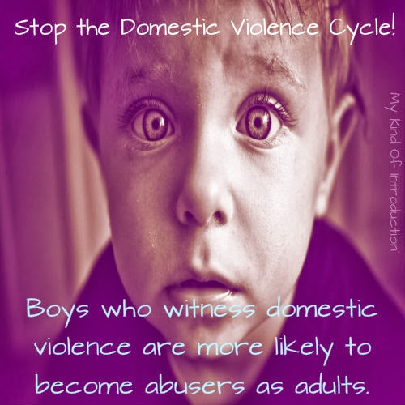
Domestic Abuse
This Photo by Unknown Author is licensed under CC BY

Slide 51
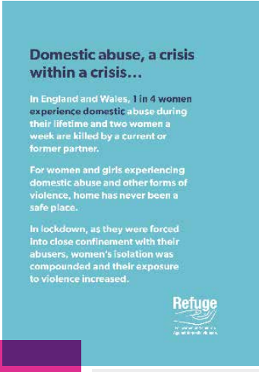
Domestic Abuse in Sutton – Lockdown
There has been a significant increase in the number of reported cases of Domestic abuse nationally.
Sutton has seen a significant rise in Domestic abuse cases since the lockdown was imposed.
The number of offences has been increasing in recent years.
Sutton Crime Prevention and Community Safety Strategy 2017-20

Slide 52
Police - Domestic Incident
Police Definition :-
Any incident or pattern of incidents of controlling, coercive or threatening behaviour, violence or abuse between those aged 16 or over who are or have been intimate partners or family members regardless of gender or sexuality.
This can encompass, but is not limited to, the following types of abuse:
•psychological
•physical
•sexual
•financial
•emotional

Slide 53
Social Care – Domestic incident
Threats and intimidation - threatening to hurt you or members of your family
Physical abuse - hitting, shoving, kicking, strangling or slapping, hair pulling, throwing things, choking or smothering, even when it doesn't leave physical marks
Sexual abuse - performing sexual acts or having sex with you when you don't want to. This can include the use of threats, intimidation, coercive behaviour or physical force, although it is still sexual abuse even without using these insults by name calling or criticism of your appearance or identity,
Criticism and put-downs - being blamed for every argument or problem.
Forced isolation from your friends or family
Controlling behaviour - telling you what to do or wear, or using manipulation or coercion. Following you or checking up on your mobile phone, post or internet use
Financial abuse - preventing you from getting or keeping a job, taking your money away or withholding the family income

Slide 54
KCSIE 2022 - Domestic Abuse (New)
43. Domestic abuse can encompass a wide range of behaviours and may be a single incident or a pattern of incidents. That abuse can be, but is not limited to, psychological, physical, sexual, financial or emotional. Children can be victims of domestic abuse. They may see, hear, or experience the effects of abuse at home and/or suffer domestic abuse in their own intimate relationships (teenage relationship abuse). All of which can have a detrimental and long-term impact on their health, well-being, development, and ability to learn.

Slide 55
Domestic Abuse in Sutton
We know that domestic abuse is a significantly underreported crime, with shame, stigma and fear often preventing reporting. Based on the information available, Sutton is 12th of 32 London boroughs in terms of reports of domestic abuse per 1000 people.
Reported figures suggest we have a higher rate of offences than Richmond, Merton and Wandsworth, but lower than Croydon.
As a proportion of total violent crime, domestic abuse in Sutton stands
at 35% which is higher than the London average (31%) (2018)
We also know that domestic abuse is a significant contributing factor in child protection issues - which have risen in the borough in recent years.
MPS Crime Reporting Information System

Slide 56
Domestic Abuse in Sutton – MARAC 2020- 2021
In Sutton, there are at least 250 known perpetrators causing high risk to victims, and of these, many are repeat offenders.
Often, perpetrators of domestic abuse have more than one
victim.
1 in 4 perpetrators are repeat offenders and some have as many as six different victims.

Slide 57
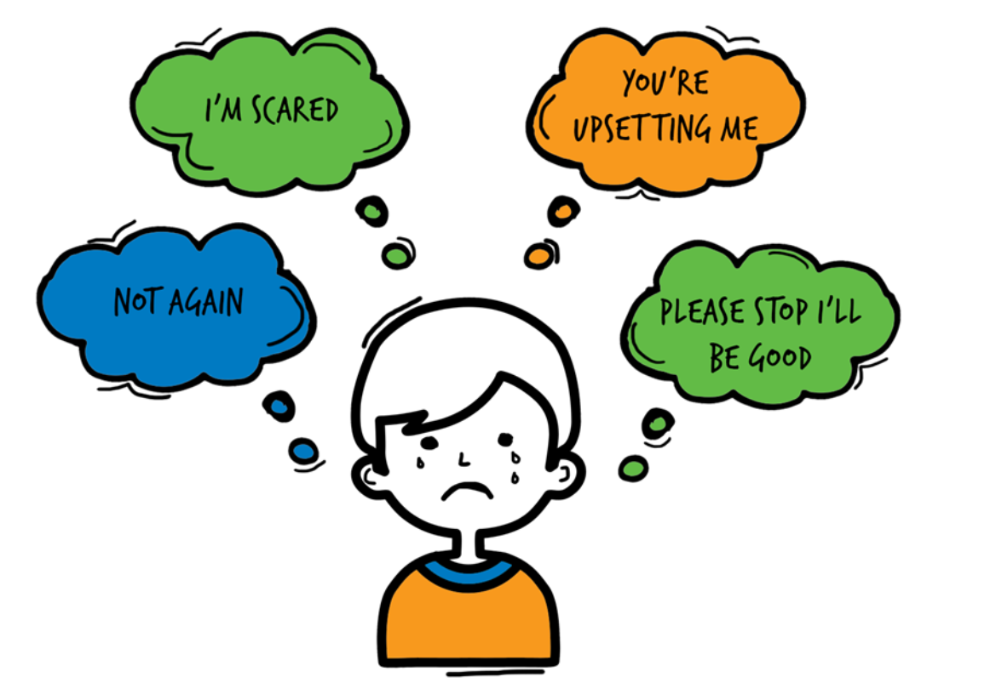
Domestic Abuse
Children living with domestic violence and abuse are over-represented among those children referred to Children Social Care, abuse and neglect represent about two thirds of cases seen at child protection conferences.
The risks of harm to children exposed to domestic violence and abuse have now been recognised. Children who live/experience DA feel:
75% of all CP cases in Sutton, Domestic Abuse is present

Slide 58
Operation Encompass - National Police Strategy
Operation Encompass operates in the majority of police forces across England. It helps police and schools work together to provide emotional and practical help to children. The system ensures that when police are called to an incident of domestic abuse, where there are children in the household who have experienced the domestic incident, the police will inform the key adult (usually the designated safeguarding lead) in school before the child or children arrive at school the following day. This ensures that the school has up to date relevant information about the child’s circumstances and can enable support to be given to the child according to their needs.

Slide 59
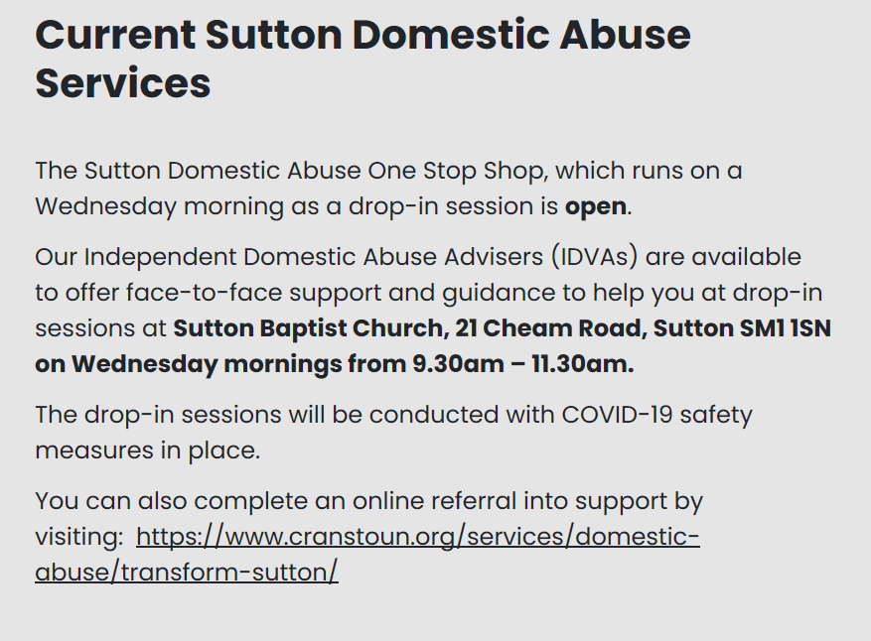

Slide 60
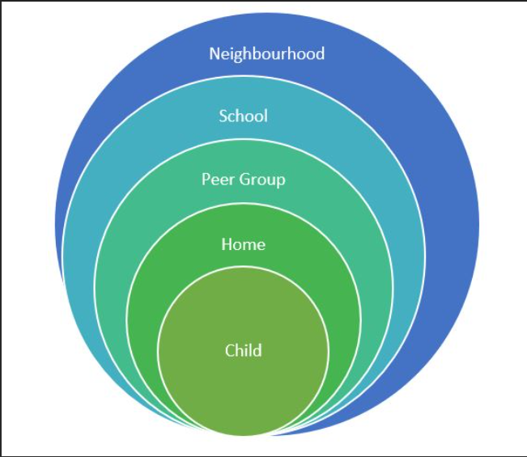
Assessment of risk outside the home
Be aware of risks in your local area –
Drugs, County Lines, gangs, Knife crime, DA, poverty, neglect, robberies, ASB, Exploitation, racism, extremism,
Hotspots (parks, vape shops, takeaways) etc

Slide 61
Counter Terrorism and Security Act 2015.
As of the 1st July 2015 – Creates a new duty on certain bodies to have “DUE REGARD TO THE NEED TO PREVENT PEOPLE FROM BEING DRAWN INTO TERRORISM”.
The duty will apply to bodies including local authorities, the police, prisons, probation, schools, colleges and universities.
Notes:
61

Slide 62
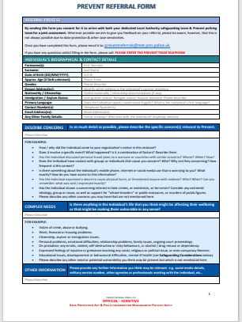
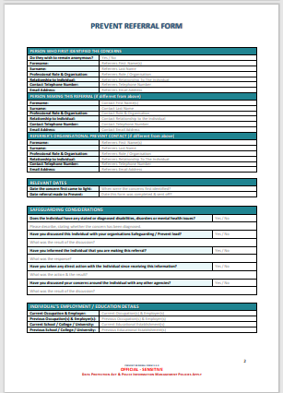
National Prevent Referral Form
preventreferrals@met.pnn.police.uk

Slide 63
Need to ask a question on Prevent?
Abu Ullah
Prevent Team Leader
Safer Sutton Partnership Service
Safer and Stronger Communities
Sutton Police Station, 6 Carshalton Road, Sutton, SM1 4RF
Tel: 020 8649 0448 Fax: 020 8642 5036
Mobile: 07710 066 807
Email: abu.ullah@sutton.gov.uk

Slide 64
What to look out for:- Abuse and Neglect
Significant changes in children’s behaviour
Deterioration in children’s general well-being
Unexplained bruising, marks or signs of possible abuse or neglect
Children’s comments which give cause for concern
Any reason to suspect neglect or abuse outside the setting
Inappropriate behaviour displayed by other members of staff, or any other person working with the children, for example, inappropriate sexual comments, excessive one-to-one attention beyond the requirements of their usual role and responsibilities or inappropriate sharing of images.

Slide 65
Common Sites for Non-Accidental Injury
The most common sites for non-accidental injury are:
Eyes, Ears
Cheeks, Mouth
Shoulders, Chest
Upper and inner arms, Stomach/abdomen
Genitals, Front and back of thighs.
Buttocks, Hands, Feet
USE THE BODY MAP TO INDICATE WHERE THE INJURIES ARE, BE SPECIFIC, NOT GENERIC

Slide 66
Responding to a Child who discloses – you should NEVER
Investigate or seek to prove or disprove possible abuse
Make promises about confidentiality or keeping ‘ secrets’
Assume that someone else will take the necessary action
Jump to conclusions, be dismissive or react with shock, anger, horror
Speculate or accuse anyone
Suggest or probe for information
Confront another person (adult or child) allegedly involved
Offer opinions about what is being said or the persons allegedly involved
Forget to record what you have been told
Fail to pass this information on to the correct person

Slide 67
T.E.D.
T – Tell me what you mean by that
E – Explain what you mean by that
D – Describe what you mean by that

Slide 68
Record Keeping- Principles
Records should be:
Accurate
Based on fact
Record what the child actually said
Jargon free
Abbreviation free
Inclusive of relevant information
Write in permanent ink (Not pencil)
Sign, Date, Time and print your full name
Your current position within the Company
Don’t cross out mistakes, put a line through and correct it.

Slide 69
Poor Practice
Failure to act soon enough
Poor record keeping
Failure to listen to the child
Failure to re-assess
Sharing too slowly
Lack of challenge to inaction

Slide 70
Managing allegations: we all have a responsibility to report
Where it is alleged that a member of staff has:
Behaved in a way that has harmed a child, or may have harmed a child;
Possibly committed a criminal offence against or related to a child;
Behaved towards a child or children in a way that indicates he or she may pose a risk of harm to children; or
Behaved or may have behaved in a way that indicates they may not be suitable to work with children.
The Head Teacher/Chair of Governors will contact the Local Authority Designated Officer (LADO) who has overall responsibility for oversight of the procedures for dealing with allegations.
The LADO will provide advice and guidance, in addition to liaising with the police and other agencies, and monitoring the progress of cases to ensure that they are dealt with as quickly as possible consistent with a thorough and fair process.

Slide 71
The term – ‘low level concern’
'The term ‘low-level’ concern does not mean that it is insignificant, it means that the behaviour towards a child does not meet the threshold of harm. A low-level concern is any concern – no matter how small, and even if no more than causing a sense of unease or a ‘nagging doubt’ - that an adult working in or on behalf of the school or college may have acted in a way that:
is inconsistent with the staff code of conduct, including inappropriate conduct outside of work.
does not meet the allegations threshold or is otherwise not considered serious enough to consider a referral to the LADO.

Slide 72
Examples of ‘low-level’ concerns KCSIE 2022
Report to the HT/Chair of Governors
being over friendly with children
having favourites
taking photographs of children on their mobile phone, contrary to school policy
engaging with a child on a one-to-one basis in a secluded area or behind a closed door
humiliating pupils.

Slide 73
Whistle blowing
If any staff member feels unable to raise an issue with their employer, or feels that their genuine concerns are not being addressed, other whistleblowing channels are open to them.
General guidance on whistleblowing can be found at:
The ‘NSPCC what you can do to report abuse dedicated helpline’ is available as an alternative route for staff who do not feel able to raise concerns regarding child protection failures internally or have concerns about the way a concern is being handled by their school or college.
Staff can call 0800 028 0285 line is available from 8.00am – 8.00pm Monday – Friday and email help@nspcc.org.uk

Slide 74
Information Sharing
Early sharing of information is the key to providing effective early help where there are emerging problems. At the other end of the continuum, sharing information can be essential to putting in place effective child protection services.
Serious Case Reviews (SCRs) have shown how poor information sharing has contributed to the deaths or serious injuries of children.
Fears about sharing information cannot be allowed to stand in the way of the need to promote the welfare and protect the safety of children.

Slide 75
Information Sharing
57. DPA and UK GDPR do not prevent the sharing of information for the purposes of keeping children safe and promoting their welfare. If in any doubt about sharing
information, staff should speak to the designated safeguarding lead or a deputy. Fears about sharing information must not be allowed to stand in the way of the need to safeguard and promote the welfare of children.
KCSIE 2022

Slide 76
Confidentiality
Safeguarding head is suspended 'for loudly discussing personal details of pupils in phone conversation on busy train
Director of Safeguarding, had been in the role 10 months
He has since been suspended pending an investigation into the incident
He also revealed one student's sexuality and discussed another's mental health
Daily Mail 9.6.22

Slide 77
After School Clubs – Get to know them
Dozens of allegations of safeguarding failures in after-school clubs - including assaults, neglect and sexual abuse - have been uncovered by BBC News.
More than 80 referrals have been made about clubs in school grounds in the past five years, according to information requests.
Many after-school clubs are not regulated as providers in England do not need to register with Ofsted unless they offer childcare for more than two hours.
They can register voluntarily with Ofsted in England but only 10% are inspected a year, meaning they may not be inspected for nearly a decade
BBC News

Slide 78
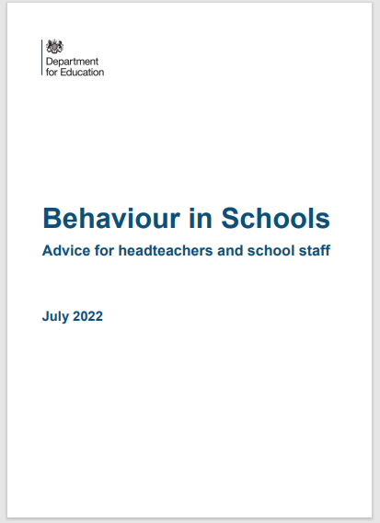
New – Behaviour in Schools
This publication provides advice to schools on behaviour in schools and the related legal duties of headteachers, and members of staff. It includes guidance on support for pupils to behave well and the powers of staff when responding to misbehaviour.

Slide 79
The Children’s First Contact Service Referral Form
Google Form, accessible via a link
Children's First Contact Service Referral Form
Telephone number 020 8770 6001/ 6072
cfcs@sutton.gov.uk
Link can also be found on the Sutton LSCP Website
www.suttonlscp.org.uk

Slide 80
CFCS SYSTEM
Referrers:
Cases not open to Children’s Social Care and there are identified support needs and/or safeguarding concerns
Contacts/Referrals from:
Statutory/PVI and the public
All contacts from statutory services, Private Voluntary and Independent and the public apart from level 4, require a Early Help Assessment EHAT and consent (Merlins received will not require consent)
*Public does not need to complete a Early Help Assessment
Tier 1 No Additional Needs
No further action/No assessment required
Advice & Information
Telephone:
020 8770 6001 (main number)
Email:
Childrensfirstcontactservice@sutton.gov.uk
Tier 2 Early Help
Assessment: CAF/Early Help Assessment
Consent required
Tier 3 Children with Complex Multiple Needs
Assessment: (Social Work Single Assessment)
Consent required
Tier 4 Children in Acute Need
Assessment: Strategy Meeting/S47
Consent not required
For a list of indicators, please follow the link to:
http://www.londoncp.co.uk/ where the indicators are outlined in the threshold section.

Slide 81
A single pathway to access support All referrals to the CFCS will be triaged to ensure they take the correct pathway
Onwards Pathways
Multi-Agency Safeguarding Hub (MASH)
Children in Need
Locality Team
Children’s Centres
Targeted Early Help
The Change up Project
Parenting Programmes
Locality Team Family Support
Restorative Family Coaches
Restorative Support and Family Group Conferencing
Short Breaks and iCount
Local Offer
LBS Website
Family Information Directory

Slide 82
Worried about a child in your school?
If you are WORRIED about a child in your school and you feel that Children Social Care should do something about it THEN YOU need pass on that WORRY to them.
You need to contextualise that WORRY into words and put it onto the CFCS referral form so when they read it THEY ARE NOW WORRIED about the child and will need to do something about it.
IT IS ALL ABOUT THE INFORMATION ON THE FORM

Slide 83
An ongoing culture of vigilance
Features of a safer culture:
Open, no secrets
Belief that ‘it could happen here’
Clear procedures for reporting concerns
Support in raising concerns and commitment to take action
Setting acceptable standards of behaviour
Policies and procedures put into practice and monitored
Induction and probationary periods.
Commitment to safeguarding and an ongoing culture of
vigilance

Slide 84
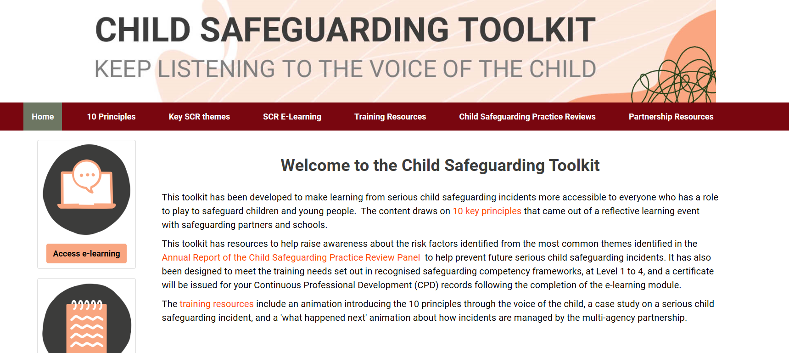
www.childsafeguardingtoolkit.org.uk

Slide 85
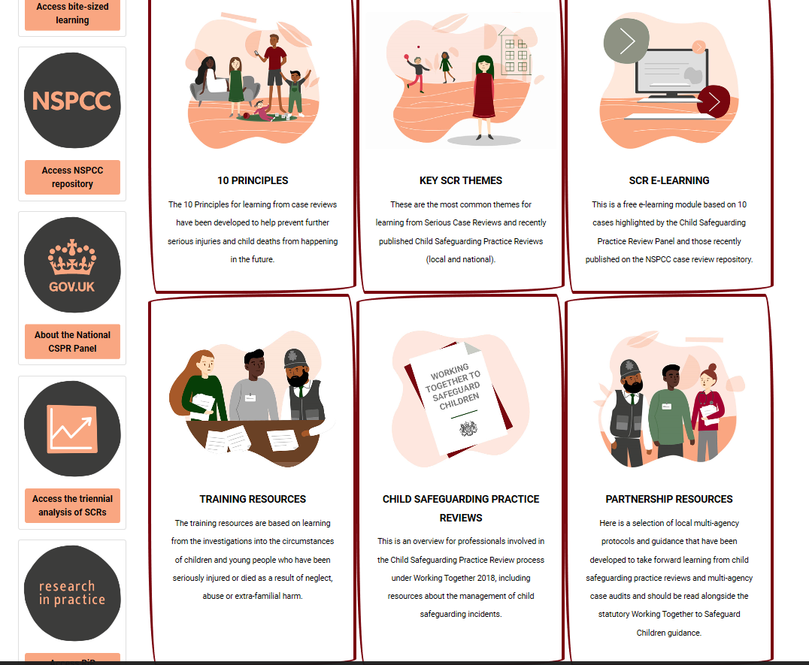

Slide 86
At a glance reminders (All Safeguarding concerns)
Always remember the child and look beyond their behaviour and consider why they are behaving like this.
Always listen to what the child is telling you.
Make a record of what the child has said (as soon as possible)
Don’t dismiss what a child tells you.
Be professionally curious if the situation doesn’t look or feel right to you then it probably isn’t right.
If in doubt always seek advice and support.
Share information with the School/Organisation Designated Safeguarding Lead.
Always share with your manager if you have a concern regarding a colleague’s behaviour towards a child.

Slide 87
Key messages for all staff
REMEMBER ‘it could happen here’
Always act in the best interest of the child

Slide 88
Don’t hold onto the RISK

Slide 89
Sutton - Local Authority Safeguarding
CFCS – 0208 770 6001
Out of Hours 0208 770 5000
cfcs@sutton.gov.uk
hayley.cameron@cognus.org.uk
stephen.welding@cognus.org.uk
gillian.bush@cognus.org.uk
mick.bradshaw@cognus.org.uk
Jan.capon@cognus.org.uk - Early Years Adviser
Nick.Banham@cognus.org.uk – Early Years Adviser

Slide 90
Thank You for Listening
Hayley Cameron: Education Safeguarding Manager
Stephen Welding: Esafety Adviser/Prevent Trainer
Gill Bush: Education Lead, MASH
Mick Bradshaw: Outdoor Education Adviser

Slide 91
Professional Curiosity can save lives
https://youtu.be/q3xoZXSW5yc

