Slide 1
Safeguarding children, young people and vulnerable adults Searching pupils, including Strip Searches
Hayley Cameron: Education Safeguarding Manager
Stephen Welding: Esafety Adviser/Prevent Trainer
Gill Bush: Education Lead, MASH
Mick Bradshaw: Outdoor Education Adviser

Slide 2
Searching, Screening and Confiscation July 2022

Slide 3
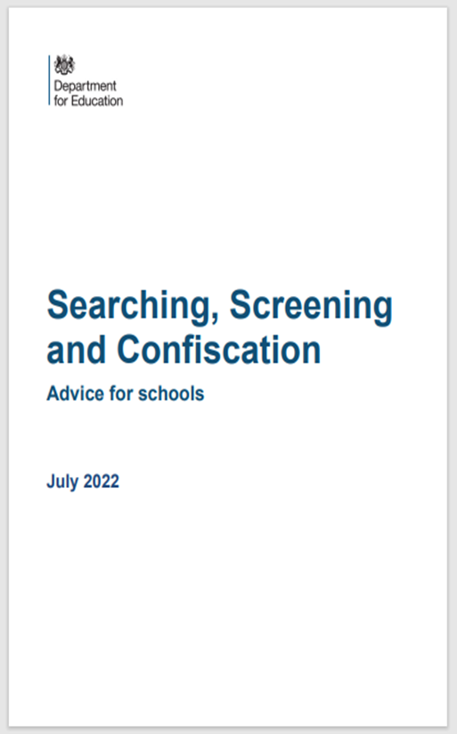
About this Guidance
This publication is intended to explain the screening, searching and confiscating powers a school has, ensuring that headteachers and members of staff have the confidence to use these powers and schools are a calm, safe and supportive environment to learn and work. This publication also provides advice to headteachers and staff on their related legal duties when it comes to these powers. It also includes statutory guidance which schools must have regard to.
Where the text uses the word ‘must’, the person in question is legally required to do something.
Where the text uses the word ‘parent’, it should be read as inclusive of carers and any other person with parental responsibility.

Slide 4
Who is this guidance for?
This guidance is for:
school leaders, school staff, governing bodies, proprietors and trust boards in all maintained schools, academies, free schools and independent schools in England; and
local authorities.
For the purposes of this advice, references to “maintained school” mean a community, foundation or voluntary school, community or foundation special school. It also means pupil referral units and non-maintained special schools.
References to “academy” mean academy schools (including mainstream and special free schools) and alternative provision academies (including alternative provision free schools).

Slide 5
Introduction
Ensuring school staff and pupils feel safe and secure is vital to establishing calm and supportive environments conducive to learning. Using searching, screening and confiscation powers appropriately is an important way to ensure pupil and staff welfare is protected and helps schools establish an environment where everyone is safe. This advice is intended to explain schools’ screening, searching and confiscation powers so that headteachers and other staff have the confidence to use them if necessary.
Schools and their staff are an important part of the wider safeguarding system for children. This system is described in the statutory guidance Working together to safeguard children. Keeping children safe in education makes clear that all school staff have a responsibility to provide a safe environment in which pupils can learn.

Slide 6
The European Convention on Human Rights. Under Article 8
Before screening or conducting a search of a pupil, it is vital that schools consider their obligations under the European Convention on Human Rights. Under Article 8, pupils have a right to respect for their private life. In the context of these rights and obligations, this means that pupils have the right to expect a reasonable level of personal privacy.
The right under Article 8 is not absolute; it can be interfered with, but any interference with this right by a school (or any public body) must be justified and proportionate.
The powers to search in the Education Act 1996 are compatible with Article 8. A school exercising those powers lawfully should have no difficulty in demonstrating that it has also acted in accordance with Article 8. This advice will assist schools in deciding how to exercise their searching powers in a lawful way.

Slide 7
Head Teacher’s authority
Only the headteacher, or a member of staff authorised by the headteacher, can carry out a search. The headteacher can authorise individual members of staff to search for specific items, or all items set out in the school's behaviour policy. For example, a member of staff may be authorised to search for stolen property and alcohol but not for weapons or drugs.
The headteacher should oversee the school’s practice of searching to ensure that a culture of safe, proportionate and appropriate searching is maintained, which safeguards the welfare of all pupils and staff with support from the designated safeguarding lead (or deputy).

Slide 8
Head Teacher’s responsibility
The headteacher should ensure that a sufficient number of staff are appropriately trained in how to lawfully and safely search a pupil who is not co-operating, so that these trained staff can support and advise other members of staff if this situation arises. However, it is vital that all staff understand their rights and the rights of the pupil who is being searched.
The designated safeguarding lead (or deputy) should be informed of any searching incidents where the member of staff had reasonable grounds to suspect a pupil was in possession of a prohibited item as listed on slide 9. The staff member should also involve the designated safeguarding lead (or deputy) without delay if they believe that a search has revealed a safeguarding risk.

Slide 9
Prohibited articles
knives and weapons;
alcohol; illegal drugs; stolen items;
Or
Any article that the member of staff reasonably suspects has been, or is likely to be used:
to commit an offence,
or to cause personal injury to, or damage to property of; any person (including the pupil).
An article specified in regulations: (The Schools (Specification and Disposal of Articles) Regulations 2012)
tobacco and cigarette papers; **
fireworks; and
pornographic images.
** This does not include e-cigarettes or vapes. Schools who wish to search for these items should ensure they are listed as items for which a search can be made in the school rules

Slide 10
Before the search takes place
A search can be considered if the member of staff has reasonable grounds for suspecting that the pupil is in possession of a prohibited item or any item identified in the school rules for which a search can be made, or if the pupil has agreed.
The authorised member of staff should make an assessment of how urgent the need for a search is and should consider the risk to other pupils and staff.
Before any search takes place, the member of staff conducting the search should explain to the pupil why they are being searched, how and where the search is going to take place and give them the opportunity to ask any questions.

Slide 11
Before the search takes place
The authorised member of staff should always seek the co-operation of the pupil before conducting a search. If the pupil is not willing to co-operate with the search, the member of staff should consider why this is. Reasons might include that they:
• are in possession of a prohibited item;
• do not understand the instruction;
• are unaware of what a search may involve; or
• have had a previous distressing experience of being searched.

Slide 12
Student refuses to be searched
If a pupil continues to refuse to co-operate, the member of staff may sanction the pupil in line with the school’s behaviour policy, ensuring that they are responding to misbehaviour consistently and fairly.
If the member of staff still considers a search to be necessary, but is not required urgently, they should seek the advice of the headteacher, designated safeguarding lead (or deputy) or pastoral member of staff who may have more information about the pupil. During this time the pupil should be supervised and kept away from other pupils.

Slide 13
Use of reasonable force
If the pupil still refuses to co-operate, the member of staff should assess whether it is appropriate to use reasonable force to conduct the search. A member of staff can use such force as is reasonable to search for any prohibited items identified on slide 9, but not to search for items which are identified only in the school rules. See guidance on the Use of reasonable force in schools.
The decision to use reasonable force should be made on a case-by-case basis. The member of staff should consider whether conducting the search will prevent the pupil harming themselves or others, damaging property or from causing disorder

Slide 14
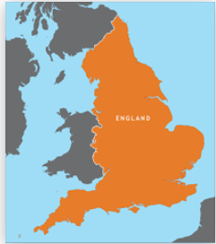
During a search
Where
An appropriate location for the search should be found. Where possible, this should be away from other pupils. The search must only take place on the school premises or where the member of staff has lawful control or charge of the pupil, for example on a school trip. (The powers to search outlined in this guidance only apply in England. When on a trip outside England, the law of that country should be followed.)

Slide 15
Who can search?
The law states the member of staff conducting the search must be of the same sex as the pupil being searched. There must be another member of staff present as a witness to the search.
There is a limited exception to this rule. This is that a member of staff can search a pupil of the opposite sex and/or without a witness present only:
if the member of staff carrying out the search reasonably believes there is risk that serious harm will be caused to a person if the search is not carried out as a matter of urgency; and

Slide 16
Who can search? Cont
in the time available, it is not reasonably practicable for the search to be carried out by a member of staff who is same sex as the pupil or it is not reasonably practicable for the search to be carried out in the presence of another member of staff
When a member of staff conducts a search without a witness they should immediately report this to another member of staff, and ensure a record of the search is kept. See paragraphs 44-46 on recording searches

Slide 17
The extent of the search
A member of staff may search a pupil’s outer clothing, pockets, possessions, desks or lockers.
The person conducting the search must not require the pupil to remove any clothing other than outer clothing. ‘Outer clothing’ means any item of clothing that is not worn wholly next to the skin or immediately over a garment that is being worn as underwear, as well as hats, shoes, boots or scarves.
Possessions’ means any goods over which the pupil has or appears to have control - this includes desks, lockers and bags.

Slide 18
Searching lockers and desks
A member of staff is able to search lockers and desks or other personal spaces at the school for any item provided the pupil agrees.
Schools can make it a condition of having the locker or space that the pupil agrees to have these searched. If the pupil withdraws their agreement to search, a search may be conducted both for the prohibited items listed on slide 9 and any items identified in the school rules for which a search can be made.

Slide 19
Searching pupil’s possessions
A pupil’s possessions can only be searched in the presence of the pupil and another member of staff, except where there is a risk that serious harm will be caused to a person if the search is not conducted immediately and where it is not reasonably practicable to summon another member of staff.
The member of staff may use a metal detector to assist with the search.
The member of staff’s power to search outlined above does not enable them to conduct a strip search.

Slide 20
Strip searches in Schools
A strip search is a search involving the removal of more than outer clothing. Strip searches on school premises can only be carried out by police officers under the Police and Criminal Evidence Act 1984 (PACE) Code A and in accordance with the Police and Criminal Evidence Act 1984 (PACE) Code C.
While the decision to undertake the strip search itself and its conduct are police matters, school staff retain a duty of care to the pupil(s) involved and should advocate for pupil wellbeing at all times.

Slide 21
Strip searches in Schools
Before calling police into school, staff should assess and balance the risk of a potential strip search on the pupil’s mental and physical wellbeing and the risk of not recovering the suspected item. Staff should consider whether introducing the potential for a strip search through police involvement is absolutely necessary, and should always ensure that other appropriate, less invasive approaches have been exhausted. Once the police are on school premises, the decision on whether to conduct a strip search lies solely with them, and the role of the school is to advocate for the safety and wellbeing of the pupil(s) involved.

Slide 22
Strip searches in Schools
A strip search is a search involving the removal of more than outer clothing. Outer clothing includes shoes and socks.
Strip searching can be highly distressing for the pupil involved, as well as for staff and other pupils affected, especially if undertaken on school premises. PACE Code C states that a strip search may take place only if it is considered necessary to remove an item related to a criminal offence, and the officer reasonably considers the pupil might have concealed such an item. Strip searches should not be routinely carried out if there
is no reason to consider that such items are concealed.

Slide 23
Strip searches in Schools
Except in cases of urgency where there is risk of serious harm to the pupil or others, whenever a strip search involves exposure of intimate body parts there must be at least two people present other than the pupil, one of which must be the appropriate adult.
The role of the appropriate adult is to safeguard the rights, entitlements and welfare of children and vulnerable adults in police custody. This adult must not be a police officer or otherwise associated with the police. Examples of an appropriate adult include, but are not limited to, a parent, relative, social worker, teacher or, if the person is in the care of a local authority or voluntary organisation, a person representing that authority or organisation. Note that an appropriate adult is not required when a pupil is eighteen or above.

Slide 24
Searching in Schools – Revised July 2022
It is important that SLT/DSL liaise with the School police teams when a student is believed to be in possession of drugs or prohibited articles. Be aware of your obligation to the student and do not be afraid to challenge the police if you believe things are not being done correctly or in the best interest of the child.

Slide 25
Refer to guidance
This was a short presentation on some of the aspects of searching pupils. Please refer to the statutory guidance for a full explanation on searching, Screening and Confiscation July 2022.

Slide 26
Thank You for Listening
Bitesize training & Podcast on Cognus website
Hayley Cameron: Education Safeguarding Manager
Stephen Welding: Esafety Adviser/Prevent Trainer
Gill Bush: Education Lead, MASH
Mick Bradshaw: Outdoor Education Adviser

