Slide 1
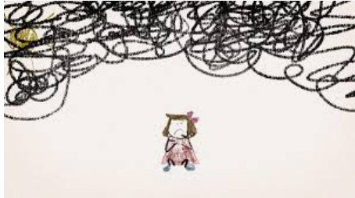
Child on Child Abuse
Haley Cameron:
Safeguarding Manager, Cognus
Steve Welding:
Esafety/Prevent trainer, Cognus

Slide 2
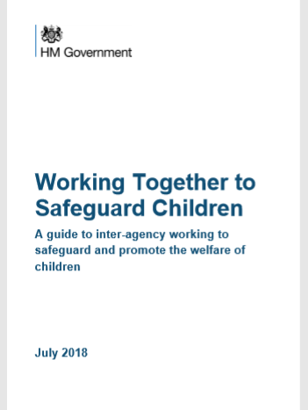
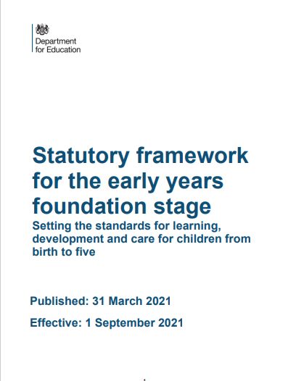
Legislation, Guidance and Procedure
Notes:
Read Keeping children safe in education (50 pages)

Slide 3
KCSIE 2022 – What is in it?
Part one: Safeguarding information for all staff. What school and college staff should know and do
Part two: The management of safeguarding. The responsibility of governing bodies, proprietors and management committees
Part three: Safer recruitment, Recruitment and selection process
Part four: Allegations made against/Concerns raised in relation to teachers, including supply teachers, other staff, volunteers and contractors
Part five: Child on child sexual violence and sexual harassment
Responding to reports of sexual violence and sexual harassment

Slide 4
What schools and colleges should be aware of
Sexual violence and sexual harassment can occur between two or more children of any age and sex, from primary through to secondary stage and into college. It can occur also through a group of children sexually assaulting or sexually harassing a single
child or group of children. Sexual violence and sexual harassment exist on a continuum and may overlap; they can occur online and face-to-face (both physically and verbally) and are never acceptable.

Slide 5
Schools and colleges should be aware of the importance of
Making clear that there is a zero-tolerance approach to sexual violence and sexual harassment, that it is never acceptable, and it will not be tolerated. It should never be passed off as “banter”, “just having a laugh”, “a part of growing up” or “boys being boys”. Failure to do so can lead to a culture of unacceptable behaviour, an unsafe environment and in worst case scenarios a culture that normalises abuse, leading to children accepting it as normal and not coming forward to report it.

Slide 6
Schools and colleges should be aware of the importance of
Recognising, acknowledging, and understanding the scale of harassment and abuse and that even if there are no reports it does not mean it is not happening, it may be the case that it is just not being reported.
Challenging physical behaviour (potentially criminal in nature) such as grabbing bottoms, breasts and genitalia, pulling down trousers, flicking bras and lifting up skirts. Dismissing or tolerating such behaviours risks normalising them.

Slide 7
KCSIE 2022 – Child on Child Abuse
Children who are victims of sexual violence and sexual harassment wherever it happens, may find the experience stressful and distressing. This will, in all likelihood, adversely affect their educational attainment and will be exacerbated if the alleged perpetrator(s) attends the same school or college.
Whilst any report of sexual violence or sexual harassment should be taken seriously, staff should be aware it is more likely that girls will be the victims of sexual violence and sexual harassment and more likely it will be perpetrated by boys. Children with special educational needs and disabilities (SEND) are also three times more likely to be abused than their peers

Slide 8
Ultimately, it is essential that all victims are reassured that they are being taken
seriously and that they will be supported and kept safe.

Slide 9
KCSIE 2022 Definition of Sexual Violence
It is important that schools and colleges are aware of sexual violence and the fact children can, and sometimes do, abuse other children in this way and that it can happen both inside and outside of school/college. When referring to sexual violence in this advice, we do so in the context of child-on-child sexual violence.
When referring to sexual violence we are referring to sexual offences under the Sexual Offences Act 2003 as described in the next slides

Slide 10
KCSIE 2022 – Sexual Violence Offences
Sexual Offences Act 2003
Rape
Assault by Penetration
Sexual Assault
Causing someone to engage in sexual activity without consent

Slide 11
KCSIE 2022 – New paragraph inserted
All staff should be aware that children may not feel ready or know how to tell someone that they are being abused, exploited, or neglected, and/or they may not recognise their experiences as harmful. For example, children may feel embarrassed, humiliated, or being threatened. This could be due to their vulnerability, disability and/or sexual orientation or language barriers. This should not prevent staff from having a professional curiosity and speaking to the DSL if they have concerns about a child. It is also important that staff determine how best to build trusted relationships with children and young people which facilitate communication

Slide 12
Sexual assault – Section 3 SOA 2003
(1) A person (A) commits an offence if—
(2) He/she intentionally touches another person (B),
(3) the touching is sexual,
(4) (B) does not consent to the touching, and
(5) (A) does not reasonably believe that (B) consents.

Slide 13
“Consent”
A person consents if he/she agrees by choice, and has the freedom and capacity to make that choice.

Slide 14
Consent under 13’s
Under-13’s can’t consent to sexual activity
Age of consent is 16
Sexual intercourse without consent is rape
Making and sharing sexual images of under 18’s is illegal

Slide 15
KCSIE 2022 - Sexual harassment
When referring to sexual harassment we mean ‘unwanted conduct of a sexual nature’ that can occur online and offline and both inside and outside of school/college.
When we reference sexual harassment, we do so in the context of child-on-child sexual harassment. Sexual harassment is likely to: violate a child’s dignity, and/or make them feel intimidated, degraded or humiliated and/or create a hostile, offensive or sexualised environment

Slide 16
KCSIE 2022 - Sexual harassment
Whilst not intended to be an exhaustive list, sexual harassment can include:
• sexual comments, such as: telling sexual stories, making lewd comments, making sexual remarks about clothes and appearance and calling someone sexualised names
• sexual “jokes” or taunting
• physical behaviour, such as: deliberately brushing against someone, interfering with someone’s clothes. Schools and colleges should be considering when any of this crosses a line into sexual violence – it is important to talk to and consider the experience of the victim.
• displaying pictures, photos or drawings of a sexual nature
• upskirting (this is a criminal offence)

Slide 17
Online Sexual Harassment
Consensual and non-consensual sharing of nude and semi-nude images
and/or videos.
Taking and sharing nude photographs of U18s is a criminal offence. UKCIS Sharing nudes and semi-nudes: advice for education settings working with children and young people provides detailed advice for schools and colleges.
o sharing of unwanted explicit content
o sexualised online bullying
o unwanted sexual comments and messages, including, on social media
o sexual exploitation; coercion and threats, and
o coercing others into sharing images of themselves or performing acts
they’re not comfortable with online.

Slide 18
Harmful sexual behaviour
Children’s sexual behaviour exists on a wide continuum, ranging from normal and developmentally expected to inappropriate, problematic, abusive and violent.
Problematic, abusive and violent sexual behaviour is developmentally inappropriate and may cause developmental damage. A useful umbrella term is “harmful sexual behaviour” (HSB). The term has been widely adopted in child protection and is used in this advice. HSB can occur online and/or face-to-face and can also occur simultaneously between the two. HSB should be considered in a child protection context.

Slide 19
Harmful sexual behaviour
When considering HSB, both ages and the stages of development of the children are critical factors. Sexual behaviour between children can be considered harmful if one of the children is much older, particularly if there is more than two years’ difference or if one of the children is pre-pubescent and the other is not. However, a younger child can abuse an older child, particularly if they have power over them, for example, if the older child is disabled or smaller in stature. Confidential specialist support and advice on HSB is available from the specialist sexual violence sector and sources are listed in KCSIE 2022 Annex B.

Slide 20
Harmful sexual behaviour
It is effective safeguarding practice for the designated safeguarding lead (and their deputies) to have a good understanding of HSB. This could form part of their safeguarding training. This will aid in planning preventative education, implementing preventative measures, drafting and implementing an effective child protection policy and incorporating the approach to sexual violence and sexual harassment into the whole school or college approach to safeguarding.
HSB can, in some cases, progress on a continuum. Addressing inappropriate behaviour can be an important intervention that helps prevent problematic, abusive and/or violent behaviour in the future. Children displaying HSB have often experienced their own abuse and trauma. It is important that they are offered appropriate support.

Slide 21
Harmful sexual behaviour
If required, the designated safeguarding lead (or a deputy) should discuss the local response to sexual violence and sexual harassment with police and local authority children’s social care colleagues in order to prepare the school’s or college’s policies (especially the child protection policy) and responses.
The designated safeguarding lead (and their deputies) should be confident as to what local specialist support is available to support all children involved (including victims and alleged perpetrators) in sexual violence and sexual harassment and be confident as to how to access this support when required. Further information on specialist support and interventions can be found in KCSIE 2022 Annex B in the additional advice and support section under sexual violence and sexual harassment.

Slide 22
Continuum of Sexual Behaviour in Children

Slide 23
Sexual violence and sexual harassment
In the year ending March 2019, the police recorded 73,260 sexual offences where there are data to identify the victim was a child. Around one-quarter (27%) of these were rape offences. These totals are likely to be a significant under-representation of the true number of offences against young people in this age group.
Police recorded crime data (England and Wales) for year ending March 2020 indicated that 51.9% of female victims and 62.4% of male victims of sexual offences were aged between 5 and 19.

Slide 24
Sexual violence and sexual harassment
NSPCC’s how safe are our children report 2020 found that girls are particularly vulnerable to sexual abuse, accounting for around 90% of victims of recorded rape offences against 13- to 15-year-olds in England, Wales and Scotland.
The Women and Equalities committee (WEC) state that a number of large-scale surveys found that girls are consistently reporting high levels of sexual harassment and sexual violence in schools and colleges.

Slide 25
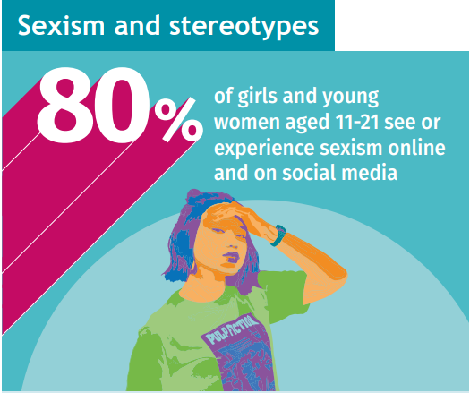
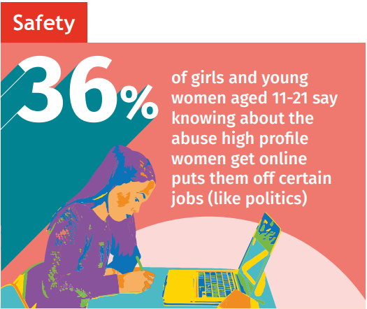
Girlguiding's Girls' 2022 Survey
Safety in school
Around 1 in 5 (19%) girls and young women aged 11 to 21 don’t feel safe in school. This is higher in Wales (24%) and in the North of England (22%) than in other areas of the country. Girls of colour aged 11 to 16 are five percentage points less likely than girls who are White to feel safe at school (65% compared to 70%).
Source - Girlguiding’s Girls’ Attitude Survey 2022

Slide 26
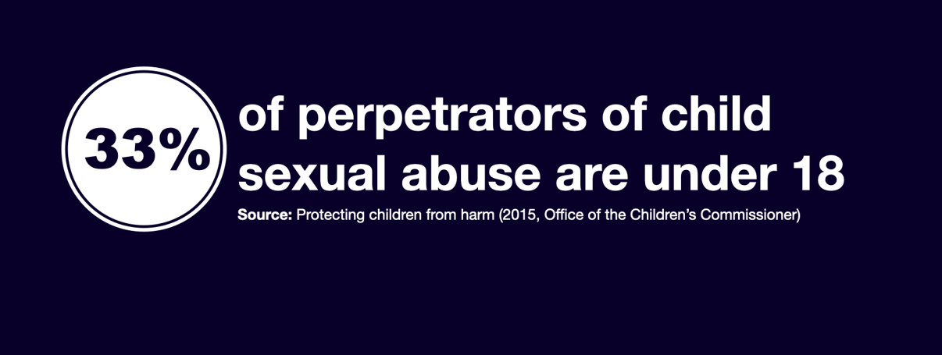
Sexual violence and sexual harassment

Slide 27
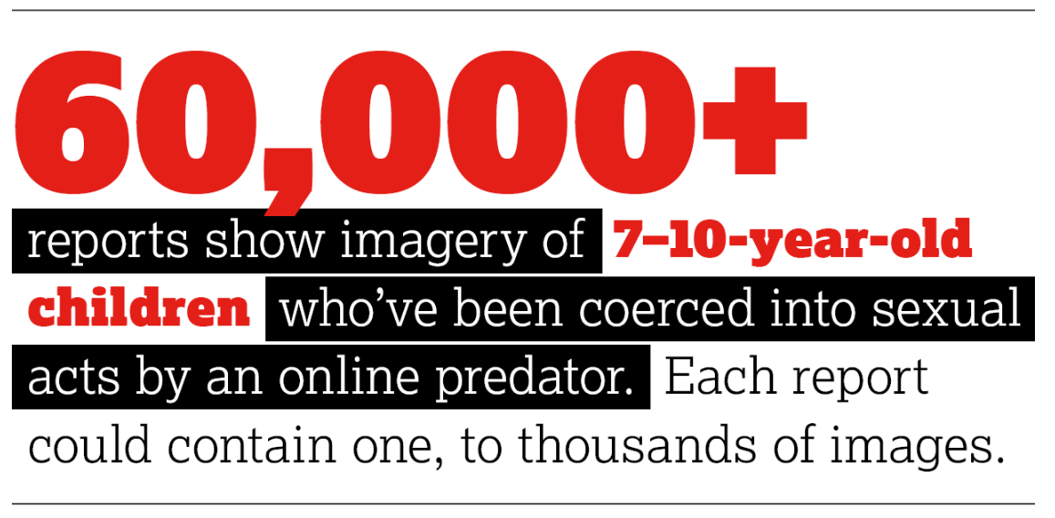

Slide 28
Sexual abuse imagery of primary school children 1,000 per cent worse since lockdown
In 2022, 63,050 reports related to imagery which had been created of children aged 7-10 who, in many cases, had been groomed, coerced, or tricked into performing sexual acts on camera by an online predator.
This is a 129 per cent increase on the 27,550 reports in this category in 2021.
The 2022 figures are a 1,058 per cent increase on the 5,443 such reports in 2019 before the outbreak of Coronavirus.
On average police arrest 900 offenders, and safeguard 1,127 young people each month. (NPCC)

Slide 29
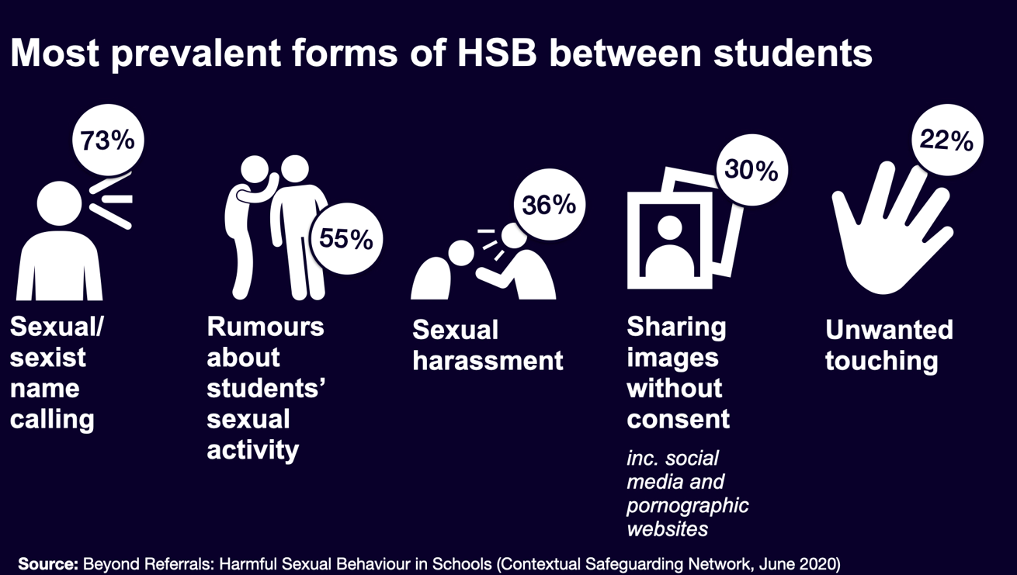
Harmful Sexual Behaviours in Schools

Slide 30
Responding to reports of sexual violence and sexual harassment
Reports of sexual violence and sexual harassment are likely to be complex and require difficult professional decisions to be made, often quickly and under pressure. Pre-planning, effective training and effective policies will provide schools and colleges with the foundation for a calm, considered and appropriate response to any reports.
Governing bodies and proprietors should ensure that the school or college contributes to multi-agency working in line with statutory guidance Working Together to Safeguard
Children (and as summarised in part 2 of KCSIE 2022)

Slide 31
Responding to a disclosure or a report
It is important to understand that children may not find it easy to tell staff about their abuse verbally. Children can show signs or act in ways that they hope adults will notice and react to. In some cases, the victim may not make a direct report. For example, a friend may make a report, or a member of school or college staff may overhear a conversation that suggests a child has been harmed or a child’s own behaviour might indicate that something is wrong. As per Part one of this guidance, if staff have any concerns about a child’s welfare, they should act on them immediately rather than wait to
be told.

Slide 32
Responding to a disclosure
It is essential that all victims are reassured that they are being taken seriously, regardless of how long it has taken them to come forward, and that they will be supported and kept safe. Abuse that occurs online or outside of the school or college should not be downplayed and should be treated equally seriously. A victim should never be given the impression that they are creating a problem by reporting sexual violence or sexual harassment. Nor should a victim ever be made to feel ashamed for making a report. It is important to explain that the law is in place to protect children and young people rather than criminalise them, and this should be explained in such a way that avoids alarming or distressing them.

Slide 33
Responding to a disclosure
If possible, managing reports with two members of staff present, (preferably one of
them being the designated safeguarding lead or a deputy)
not promising confidentiality at this initial stage as it is very likely a concern will have to be shared further (for example, with the designated safeguarding lead (or deputy) or local authority children’s social care) to discuss next steps.
recognising that a child is likely to disclose to someone they trust: this could be anyone on the school or college staff.
recognising that an initial disclosure to a trusted adult may only be the first part to further disclosures.
keeping in mind that certain children may face additional barriers to telling someone because of their vulnerability, disability, sex, ethnicity, and/or sexual orientation.
listening carefully to the child, reflecting back, using the child’s language, being non-judgemental, being clear about boundaries and how the report will be progressed.
only recording the facts as the child presents them. The notes should not reflect the personal opinion of the note taker.
Ensure the DSL is aware of the disclosure as soon as possible and that a record is made using the child’s words.

Slide 34
Immediate response
How the report is dealt with, will affect whether others will come forward in the future.
A child is likely to report to someone they trust – it could be anyone
Victim must not feel like they’re a nuisance for reporting their concerns.
They need to feel listened to and be taken seriously
A written report is essential: record only the facts as reported.
Source: KCSIE (2022)

Slide 35
Next Steps
Report to the school’s Designated Safeguarding Lead (DSL)
DSL will review the report; and then carry out a risk and needs assessment
Source: KCSIE (2022)

Slide 36
Designated Safeguarding Lead will consider:
Wishes of the victim
Nature of the alleged incident
Ages of the children involved
Developmental stages of the children involved
Any power imbalance between the children
Whether this is a one-off, or a sustained pattern of behaviour
Any on-going risks to others, children or staff
Any potential links to sexual abuse or exploitation
Source KCSIE (2022)

Slide 37
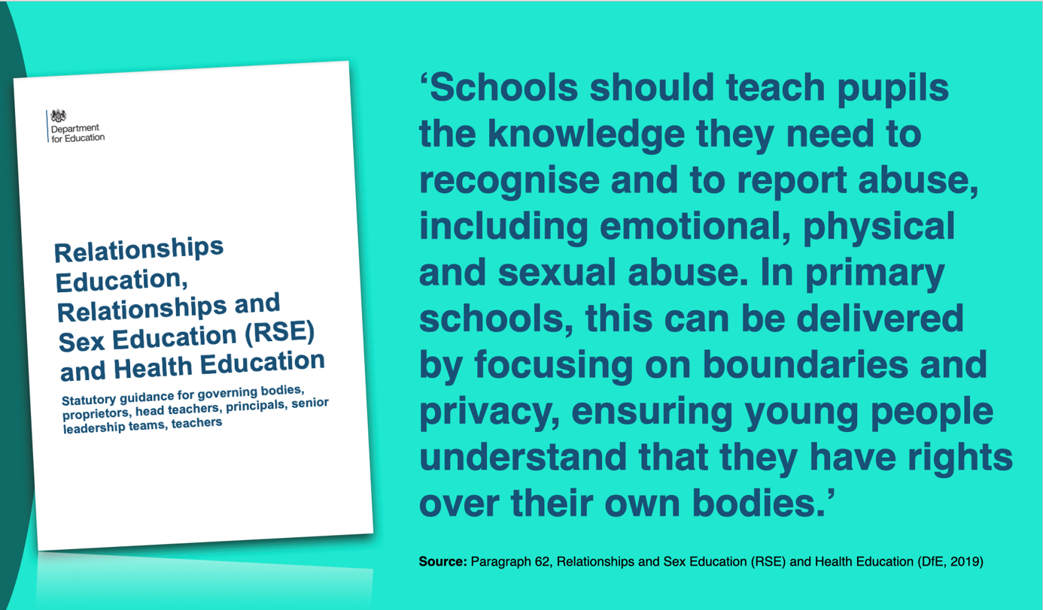
RE and RSE

Slide 38
Relationships Education & Relationships & Sex Education
Caring Friendships - Pupils should know…. how to recognise who to trust and who not to trust, how to judge when a friendship is making them feel unhappy or uncomfortable.
Respectful relationships - Pupils should know …. The importance of permission-seeking and giving in relationships with friends, peers and adults.
Online relationships – Pupils should know …. That the same principles apply to online relationships as to face-to-face relationships, including the importance of respect for others online.
Being safe – Pupils should know …. That each person’s body belongs to them, and the differences between appropriate and inappropriate or unsafe physical, and other contact.
Source – Relationships & Sex Education (RSE) & Health Education (DfE 2019)

Slide 39
At a glance reminders (All Safeguarding concerns)
Always remember the child and look beyond their behaviour and consider why they are behaving like this.
Always listen to what the child is telling you.
Make a record of what the child has said (as soon as possible)
Don’t dismiss what a child tells you.
Be professionally curious if the situation doesn’t look or feel right to you then it probably isn’t right.
If in doubt always seek advice and support.
Share information with the School/Organisation Designated Safeguarding Lead.
Always share with your manager if you have a concern regarding a colleague’s behaviour towards a child.

Slide 40
Key messages for all staff
REMEMBER ‘it could happen here’
Always act in the best interest of the child

Slide 41
Child on Child Abuse
Haley Cameron:
Safeguarding Manager, Cognus
Steve Welding:
Esafety/Prevent trainer, Cognus

Slide 42
Sexual violence and sexual harassment
Ofsted’s Review of sexual abuse in schools and colleges revealed how prevalent sexual harassment and online sexual abuse is for children and young people and that, the issues are so widespread that they need addressing for all children and young people.
Nationally collected statistics show that there has been a sharp increase in reporting of child sexual abuse to the police in recent years. Figures that include all child sexual abuse cases show that the police recorded over 83,000 child sexual abuse offences (including obscene publications) in the year ending March 2020.

Slide 43
Harmful Sexual Behaviours - HSB
Examples include:
Touching the genitals of other young people
Forcing other into sexual activity
Exposing themselves or masturbating in public
Sexually explicit talk to or touching of younger children

Slide 44
HSB – A continuum of behaviours
It is vital for professionals to distinguish normal from abnormal sexual behaviours. A child’s sexual behaviour should be considered abnormal if it:
Occurs at a frequency greater than would be developmentally expected.
Interferes with the child’s development
Occurs with coercion, intimidation, or force
Is associated with emotional distress
Occurs between children of divergent ages or developmental abilities
Repeatedly recurs in secrecy after intervention by caregivers.

Slide 45
Immediate response
Children may well not directly verbalise their abuse to adults:
May be shown in behaviour.
Information may come from a friend: or
An overheard conversation.

Slide 46
Immediate response
Listening carefully to the child
Reflecting back, using the child’s language
Being non-judgmental,
Clear about boundaries
Give information about how the report will be progressed.
Don’t ask leading questions
Only prompt the child where necessary using open questions, like, where, when, what etc.
Source: KCSIE (2021)

Slide 47
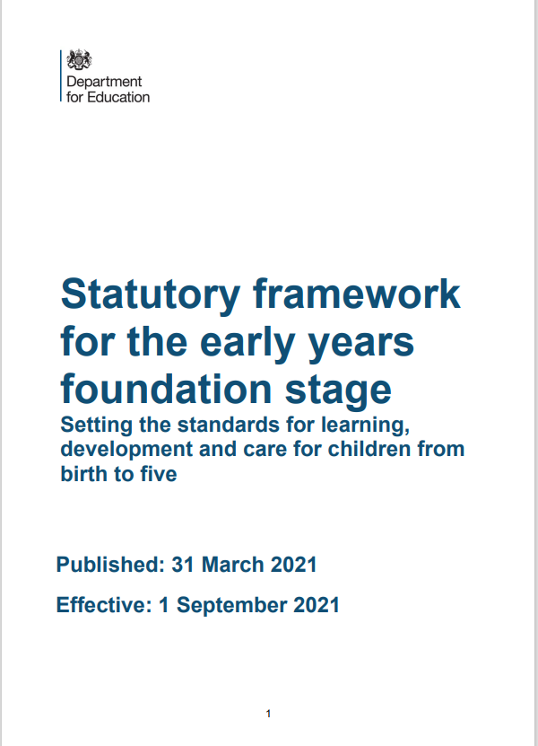
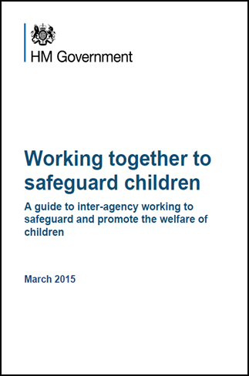
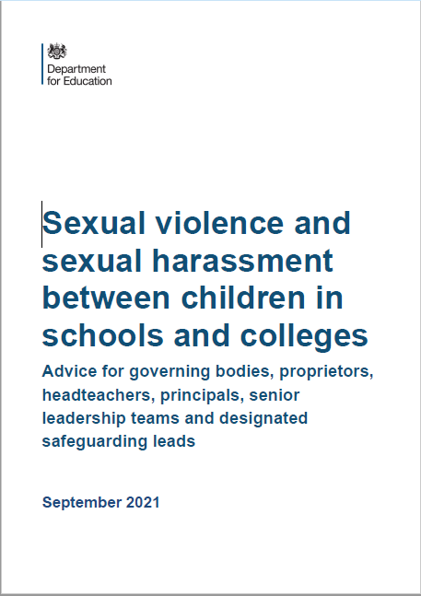
Legislation, Guidance and Procedure
July 2018
September 2021
Notes:
Read Keeping children safe in education (50 pages)

