Slide 1
Safeguarding children, young people Criminal Exploitation of Children County Lines
Hayley Cameron: Education Safeguarding Manager
Stephen Welding: Esafety Adviser/Prevent Trainer
Gill Bush: Education Lead, MASH
Mick Bradshaw: Outdoor Education Adviser

Slide 2
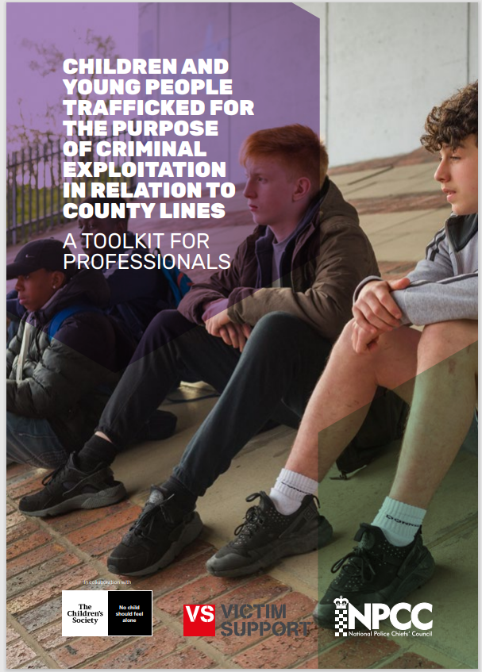
Key Guidance – Child Exploitation and County Lines

Slide 3
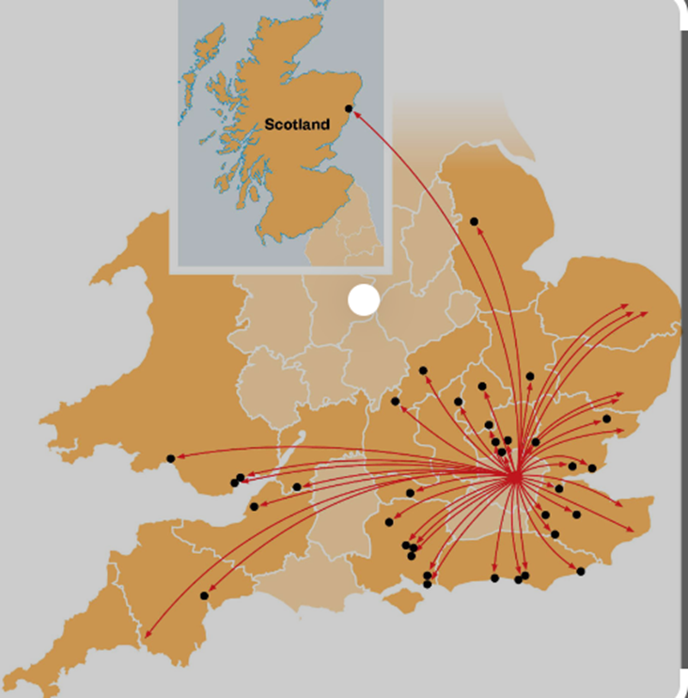
County Lines Definition
County lines is the name given to drug dealing where organised criminal groups (OCGs) use phone lines to move and supply drugs, usually from cities into smaller towns and rural areas.
They exploit vulnerable people, including children and those with mental health or addiction issues, by recruiting them to distribute the drugs. This is often referred to as ‘drug running’. Criminals may also use a vulnerable person’s home as their base of operations. This is known as ‘cuckooing’.

Slide 4
Exploitation of young and vulnerable people
A common feature in county lines drug supply is the exploitation of young and vulnerable people. The dealers will frequently target children and adults - often with mental health or addiction problems - to act as drug runners or move cash so they can stay under the radar of law enforcement.
In some cases the dealers will take over a local property, normally belonging to a vulnerable person, and use it to operate their criminal activity from. This is known as cuckooing.

Slide 5
Exploitation of young and vulnerable people
People exploited in this way will quite often be exposed to physical, mental and sexual abuse, and in some instances will be trafficked to areas a long way from home as part of the network's drug dealing business.
As we have seen in child sexual exploitation, children often don't see themselves as victims or realise they have been groomed to get involved in criminality. So it's important that we all play our part to understand county lines and speak out if we have concerns.

Slide 6
KCSIE 2022 – Annex B
We know that different forms of harm often overlap, and that perpetrators may subject children and young people to multiple forms of abuse, such as criminal exploitation (including county lines) and sexual exploitation.
In some cases the exploitation or abuse will be in exchange for something the victim needs or wants (for example, money, gifts or affection), and/or will be to the financial benefit or other advantage, such as increased status, of the perpetrator or facilitator.

Slide 7
KCSIE 2022 – Annex B
Children can be exploited by adult males or females, as individuals or in groups. They may also be exploited by other children, who themselves may be experiencing exploitation – where this is the case, it is important that the child perpetrator is also recognised as a victim.
Whilst the age of the child may be a contributing factor for an imbalance of power, there are a range of other factors that could make a child more vulnerable to exploitation, including, sexual identity, cognitive ability, learning difficulties, communication ability,
physical strength, status, and access to economic or other resources.

Slide 8
County Lines – How does it work

Slide 9
Cuckooing
Crime Gangs often use high levels of violence and intimidation to protect the ‘county line’ and control them. One of these forms of control exploits vulnerable people by using their home as a base for dealing drugs, a process known as cuckooing. Dealers often convince the vulnerable person to let their home be used for drug dealing by giving them free drugs or offering to pay for food or utilities.
Often Crime Gangs target people who are lonely, isolated, or have addiction issues. It's common for these gangs to use a property for a short amount of time, moving address frequently to reduce the chance of being caught.

Slide 10
Cuckooing
There are several signs to look out for that may indicate someone is a victim of cuckooing:
frequent visitors at unsociable hours
changes in your neighbour’s daily routine
unusual smells coming from a property
suspicious or unfamiliar vehicles outside an address

Slide 11
Avoiding detection
Crime Gangs employ various tactics to evade detection, including rotating group members between locations so they are not identified by law enforcement or competitors. Perpetrators will also use women and children to transport drugs in the belief that they are less likely to be stopped and searched. Children are often ‘plugged’ (sometimes by the offender or by themselves) to transport the drugs.
Evidence of county lines will often become apparent to professionals when children are located after missing episodes outside the London area, where there is no apparent reason.
The London Child Exploitation Operating Protocol 2021

Slide 12
Indicators of Child Criminal Exploitation (County Lines)
repeatedly going missing from school or home and being found in other areas
having money, new clothes or electronic devices and they can't explain how they paid for them
getting high numbers of texts or phone calls, being secretive about who they're speaking to
decline in school or work performance
significant changes in emotional or physical well-being
are found in accommodation that they have no connection with, often called a ‘trap house or cuckooing’ or hotel room where there is drug activity
have their bank accounts used to facilitate drug dealing and the laundering of cash

Slide 13
The use of Social media by Criminal Gangs
Criminal networks use social media to groom and recruit children for county lines. They may send them direct messages (knowns as ‘DMs’), or share messages to wider groups as ‘stories’ or ‘posts’.
advertising drugs through photos, emojis, and price lists
posting statuses that show money, new drugs or when a dealer is open for business
dealers sharing ‘stories’ to followers, and using social platforms to expand their network with ‘suggested’ friends
Victims may end up working for little or no money, which is known as ‘debt bondage’
tricking people with ‘fast cash’ scams, which is often referred to as ‘squares’. advertising for ‘workers’ or ‘runners’ to recruit people into county lines activity
using hashtags linked to drugs
using emojis as code for drug, violence and sexual activities, eg the snowflake emoji (for buying cocaine), 8-ball emoji (for buying an eighth of an ounce) or the rocket emoji (for purity of drugs)

Slide 14
Some key facts to remember with regards to criminal exploitation include:
Both males and females can be exploited.
Children and young people are targeted and groomed for criminal exploitation in major cities and trafficked into county areas.
Children and young people are also targeted in the county authority.
Boys aged 14 to 17 are the most often targeted, however girls and children as young as often 10 are targeted too.
Children and young people can be shown how, or made, to internally insert and carry drugs in their rectum or vagina.
Children and young people can often store wrapped drugs in their cheeks, which can then be more easily swallowed if approached by police.
The children and young people will be sent to ‘trap’ houses, or ‘bandos’ where they will be made to sell drugs for anything from a few days to six weeks or more. These established bases can often involve exploitation of vulnerable adults.

Slide 15
Phrases that young people may use to refer to county lines include:
‘running a line’,
‘going OT/out there’
‘going country’
‘going cunch’.

Slide 16
Slang terms used in County Lines
Burner Phone – Disposable phone
Clean Skins – No Criminal Record
Trap House – Base for Dealing drugs
Cuckooing – Taking over a house to use as a Trap House
Debt Bondage – Owing money
Bic – Gun or a child
Plugging – Hiding drugs inside the body
Road Man – Drug Courier
Shank – Knife or blade or to Stab
Bando – An abandoned property to use as a Trap House

Slide 17
The Child Exploitation Operating Protocol 2021 - Schools
Schools should ensure that they provide an environment which is trauma-informed where staff can recognise and appropriately respond to behaviour which is a signifier of abuse and exploitation. Maintaining children in education is a critical protective factor against
exploitation.
Schools, colleges and other educational institutes have a key role to play in raising awareness and there is a clear need for early and continuous education. Child exploitation can impact very young children and the risks are heightened due to the online world. If
children are not educated about the dangers and what a healthy relationship is, then they will be left exposed to the risks of child exploitation.

Slide 18
The Child Exploitation Operating Protocol 2021 - Schools
Personal, social, health and economic lessons are an obvious route for educating children about the risks of child exploitation and other forms of harm and risks. School nurses, dedicated schools officers and safeguarding leads are also well equipped to deliver these sessions.
Consideration must be given to special educational needs (SEND) children and children who sit outside of the mainstream education settings. Options must be explored on how to educate these children on the associated risks. Professionals are encouraged to deliver these sessions in safe environments such as the family home or youth centres.
SEND children or children who sit outside of main education are at higher risk of exploitation and therefore need particular attention and a bespoke response.

Slide 19
The Child Exploitation Operating Protocol 2021 - Health
Health can provide key early intervention opportunities for child exploitation victims. Health services such as A&E, school nurses, GPs and sexual health clinics will encounter children demonstrating the child exploitation warning signs so it’s pivotal they are aware of their statuary safeguarding responsibilities. Children may attend A&E as victims of serious youth violence and this could be a pivotal stage in the child’s journey to accepting they are a victim of exploitation

Slide 20
The Child Exploitation Operating Protocol 2021 - Health
Health professionals are key contributors in providing the multi-agency, holistic approach to child exploitation. Health partners offer a range of services that can prevent child
exploitation, provide intervention opportunities and support victim safeguarding plans.
These include:
• school nursing services,
• mental health services,
• alcohol and drug misuse services,
• health visitors,
• sexual Health and reproductive services,
• community safety, and
• healthy relationships and sex education to schools and colleges.

Slide 21
The Child Exploitation Operating Protocol 2021- Parents
Parents play a crucial role in safeguarding and protecting their children from child exploitation. Research shows that confident, authoritative parenting which supports children to make informed decisions is a key protective factor in relation to child exploitation. They can educate their children on healthy relationships, sex and the risks associated with child exploitation. Parents have a responsibility to ensure their child’s voice is heard and create a safe support environment where the children have the confidence to speak. Parents must not be afraid to speak out and request help from professionals when needed

Slide 22
The Child Exploitation Operating Protocol 2021- Parents
All professionals must take every opportunity to support parents by ensuring:
child exploitation is on the agenda of parents
parents are aware of the associated risks linked to child exploitation,
they have the information to spot the warning signs.
parents know how to raise the alarm and where to go for help
they are provided a tailored support to assist families in safeguarding their children including through online exploitation.
Tools to assist parents to identify signs of exploitation are available through NSPCC and Children’s Society websites and specific interventions and supporting materials are also available through Parents Against Child Exploitation https://paceuk.info/for-parents/

Slide 23
The Child Exploitation Operating Protocol 2021- Police
Criminalisation of children
Children linked to Gangs are often not aware of the likely criminal consequences and associated violence. Children who come to police attention for gang-related violence (as victims or perpetrators) should be treated as ‘children first’ and potential subjects of exploitation who require assessment of their safeguarding needs. Professionals are reminded to keep the gang-related violence and exploitation links at the forefront of all decision making and safeguarding plans.

Slide 24
The Child Exploitation Operating Protocol 2021- Police
It's not illegal for a young person to be in a gang – there are different types of ‘gang’ and not every ‘gang’ is criminal or dangerous. However, gang membership can be linked to illegal activity, particularly organised crime involving child trafficking, county lines and serious youth violence.
Peer group – A relatively small and transient social grouping which may or may not describe themselves as a gang depending on the context.
Street gang – Groups of young people who see themselves (and are seen by others) as a discernible group for whom crime and violence is integral to the group's identity.
Organised Criminal Gangs – A group of individuals for whom involvement in crime is for personal gain (financial or otherwise). For most, crime is their ‘occupation’

Slide 25
The Child Exploitation Operating Protocol 2021- Police
A child might be lured into an OCG or gang with the promise of status, wealth, belonging or protection. Other pull factors that might create barriers to engagement may include:
peer pressure and wanting to fit in,
gangs using grooming, coercion and control to manipulate and force them to
do so,
where they live,
the need to feel respected and important,
the need to make money or are promised rewards,
wanting to gain status and feel powerful, or
exclusion from school or family breakdown.

Slide 26
Criminalisation of children
Children linked to Gangs are often not aware of the likely criminal consequences and associated violence. Children who come to police attention for gang-related violence (as victims or perpetrators) should be treated as ‘children first’ and potential subjects of exploitation who require assessment of their safeguarding needs.
Professionals are reminded to keep the gang-related violence and exploitation links at the forefront of all decision making and safeguarding plans.

Slide 27
What support is out there?

Slide 28
Referral process for Professionals

Slide 29
Safeguarding contacts Sutton
childrensfirstcontactservice@sutton.gov.uk
Tel: 020 8770 6001
Emergency Duty Team (Out of Hours)
Tel: 020 8770 5000x9
Email: childrens.edt@sutton.gov.uk
suttonlscp@sutton.gov.uk
lado@Sutton.gov.uk
0208 770 4532

Slide 30
Safeguarding contacts Croydon
Single Point of Contact (SPOC)
Phone: 0208 255 2888
Monday to Friday, 9am to 5pm
Emergency Duty Team
Telephone: 0208 726 6000
Email: SSD-EMERGENCY-DUTY-TEAM@croydon.gov.uk
Monday to Friday, 5pm to 9am
Weekends and bank holidays, 24 hours
Contact the LADO
Telephone: 020 8255 2889
Email: LADO@croydon.gov.uk

Slide 31
Safeguarding contacts Merton
Children and Family Hub: 020 8545 4226/4227
CandFhub@merton.gov.uk
Emergency Duty Team
Out of hours: 020 8770 5000
LADO: John Shelley
Email: lado@merton.gov.uk
Tel: 020 8545 3187

Slide 32
https://www.lgfl.net/digisafe/countylines

Slide 33
Thank You for Listening
Please visit www.Cognus.org.uk where you will find more bitesize training packages.
Hayley Cameron: Education Safeguarding Manager
Stephen Welding: E safety Adviser/Prevent Trainer
Gill Bush: Education Lead, CFCS
Mick Bradshaw: Outdoor Education Adviser

