Slide 1
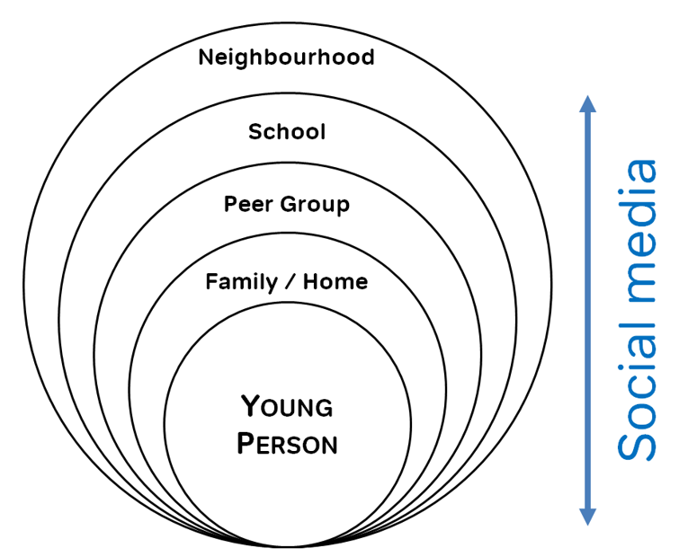
A Guide to Contextual Safeguarding
Haley Cameron:
Safeguarding Manager, Cognus
Steve Welding:
Esafety/Prevent trainer, Cognus

Slide 2
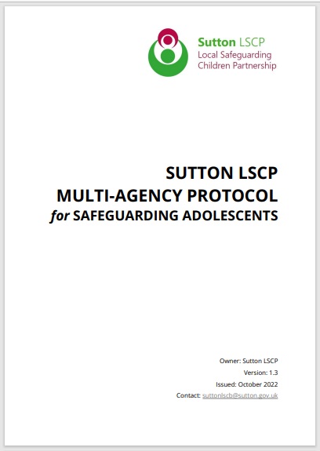
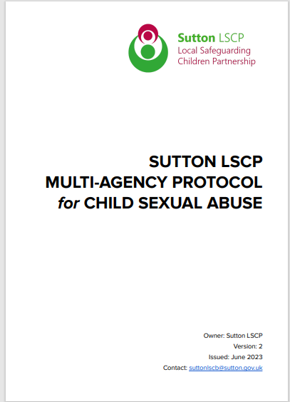
Key Documents LSCP

Slide 3
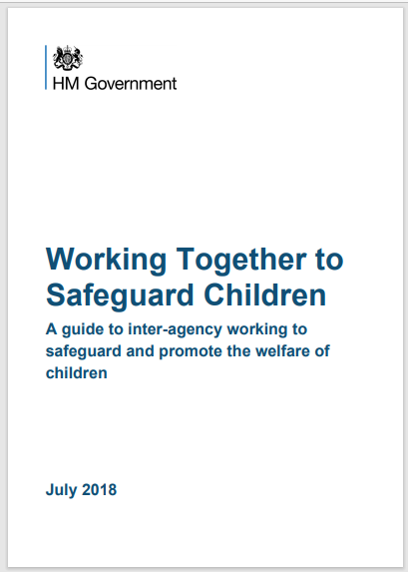
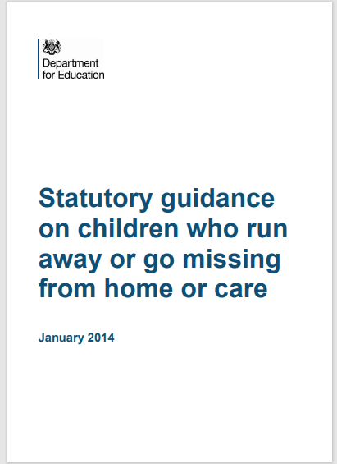
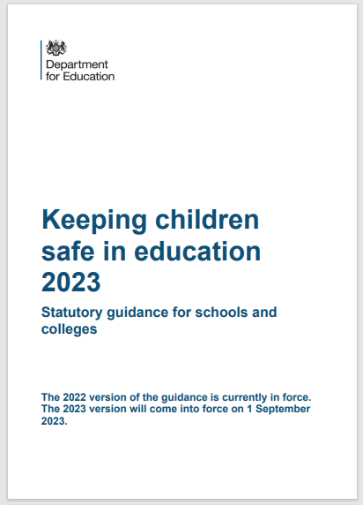
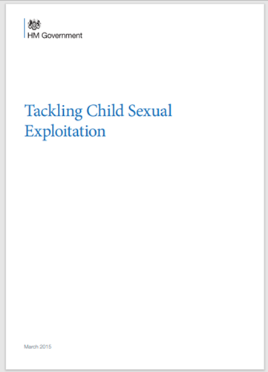
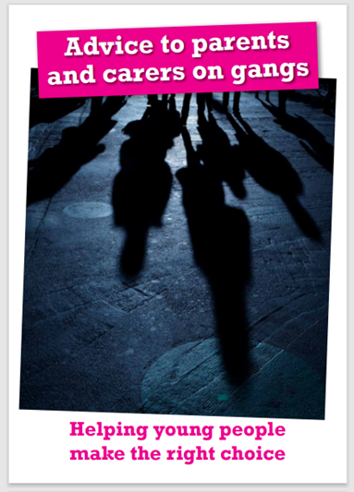
Key Documents – Department of Education

Slide 4
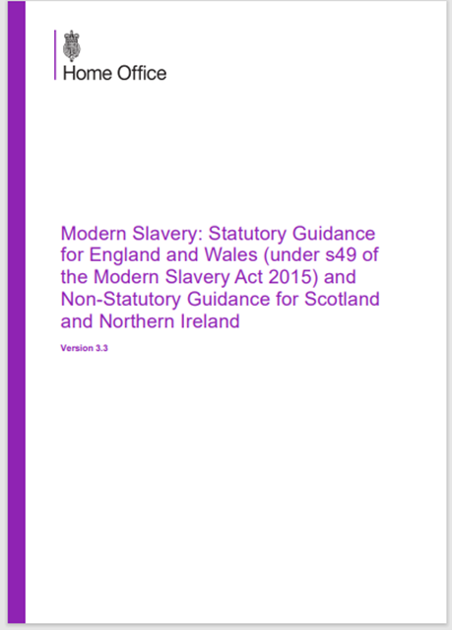
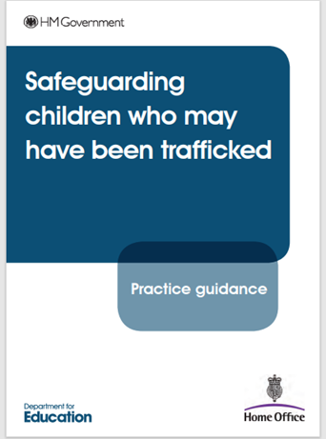
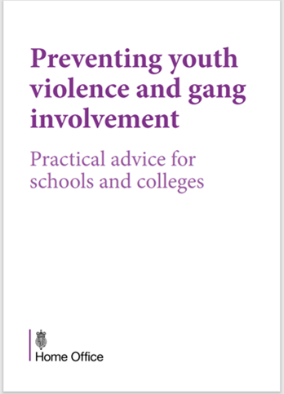
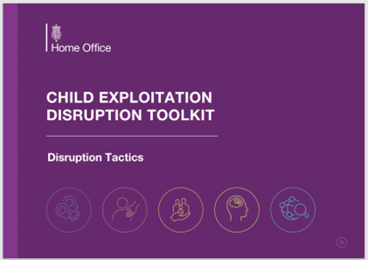
Key Documents – Home Office

Slide 5
KCSIE 2023
All staff, but especially the designated safeguarding lead (and deputies) should consider whether children are at risk of abuse or exploitation in situations outside their families. Extra-familial harms take a variety of different forms and children can be vulnerable to multiple harms including (but not limited to) sexual abuse (including harassment and exploitation), domestic abuse in their own intimate relationships (teenage relationship abuse), criminal exploitation, serious youth violence, county lines, and radicalisation.

Slide 6
KCSIE 2023
All staff should be aware that technology is a significant component in many safeguarding and wellbeing issues. Children are at risk of abuse and other risks online as well as face to face. In many cases abuse and other risks will take place concurrently
both online and offline. Children can also abuse other children online, this can take the form of abusive, harassing, and misogynistic/misandrist messages, the non-consensual sharing of indecent images, especially around chat groups, and the sharing of abusive images and pornography to those who do not want to receive such content.

Slide 7
Extra-Familial Harm

Slide 8
Extra-Familial Harm
“As individuals move from early childhood and into adolescence they spend increasing amounts of time socialising independently of their families. During this time the nature of young people’s schools and neighbourhoods, and the relationships that they form in these settings, inform the extent to which they encounter protection or abuse.
Evidence shows that, for example: from robbery on public transport, sexual violence in parks and gang related violence on streets, through to online bullying and harassment from school-based peers and abuse within their intimate relationships, young people encounter significant harm in a range of settings beyond their families. Peer relationships are increasingly influential during adolescence, setting social norms which inform young people’s experiences, behaviours and choices and determine peer status.
These relationships are, in turn, shaped by the school, neighbourhood and online contexts in which they develop. So if young people socialise in safe and protective schools and community settings they will be supported to form safe and protective peer relationships. However, if they form friendships in contexts characterised by violence and/or harmful attitudes these relationships too may be anti-social, unsafe or promote problematic social norms as a means of navigating, or surviving in those spaces.” (Firmin, C., 2017)

Slide 9
Extra-Familial Harm

Slide 11
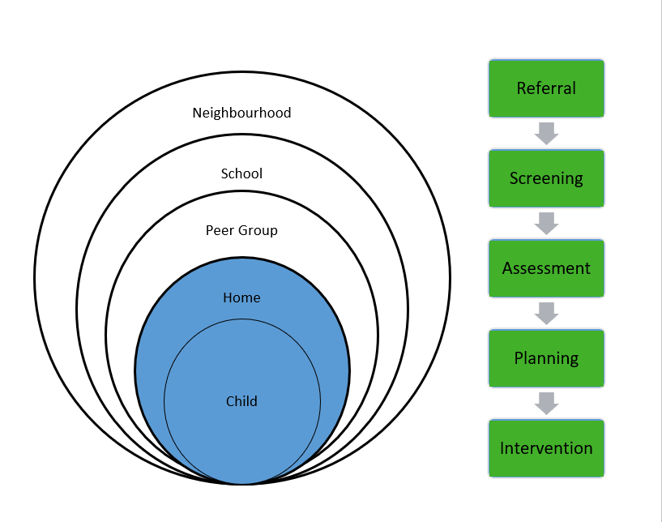
Child Protection Systems
Child protection systems have been designed to respond to risks in families/homes
(Bilston, 2006; Firmin, 2017 Hanson and Holmes, 2014)

Slide 12
Working with adolescents

Slide 13
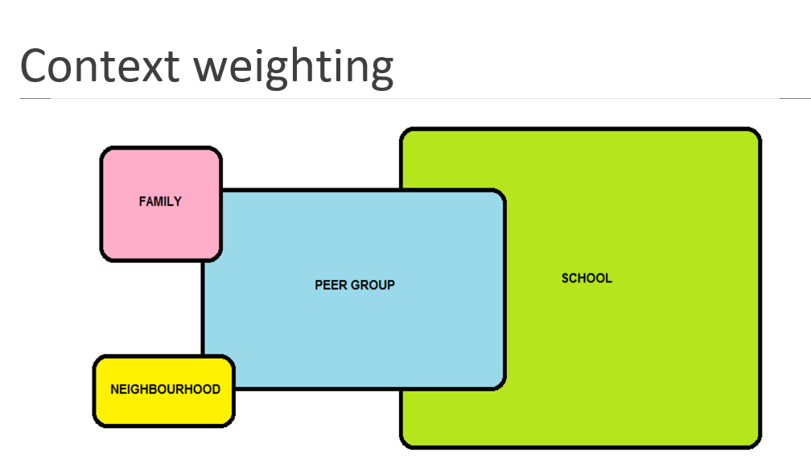
Prioritising risk

Slide 14
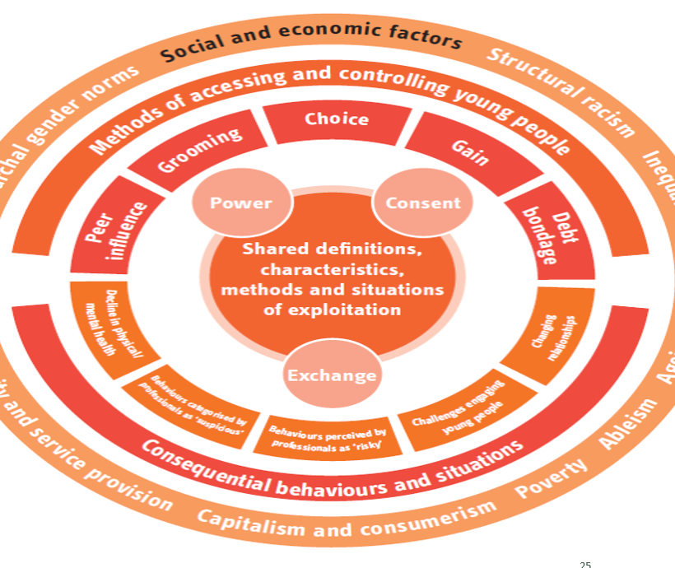
Holistic responses
This requires us to build holistic responses to exploitation and other forms of extra-familial harm

Slide 15
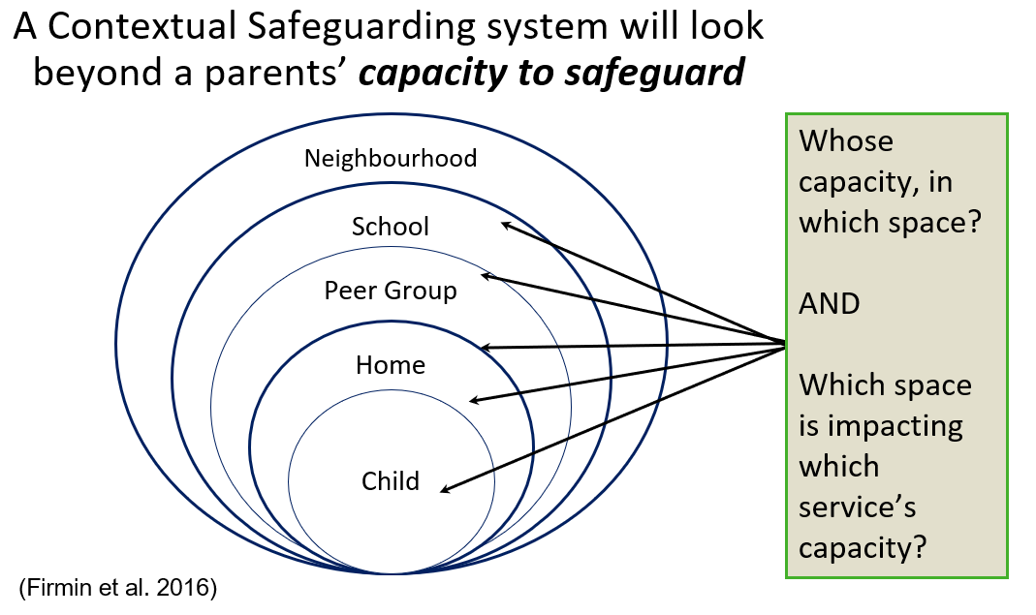
Parents’ capacity to safeguard

Slide 16
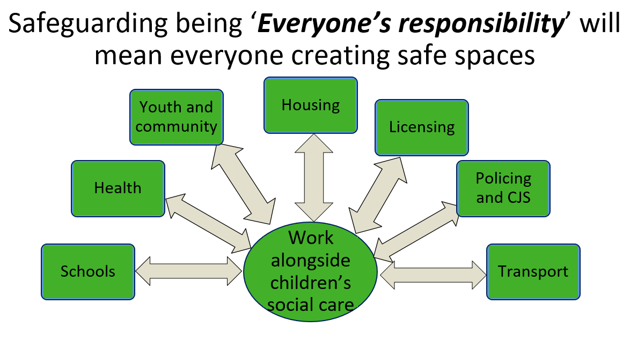
Everyone’s responsibility

Slide 17
Peer mapping

Slide 18
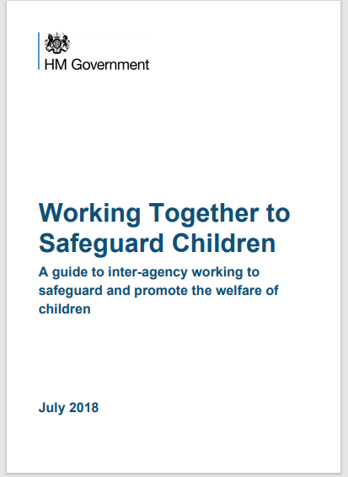
Inter-agency working
“Nothing is more important than children’s welfare. Children who need help and protection deserve high quality and effective support as soon as a need is identified.”

Slide 19
Assessment of risk outside the home
As well as threats to the welfare of children from within their families, children may be vulnerable to abuse or exploitation from outside their families. These extra-familial threats might arise at school and other educational establishments, from within peer groups, or more widely from within the wider community and/or online. These threats can take a variety of different forms and children can be vulnerable to multiple threats, including: exploitation by criminal gangs and organised crime groups such as county lines; trafficking; online abuse; teenage relationship abuse; sexual exploitation and the influences of extremism leading to radicalisation. Extremist groups make use of the internet to radicalise and recruit and to promote extremist materials. Any potential harmful effects to individuals identified as vulnerable to extremist ideologies or being drawn into terrorism should also be considered.
Working Together to
Safeguard Children

Slide 20
Assessment of risk outside the home
Assessments of children in such cases should consider whether wider environmental factors are present in a child’s life and are a threat to their safety and/or welfare. Children who may be alleged perpetrators should also be assessed to understand the impact of contextual issues on their safety and welfare. Interventions should focus on addressing these wider environmental factors, which are likely to be a threat to the safety and welfare of a number of different children who may or may not be known to local authority children’s social care. Assessments of children in such cases should consider the individual needs and vulnerabilities of each child. They should look at the parental capacity to support the child, including helping the parents and carers to understand any risks and support them to keep children safe and assess potential risk to the child.
Working Together to
Safeguard Children

Slide 21
Statutory obligation
The Children Act 1989 promotes the view that all children and their parents should be considered as individuals and that family structures, culture, religion, ethnic origins and other characteristics should be respected. Local authorities should ensure they support and promote fundamental British values, of democracy, the rule of law, individual liberty, and mutual respect and tolerance of those with different faiths and beliefs.
The Counter-Terrorism and Security Act 2015 contains a duty on specified authorities in England, Wales and Scotland to have due regard to the need to prevent people from being drawn into terrorism.
Working Together to
Safeguard Children

Slide 22
Sutton LSCP Threshold document – November 2021

Slide 23
Focusing on the needs and views of the child
Every assessment should reflect the unique characteristics of the child within their family and community context. Each child whose referral has been accepted by children’s social care should have their individual needs assessed, including an analysis of the parental capacity to meet those needs whether they arise from issues within the family or the wider community. Frequently, more than one child from the same family is referred and siblings within the family should always be considered. Family assessments that include all members of the family should always ensure that the needs of individual children are distinct considerations.
Working Together to
Safeguard Children

Slide 24
A reminder of all School Staff
What school and college staff should do if they have concerns
about a child
Staff working with children are advised to maintain an attitude of ‘it could happen here’ where safeguarding is concerned. When concerned about the welfare of a child, staff should always act in the best interests of the child.
If staff have any concerns about a child’s welfare, they should act on them immediately.
If staff have a concern, they should follow their own organisation’s child protection policy and speak to the designated safeguarding lead (or a deputy).

Slide 25
Thank You for Listening
Please visit www.Cognus.org.uk where you will find more bitesize training packages.
Hayley Cameron: Education Safeguarding Manager
Stephen Welding: E safety Adviser/Prevent Trainer
Gill Bush: Education Lead, CFCS
Mick Bradshaw: Outdoor Education Adviser

