Slide 1
Safeguarding children, young people All School Staff Safeguarding Training
Hayley Cameron: Education Safeguarding Manager
Stephen Welding: Esafety Adviser/Prevent Trainer
Gill Bush: Education Lead, MASH
Mick Bradshaw: Outdoor Education Adviser

Slide 2
Setting the scene - agenda
Key Guidance and Policies
What’s new in KCSIE 2023
Key safeguarding issues – in Sutton
Safeguarding refresher
Managing disclosures, how to report
Record keeping principles
Insight into the CFCS processes

Slide 3
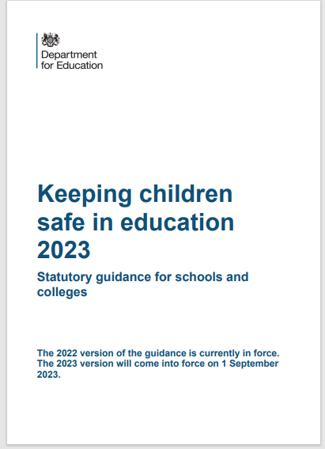
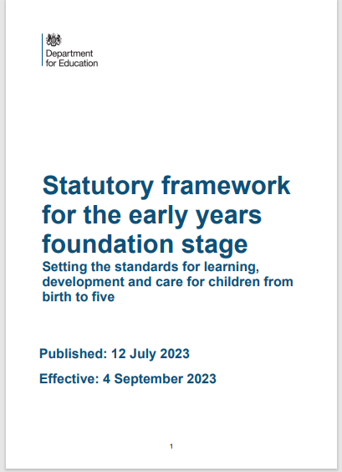
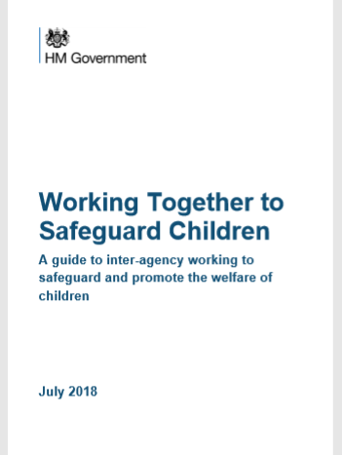
Legislation, Guidance and Procedure
Notes:
Read Keeping children safe in education (50 pages)

Slide 4
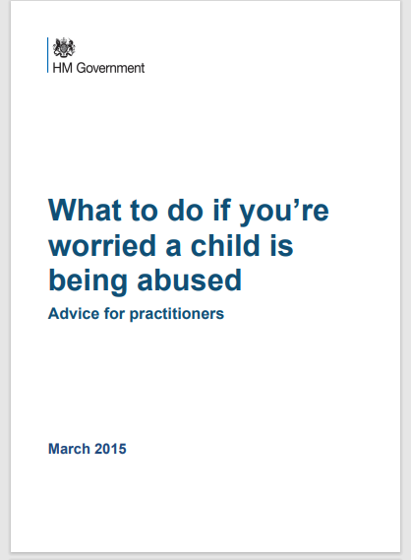
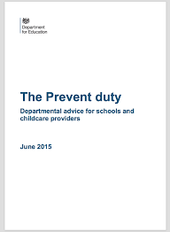
Key Guidance and Legislation

Slide 5
Introduction to the School Safeguarding Documents
School Safeguarding Policy
School Child protection/safeguarding young people and vulnerable adults – Procedure
Staff Code of Conduct and Social Media policy
Keeping Children Safe in Education September 2023 DfE
All staff are expected to read and understand PART 1 of the KCSIE document

Slide 6
Ofsted - School inspection handbook
343. All schools should have a culture of safeguarding. This means they should have effective arrangements to:
Always act in the best interests of children, pupils and students to protect them online and offline, including when they are receiving remote education.
Identify children, pupils and students who may need early help, and who are at risk of harm or have been harmed. This can include, but is not limited to, neglect, abuse (including by their peers), grooming or exploitation.
Secure the help that children, pupils and students need and, if required, refer in a timely way to those who have the expertise to help.
Manage safe recruitment and allegations about adults who may be a risk to children, pupils, students and vulnerable adults.

Slide 7
KCSIE 2023 – What is in it?
Part one: Safeguarding information for all staff. What school and college staff should know and do
Part two: The management of safeguarding. The responsibility of governing bodies, proprietors and management committees
Part three: Safer recruitment, Recruitment and selection process
Part four: Allegations made against/Concerns raised in relation to teachers, including supply teachers, other staff, volunteers and contractors
Part five: Child on child sexual violence and sexual harassment
Responding to reports of sexual violence and sexual harassment

Slide 8
KCSIE 2023 – What is in it?
Annex A: Safeguarding information for school and college staff
Annex B: Further information. Additional advice and support
Annex C: Role of the designated safeguarding lead
Annex D: Host families - homestay during exchange visits
Annex E: Statutory guidance - Regulated activity (children) - Supervision of activity with children which is regulated activity when unsupervised.
Annex F: Table of substantive changes from September 2022

Slide 9
Policy & Procedures
Pupil's health & safety
Attendance
Behaviour
Child protection/Safeguarding
Meeting the needs of children with medical needs
Intimate care and emotional well-being
Providing first aid
Physical intervention/reasonable force
Risk assessments for educational trips/visits
E-safety and associated issues
Staff Code of Conduct
Acceptable Use Policies – Staff/students/parents
Lockdown/Evacuation

Slide 10
Key education personnel
Safeguarding Governor
Head teacher, head of school, manager
Designated Safeguarding Lead (and Deputies)
LA Safeguarding Lead
CFCS Education Safeguarding Lead
Designated Teacher for Looked After Children (LAC)
Designated Teacher for pupils with SEND
Designated Officer(s)/ Local Authority (LADO)

Slide 11
Wider safeguarding agenda
Safer recruitment
DBS
Regulated activity
Disqualification (Childcare Act)
Allegations against staff
Premises and the school
environment

Slide 12
Sutton Local Safeguarding Children’s Partnership (LSCP)
The “Go To” place for Safeguarding Advice
www.suttonlscp.org.uk

Slide 13
SO WHY ARE WE HERE TODAY??
We can all make a difference to a child’s life.
We can all help a child to achieve.
We can all listen to what a child is telling us.
We can all be “there” for the child.
We can provide the best support for the child.
We all know “right from wrong”.
We must all report any worry or a concern.
WE ALL HAVE TO BE PROFESSIONALY CURIOUS
It’s Safeguarding

Slide 14
KCSIE 2023 – Safeguarding Definition
Safeguarding and promoting the welfare of children is defined for the purposes of this guidance as:
protecting children from maltreatment;
preventing the impairment of children’s mental and physical health or development;
ensuring that children grow up in circumstances consistent with the provision of safe and effective care; and
taking action to enable all children to have the best outcomes.

Slide 15
KCSIE 2023
Safeguarding and promoting the welfare of children is everyone’s responsibility.
Everyone who comes into contact with children and their families has a role to play. In order to fulfil this responsibility effectively, all practitioners should make sure their approach is child-centred. This means that they should consider, at all times, what is in the best interest of the child.

Slide 16
KCSIE 2023
No single practitioner can have a full picture of a child’s needs and circumstances. If children and families are to receive the right help at the right time, everyone who comes into contact with them has a role to play in identifying concerns, sharing information and taking prompt action.

Slide 17
KCSIE 2023 – Children may not be ready to disclose
All staff should be aware that children may not feel ready or know how to tell someone that they are being abused, exploited, or neglected, and/or they may not recognise their experiences as harmful. For example, children may feel embarrassed, humiliated, or being threatened. This could be due to their vulnerability, disability and/or sexual orientation or language barriers. This should not prevent staff from having a professional curiosity and speaking to the DSL if they have concerns about a child. It is also important that staff determine how best to build trusted relationships with children and young people which facilitate communication

Slide 18
KCSIE 2023
All staff, but especially the designated safeguarding lead (and deputies) should consider whether children are at risk of abuse or exploitation in situations outside their families. Extra-familial harms take a variety of different forms and children can be vulnerable to multiple harms including (but not limited to) sexual abuse (including harassment and exploitation), domestic abuse in their own intimate relationships (teenage relationship abuse), criminal exploitation, serious youth violence, county lines, and radicalisation.

Slide 19
KCSIE 2023
All staff should be aware that technology is a significant component in many safeguarding and wellbeing issues. Children are at risk of abuse and other risks online as well as face to face. In many cases abuse and other risks will take place concurrently
both online and offline. Children can also abuse other children online, this can take the form of abusive, harassing, and misogynistic/misandrist messages, the non-consensual sharing of indecent images, especially around chat groups, and the sharing of abusive images and pornography to those who do not want to receive such content.

Slide 20
What all staff should know
What to do if a child says they are being abused or neglected
Manage confidentiality appropriately
Identify early help needs
How to follow school referral processes
Be aware of referral processes for social care.
That all concerns/discussions and decisions made and the reasons for those decisions are accurately recorded in writing
QUESTION: are you secure in your knowledge and understanding

Slide 21
What all staff should know – KCSIE 2023
All staff should be aware of systems within their school or college which support safeguarding, and these should be explained to them as part of staff induction. This should include the:
child protection policy (which should amongst other things also include the policy and procedures to deal with child-on-child abuse).
behaviour policy (which should include measures to prevent bullying, including
cyberbullying, prejudice-based and discriminatory bullying).
staff behaviour policy (sometimes called a code of conduct) should amongst other things, include low-level concerns, allegations against staff and whistleblowing.
safeguarding response to children who are absent from education, particularly on repeat occasions and/or prolonged periods.
The role of the designated safeguarding lead (including the identity of the designated safeguarding lead and any deputies).

Slide 22
KCSIE 2023 – Part 1
14. All staff should receive appropriate safeguarding and child protection training (including online safety which, amongst other things, includes an understanding of the
expectations, applicable roles and responsibilities in relation to filtering and monitoring at induction. The training should be regularly updated. In addition, all staff should receive safeguarding and child protection (including online safety) updates (for example, via email, e-bulletins, and staff meetings), as required, and at least annually, to continue to provide them with relevant skills and knowledge to safeguard children effectively

Slide 23
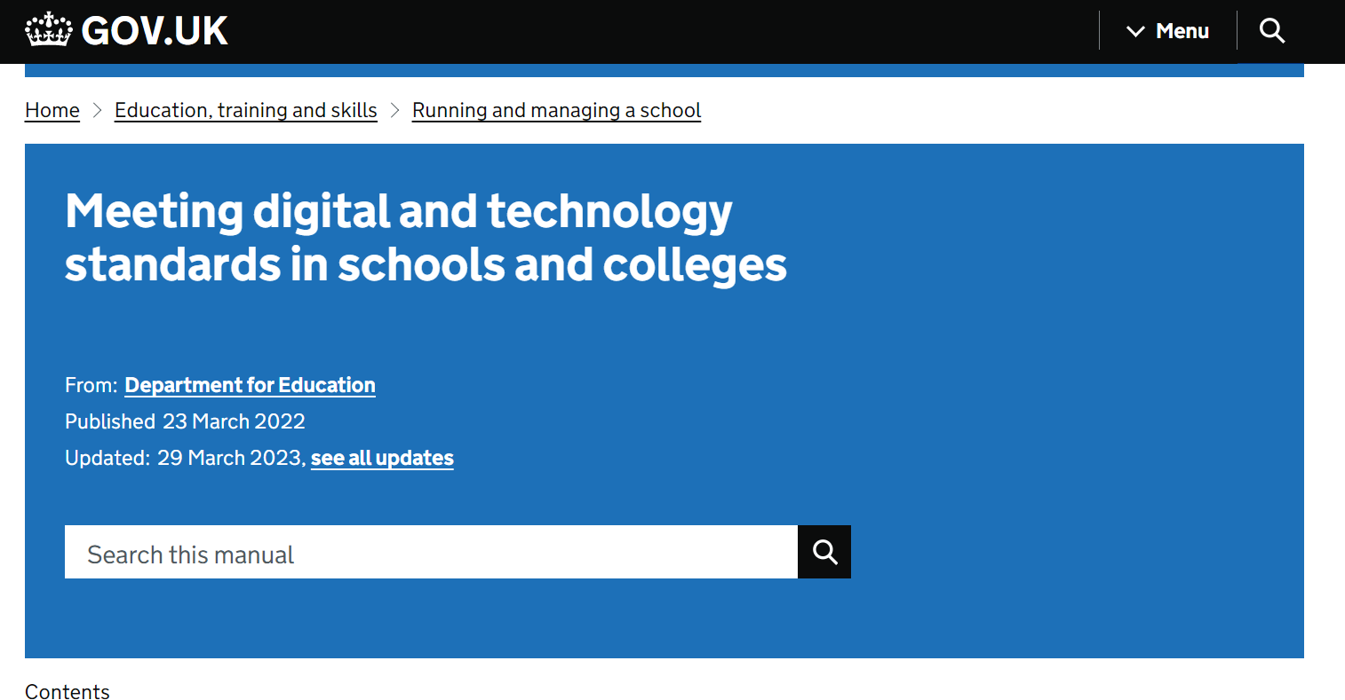

Slide 24
Filtering and Monitoring

Slide 25
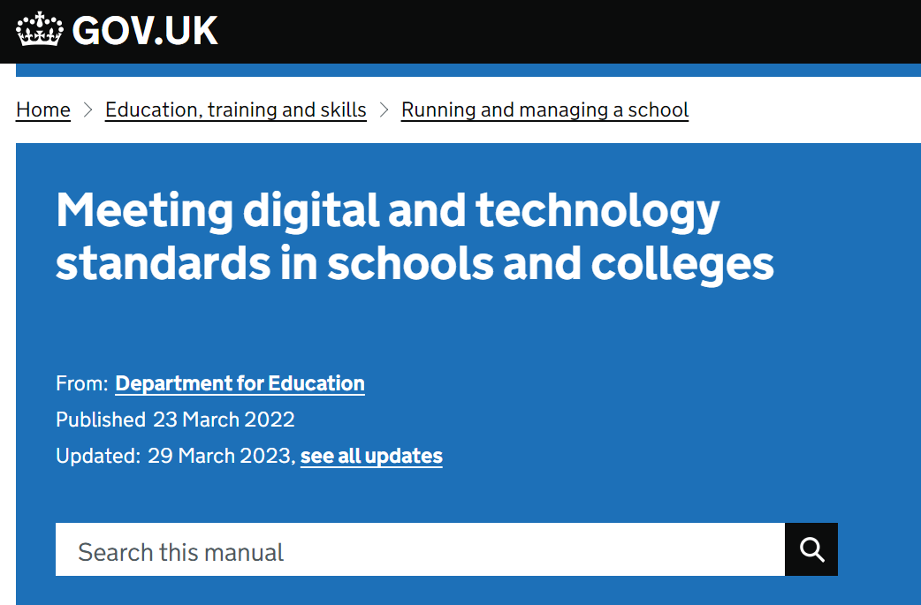
Filtering and Monitoring
Governing bodies and proprietors have overall strategic responsibility for filtering and monitoring and need assurance that the standards are being met.
To do this, they should identify and assign:
a member of the senior leadership team and a governor, to be responsible for ensuring these standards are met.
the roles and responsibilities of staff and third parties, for example, external service providers.
We are aware that there may not be full-time staff for each of these roles and responsibility may lie as part of a wider role within the school, college, or trust. However, it must be clear who is responsible and it must be possible to make prompt changes to your provision.

Slide 26
KCSIE 2023 - Check arrangements around online filtering and monitoring are effective (part 2)
Your governing board should make sure that:
The designated safeguarding lead (DSL) takes responsibility for understanding the filtering and monitoring systems and processes in place as part of their role (paragraph 103)
All staff understand their expectations, roles and responsibilities around filtering and monitoring as part of safeguarding training (paragraph 124)
Your school's child protection policy includes how your school approaches filtering and monitoring on school devices and school networks (paragraph 138)
Your board should also review the DfE’s filtering and monitoring standards. It should discuss with IT staff and service providers what needs to be done to support your school in meeting the standards (paragraph 142).

Slide 27
Online checks for short-listed candidates
Schools are reminded that short-listed candidates should be informed that online searches will be carried out.
KCSIE 2023 Para 221. In addition, as part of the shortlisting process schools and colleges should consider carrying out an online search as part of their due diligence on the short-listed candidates. This may help identify any incidents or issues that have happened, and are publicly available online, which the school or college might want to explore with the applicant at interview. Schools and colleges should inform shortlisted candidates that online searches may be done as part of due diligence checks.

Slide 28
New – Out of school settings
This is non-statutory guidance from the Department for Education (DfE). It aims to:
help providers of out-of-school settings (OOSS) understand best practice for creating a safe environment for children in their care.
give parents and carers confidence that their child is in a safe activity or learning environment.

Slide 29
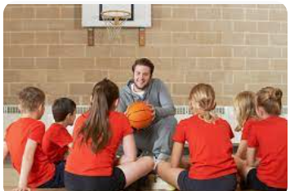
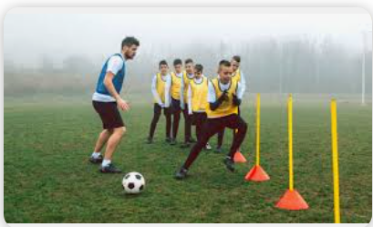
Allegations made against staff using your premises
If school receive allegations about staff using their premises to run activities for children, they should follow their own safeguarding policy, including contacting the LADO

Slide 30
The ‘Prevent Duty’
The guidance now talks about children and young people who are ‘susceptible’ to being drawn into terrorism, rather than being ‘vulnerable’ to being drawn into terrorism.

Slide 31
KCSIE 2023 - Children ‘Missing Education’
Guidance about children ‘missing education’ now talks about children who are ‘absent’ from education, particularly on repeat occasions or for prolonged periods.

Slide 32
What schools need to do next
Ensure ‘Filtering and Monitoring Standards’ are met, including cyber security training.
Ensure DSLs are aware of their lead role in ‘Filtering and Monitoring’.
Update Child Protection policy, especially using ‘new language’.
Make sure any hire agreement references ’Keeping Children Safe in Out of School settings’ and school checks compliance.
Ensure hire policy refers to school safeguarding policy for allegations against the hirer’s staff

Slide 33
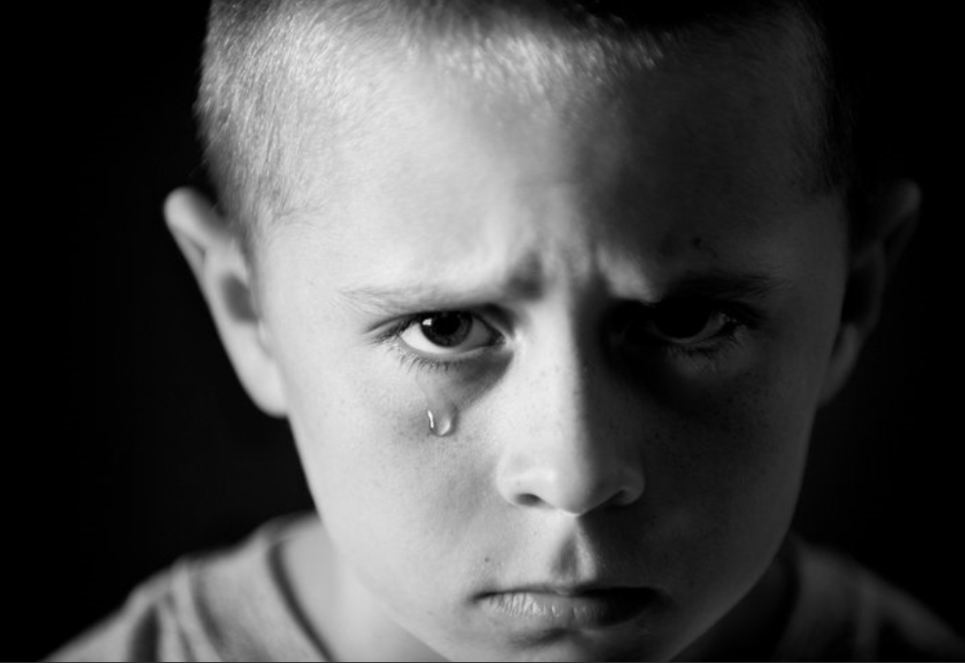
Neglect and Abuse
NEGLECT
EMOTIONAL ABUSE
PHYSICAL ABUSE
SEXUAL ABUSE

Slide 35
Key safeguarding issues – Sutton
Child abuse
Self Harm
Mental Health issues
Domestic abuse that Impact on Children
Child Sexual Exploitation (CSE)
Child Criminal Exploitation (CCE)
Children Missing Education (CME)

Slide 36
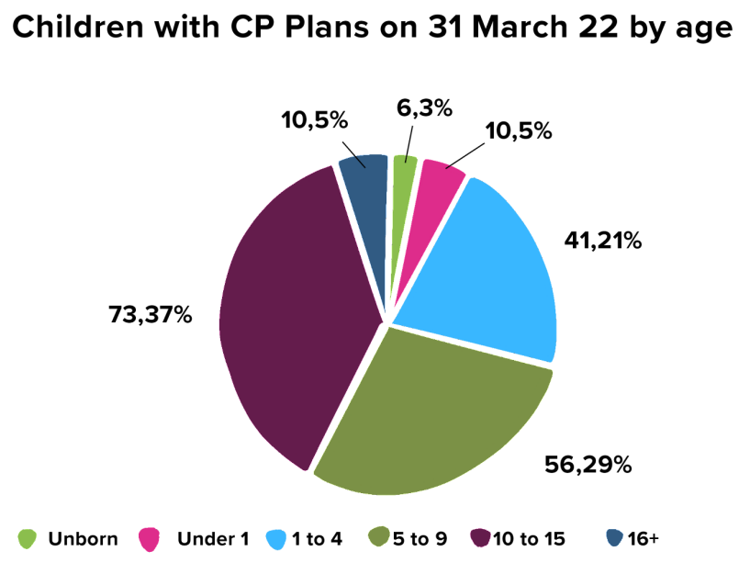

Slide 37
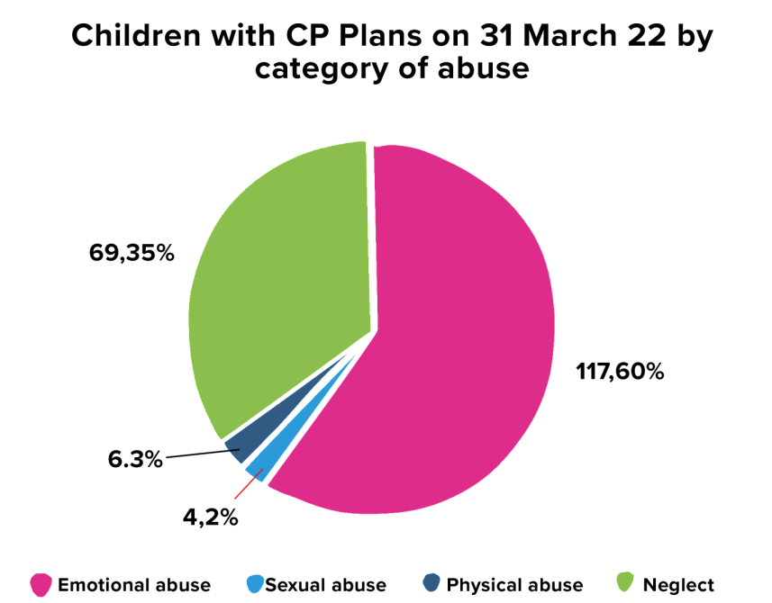

Slide 38
Key Safeguarding Issues in Education settings
Children and the Court System
Children Missing Education
Child Sexual Exploitation
Child on Child abuse
Upskirting
FGM
Self-harm
Mental Health
Homelessness
Domestic Abuse
Honour based abuse
Radicalisation & extremism
Cyber bullying and social media
Children with family members in prison
Child Criminal Exploitation – County lines

Slide 39
Child Abuse
Child abuse is the range of ways in which people significantly harm children or young people
Inflicting harm or failing to prevent harm
Children or young people may be sexually abused in a family or in an institutional or community setting, by those known to them or, more rarely, by a stranger
They may be abused by an adult or adults, or by another child or children
Neglectful behaviours may include: missing medical appointments, lack of food/inappropriate clothing, prioritising adult need rather than children’s, poor attendance at school.

Slide 40
T.E.D.
T – Tell me what you mean by that
E – Explain what you mean by that
D – Describe what you mean by that

Slide 41
What to look out for:- Abuse and Neglect
Significant changes in children’s behaviour
Deterioration in children’s general well-being
Unexplained bruising, marks or signs of possible abuse or neglect
Children’s comments which give cause for concern
Any reason to suspect neglect or abuse outside the setting
Inappropriate behaviour displayed by other members of staff, or any other person working with the children, for example, inappropriate sexual comments, excessive one-to-one attention beyond the requirements of their usual role and responsibilities or inappropriate sharing of images.

Slide 42
What is Physical Abuse?
Physical abuse is defined as hitting, shaking, throwing, poisoning, burning, scalding, drowning, suffocating or otherwise causing physical harm to a child.
Physical harm may also be caused when a parent or carer feigns the symptoms of, or deliberately causes, ill-heath to a child whom they are looking after.
Police - An assault is where a person intentionally or recklessly uses unlawful force against someone else.

Slide 43
Common Sites for Non-Accidental Injury
The most common sites for non-accidental injury are:
Eyes, Ears
Cheeks, Mouth
Shoulders, Chest
Upper and inner arms, Stomach/abdomen
Genitals, Front and back of thighs.
Buttocks, Hands, Feet
USE THE BODY MAP TO INDICATE WHERE THE INJURIES ARE, BE SPECIFIC, NOT GENERIC

Slide 44
Chastisement – Sutton Children Social Care
The Education Safeguarding Manager has been working with the Police and Children Social care to get a definitive protocol on what Schools are expected to do should they become aware that a child has been hit/smacked by a parent, carer, guardian or any other adult family member.
If a member of school staff become aware that a child has been chastised in any way they should immediately inform the DSL/DDSL.
DSL/DDSL can unpick with the child using TED to get context in what the child is disclosing.
DSL/DDSL should contact CFCS and discuss concern with a Social Worker before contacted parents/carers.
DSL/DDSL act on the advise given to you by the Social Worker. Make a note of all conversations.

Slide 45
KCSIE 2023 - Neglect
The persistent failure to meet a child’s basic physical and/or
psychological needs, likely to result in the serious impairment of the child’s health or development. Neglect may involve a parent or carer failing to provide adequate food, clothing and shelter (including exclusion from home or abandonment); protect a child from physical and emotional harm or danger; ensure adequate supervision (including the use of inadequate caregivers); or ensure access to appropriate medical care or
treatment. It may also include neglect of, or unresponsiveness to, a child’s basic emotional needs.

Slide 46
Together for Sutton

Slide 47
Together for Sutton

Slide 48
Family Hubs in Sutton

Slide 49
Family Hubs in Sutton

Slide 50
Supporting parents in Sutton

Slide 51
How common is child sexual abuse?
1 in 20 children in the UK
1 in 3 children did not tell anyone
Over 90% of sexually abused children were abused by someone they knew
450,000 abused in the UK last year
50,000 reported to police
Sources:
Radford, L. et al (2011) Child abuse and neglect in the UK today
Jütte, S. et al (2014) How safe are our children? 2014. London: NSPCC
Office of the English Children’s Commissioner 2015

Slide 52
NSPCC - statistics briefing
In the last five years there was an average of 58 child deaths by assault or undetermined intent a year in the UK.
Children under the age of one are the most likely age group to be killed by another person, followed by 16- to 24-year-olds.
Child homicides are most commonly caused by the child’s parent or step-parent
Over a third of all police-recorded sexual offences are against children.
Girls and older children are more likely to experience sexual abuse.
The vast majority of children who experience sexual abuse were abused by someone they knew
Neglect is the most common form of abuse.
Concerns around neglect have been identified for half of children who are the subject of a child protection plan or on a child protection register in the UK.
The number of police recorded child cruelty offences is increasing.
Neglect is the most commonly mentioned form of abuse by adults contacting the NSPCC helpline

Slide 53
NSPCC - statistics briefing
Concerns around physical abuse have been identified for around 1 in 10 children who are the subject of a child protection plan or on a child protection register in the UK.
There were over 160,000 offences related to child physical abuse recorded by police in England, Wales and Northern Ireland in 2019/20.
Physical abuse is the second most commonly mentioned form of abuse in both contacts to the NSPCC helpline and Childline counselling sessions
Most child abuse includes an element of emotional abuse, but it is recorded as a specific concern for just over 1 in 3 children who are the subject of a child protection plan or on a child protection register in the UK.
There were over 11,000 contacts to the NSPCC’s helpline and almost 5,000 Childline counselling sessions in 2020/21 about emotional abuse.
There were over 34,000 police-recorded offences related to emotional abuse in England, Wales and Northern Ireland in 2019/20

Slide 54
KCSIE 2023 – Child-on-Child Abuse
All staff should be aware that children can abuse other children at any age (often referred to as child-on-child abuse). And that it can happen both inside and outside of school or college and online. It is important that all staff recognise the indicators and signs of abuse and know how to identify it and respond to reports.
All staff should be clear as to the school or college’s policy and procedures with regards to child-on-child abuse.
Following the end of the Independent Inquiry in to Child Sexual Abuse, the obligation to retain records has now been removed.

Slide 55
KCSIE 2023 – Child-on-Child Abuse
Child-on-child abuse is most likely to include, but may
not be limited to:
bullying (including cyberbullying, prejudice-based and discriminatory bullying).
abuse in intimate personal relationships between children (sometimes known as ‘teenage relationship abuse’).
physical abuse which can include hitting, kicking, shaking, biting, hair pulling, or otherwise causing physical harm.
sexual violence, such as rape, assault by penetration and sexual assault.
sexual harassment, such as sexual comments, remarks, jokes and online sexual Harassment.

Slide 56
Child-on-child sexual violence and sexual harassment (Part 5 KCSIE 2023)
All Staff should be aware of the importance of :
making clear that there is a zero-tolerance approach to sexual violence and
sexual harassment, that it is never acceptable, and it will not be tolerated
It should never be passed off as “banter”, “just having a laugh”, “a part of growing up” or “boys being boys”
Failure to do so can lead to a culture of unacceptable behaviour, an unsafe environment and in worst case scenarios a culture that normalises abuse, leading to children accepting it as normal and not coming forward to report it.
Dismissing or tolerating such behaviours risks normalising them

Slide 57
Sexual assault
(1) A person (A) commits an offence if—
(2) He/she intentionally touches another person (B),
(3) the touching is sexual,
(4) (B) does not consent to the touching, and
(5) (A) does not reasonably believe that (B) consents.

Slide 58
“Consent”
A person consents if he/she agrees by choice, and has the freedom and capacity to make that choice.

Slide 59
NO Consent - under 13’s
Under-13’s can’t consent to any kind of sexual activity
Age of consent for sexual intercourse is 16
Sexual intercourse without consent is rape
Making and sharing sexual images of under 18’s is illegal

Slide 60
Communities at risk of FGM
FGM is practised in at least 28 African countries, in the Middle East and Asia.
In the UK, FGM tends to occur in areas with large populations of FGM practising communities. These include London, Cardiff, Manchester, Sheffield, Northampton, Birmingham, Oxford, Crawley, Reading, Slough and Milton Keynes.
However, FGM can happen anywhere in the UK (NHS Choices, 2013).
It is a criminal act in the UK and should be reported to the police if staff/volunteers become aware of the procedure taking place.
If a member of staff/volunteer becomes aware that it may be taking place then it is a referral to CFCS.
Notes:
How prevalent is FGM?
FGM is usually carried out on girls between infancy and age 15, with the majority of cases occurring between the ages of 5 and 8 years (HM Government, 2011). Because of the hidden nature of the crime, it is difficult to estimate FGM's prevalence, but a study based on 2001 census data in England and Wales estimated that 23,000 girls under the age of 15 could be at risk of FGM each year; and nearly 66,000 women are living with its consequences (Dorkenoo et al, 2007). FGM could be even more prevalent than these figures suggest due to population growth and immigration from practising countries since 2001 (HM Government, 2011).

Slide 61
FGM Guidance for Schools
nationalfgmcentre.org.uk

Slide 62
Holistic Approach

Slide 63
'Honour-based Abuse’ – KCSIE 2023
Along with FGM, Keeping Children Safe in Education (2023) mentions Breast Ironing and Forced marriage, under so-called 'Honour-based Abuse’.
Breast Ironing is practiced in some African countries, notably Cameroon. Girls aged between 9 and 15 have hot pestles, stones or other implements rubbed on their developing breast to stop them growing further.
Forcing a person into a marriage is a crime in England and Wales. A forced marriage is one entered into without the full and free consent of one or both parties and where violence, threats or any other form of coercion is used to cause a person to enter into a marriage.
In addition, since February 2023 it has also been a crime to carry out any conduct whose purpose is to cause a child to marry before their eighteenth birthday, even if violence, threats or another form of coercion are not used. As with the existing forced marriage law, this applies to non-binding, unofficial ‘marriages’ as well as legal marriages

Slide 64
Legal age of marriage/civil partnerships (New)
The legal age of marriage and civil partnerships has been raised to 18 in England and Wales. Previously, people could get married at 16 or 17 as long as they had parental consent.
The new law also applies to cultural or religious marriages that are not registered with the local council.
Under the new rules, children will not face penalties but adults who facilitate their marriage could face up to seven years in jail and a fine.
This would include adults who took children abroad to carry out the marriage.

Slide 65
Health and Care Act 2022 (New)
The Department for Health and Social Care (DHSC) has published non-statutory guidance providing advice for professionals in the UK who may encounter women and girls affected by virginity testing and hymenoplasty (a procedure undertaken to reconstruct a hymen). The government has made it illegal to carry out, offer or aid and abet virginity testing or hymenoplasty in any part of the UK, as part of the Health and Care Act 2022. The guidance includes: information on how the law applies; support with identifying women and girls at risk or who may have been subjected to a virginity test and/or hymenoplasty; and help to prevent this from taking place.

Slide 66
Self harm
Self-harm is a serious public health problem and is the reason behind many admissions to accident and emergency departments every year.
Sutton has a multi-agency self-harm protocol (Sept 2020)
Self-harm and suicidal threats by a child/young person put them at risk of significant harm, and should always be taken seriously and responded to without delay.
Self-harming is NOT attention seeking behaviour, it is attention NEEDING behaviour.
Self-harm is a way of coping with difficult or overwhelming situations or emotional states.

Slide 67
Referral pathways
Self Harm Nurse – Awaits appointment

Slide 69
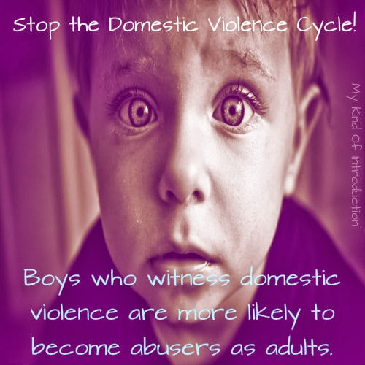
Domestic Abuse
This Photo by Unknown Author is licensed under CC BY

Slide 70
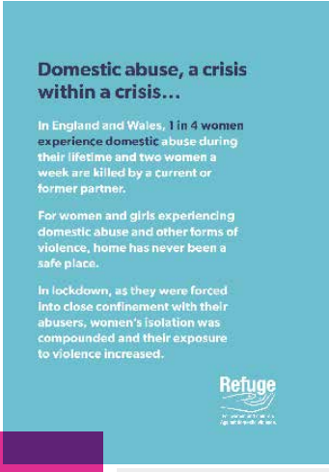
Domestic Abuse in Sutton – Lockdown
There has been a significant increase in the number of reported cases of Domestic abuse nationally.
Sutton has seen a significant rise in Domestic abuse cases since the lockdown was imposed.
The number of offences has been increasing in recent years.
Sutton Crime Prevention and Community Safety Strategy 2017-20

Slide 71
Police - Domestic Incident
Police Definition :-
Any incident or pattern of incidents of controlling, coercive or threatening behaviour, violence or abuse between those aged 16 or over who are or have been intimate partners or family members regardless of gender or sexuality.
This can encompass, but is not limited to, the following types of abuse:
•psychological
•physical
•sexual
•financial
•emotional
Domestic abuse also includes honour-based abuse and forced marriage.

Slide 72
Social Care – Domestic incident
Threats and intimidation - threatening to hurt you or members of your family
Physical abuse - hitting, shoving, kicking, strangling or slapping, hair pulling, throwing things, choking or smothering, even when it doesn't leave physical marks
Sexual abuse - performing sexual acts or having sex with you when you don't want to. This can include the use of threats, intimidation, coercive behaviour or physical force, although it is still sexual abuse even without using these insults by name calling or criticism of your appearance or identity,
Criticism and put-downs - being blamed for every argument or problem.
Forced isolation from your friends or family
Controlling behaviour - telling you what to do or wear, or using manipulation or coercion. Following you or checking up on your mobile phone, post or internet use
Financial abuse - preventing you from getting or keeping a job, taking your money away or withholding the family income

Slide 73
KCSIE 2023 - Domestic Abuse
43. Domestic abuse can encompass a wide range of behaviours and may be a single incident or a pattern of incidents. That abuse can be, but is not limited to, psychological, physical, sexual, financial or emotional. Children can be victims of domestic abuse. They may see, hear, or experience the effects of abuse at home and/or suffer domestic abuse in their own intimate relationships (teenage relationship abuse). All of which can have a detrimental and long-term impact on their health, well-being, development, and ability to learn.

Slide 74
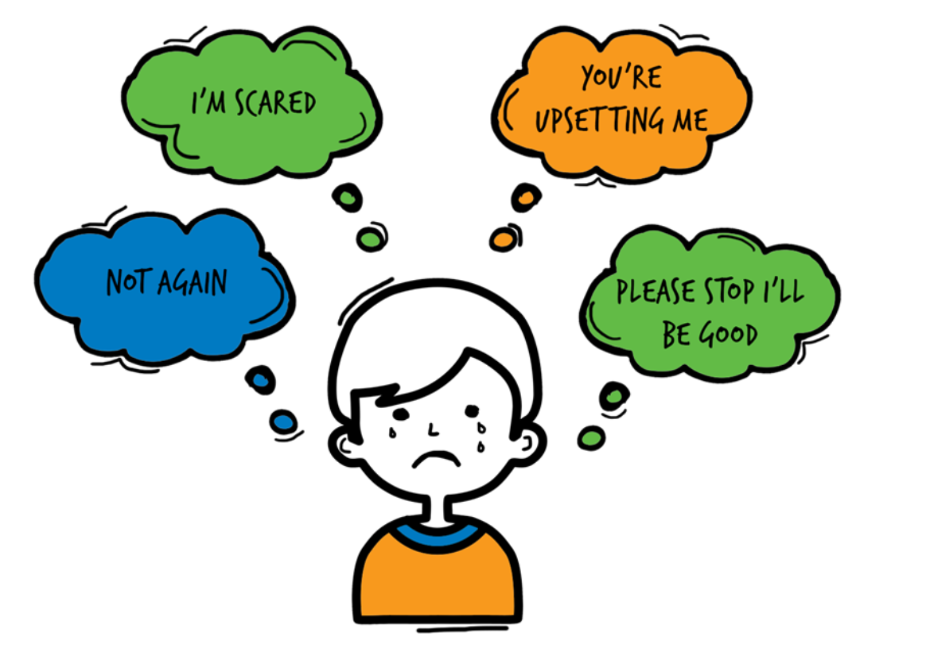
Domestic Abuse
Children living with domestic violence and abuse are over-represented among those children referred to Children Social Care, abuse and neglect represent about two thirds of cases seen at child protection conferences.
The risks of harm to children exposed to domestic violence and abuse have now been recognised. Children who live/experience DA feel:
75% of all CP cases in Sutton, Domestic Abuse is present

Slide 75
Operation Encompass - National Police Strategy
Operation Encompass operates in the majority of police forces across England. It helps police and schools work together to provide emotional and practical help to children. The system ensures that when police are called to an incident of domestic abuse, where there are children in the household who have experienced the domestic incident, the police will inform the key adult (usually the designated safeguarding lead) in school before the child or children arrive at school the following day. This ensures that the school has up to date relevant information about the child’s circumstances and can enable support to be given to the child according to their needs.

Slide 76
Not alone in Sutton -
Not Alone In Sutton
​: A website full of useful information about domestic abuse, including what to do if someone is affected by domestic abuse:
​www.notaloneinsutton.org.uk

Slide 77
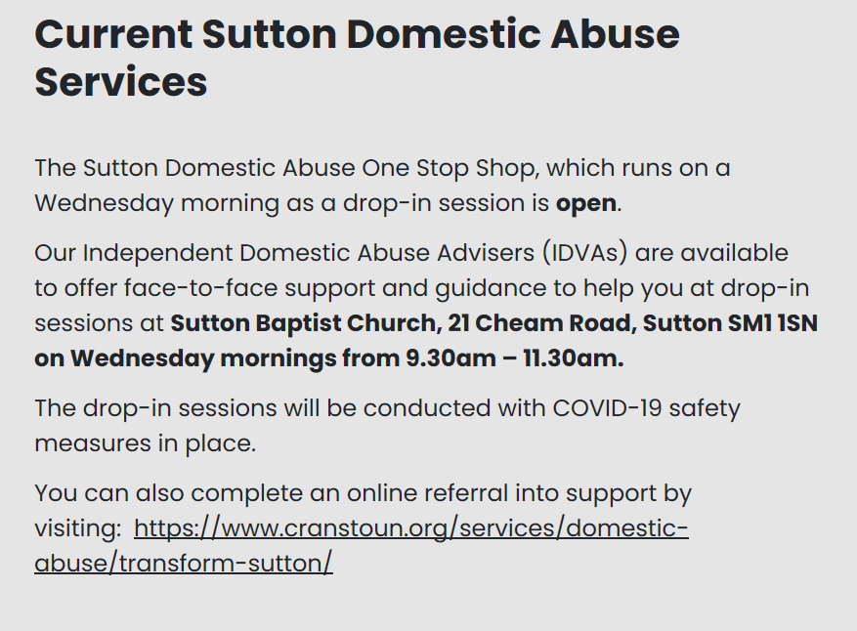

Slide 79
Bromley & Croydon Women’s Aid
Bromley & Croydon Women’s Aid
For any enquiries, you can email info@bcwa.org.uk or call 0208 3139303.
They are open Monday to Friday, from 9.00am to 4.30pm. This applies to all types of information, including
Notes:
Remind staff that, today, you’re going to be focusing more on the lower end of this continuum
Click to bring up the examples on the slide
These ‘small’ behaviours contribute to the 'bigger', more violent issues, as you’ve already touched on
The things at the lower level of the pyramid can and do happen in schools across the country, and staff have probably seen them too
These behaviours normalise a culture where women are treated like objects or where we control and police their sexuality. This low-level harassment and sexism contribute to a culture where the behaviours at the top of the pyramid become accepted
By dealing with the issues at the lower levels of the pyramid, we can help stop escalation to the higher levels of the pyramid. That’s why it’s so important that our school challenges sexual harassment and violence at all levels of the continuum
Note the categorisation in this pyramid differs from the categorisation in Keeping Children Safe in Education in some places. The pyramid is being used here to illustrate the escalation of behaviours rather than as a reflection of statutory guidance
Emphasise that staff should assume sexual harassment is happening in your school, even if there are no specific reports of it – as Ofsted recommended in its review of sexual abuse in schools and colleges
Sources
Bold Voices, https://www.boldvoices.co.uk/
EqualiTeach, https://equaliteach.co.uk/
GOV.UK – Ofsted, Review of sexual abuse in schools and colleges. https://www.gov.uk/government/publications/review-of-sexual-abuse-in-schools-and-colleges/review-of-sexual-abuse-in-schools-and-colleges

Slide 80
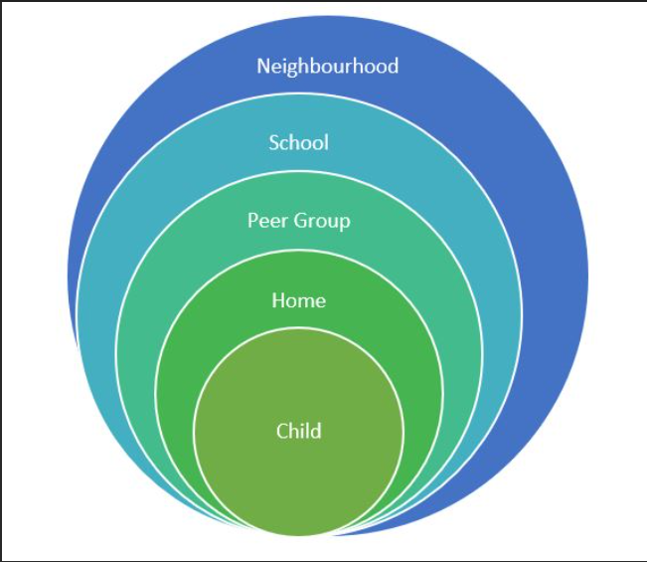
Assessment of risk outside the home
Be aware of risks in your local area –
Drugs, County Lines, gangs, Knife crime, DA, poverty, neglect, robberies, ASB, Exploitation, racism, extremism,
Hotspots (parks, vape shops, takeaways) etc

Slide 81
Counter Terrorism and Security Act 2015.
As of the 1st July 2015 – Creates a new duty on certain bodies to have “DUE REGARD TO THE NEED TO PREVENT PEOPLE FROM BEING DRAWN INTO TERRORISM”.
The duty will apply to bodies including local authorities, the police, prisons, probation, schools, colleges and universities.
Notes:
81

Slide 82
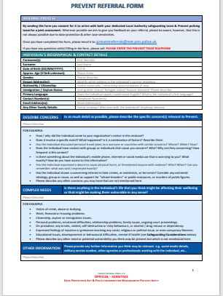
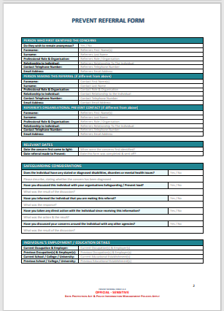
National Prevent Referral Form
preventreferrals@met.pnn.police.uk

Slide 83
Develop a School Prevent Action Plan
Develop a Prevent action plan – consider completing the self-assessment here:
https://www.gov.uk/government/publications/prevent-duty-self-assessment-tool-for-schools

Slide 84
Need to ask a question on Prevent?
Abu Ullah
Prevent Team Leader
Safer Sutton Partnership Service
Safer and Stronger Communities
Sutton Police Station, 6 Carshalton Road, Sutton, SM1 4RF
Tel: 020 8649 0448 Fax: 020 8642 5036
Mobile: 07710 066 807
Email: abu.ullah@sutton.gov.uk

Slide 85
Online Training
https://www.support-people-vulnerable-to-radicalisation.service.gov.uk/portal
Notes:
85

Slide 86
Responding to a Child who discloses – you should NEVER
Investigate or seek to prove or disprove possible abuse
Make promises about confidentiality or keeping ‘ secrets’
Assume that someone else will take the necessary action
Jump to conclusions, be dismissive or react with shock, anger, horror
Speculate or accuse anyone
Suggest or probe for information
Confront another person (adult or child) allegedly involved
Offer opinions about what is being said or the persons allegedly involved
Forget to record what you have been told
Fail to pass this information on to the correct person

Slide 87
T.E.D.
T – Tell me what you mean by that
E – Explain what you mean by that
D – Describe what you mean by that

Slide 88
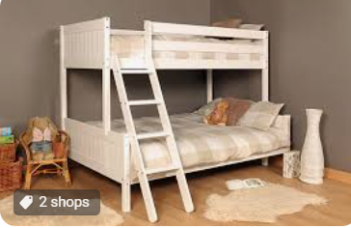
WHAT CHILDREN SAY

Slide 89
Record Keeping- Principles
Records should be:
Accurate
Based on fact
Record what the child actually said
Jargon free
Abbreviation free
Inclusive of relevant information
Write in permanent ink (Not pencil)
Sign, Date, Time and print your full name
Your current position within the Company
Don’t cross out mistakes, put a line through and correct it.

Slide 90
KCSIE 2023 - Examples of Poor Practice
include:
• failing to act on and refer the early signs of abuse and neglect
• poor record keeping
• failing to listen to the views of the child
• failing to re-assess concerns when situations do not improve
• not sharing information with the right people within and between agencies
• sharing information too slowly, and
• a lack of challenge to those who appear not to be taking action.

Slide 91
Managing allegations: we all have a responsibility to report
Where it is alleged that a member of staff has:
Behaved in a way that has harmed a child, or may have harmed a child;
Possibly committed a criminal offence against or related to a child;
Behaved towards a child or children in a way that indicates he or she may pose a risk of harm to children; or
Behaved or may have behaved in a way that indicates they may not be suitable to work with children.
The Head Teacher/Chair of Governors will contact the Local Authority Designated Officer (LADO) who has overall responsibility for oversight of the procedures for dealing with allegations.
The LADO will provide advice and guidance, in addition to liaising with the police and other agencies, and monitoring the progress of cases to ensure that they are dealt with as quickly as possible consistent with a thorough and fair process.

Slide 92
The term – ‘low level concern’
'The term ‘low-level’ concern does not mean that it is insignificant, it means that the behaviour towards a child does not meet the threshold of harm. A low-level concern is any concern – no matter how small, and even if no more than causing a sense of unease or a ‘nagging doubt’ - that an adult working in or on behalf of the school or college may have acted in a way that:
is inconsistent with the staff code of conduct, including inappropriate conduct outside of work.
does not meet the allegations threshold or is otherwise not considered serious enough to consider a referral to the LADO.

Slide 93
Examples of ‘low-level’ concerns KCSIE 2023
Report to the HT/Chair of Governors
being over friendly with children
having favourites
taking photographs of children on their mobile phone, contrary to school policy
engaging with a child on a one-to-one basis in a secluded area or behind a closed door
humiliating pupils.

Slide 94
Whistle blowing
If any staff member feels unable to raise an issue with their employer, or feels that their genuine concerns are not being addressed, other whistleblowing channels are open to them.
General guidance on whistleblowing can be found at:
The ‘NSPCC what you can do to report abuse dedicated helpline’ is available as an alternative route for staff who do not feel able to raise concerns regarding child protection failures internally or have concerns about the way a concern is being handled by their school or college.
Staff can call 0800 028 0285 line is available from 8.00am – 8.00pm Monday – Friday and email help@nspcc.org.uk

Slide 95
An ongoing culture of vigilance
Features of a safer culture:
Open, no secrets
Belief that ‘it could happen here’
Clear procedures for reporting concerns
Support in raising concerns and commitment to take action
Setting acceptable standards of behaviour
Policies and procedures put into practice and monitored
Induction and probationary periods.
Commitment to safeguarding and an ongoing culture of
vigilance

Slide 96
Information Sharing
Early sharing of information is the key to providing effective early help where there are emerging problems. At the other end of the continuum, sharing information can be essential to putting in place effective child protection services.
Safeguarding Practice Reviews (SPRs) have shown how poor information sharing has contributed to the deaths or serious injuries of children.
Fears about sharing information cannot be allowed to stand in the way of the need to promote the welfare and protect the safety of children.

Slide 97
Information Sharing
57. DPA and UK GDPR do not prevent the sharing of information for the purposes of keeping children safe and promoting their welfare. If in any doubt about sharing information, staff should speak to the designated safeguarding lead (or a deputy). Fears
about sharing information must not be allowed to stand in the way of the need to safeguard and promote the welfare of children
KCSIE 2023

Slide 98
Confidentiality
Safeguarding head is suspended 'for loudly discussing personal details of pupils in phone conversation on busy train
Director of Safeguarding, had been in the role 10 months
He has since been suspended pending an investigation into the incident
He also revealed one student's sexuality and discussed another's mental health
Daily Mail 9.6.22

Slide 99
The Children’s First Contact Service Referral Form
Google Form, accessible via a link
Children's First Contact Service Referral Form
Telephone number 020 8770 6001/ 6072
cfcs@sutton.gov.uk
Link can also be found on the Sutton LSCP Website
www.suttonlscp.org.uk

Slide 100
Referring a concern to CFCS
The Children’s First Contact Service (CFCS) is the single referral and assessment pathway to access services in the London Borough of Sutton and the referral form can be found on https://www.sutton.gov.uk/cfcs
CFCS is the referral route for the following services:
Statutory Children’s Services;
Targeted Early Help;
Early Help Assessment Tool (EHAT) submission and feedback;
Children with Disabilities (Access Point); and
Parenting Plus.

Slide 101
A single pathway to access support All referrals to the CFCS will be triaged to ensure they take the correct pathway
Onwards Pathways
Multi-Agency Safeguarding Hub (MASH)
Children in Need
Locality Team
Children’s Centres
Targeted Early Help
The Change up Project
Parenting Programmes
Locality Team Family Support
Restorative Family Coaches
Restorative Support and Family Group Conferencing
Short Breaks and iCount
Local Offer
LBS Website
Family Information Directory

Slide 102
CFCS SYSTEM
Referrers:
Cases not open to Children’s Social Care and there are identified support needs and/or safeguarding concerns
Contacts/Referrals from:
Statutory/PVI and the public
All contacts from statutory services, Private Voluntary and Independent and the public apart from level 4, require a Early Help Assessment EHAT and consent (Merlins received will not require consent)
*Public does not need to complete a Early Help Assessment
Tier 1 No Additional Needs
No further action/No assessment required
Advice & Information
Telephone:
020 8770 6001 (main number)
Email:
Childrensfirstcontactservice@sutton.gov.uk
Tier 2 Early Help
Assessment: CAF/Early Help Assessment
Consent required
Tier 3 Children with Complex Multiple Needs
Assessment: (Social Work Single Assessment)
Consent required
Tier 4 Children in Acute Need
Assessment: Strategy Meeting/S47
Consent not required
For a list of indicators, please follow the link to:
http://www.londoncp.co.uk/ where the indicators are outlined in the threshold section.

Slide 103
Worried about a child in your school?
If you are WORRIED about a child in your school and you feel that Children Social Care should do something about it THEN YOU need pass on that WORRY to them.
You need to contextualise that WORRY into words and put it onto the CFCS referral form so when they read it THEY ARE NOW WORRIED about the child and will need to do something about it.
IT IS ALL ABOUT THE INFORMATION ON THE FORM

Slide 104
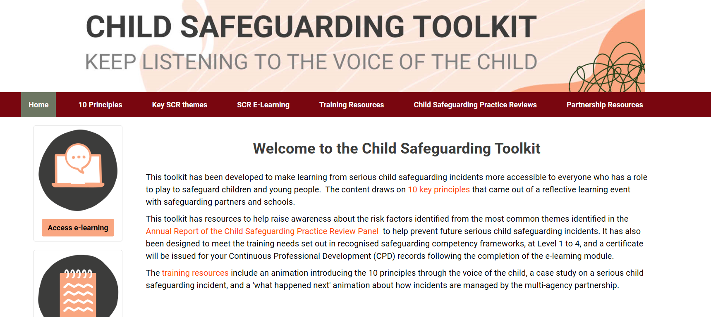
www.childsafeguardingtoolkit.org.uk

Slide 105
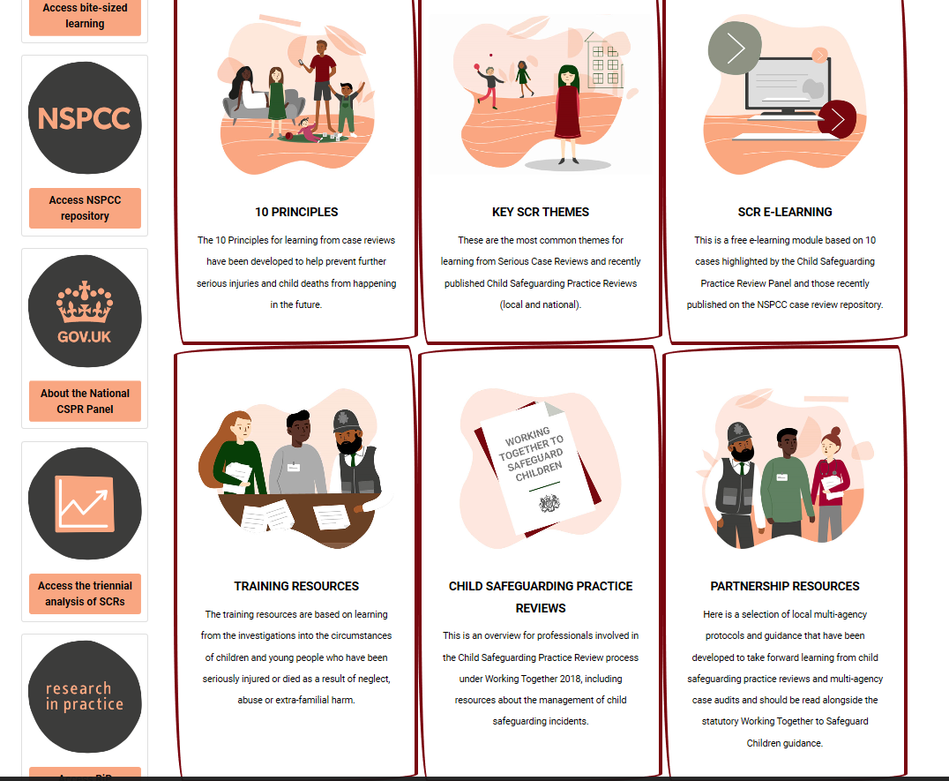

Slide 106
At a glance reminders (All Safeguarding concerns)
Always remember the child and look beyond their behaviour and consider why they are behaving like this.
Always listen to what the child is telling you.
Make a record of what the child has said (as soon as possible)
Don’t dismiss what a child tells you.
Be professionally curious if the situation doesn’t look or feel right to you then it probably isn’t right.
If in doubt always seek advice and support.
Share information with the School/Organisation Designated Safeguarding Lead.
Always share with your manager if you have a concern regarding a colleague’s behaviour towards a child.

Slide 107
Key messages for all staff
REMEMBER ‘it could happen here’
Always act in the best interest of the child

Slide 108
Don’t hold onto the RISK

Slide 109
Sutton - Local Authority Safeguarding
CFCS – 0208 770 6001
Out of Hours 0208 770 5000
cfcs@sutton.gov.uk
hayley.cameron@cognus.org.uk
stephen.welding@cognus.org.uk
gillian.bush@cognus.org.uk
mick.bradshaw@cognus.org.uk
Jan.capon@cognus.org.uk - Early Years Adviser
Nick.Banham@cognus.org.uk – Early Years Adviser

Slide 110
Thank You for Listening
Hayley Cameron: Education Safeguarding Manager
Stephen Welding: Esafety Adviser/Prevent Trainer
Gill Bush: Education Lead, CFCS
Mick Bradshaw: Outdoor Education Adviser

