Slide 1
Safeguarding children and young people VOICE OF THE CHILD
Hayley Cameron: Education Safeguarding Manager
Stephen Welding: Esafety Adviser/Prevent Trainer
Gill Bush: Education Lead, CFCS
Mick Bradshaw: Outdoor Education Adviser

Slide 2
Voice of the Child
The 4Rs of Safeguarding Children.
Recognise
Record
Report
Refer
The Voice of the child in the situation of child abuse.

Slide 3
RECOGNISE
Interviewing a child/young person should be done carefully and sensitively by professionals who are trained and skilled in this practise and usually Police and Social Workers.
In Education children /young people often come to us to discuss concerns and we are often the first point of contact for disclosures.
Listening to their voice and allowing them to talk freely without interruption but also obtaining clarity in order that any possible risks be identified and help to make a decision on any possible next steps.
These conversations with the child are very important as they help identify the circumstances as much as possible in their own words so the right decisions for child and families can be made at the earliest opportunity.

Slide 4
How do we do this?
Open questions should always be used as much as possible.
They help to paint a picture and gain information from a child in his or her own words.
They are open ended and often start with words like why, how, what, or when.
Closed questions should be avoided where possible.
These are questions that can be answered with either yes or no or where you give a possible answer or options of answers along with the question.
Example: “was it Mum or Dad” rather than “ who did that” or “who said that ”
We always want the voice of the child in their own words and not ours.
Remember Describe what you see including any marks, note the child’s reaction, behaviour and demeanour as this can often also help with that important picture.
Bearing all this mind, ask yourself what is it that I need to clarify and how can I do this being mindful of this and importantly in the child’s own words

Slide 5
T.E.D.
If a student makes a disclosure but it did not really make sense to you, then you have to ask open questions in order to put some context into what the student is disclosing.
My mum hurt me last night

Slide 6
T.E.D.
T – Tell me what you mean by that
E – Explain what you mean by that
D – Describe what you mean by that

Slide 7
Examples of Additional Open Questions
Tell me what happened
Show me what happened
What do you mean
Describe to me.
When did this happen
Then what happened.
How do you feel.
How did you do that.
Why did you do that
Why did they do that
How can we find out
What made you think that
Why do you think that happened.

Slide 8
RECORD
Note your conversation as factual as possible using the child’s words not yours.
Describe what you saw including child’s demeanour.
Date, time and sign your notes.
Note in the child’s Safeguarding File and if they don’t have one create one.
Remember we never make promises to a child on any possible next steps following any disclosure.

Slide 9
REPORT and REFER
Once we have unpicked and obtained clarity the below should be borne in mind when calling for advice or making a referral to CFCS or in some circumstances calling the Police.
Has the child made any disclosures before.
Remember to check any safeguarding file for concerns from previous education provision.
If there is a sibling are we aware if they have made previous disclosures.
If so what, and what action if any was taken.
Remember if the family are new to Sutton Borough social care may not have any history but the safeguarding file may contain information.

Slide 10
What to look out for:- Child Abuse, Neglect
Significant changes in children’s behaviour
Deterioration in children’s general well-being
Unexplained bruising, marks or signs of possible abuse or neglect
Children’s comments which give cause for concern
Any reason to suspect neglect or abuse outside the setting
Inappropriate behaviour displayed by other members of staff, or any other person working with the children, for example, inappropriate sexual comments, excessive one-to-one attention beyond the requirements of their usual role and responsibilities or inappropriate sharing of images.

Slide 11
Responding to a Child who discloses – you should NEVER
Investigate or seek to prove or disprove possible abuse
Make promises about confidentiality or keeping ‘ secrets’
Assume that someone else will take the necessary action
Jump to conclusions, be dismissive or react with shock, anger, horror
Speculate or accuse anyone
Suggest or probe for information
Confront another person (adult or child) allegedly involved
Offer opinions about what is being said or the persons allegedly involved
Forget to record what you have been told
Fail to pass this information on to the correct person

Slide 12
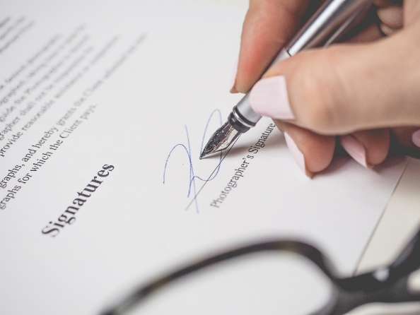
Record Keeping- Principles
Records should be:
Accurate
Based on fact
Record what the child actually said
Jargon free
Abbreviation free
Inclusive of relevant information
Write in permanent ink (Not pencil)
Sign, Date, Time and print your full name
Your current position within the Company
Don’t cross out mistakes, put a line through and correct it.

Slide 13
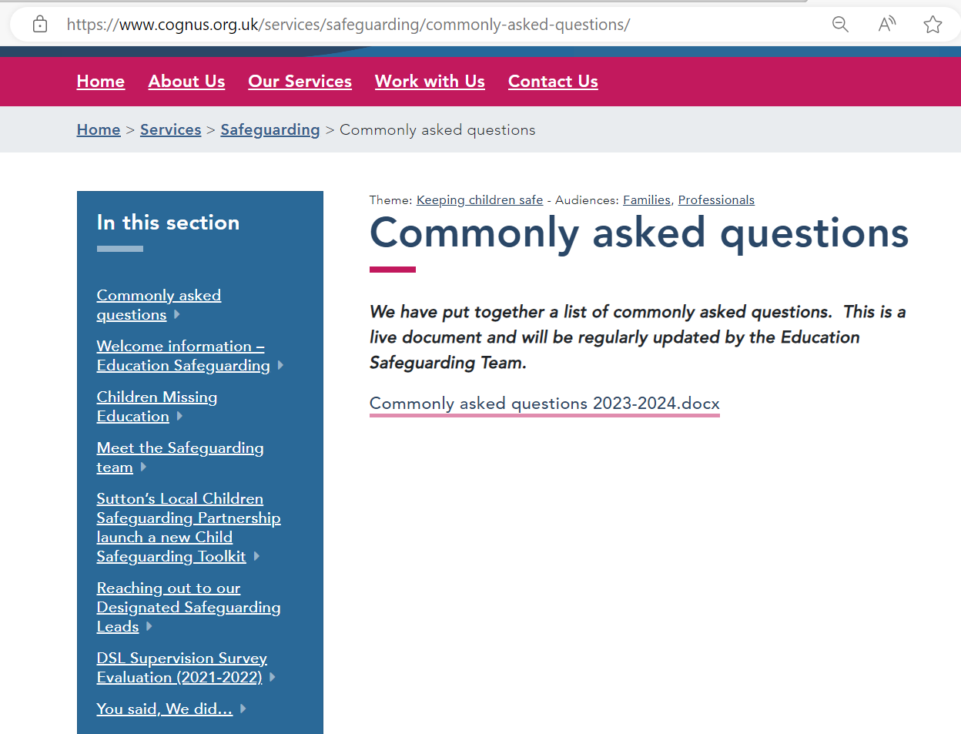
WWW.COGNUS.ORG.UK

Slide 14
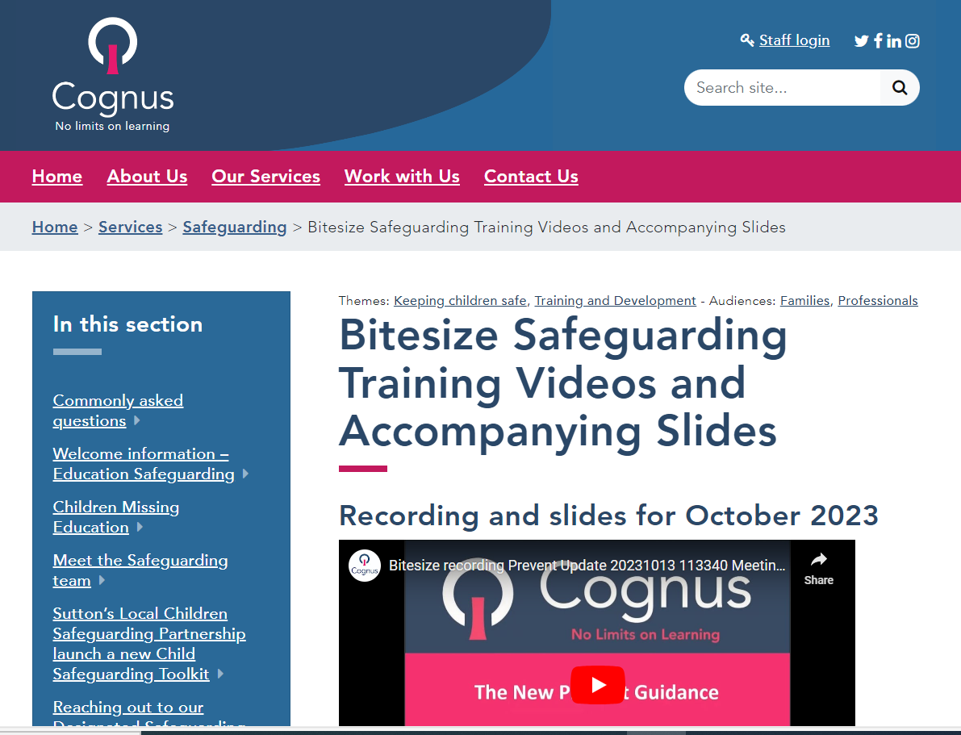
Bitesize training on the Cognus Website

Slide 15
Thank You for Listening
Hayley Cameron: Education Safeguarding Manager
Stephen Welding: Esafety Adviser/Prevent Trainer
Gill Bush: Education Lead, CFCS
Mick Bradshaw: Outdoor Education Adviser

