Slide 1
Safeguarding children, young people Working Together To Safeguard Children Key Changes to New Guidance Dec 2023
Hayley Cameron: Education Safeguarding Manager
Stephen Welding: Esafety Adviser/Prevent Trainer
Gill Bush: Education Lead, CFCS
Mick Bradshaw: Outdoor Education Adviser

Slide 2
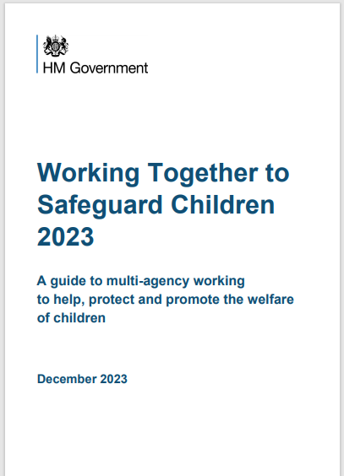
Key Guidance – Working Together to Safeguard Children

Slide 3
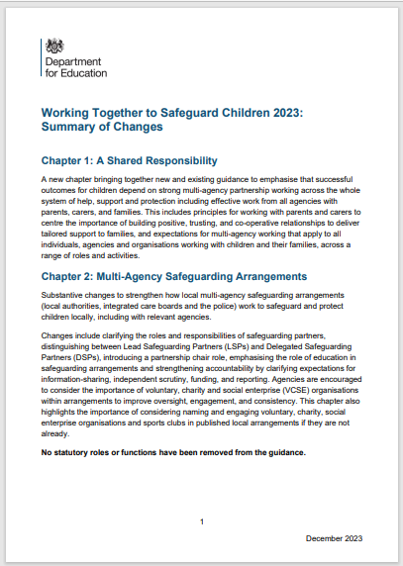
Agenda
Safeguarding Children: Stronger Together - Navigating the 2023 Updates
Exploring key changes in Working Together to Safeguard Children
What does this mean for Education
Useful resources

Slide 4
Who is this guidance for?
This statutory guidance sets out key roles for individual organisations and agencies to deliver effective arrangements for help, support, safeguarding, and protection. It should be read and followed by leaders, managers and frontline practitioners of all organisations
and agencies as set out in chapter 4 of this document. (WTSC 2023)

Slide 5
Introduction
Nothing is more important than children’s welfare. Every child deserves to grow up in a safe, stable, and loving home. Children who need help and protection deserve high quality and effective support.
This requires individuals, agencies, and organisations to be clear about their own and each other’s roles and responsibilities, and how they work together.

Slide 6
A child-centred approach within a whole family focus
A child-centred approach is fundamental to safeguarding and promoting the welfare of every child. All practitioners should follow the principles of the Children Acts 1989 and 2004. These Acts make clear that the welfare of children is paramount and that they are best looked after within their families, with their parents playing a full part in their lives, unless compulsory intervention in family life is necessary.

Slide 7
Children and Young People
In this guidance, a child is defined as anyone who has not yet reached their 18th birthday.
‘Children’ therefore means ‘children and young people’ throughout.
The term practitioner is used in the guidance to refer to individuals who work with children and their families in any capacity, including a range of professionals, such as qualified social workers and those who work for the statutory safeguarding partners or in education settings.

Slide 8
Working with parents and carers
The updated guidance sets out four principles that professionals should follow when working with parents and carers:
effective partnership and the importance of building strong, positive, trusting and co-operative relationships.
respectful, non-blaming, clear and inclusive verbal and non-verbal communication that is adapted to the needs of parents and carers.
empowering parents and carers to participate in decision making by equipping them with information, keeping them updated and directing them to further resources.
involving parents and carers in the design of processes and services that affect them.

Slide 9
The Children Act 1989
Whilst it is parents and carers who have primary care for their children, local authorities, working with partner organisations and agencies, have specific duties to safeguard and promote the welfare of all children in their area. The Children Act 1989 1 sets out specific duties to provide services to children in their area if they are in need and to undertake enquiries if they believe a child has suffered or is likely to suffer significant harm. The Director of Children’s Services and Lead Member for Children’s Services in local authorities are the key points of professional and political accountability, with responsibility for the effective delivery of these functions

Slide 10
The Children Act 2004
The Children Act 2004 placed a duty on the local authority to promote co-operation with partners and other agencies in order to improve the wellbeing of children in their area.
It also placed duties on a range of organisations and individuals to ensure they too give sufficient regard to children in need of help and safeguarding.

Slide 11
Children and Social Work Act 2017
Amendments made by the Children and Social Work Act 2017 to the Children Act 2004 strengthened this already important relationship by placing new duties on the police, integrated care boards (ICBs) and the local authority, as statutory safeguarding partners.
Safeguarding partners are under a duty to make arrangements to work together, and with other partners locally including education providers and childcare settings, to safeguard and promote the welfare of all children in their area.

Slide 12
Definition - Safeguarding and promoting the welfare of children
providing help and support to meet the needs of children as soon as problems
Emerge.
protecting children from maltreatment, whether that is within or outside the home, including online.
preventing impairment of children’s mental and physical health or development
ensuring that children grow up in circumstances consistent with the provision of
safe and effective care.
promoting the upbringing of children with their birth parents, or otherwise their
family network through a kinship care arrangement, whenever possible and where
this is in the best interests of the children.
taking action to enable all children to have the best outcomes in line with the
outcomes set out in the Children’s Social Care National Framework

Slide 13
Neglect -
Neglect - The persistent failure to meet a child’s basic physical and/or psychological needs, likely to result in the serious impairment of the child’s health or development. Neglect may occur during pregnancy as a result of maternal substance abuse. Once a child is born, neglect may involve a parent or carer failing to:
• provide adequate food, clothing, and shelter (including exclusion from home or abandonment)
• protect a child from physical and emotional harm or danger
• ensure adequate supervision (including the use of inadequate caregivers)
• ensure access to appropriate medical care or treatment
• provide suitable education
It may also include neglect of, or unresponsiveness to, a child’s basic emotional needs

Slide 14
Child protection
Child protection is part of safeguarding and promoting the welfare of children and is defined for the purpose of this guidance as activity that is undertaken to protect specific children who are suspected to be suffering, or likely to suffer, significant harm. This
includes harm that occurs inside or outside the home, including online.
Effective safeguarding means practitioners should understand and be sensitive to factors, including economic and social circumstances and ethnicity, which can impact children and families’ lives.

Slide 15
Emphasis on Multi-Agency Collaboration
Introduce the revised roles and responsibilities of Lead and Delegated Safeguarding Partners.
Explain the new Partnership Chair role and its importance in facilitating coordination.
Emphasise the strengthened role of education and childcare providers in information-sharing and joint working.
Illustrate this with an example of how effective multi-agency collaboration can benefit a child in need.

Slide 16
Enhanced Multi-Agency Collaboration:
Clearer Roles and Responsibilities:
Lead Safeguarding Partners (LSPs) coordinate overall safeguarding efforts.
Delegated Safeguarding Partners (DSPs) fulfil specific roles within their areas.
Partnership Chair: Facilitates effective communication and decision-making.
Education and Childcare Providers: Stronger role in information-sharing and joint working.
National Multi-Agency Child Protection Standards: Minimum expectations for effective practice

Slide 17
Lead Safeguarding Partners (LSPs)
The LSP is the head of each statutory safeguarding partner agency. For local authorities, for example, the LSP should be the Head of Paid Service, also known as the Chief Executive.
The LSP is responsible for holding their own organisation or agency to account, speaking and making decisions on behalf of their agency, and meeting the statutory and legislative duties of their agency.
LSPs from different agencies are jointly responsible for the proper involvement of all relevant agencies, and should work as a team, as opposed to as a voice for their own organisation.

Slide 18
Delegated Safeguarding Partners (DSPs)
The LSP of each partner agency should appoint a delegated safeguarding partner (DSP) responsible for operational delivery.
One DSP within the partnership should be appointed partnership chair for multi-agency arrangements. This role can be rotated between the DSPs if deemed appropriate by the LSPs.
The partnership chair should facilitate partner discussions, provide greater continuity, and act as a single point of contact for the partnership.
The role of partnership chair should not replace existing formal complaints procedures and does not provide independent scrutiny.

Slide 19
Schools, colleges and education providers
It is recommended that LSPs have a representative from the education sector present at strategic discussions.
It is expected that all local education and childcare providers working with children up to the age of 18 will be included in local arrangements.
LSPs should consider including voluntary, charity, social enterprise (VCSE) organisations, childcare settings, and sports clubs in their arrangements.

Slide 20
Prioritising Early Help and Support:
Principles for Working with Parents and Carers: Building trust and collaboration for tailored family support.
Whole-Family Focus: Recognizing the needs of all family members in safeguarding efforts.
Early Help System Guide: Practical guidance for implementing effective early intervention strategies

Slide 21
Considering family needs in the context of early help
Assessments for early help should consider how the needs of different family members impact each other. This includes needs relating to education, mental and physical health, financial stability, housing, substance use and crime.
Specific needs should be considered such as disabilities, those whose first language isn’t English, fathers or male carers, and parents who identify as LGBTQ.
Early help services may focus on improving family functioning and developing the family’s capacity to establish positive routines and solve problems. Where family networks are supporting the child and parents, services may take an approach that enables family group decision making, such as family group conferences.

Slide 22
The Role of Education
Schools, colleges, early years and childcare settings, and other educational providers (including alternative provision) all have a pivotal role to play in safeguarding children and promoting their welfare.
Their insight and co-operation are vital to the successful delivery of multi-agency safeguarding arrangements. People working in
education settings play an important role in building relationships, identifying concerns and providing direct support to children.

Slide 23
Education's Role in the New Working Together to Safeguard Children (2023)
The updated Working Together to Safeguard Children (2023) document places a stronger emphasis on education's role in safeguarding children. Here's a breakdown of the key changes:
Education providers, including schools, colleges, and early years settings, are now recognised as key safeguarding partners.
They have a clearer duty to work together with other agencies like health, social care, and police to safeguard children.
This includes sharing information, identifying concerns, and supporting children and families

Slide 24
The Role of Education
They may be the first trusted adult to whom children report safeguarding concerns. LSPs should give careful consideration to naming all local schools, colleges and education providers set out in the 2018 Regulations as relevant agencies.
The statutory guidance ‘Keeping children safe in education’ and ‘Early years foundation stage (EYFS) statutory framework’ set out the safeguarding duties and expectations on schools, colleges and other education providers and should be read alongside the new “Working Together to Safeguard children Dec 2023.

Slide 25
Enhanced Information Sharing:
Education settings are expected to proactively share information about children's welfare with other safeguarding partners when concerns arise.
This includes concerns about abuse, neglect, mental health, or any other factors impacting a child's well-being.
However, the guidance also emphasises the importance of maintaining confidentiality and respecting families' privacy.

Slide 26
Promoting a Culture of Safeguarding:
The updated guidance emphasises the importance of creating a culture of safeguarding within all education settings.
This means embedding safeguarding principles into policies, procedures, and everyday practices.
It also involves raising awareness among all staff, students, and parents about their roles and responsibilities in keeping children safe.

Slide 27
Dedicated Training and Resources:
The document calls for better training and resources for education staff on identifying and responding to safeguarding concerns.
This includes training on child abuse awareness, recognising signs of neglect, and reporting procedures.
Additionally, resources should be available to support children who have experienced abuse or are at risk of harm.

Slide 28
Early Intervention and Support:
Schools and other education settings play a crucial role in early identification of problems that could put children at risk.
They are encouraged to develop strong relationships with children and families to create a safe and supportive environment where concerns can be raised early.
This can help prevent issues from escalating and ensure children receive the necessary support before they reach crisis point.

Slide 29
Other Significant Updates:
Clarified Terminology: Reflecting recent legislation and language changes.
Information Sharing: Balancing transparency with confidentiality concerns.
Independent Scrutiny: Stronger role for independent review of safeguarding practices.
Reporting Changes: Clarifying procedures for reporting concerns about children, including non-mandatory reporting of care leaver deaths.

Slide 30
Conclusion:
The 2023 update to "Working Together to Safeguard Children" is a significant step forward in strengthening multi-agency collaboration, prioritising early help, and ensuring effective child protection practices.
By understanding these changes and working together, we can create a safer environment for all children.
Overall, the new Working Together to Safeguard Children document recognises the vital role education plays in protecting children. By strengthening collaboration, information sharing, and early intervention, education settings can make a significant contribution to keeping children safe and promoting their well-being.

Slide 31
Key Guidance – Working Together to Safeguard Children

Slide 32
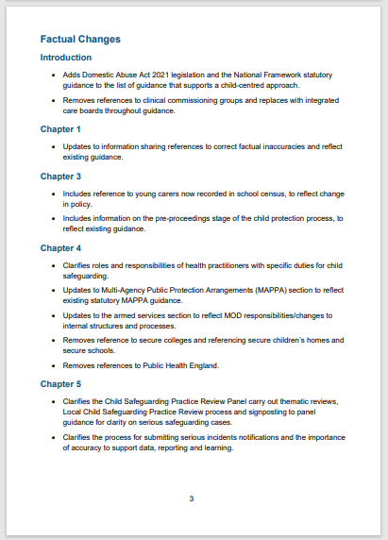
https://www.gov.uk/government/publications

Slide 33
Safeguarding contacts Sutton
childrensfirstcontactservice@sutton.gov.uk
Tel: 020 8770 6001
Emergency Duty Team (Out of Hours)
Tel: 020 8770 5000x9
Email: childrens.edt@sutton.gov.uk
suttonlscp@sutton.gov.uk
lado@Sutton.gov.uk
0208 770 4532

Slide 34
Safeguarding contacts Croydon
Single Point of Contact (SPOC)
Phone: 0208 255 2888
Monday to Friday, 9am to 5pm
Emergency Duty Team
Telephone: 0208 726 6000
Email: SSD-EMERGENCY-DUTY-TEAM@croydon.gov.uk
Monday to Friday, 5pm to 9am
Weekends and bank holidays, 24 hours
Contact the LADO
Telephone: 020 8255 2889
Email: LADO@croydon.gov.uk

Slide 35
Safeguarding contacts Merton
Children and Family Hub: 020 8545 4226/4227
CandFhub@merton.gov.uk
Emergency Duty Team
Out of hours: 020 8770 5000
LADO: John Shelley
Email: lado@merton.gov.uk
Tel: 020 8545 3187

Slide 36
Thank You for Listening
Please visit www.Cognus.org.uk where you will find more bitesize training packages.
Hayley Cameron: Education Safeguarding Manager
Stephen Welding: E safety Adviser/Prevent Trainer
Gill Bush: Education Lead, CFCS
Mick Bradshaw: Outdoor Education Adviser

