Slide 1
Safeguarding children and young people Child Sexual Exploitation Sextortion & Grooming
Hayley Cameron: Education Safeguarding Manager
Stephen Welding: Esafety Adviser/Prevent Trainer
Gill Bush: Education Lead, CFCS
Mick Bradshaw: Outdoor Education Adviser

Slide 2
What is SEXTORTION
Sextortion is a type of blackmail in which an individual manipulates or threatens to distribute explicit or intimate material (such as explicit sexual images or videos) of the victim unless certain demands are met.
Criminals often target individuals through online platforms, social media, or dating apps. They may establish trust and rapport, leading victims to share intimate content willingly or unknowingly through webcam sessions or private messages.
Sextortion can cause significant emotional distress, feelings of shame, fear, and anxiety. It's crucial to remember that victims are never at fault, and support is available to help cope with the aftermath.

Slide 3
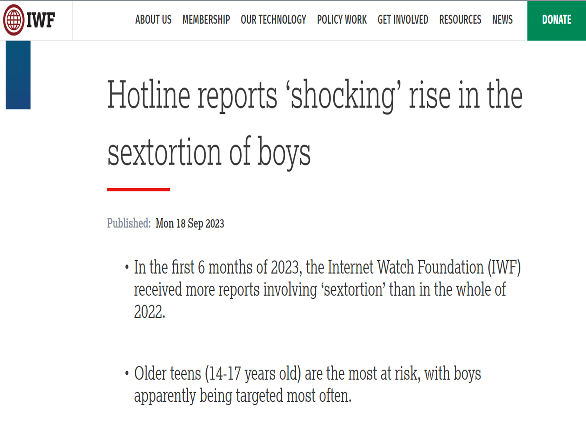
IWF Report 2023

Slide 4
Child Exploitation and online Protection Centre
According to the Child Exploitation and Online Protection Centre most child sexual exploitation offences take place online. These offences include deceiving children into producing indecent images of themselves, engaging in sexual chat online or sexual activity over a webcam.
Analysis by the centre reveals that 13- and 14-year-olds represent the largest single victim group.

Slide 5
Recognising sextortion warning signs
Be vigilant for potential red flags indicating sextortion attempts, such as receiving unsolicited explicit content, sudden or relentless requests for intimate images, or persistent demands for personal information.
Threatening language around the loss of viewers or followers on social media if demands are not met or images and videos are not sent
Sextortion can be committed by individuals, but organised crime gangs are usually behind it.

Slide 6
Recognising your child, or a child you know, may be a victim of sextortion
It's important to note that every child may react differently when being sexually extorted, and the signs may vary depending on their personality, age, and other factors. However, here are some potential changes in behaviour that could indicate a child is being sexually extorted
Emotional distress: The child may display signs of increased anxiety, fear, or mood swings. They may appear more withdrawn, depressed, or easily agitated.
Social withdrawal: The child might start avoiding social interactions or spending less time with friends and family. They may become isolated and reluctant to participate in activities they used to enjoy.
Change in online behaviour: If a child is being sexually extorted, they may exhibit specific alterations in their online activities, such as spending excessive amounts of time online, becoming secretive about their online interactions, or suddenly avoiding or deleting social media accounts.
Unusual behaviour with money, gift vouchers, online currencies etc.: The child is spending more money than usual or has less money than you would expect. They may steal money from you or other family members.
Cont….

Slide 7
Recognising your child, or a child you know, may be a victim of sextortion
Unusual secrecy: The child may become unusually secretive about their personal life, activities, or online interactions. They might express reluctance or defensiveness when questioned about their online behaviour or communication.
Sudden drop in academic performance: Sextortion can have a significant impact on a child's emotional wellbeing, which may lead to a decline in their academic performance. They may struggle with concentration, lose interest in schoolwork, or show signs of distress during school hours.
Change in attitude to school: They may see school as their safe place and enjoy the break from devices if the perpetrator/extortionist is outside the school community.
Sleep disturbances: Sextortion can cause significant stress and anxiety, leading to changes in sleep patterns. The child may experience difficulties falling asleep, frequent nightmares, or increased night-time awakenings.
Avoidance of electronic devices: If a child is being sexually extorted, they might display an unusual aversion to using electronic devices or express discomfort when receiving messages or calls. They may try to limit their online presence or avoid using specific apps or platforms altogether.
Self-harm or suicidal ideation: The child might exhibit signs of self-harm, suicidal thoughts or express feelings of hopelessness. These signs should be taken extremely seriously, and immediate professional help should be sought

Slide 8
What to do if you are a victim of sextortion
This is not your fault and there is nothing to be ashamed or embarrassed about. It may make you feel upset and helpless, but support is available from trusted, non-judgemental and understanding people and organisations (See Help and support).
Stay calm and reach out for help: Ask for assistance from a trusted adult or support helpline immediately.
Preserve evidence if possible: Save messages and record any communication related to the incident. This evidence can be valuable for legal purposes and reporting the crime.
Stop all communication: Discontinue any interaction with the perpetrator and block them on all platforms to prevent further manipulation or harassment.
Report the incident: Contact your local police and provide them with the evidence and details of the sextortion incident. They can guide you on the necessary steps to take.
Cont ….

Slide 9
What to do if you are a victim of sextortion
Inform parents or a trusted adult: Share the situation with a responsible adult who can provide support, help in reporting the crime, and assist in navigating the emotional challenges that may arise.
Seek professional help: Reach out to counsellors, therapists, or support organisations specialising in cybercrime or victim support. They can offer guidance and help you cope with the emotional impact of being sexually extorted.
Alert relevant platforms: Report the offender and the incident to the platform or website where the initial contact or harassment occurred. They can take necessary action to prevent others from becoming victims.
Be cautious of re-victimisation: Offenders can be persistent. Despite all attempts to avoid, block and secure your personal information and online presence, they may still manage to contact you. They can be very determined. Again, this is not your fault. Try to ignore and continue to report.

Slide 10
Why a young person might share nudes
Not all children who share nudes do so because they feel coerced.
In some cases, they might want to. However, this is often because they believe they might get something in return. This could include getting a modelling job, money, gift cards, a new mobile phone or other ‘gifts’.
Additionally, sextortion can actually come from someone your child is in a relationship with. They might share an image with the recipient who then pressures them for more. Research shows that this can happen to anyone from any background and at any age. The FBI, for instance, have interviewed victims as young as 8.
At the time of writing there is a significant spike in sextortion cases globally. This this includes the UK with many of the scams targeting teenage boys.

Slide 11
How to help children and young people
Parents and carers need to recognise just how embarrassing and shaming sextortion can feel for young people.
As such, they will often struggle to admit they have shared nude images with someone who took advantage of them. Again, those behind the scams know this. As such, if your child has told you that this has happened then that is a massive first step.
If a child or young person tells you about an incident of coercion, remember they are a victim of a crime. Often, victims don’t report sextortion crimes. Additionally, extreme cases have led to children and young people taking their own lives. So, reassure them that you are there to help.

Slide 12
Reporting to Police
Report what has happened. You can do this by contacting your local police on 101 or making a report to the National Crime Agency’s CEOP Safety Centre, where a Child Protection Advisor will make sure you get the help you need. Find out more about how CEOP can help you here. Always call 999 if you are in immediate danger.
If you’re not ready to make a report to the police or feel worried about what might happen, you can speak to understanding and non-judgemental people at Childline. You don’t need to give your name or details.
If you have copies of the images, videos, or links to the website where images or videos may be shown, you can use an online tool called Report Remove. Report Remove is here to help young people, under 18, in the UK to confidentially report sexual images and videos of themselves and the IWF will then try to have them removed from the internet. Once you’ve used Report Remove, you will also be able to talk to a trained Childline counsellor, who will have provided support to other children and young people in the same situation. Check out the Report Remove.

Slide 13
Reporting to Police
We advise stopping all contact with anyone who is trying to blackmail or threaten. Do not share any more images or videos or pay any money of any sort (Bitcoin, cash transfer etc). If you have been communicating on an app, there should be in-built tools to block and report the user. You can find helpful information on how to block and report people on apps and social media here.
Finally, remember - this is not your fault. The person trying to blackmail or sexually extort you is the one who is in the wrong. Lots of other young people have been in a similar situation. If you're feeling upset and need to talk to someone, you can get in touch with Childline.

Slide 14
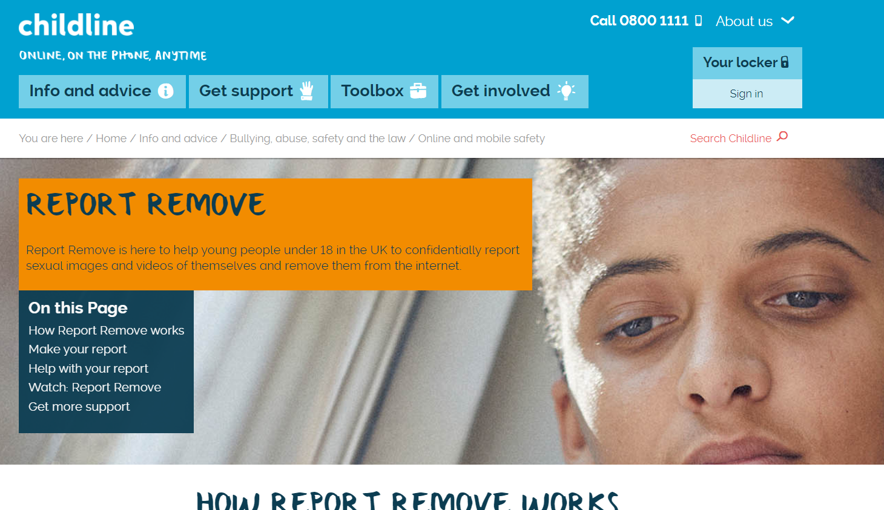

Slide 15
How do I remove a nude image of myself?
If you are under 18 and an explicit or nude image of you has been shared online, we can confidentially help you to get it removed.
Follow these 3 simple steps:
Download Yoti – The easiest, most secure way to prove identity. Take a selfie and then a photo of your ID, like a passport, to verify it’s you.
Report: Give details of the nude image and where it could be online (don’t worry if you don’t know all the details)
Remove: We’ll then review the details and the IWF will work to have it removed
The IWF (Internet Watch Foundation) use image hashing technology. This means each photo has its very own ID and using this ID it can identify the image, and have it removed, wherever it is uploaded to the internet.

Slide 16
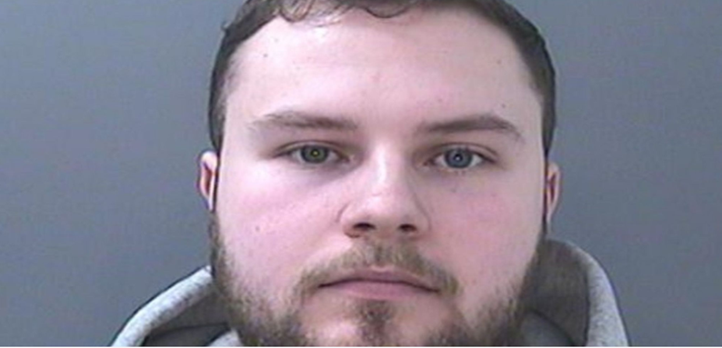
Tactics used by Offenders
Lewis Edwards, who admitted more than 100 sexual offences against children, has been handed a life sentence. He will serve a minimum of 12 years behind bars.
He used fake Snapchat accounts - posing as a 14-year-old boy - to groom more than 200 girls aged between 10 and 16 online.
Edwards asked scores of his victims for indecent images in school uniform and blackmailed many young girls - threatening to publish their photos or hurt their families to get them to cooperate.
He pleaded guilty to 22 counts of blackmail, 138 child sex offences and a further offence of refusing to disclose the password to a mobile phone and USB stick.

Slide 17
Tactics used by Offenders
Psychological manipulation
“Police examination of the devices revealed the defendant’s very significant offending against a large number of young girls. He had been in online contact with 210 girls ranging in age from 10-years-old to 16-years-old.
“The defendant had a pattern of behaviour. He made online contact with girls, sometimes pretending to be someone they knew, sometimes making contact through friends of friends. He pretended to be a boy of similar age and groomed his victims by psychologically manipulating them until he had gained control.
“He was friendly, complimentary, pretended to have an interest in the victims and their lives. He gained trust by building relationships with them while continuing he was a teenage boy.
"Often, he gained the victim’s sympathy by claiming that contact with her helped his well-being."

Slide 18
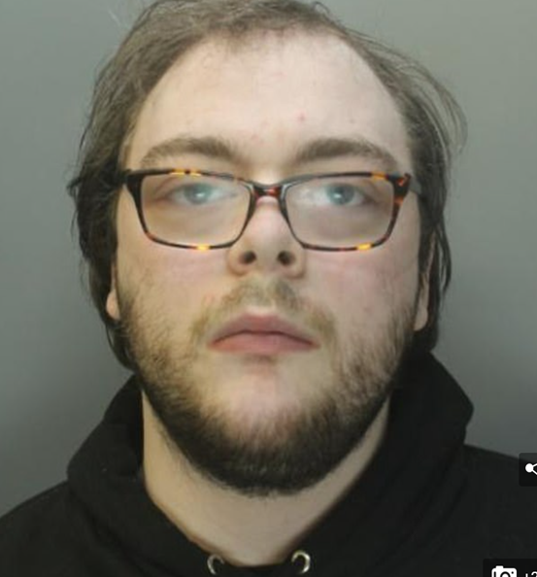
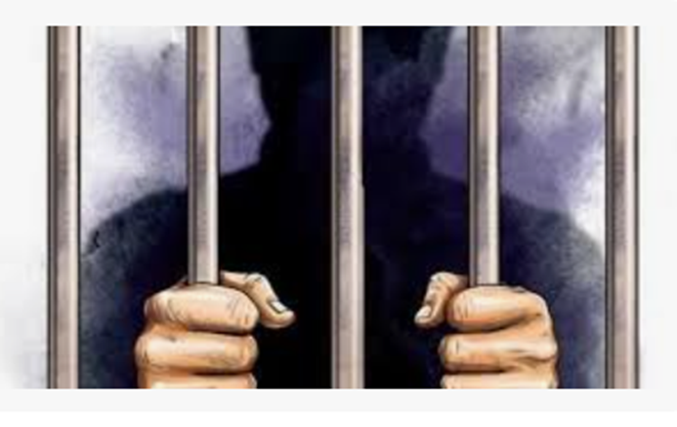
Tactics used by Offenders
Elliot Nicklin 22 years old. used online chat groups to blackmail over 70 teenage girls into sending explicit photos of themselves.
He used online personas in chat groups to lure his victims in.
He admitted 27 offences - between 2014 and the day he was arrested of May 21, 2020 - Jailed for 10 years.

Slide 19
FAKE
FAKE
FAKE

Slide 20
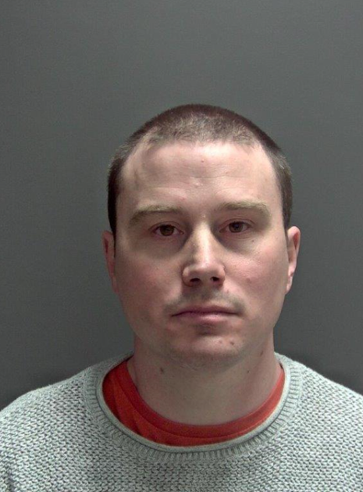
Tactics used by Offenders
Prolific male sex offender convicted after posing as a girl
A 36-year-old man from eastern England was convicted of 96 sex offences against 51 boys aged from four to 14. The National Crime Agency (NCA) say he is one of the most prolific child sexual abuse (CSA) offenders it has ever investigated. The offender created dozens of fake social media accounts pretending to be a 13 year old girl, encouraging boys to send videos and images of themselves by sending sexual images of young women.
The National Crime Agency said they had evidence up to 500 victims had sent images and that Wilson had approached more than 5,000 children worldwide.
Wilson was sentenced on January 12, 2021, to 25 years imprisonment.

Slide 21
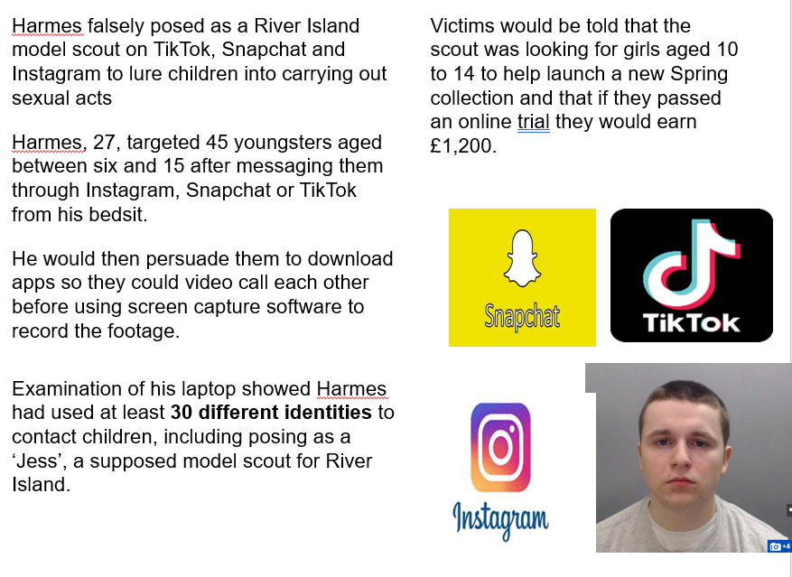
Tactics used by Offenders

Slide 22
Contents:
P2: Introduction
P3: What does it mean? P3: Consensual or non-consensual
P4: Sharing pictures
P5-7: All about trust
P7: Where your picture might be
P8: Will I get in trouble? P9: Who can help me?
P10: The future
P10: Organisations that can help
P11: Self-care tips
P12: About this resource
https://swgfl.org.uk

Slide 23
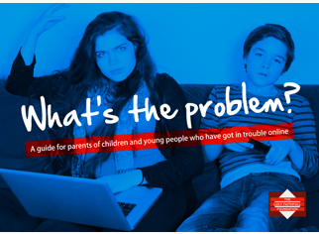
www.parentsprotect.co.uk
This is a guide for parents of children and young people who have got into trouble online.
It is designed to answer some of the immediate questions you may have after learning that something is happening, or has happened, in your child's online life

Slide 24
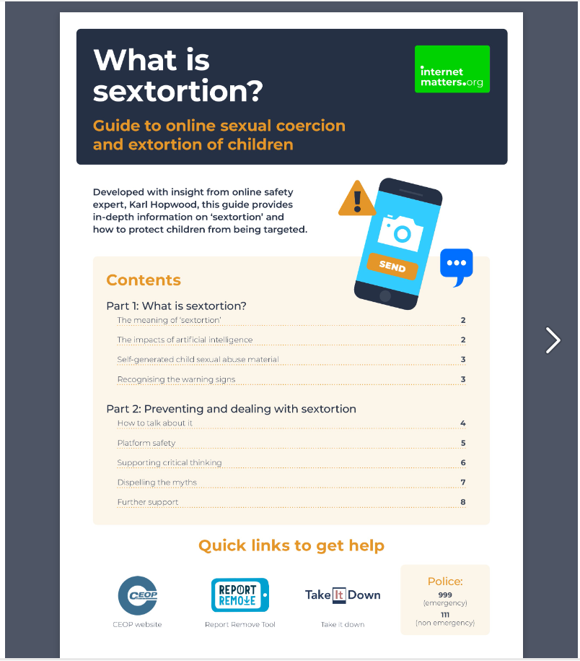
www.Internetmatters.org

Slide 25
Guidance for Schools – March 2023
This advice outlines how to respond to an incident of nudes and semi-nudes being shared, including:
risk assessing situations
safeguarding and supporting children and young people
handling devices and images recording incidents, including the role of other agencies
informing parents and carers

Slide 26
Searching Electronic Devices
Searching for devices
The Searching, Screening and Confiscation advice for schools highlights how the Education Act 2011 gives schools the power to search pupils for devices, search data on devices. This power applies to all schools and there is no need to have parental consent to search through a young person’s mobile phone.
If during a search a teacher finds material which concerns them and they reasonably suspect the material has been or could be used to cause harm or commit an offence, they can decide whether they should delete the material or retain it as evidence of a criminal offence or a breach of school discipline. They can also decide whether the material is of such seriousness that the police need to be involved.

Slide 27
Thinkyouknow CEOP

Slide 28
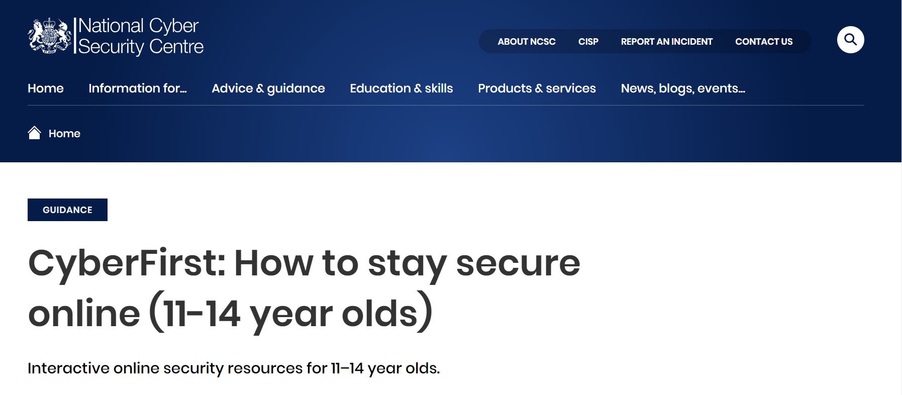

Slide 29
Crimestoppers – Encourage young people to speak about Crime

Slide 30
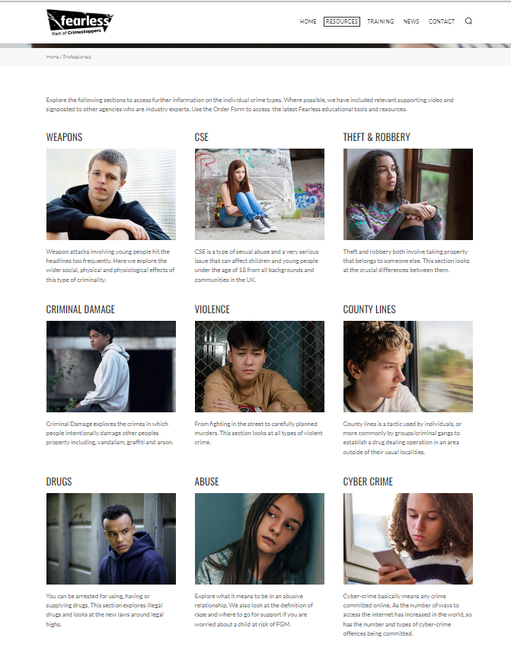

Slide 31
This Photo by Unknown Author is licensed under CC BY-SA

Slide 32
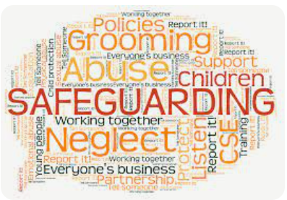
PASTORAL CARE TEAM

Slide 33
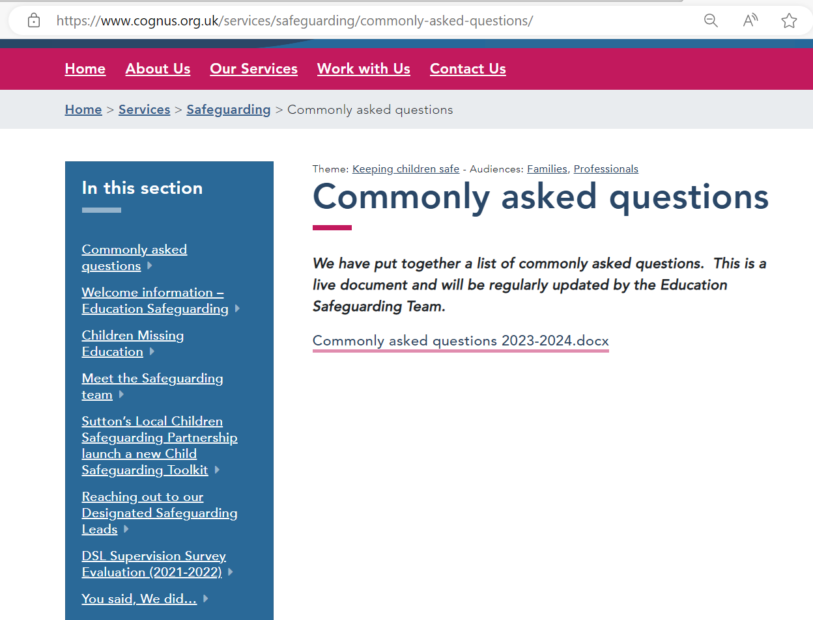
WWW.COGNUS.ORG.UK

Slide 34
Bitesize training on the Cognus Website

Slide 35
Safeguarding children and young people Thank you for Listening
Hayley Cameron: Education Safeguarding Manager
Stephen Welding: Esafety Adviser/Prevent Trainer
Gill Bush: Education Lead, CFCS
Mick Bradshaw: Outdoor Education Adviser

