Slide 1

Learning from Child Safeguarding Practice Reviews
-My Story-
Bitesize Training – June 2024
Hayley Cameron: Education Safeguarding Manager

Slide 2
www.childsafeguardingtoolkit.org.uk
Over the last 12 months, the Education Safeguarding Team have been working hard to promote The Child Safeguarding Toolkit. This recording has been shared in lots of different boroughs. We hope you find it useful.

Slide 3


Slide 4
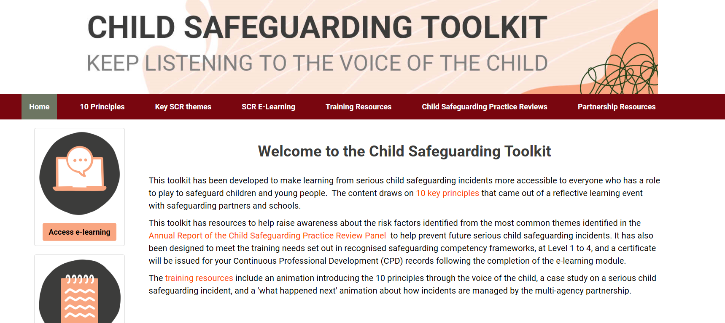
www.childsafeguardingtoolkit.org.uk

Slide 5
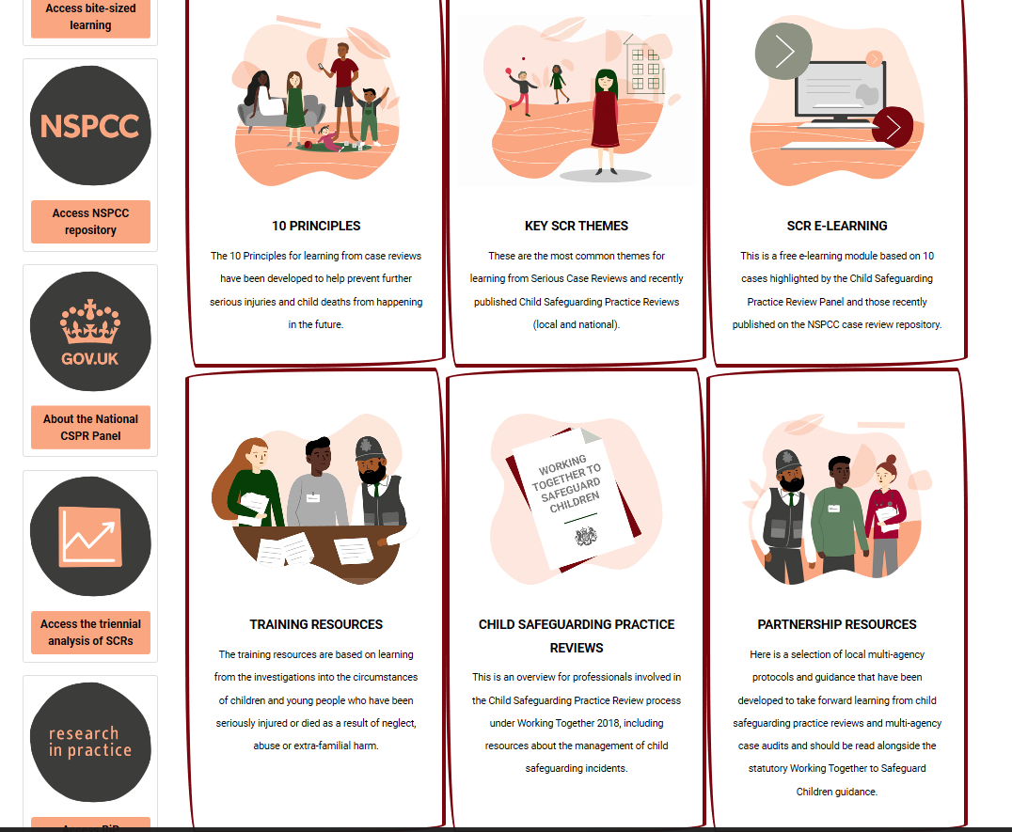

Slide 6
Thank You for Listening
For more information on our supervision offer or to discuss bespoke
needs for your school/setting, please contact:
hayley.cameron@cognus.org.uk

