Slide 1
Safeguarding children, young people All School Staff Safeguarding Training
Hayley Cameron: Education Safeguarding Manager
Stephen Welding: Esafety Adviser
Gill Bush: Education Lead, CFCS
Mick Bradshaw: Outdoor Education Adviser

Slide 2
Setting the scene - agenda
Key Guidance and Policies
What’s new in KCSIE 2024
Key safeguarding issues – in Sutton
Safeguarding refresher
Managing disclosures, how to report
Record keeping principles
Insight into the CFCS processes

Slide 3
SO WHY ARE WE HERE TODAY??
We can all make a difference to a child’s life.
We can all help a child to achieve.
We can all listen to what a child is telling us.
We can all be “there” for the child.
We can provide the best support for the child.
We all know “right from wrong”.
We must all report any worry or a concern.
WE ALL HAVE TO BE PROFESSIONALY CURIOUS
It’s Safeguarding

Slide 4
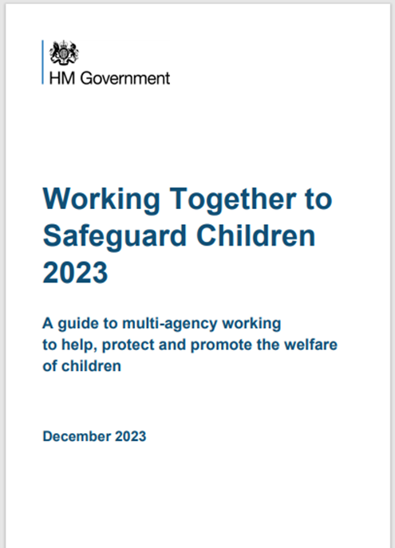
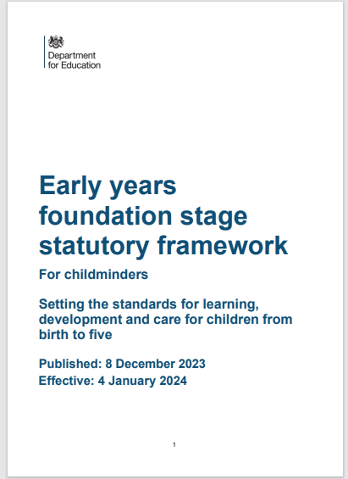
Legislation, Guidance and Procedure
Updated: 25th April 2024
Notes:
Read Keeping children safe in education (50 pages)

Slide 5
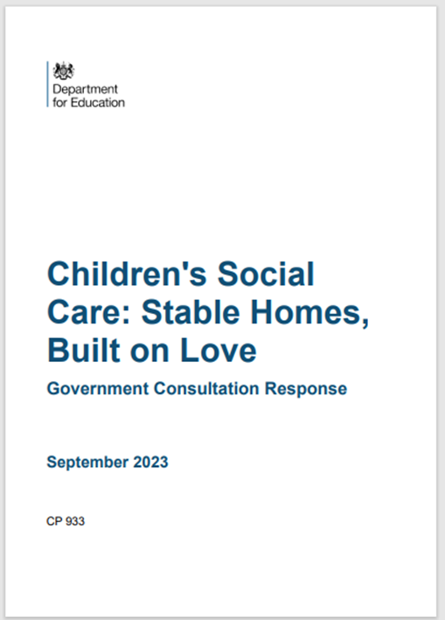
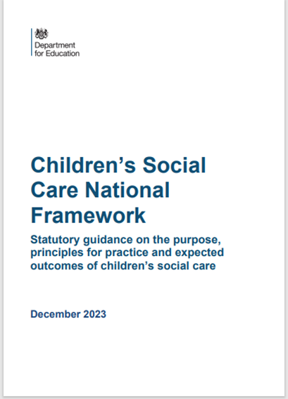
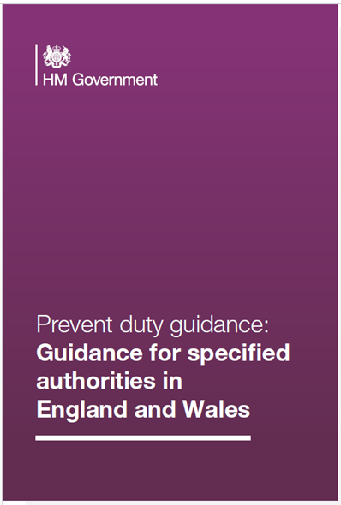
Key Guidance and Legislation

Slide 6
Sutton Local Safeguarding Children’s Partnership (LSCP)
The “Go To” place for Safeguarding Advice
www.suttonlscp.org.uk

Slide 7
Key education personnel
Safeguarding Governor
Head teacher, head of school, manager
Designated Safeguarding Lead (and Deputies)
LA Safeguarding Lead
CFCS Education Safeguarding Lead
Designated Teacher for Children Looked After (CLA)
Designated Teacher for pupils with SEND
Designated Officer(s)/ Local Authority (LADO)

Slide 8
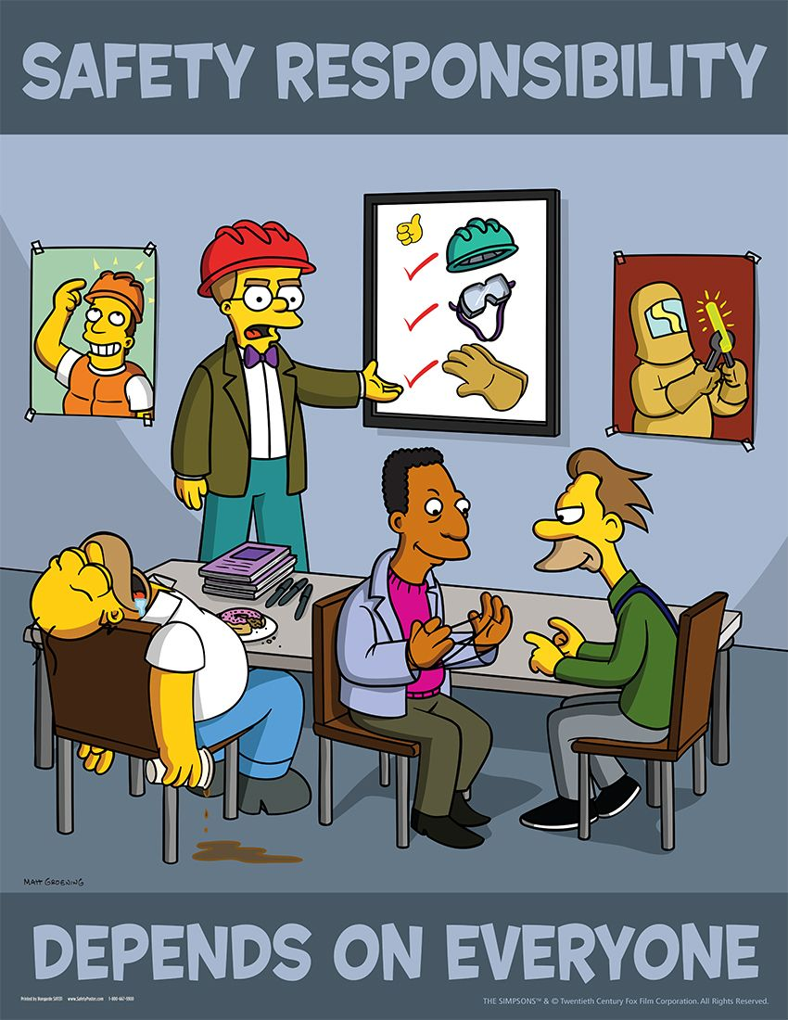
Wider safeguarding agenda
Safer recruitment
DBS
Regulated activity
Disqualification (Childcare Act)
Allegations against staff
Premises and the school
environment

Slide 9
Introduction to the School Safeguarding Documents
School Safeguarding Policy
School Child protection/safeguarding young people and vulnerable adults – Procedure
Staff Code of Conduct and Social Media policy
Keeping Children Safe in Education September 2024 DfE
All staff are expected to read and understand PART 1 of the KCSIE document
Annex B contains important additional information about specific forms of abuse, exploitation and safeguarding issues. School and college leaders and those staff who work directly with children should read Annex B.

Slide 10
KCSIE 2024 – What is in it?
Part one: Safeguarding information for all staff. What school and college staff should know and do
Part two: The management of safeguarding. Legislation and law. Part three: Safer recruitment, Recruitment and selection process.
Part four: Safeguarding concerns or allegations made about staff, including supply teachers, volunteers and contractors.
Part five: Child on child sexual violence and sexual harassment. What schools and colleges should be aware of.

Slide 11
KCSIE 2024 – What is in it?
Annex A: Safeguarding information for school and college staff
Annex B: Further information. Additional advice and support
Annex C: Role of the designated safeguarding lead
Annex D: Host families - homestay during exchange visits
Annex E: Statutory guidance - Regulated activity (children) - Supervision of activity with children which is regulated activity when unsupervised.
Annex F: Table of substantive changes from September 2023

Slide 12
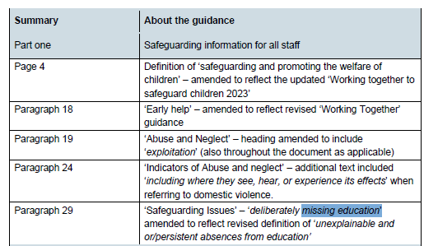
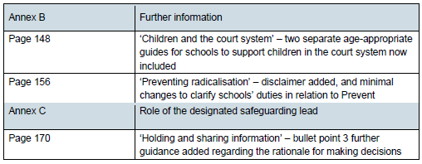
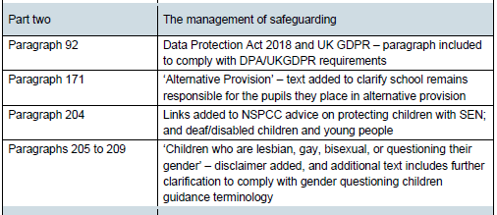
Annex F – Table of substantive changes from September 2023

Slide 13
KCSIE 2024 – Safeguarding Definition
providing help and support to meet the needs of children as soon as problems
Emerge.
protecting children from maltreatment, whether that is within or outside the home, including online.
preventing impairment of children’s mental and physical health or development
ensuring that children grow up in circumstances consistent with the provision of
safe and effective care.
promoting the upbringing of children with their birth parents, or otherwise their
family network through a kinship care arrangement, whenever possible and where
this is in the best interests of the children.
taking action to enable all children to have the best outcomes in line with the
outcomes set out in the Children’s Social Care National Framework

Slide 14
KCSIE 2024
Safeguarding and promoting the welfare of children is everyone’s responsibility. ‘Children’ includes everyone under the age of 18. Everyone who
comes into contact with children and their families has a role to play. In order to fulfil this responsibility effectively, all practitioners should make sure their approach is child centred. This means that they should consider, at all times, what is in the best
interests of the child.

Slide 15
KCSIE 2024
No single practitioner can have a full picture of a child’s needs and circumstances. If children and families are to receive the right help at the right time, everyone who comes into contact with them has a role to play in identifying concerns, sharing information and taking prompt action.

Slide 16
KCSIE 2024 – Children may not be ready to disclose
All staff should be aware that children may not feel ready or know how to tell someone that they are being abused, exploited, or neglected, and/or they may not recognise their experiences as harmful. For example, children may feel
embarrassed, humiliated, or are being threatened. This could be due to their vulnerability, disability and/or sexual orientation or language barriers. This should not prevent staff from having a professional curiosity and speaking to the designated safeguarding lead if they have concerns about a child. It is also
important that staff determine how best to build trusted relationships which facilitate communication with children and young people.

Slide 17
KCSIE 2024
All staff should be aware of the indicators of abuse, neglect and exploitation understanding that children can be at risk of harm inside and outside of the school/college, inside and outside of home, and online. Exercising professional curiosity and knowing what to look for is vital for the early identification of abuse and neglect so that staff are able to identify cases of children who may be in need of help or protection.
All school and college staff should be aware that abuse, neglect, exploitation, and safeguarding issues are rarely standalone events and cannot be covered by one definition or one label alone. In most cases, multiple issues will overlap.

Slide 18
KCSIE 2024
All staff should be aware that technology is a significant component in many safeguarding and wellbeing issues. Children are at risk of abuse and other risks online as well as face to face. In many cases abuse and other risks will take place concurrently
both online and offline.
Children can also abuse other children online, this can take the form of abusive, harassing, and misogynistic/misandrist messages, the non-consensual sharing of indecent images, especially around chat groups, and the sharing of abusive images and pornography to those who do not want to receive such content.

Slide 19
Children who are absent from education – KCSIE 2024
All staff should be aware that children being absent from school or college, particularly repeatedly and/or for prolonged periods, and children missing education can act as a vital warning sign of a range of safeguarding possibilities. This may include abuse and neglect such as sexual abuse or exploitation and can also be a sign of child criminal exploitation including involvement in county lines. It may indicate mental health problems, risk of substance abuse, risk of travelling to conflict zones, risk of female genital mutilation, so-called ‘honour’-based abuse or risk of forced marriage. Early intervention is essential to identify the existence of any underlying safeguarding risk and to help prevent the risks of a child going missing in the future. It is important that staff are aware of their school or college’s unauthorised absence procedures and children missing education procedures.

Slide 20
What all staff should know
What to do if a child says they are being abused or neglected
Manage confidentiality appropriately
Identify early help needs
How to follow school referral processes
Be aware of referral processes for social care.
That all concerns/discussions and decisions made and the reasons for those decisions are accurately recorded in writing
QUESTION: are you secure in your knowledge and understanding

Slide 21
What all staff should know – KCSIE 2024
All staff should be aware of systems within their school or college which
support safeguarding, and these should be explained to them as part of staff induction. This should include the:
child protection policy (which should amongst other things also include the
policy and procedures to deal with child-on-child abuse)
behaviour policy (which should include measures to prevent bullying,
including cyberbullying, prejudice-based and discriminatory bullying).
staff behaviour policy (sometimes called a code of conduct) should amongst
other things, include low-level concerns, allegations against staff and
whistleblowing
safeguarding response to children who are absent from education, particularly on repeat occasions and/or prolonged periods.
role of the designated safeguarding lead (including the identity of the designated safeguarding lead and any deputies).

Slide 22
KCSIE 2024 – Part 1
14. All staff should receive appropriate safeguarding and child protection training (including online safety which, amongst other things, includes an understanding of the
expectations, applicable roles and responsibilities in relation to filtering and monitoring at induction. The training should be regularly updated. In addition, all staff should receive safeguarding and child protection (including online safety) updates (for example, via email, e-bulletins, and staff meetings), as required, and at least annually, to continue to provide them with relevant skills and knowledge to safeguard children effectively

Slide 23
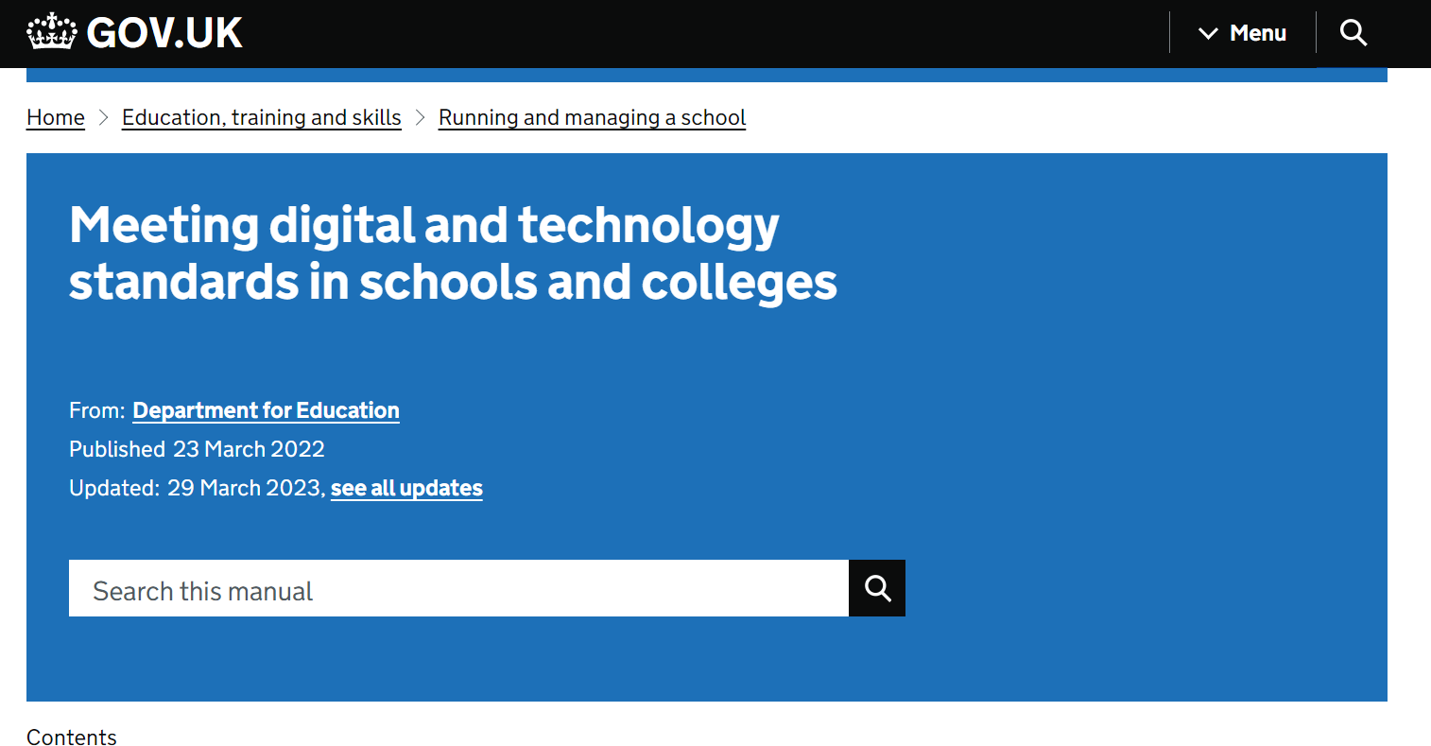

Slide 24
Filtering and Monitoring

Slide 25
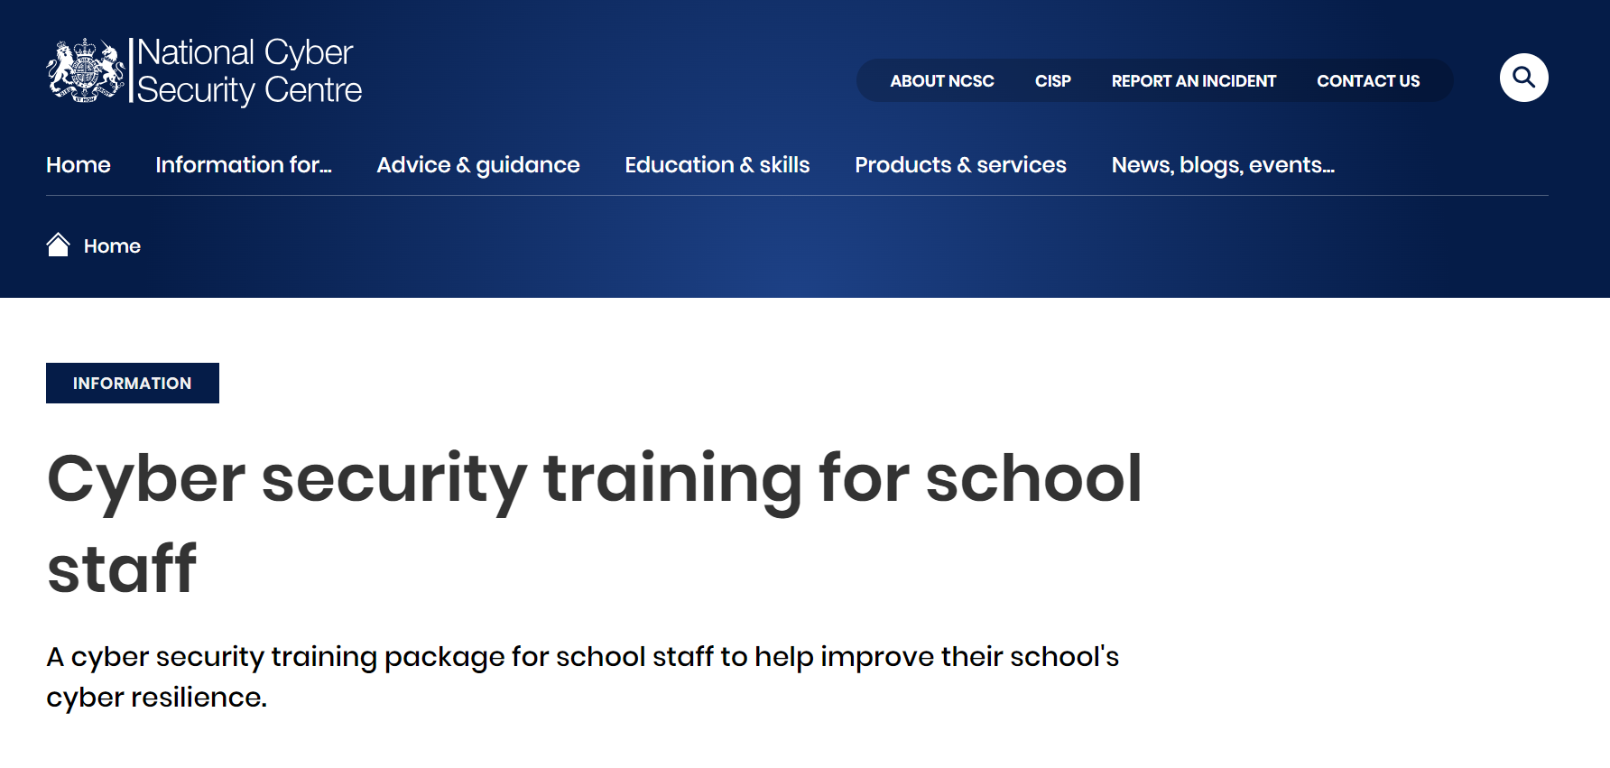
Cyber Security Training
a scripted presentation pack, or
a self-learn video. Provides Certificates once complete.

Slide 26
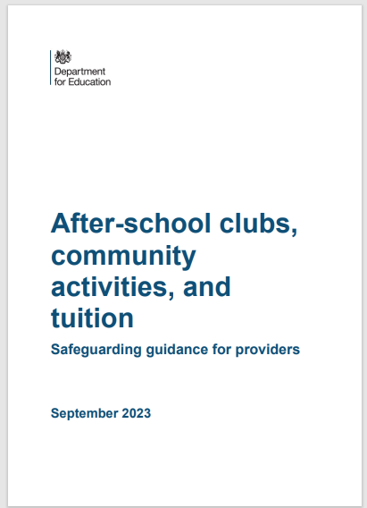
Out of school settings
This is non-statutory guidance for organisations or individuals who provide community activities, tuition or after-school clubs for children. These are also known as out-of-school settings (OOSS).
It covers best practices on:
• safeguarding and child protection
• the suitability of staff and volunteers
• health and safety
• governance

Slide 27
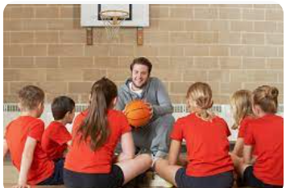
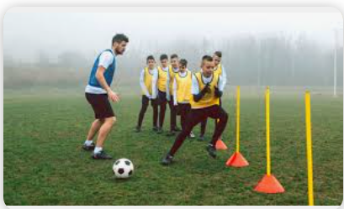
Allegations made against staff using your premises
If school receive allegations about staff using their premises to run activities for children, they should follow their own safeguarding policy, including contacting the LADO

Slide 28
Key safeguarding issues – Sutton
Child abuse
Self Harm
Mental Health issues
Domestic abuse that Impact on Children
Child Sexual Exploitation (CSE)
Child Criminal Exploitation (CCE)
Children Missing Education (CME)

Slide 29
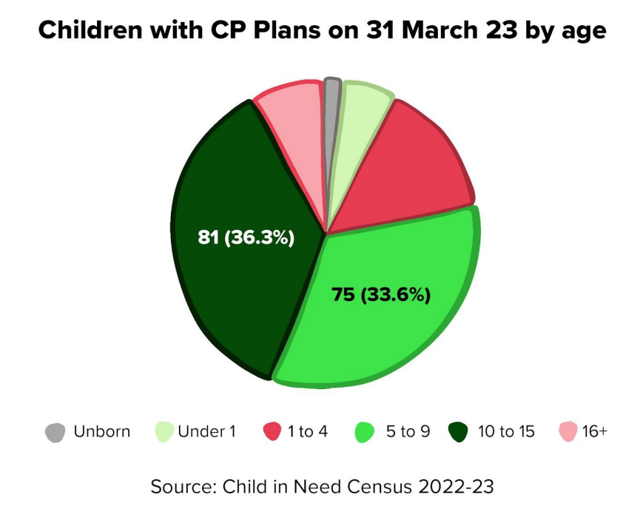

Slide 30
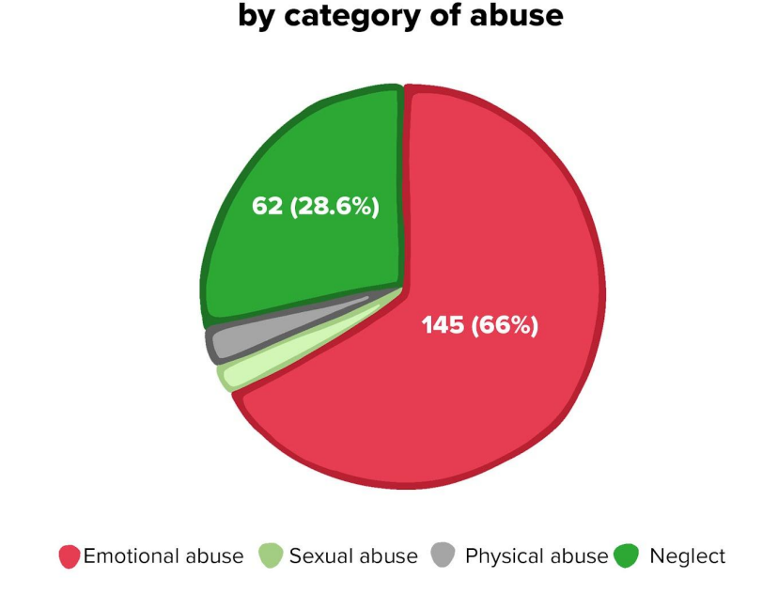
Children with CP Plans n 31 March 23
March

Slide 31
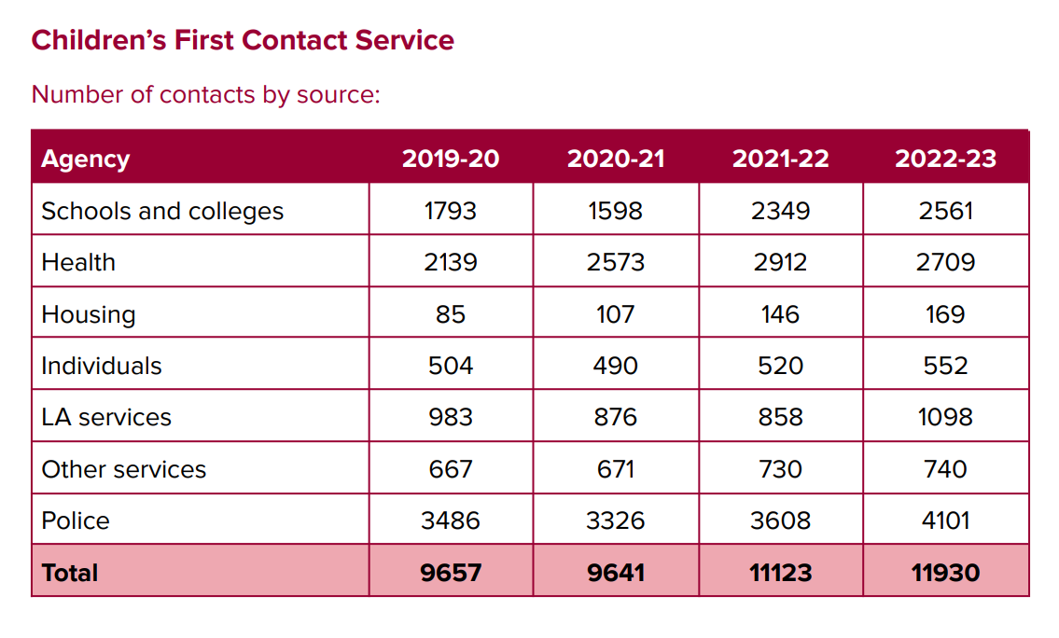

Slide 32
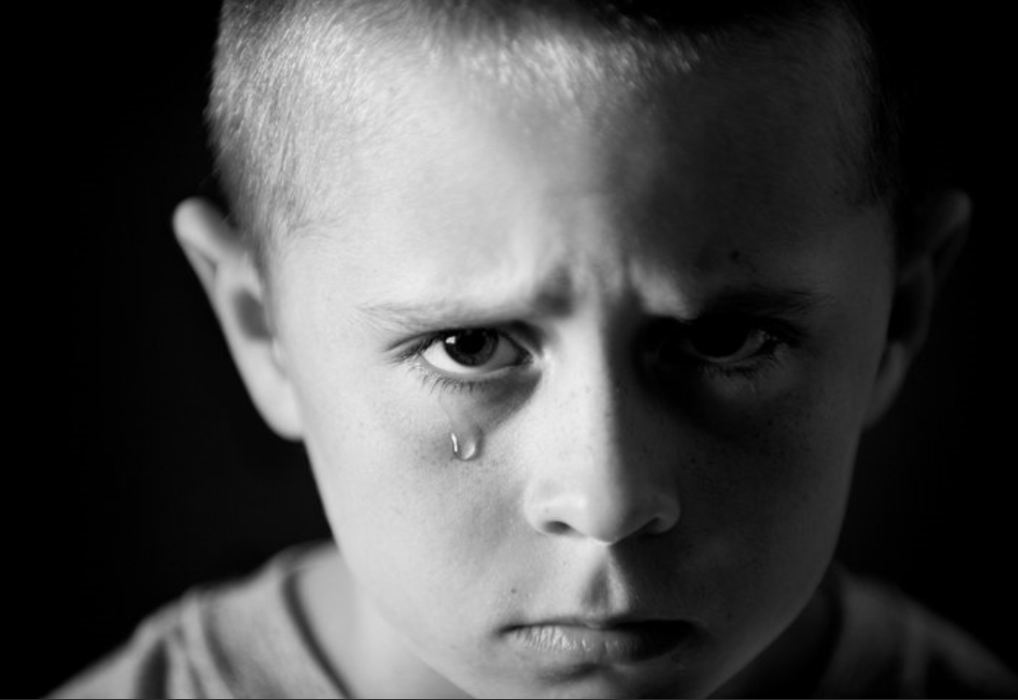
Neglect and Abuse
NEGLECT
EMOTIONAL ABUSE
PHYSICAL ABUSE
SEXUAL ABUSE

Slide 34
Key Safeguarding Issues in Education settings
Children and the Court System
Children Missing Education
Child Sexual Exploitation
Child on Child abuse
Upskirting
FGM
Self-harm
Mental Health
Homelessness
Domestic Abuse
Honour based abuse
Radicalisation & extremism
Cyber bullying and social media
Children with family members in prison
Child Criminal Exploitation – County lines

Slide 35
Child Abuse
Child abuse is the range of ways in which people significantly harm children or young people
Inflicting harm or failing to prevent harm
Children or young people may be sexually abused in a family or in an institutional or community setting, by those known to them or, more rarely, by a stranger
They may be abused by an adult or adults, or by another child or children
Neglectful behaviours may include: missing medical appointments, lack of food/appropriate clothing, prioritising adult need rather than children’s, poor attendance at school.

Slide 36
What is Physical Abuse?
Physical abuse is defined as hitting, shaking, throwing, poisoning, burning, scalding, drowning, suffocating or otherwise causing physical harm to a child.
Physical harm may also be caused when a parent or carer feigns the symptoms of, or deliberately causes, ill-heath to a child whom they are looking after.
Police - An assault is where a person intentionally or recklessly uses unlawful force against someone else.

Slide 37
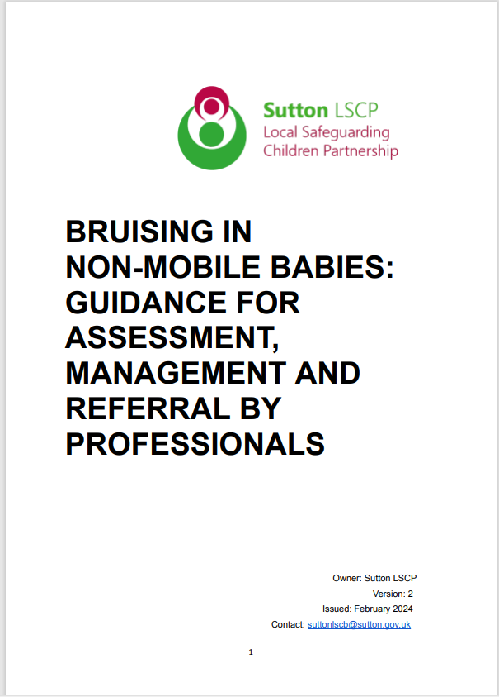
Common Sites for Non-Accidental Injury
The most common sites for non-accidental injury are:
Eyes. Ears
Cheeks. Mouth.
Shoulders. Chest.
Upper and inner arms.
Stomach/abdomen
Genitals.
Front and back of thighs.
Buttocks. Hands. Feet.

Slide 38
How many children experience physical abuse?
Concerns around physical abuse have been identified for around 1 in 10 children who are the subject of a child protection plan or on a child protection register in the UK.
There were over 200,000 offences related to child physical abuse recorded by police in England, Wales and Northern Ireland in 2022/2023.
Physical abuse is the second most commonly mentioned form of abuse in both contacts to the NSPCC Helpline and Childline counselling sessions.
NSPCC April 2024

Slide 39
How many children experience emotional abuse?
Most child abuse includes an element of emotional abuse, but it is recorded as a specific concern for over 1 in 3 children who are the subject of a child protection plan or on a child protection register in the UK.
There were over 7,000 contacts to the NSPCC’s Helpline and over 2,700 Childline counselling sessions in 2022/23 about emotional abuse.
There were over 61,000 police-recorded offences related to emotional abuse in England, Wales and Northern Ireland in 2022/23.
NSPCC April 2024

Slide 40
How common is child sexual abuse?
1 in 20 children in the UK
1 in 3 children did not tell anyone
Over 90% of sexually abused children were abused by someone they knew
450,000 abused in the UK last year
50,000 reported to police
Sources:
Radford, L. et al (2011) Child abuse and neglect in the UK today
Jütte, S. et al (2014) How safe are our children? 2014. London: NSPCC
Office of the English Children’s Commissioner 2015

Slide 41
How many Children Experience sexual abuse?
Concerns around sexual abuse have been identified for over 2,400 children in the UK who are the subject of a child protection plan or on a child protection register.
Over a third of all police-recorded sexual offences are against children.
Girls and older children are more likely to experience sexual abuse.
The vast majority of children who experience contact sexual abuse were abused by someone they knew.
NSPCC April 2024

Slide 42
Neglect -
Neglect - The persistent failure to meet a child’s basic physical and/or psychological needs, likely to result in the serious impairment of the child’s health or development. Neglect may occur during pregnancy as a result of maternal substance abuse. Once a child is born, neglect may involve a parent or carer failing to:
• provide adequate food, clothing, and shelter (including exclusion from home or abandonment)
• protect a child from physical and emotional harm or danger
• ensure adequate supervision (including the use of inadequate caregivers)
• ensure access to appropriate medical care or treatment
• provide suitable education
It may also include neglect of, or unresponsiveness to, a child’s basic emotional needs

Slide 43
How many children experience neglect?
Neglect is the most common form of abuse.
Concerns around neglect have been identified for around half of children who are the subject of a child protection plan or on a child protection register in the UK.
The number of police recorded child cruelty offences is increasing.
Neglect is the most commonly mentioned form of abuse by adults contacting the NSPCC helpline.
NSPCC April 2024

Slide 44
Child deaths due to abuse or neglect
In the last five years there was an average of 52 child deaths by assault or undetermined intent a year in the UK.
Children under the age of one are the most likely age group to be killed by another person, followed by 16- to 24-year-olds.
Child homicides are most commonly caused by the child’s parent or step-parent.
NSPCC April 2024

Slide 45
What to look out for:- Child Abuse, Neglect
Significant changes in children’s behaviour
Deterioration in children’s general well-being
Unexplained bruising, marks or signs of possible abuse or neglect
Children’s comments which give cause for concern
Any reason to suspect neglect or abuse outside the setting

Slide 46
T.E.D.
If a student makes a disclosure but it does not make sense to you, then you have to ask open questions in order to put some context into what the student is disclosing.
My mum hurt me last night

Slide 47
T.E.D.
T – Tell me what you mean by that
E – Explain what you mean by that
D – Describe what you mean by that

Slide 48
Examples of Additional Open Questions
Tell me what happened
Show me what happened
What do you mean
Describe to me.
When did this happen
Then what happened.
How do you feel.
How did you do that.
Why did you do that
Why did they do that
How can we find out
What made you think that
Why do you think that happened.

Slide 49
Chastisement – Sutton Children Social Care
The Education Safeguarding Manager has been working with the Police and Children Social care to get a definitive protocol on what Schools are expected to do should they become aware that a child has been hit/smacked by a parent, carer, guardian or any other adult family member.
If a member of school staff become aware that a child has been chastised in any way they should immediately inform the DSL/DDSL.
DSL/DDSL can unpick with the child using TED to get context in what the child is disclosing.
DSL/DDSL should contact CFCS and discuss concern with a Social Worker before contacted parents/carers.
DSL/DDSL act on the advise given to you by the Social Worker. Make a note of all conversations.

Slide 50
KCSIE 2024 – Child-on-Child Abuse
All staff should be aware that children can abuse other children at any age (often referred to as child-on-child abuse). And that it can happen both inside and outside of school or college and online. It is important that all staff recognise the indicators and signs of abuse and know how to identify it and respond to reports.
All staff should be clear as to the school or college’s policy and procedures with regards to child-on-child abuse.
50

Slide 51
KCSIE 2024 – Child-on-Child Abuse
Child-on-child abuse is most likely to include, but may
not be limited to:
bullying (including cyberbullying, prejudice-based and discriminatory bullying).
abuse in intimate personal relationships between children (sometimes known as ‘teenage relationship abuse’).
physical abuse which can include hitting, kicking, shaking, biting, hair pulling, or otherwise causing physical harm.
sexual violence, such as rape, assault by penetration and sexual assault.
sexual harassment, such as sexual comments, remarks, jokes and online sexual Harassment.

Slide 52
Child-on-child sexual violence and sexual harassment (Part 5 KCSIE 2024)
There needs to be a recognition that even if there are no reported cases of child-on-child abuse, such abuse may still be taking place and is simply not being reported
• There needs to be a statement which makes clear there should be a zero-tolerance approach to abuse, and it should never be passed off as “banter”, “just having a laugh”, “part of growing up” or “boys being boys” as this can lead to a culture of unacceptable behaviours and an unsafe environment for children
• There needs to be recognition that it is more likely that girls will be victims and boys' perpetrators, but that all child-on-child abuse is unacceptable and will be taken seriously,
All staff working with children are advised to maintain an attitude of ‘it could happen here’, and this is especially important when considering child-on-child abuse.

Slide 53
How to respond to the online sexual harassment of school/college staff
Nov 2023

Slide 54
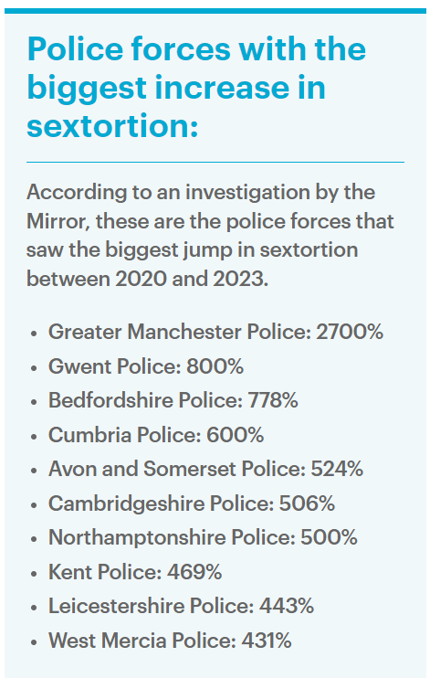
Sextortion
Tragic toll of nude photos sextortion scandal laid bare: How '100 children a day' are falling victim to scammers - after inquest heard 16-year-old private schoolboy killed himself over naked Snapchat pic blackmail

Slide 55
Sexual abuse imagery of primary school children 1,000 per cent worse since lockdown
The Internet Watch Foundation (IWF) has found that in the first six months of 2023 reports of confirmed child sexual abuse involving ‘sextortion’ surged by 257%* compared with the whole of 2022.
The IWF removed a record-breaking amount of criminal child sexual abuse imagery in 2023 (275,655 webpages). Almost every webpage the team worked to remove (92%) included what has been termed as ‘self-generated’ material, where children have been coerced into performing sexually via a webcam or handheld device. Of these, 42% (107,615) featured children under 10, a 66% increase on the number of webpages seen last year (64,735).
There has been a “shocking” increase in the reports of children tricked into sharing sexual images of themselves by abuser’s intent on extorting money or further imagery from their victims.

Slide 56
Indecent Images of Children (IIOC)
“Indecent” is not defined in legislation. It is a matter for the Jury or the Magistrate to decide whether an image of a child is “Indecent”.
For most purposes, if the imagery contains a naked young person, a topless girl, and/or displays genitals or sex acts, including masturbation, then it will be considered indecent. Indecent images may also include overtly sexual images of young people in their underwear.

Slide 57
An Immediate referral to police and/or Social Services should be made if at this initial stage:-
The incident involves an adult
A young person has been coerced, blackmailed or groomed, or if there are concerns about their capacity to consent (for example, owing to special educational needs)
The content depicts sexual acts which are unusual for the young person’s developmental stage or is violent.
The imagery involves sexual acts and any pupil in the imagery is under 13.
You have reason to believe a young person is at immediate risk of harm owing to the sharing of the imagery, for example, the young person is presenting as suicidal or self-harming.

Slide 58
Guidance for Schools – March 2023
This advice outlines how to respond to an incident of nudes and semi-nudes being shared, including:
risk assessing situations
safeguarding and supporting children and young people
handling devices and images recording incidents, including the role of other agencies
informing parents and carers

Slide 59
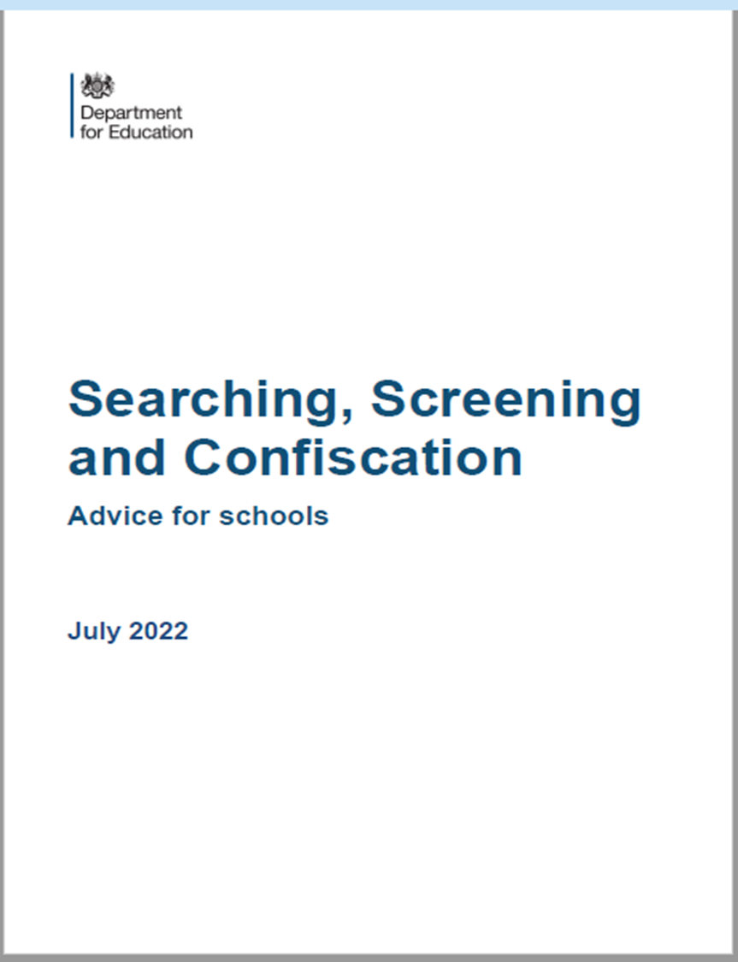
Searching Electronic Devices
Searching for devices
The Searching, Screening and Confiscation advice for schools highlights how the Education Act 2011 gives schools the power to search pupils for devices, search data on devices. This power applies to all schools and there is no need to have parental consent to search through a young person’s mobile phone.
If during a search a teacher finds material which concerns them and they reasonably suspect the material has been or could be used to cause harm or commit an offence, they can decide whether they should delete the material or retain it as evidence of a criminal offence or a breach of school discipline. They can also decide whether the material is of such seriousness that the police need to be involved.

Slide 60
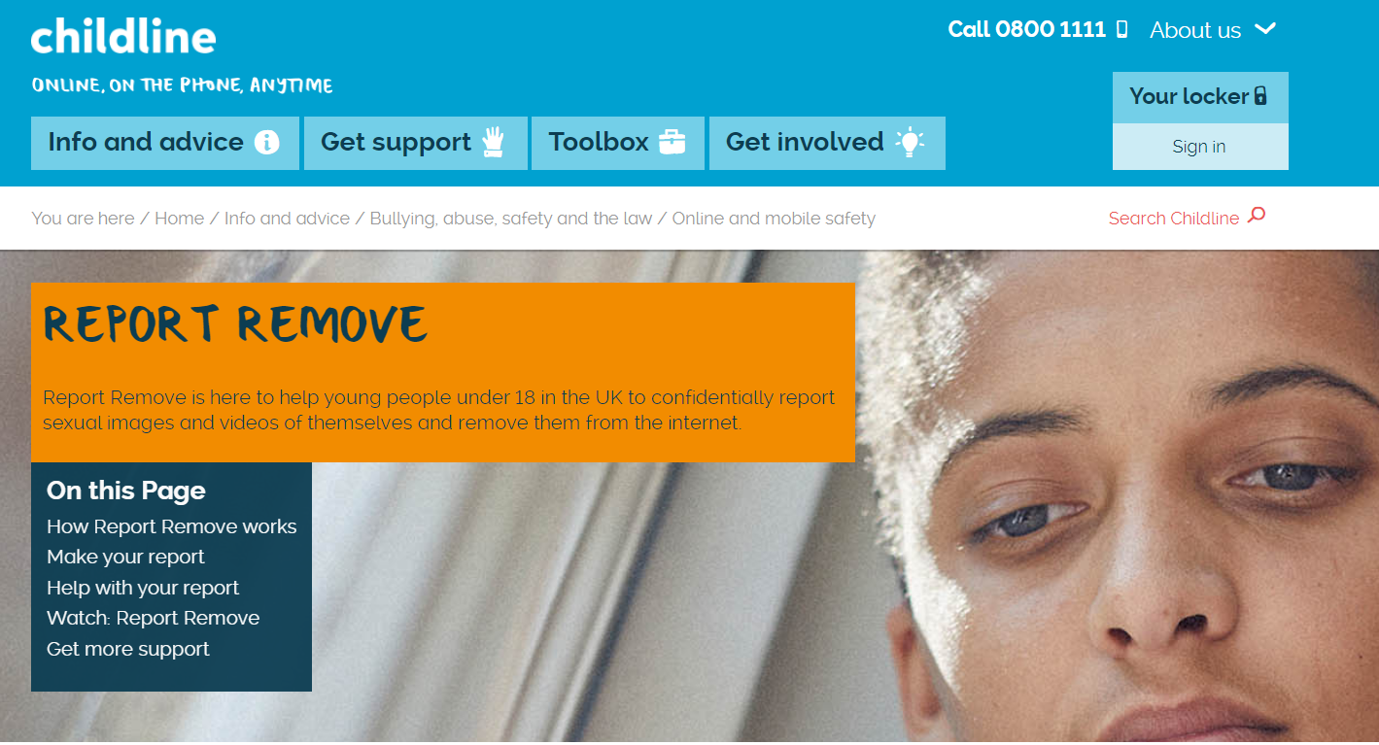

Slide 62
Communities at risk of FGM
FGM is practised in at least 28 African countries, in the Middle East and Asia.
In the UK, FGM tends to occur in areas with large populations of FGM practising communities. These include London, Cardiff, Manchester, Sheffield, Northampton, Birmingham, Oxford, Crawley, Reading, Slough and Milton Keynes.
However, FGM can happen anywhere in the UK (NHS Choices, 2013).
It is a criminal act in the UK and should be reported to the police if staff/volunteers become aware of the procedure taking place.
If a member of staff/volunteer becomes aware that it may be taking place then it is a referral to CFCS.
Notes:
How prevalent is FGM?
FGM is usually carried out on girls between infancy and age 15, with the majority of cases occurring between the ages of 5 and 8 years (HM Government, 2011). Because of the hidden nature of the crime, it is difficult to estimate FGM's prevalence, but a study based on 2001 census data in England and Wales estimated that 23,000 girls under the age of 15 could be at risk of FGM each year; and nearly 66,000 women are living with its consequences (Dorkenoo et al, 2007). FGM could be even more prevalent than these figures suggest due to population growth and immigration from practising countries since 2001 (HM Government, 2011).

Slide 63
FGM Guidance for Schools
nationalfgmcentre.org.uk

Slide 64
'Honour-based Abuse’ – KCSIE 2024
Along with FGM, Keeping Children Safe in Education (2024) mentions Breast Ironing and Forced marriage, under so-called 'Honour-based Abuse’.
Breast Ironing is practiced in some African countries, notably Cameroon. Girls aged between 9 and 15 have hot pestles, stones or other implements rubbed on their developing breast to stop them growing further.
Forcing a person into a marriage is a crime in England and Wales. A forced marriage is one entered into without the full and free consent of one or both parties and where violence, threats or any other form of coercion is used to cause a person to enter into a marriage.

Slide 65
'Honour-based Abuse’ – Action required
If staff have a concern regarding a child who might be at risk of HBA or who has suffered from HBA, they should speak to the designated safeguarding lead (or a deputy). As appropriate, the designated safeguarding lead (or a deputy) will activate local safeguarding procedures, using existing national and local protocols for multi-agency liaison with the police and local authority children’s social care.
Where FGM has taken place, since 31 October 2015 there has been a mandatory reporting duty placed on teachers that they must report to the Police.
KCSIE 2024

Slide 66
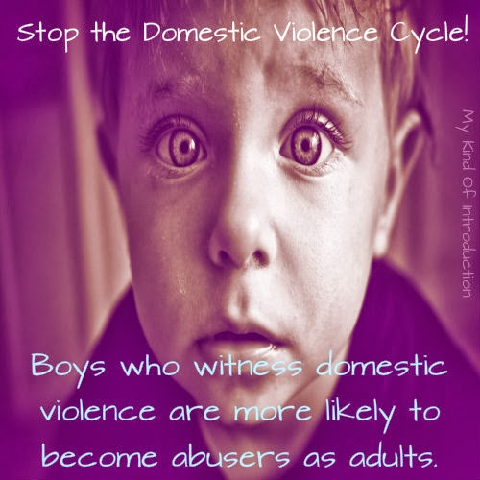
Domestic Abuse
This Photo by Unknown Author is licensed under CC BY

Slide 67
Fact: 20% of children in the UK have lived with an adult perpetrating domestic abuse. That’s 1 in 5 kids.
Fact: Young girls in the UK report high incidence of sexual violence.
41% of UK girls aged 14 to 17 in an intimate relationship experienced some form of sexual violence from their partner.
Fact: Domestic abuse gets worse during pregnancy.
About 20% of women in Refuge’s services are pregnant or have recently given birth.
Fact: It takes, on average, 7 attempts before a woman is able to leave for good.
Leaving an abusive partner is a process, not a single act.
refuge.org.uk

Slide 68
KCSIE 2024 - Domestic Abuse
Domestic abuse can encompass a wide range of behaviours and may be a single incident or a pattern of incidents. That abuse can be, but is not limited to, psychological, physical, sexual, financial or emotional. Children can be victims of domestic abuse. They may see, hear, or experience the effects of abuse at home and/or suffer domestic abuse in their own intimate relationships (teenage relationship abuse). All of which can have a detrimental and long-term impact on their health, well-being, development, and ability to learn.

Slide 69
Domestic Abuse in Sutton
We know that domestic abuse is a significantly underreported crime, with shame, stigma and
fear often preventing reporting. Based on the information available, Sutton is 12th of 32
London boroughs in terms of reports of domestic abuse per 1000 people . Reported figures suggest we have a higher rate of offences than Richmond, Merton and Wandsworth, but lower than Croydon. As a proportion of total violent crime, domestic abuse in Sutton stands at 35% which is higher than the London average (31%) . We also know that domestic abuse is a significant contributing factor in child protection issues - which have risen in the borough in recent years

Slide 70
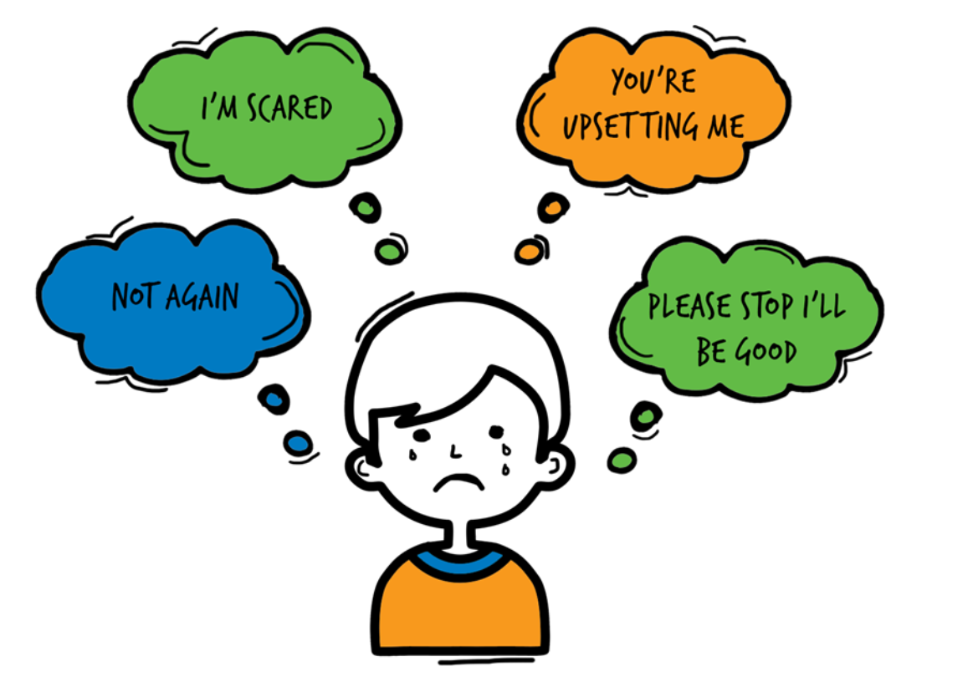
Domestic Abuse
Children living with domestic violence and abuse are over-represented among those children referred to Children Social Care, abuse and neglect represent about two thirds of cases seen at child protection conferences.
The risks of harm to children exposed to domestic violence and abuse have now been recognised. Children who live/experience DA feel:
75% of all CP cases in Sutton, Domestic Abuse is present

Slide 71
Operation Encompass - National Police Strategy
Operation Encompass operates in the majority of police forces across England. It helps police and schools work together to provide emotional and practical help to children. The system ensures that when police are called to an incident of domestic abuse, where there are children in the household who have experienced the domestic incident, the police will inform the key adult (usually the designated safeguarding lead) in school before the child or children arrive at school the following day. This ensures that the school has up to date relevant information about the child’s circumstances and can enable support to be given to the child according to their needs.

Slide 72
Not alone in Sutton -
Not Alone In Sutton
​: A website full of useful information about domestic abuse, including what to do if someone is affected by domestic abuse:
​www.notaloneinsutton.org.uk

Slide 75
Bromley & Croydon Women’s Aid
Bromley & Croydon Women’s Aid
For any enquiries, you can email info@bcwa.org.uk or call 0208 3139303.
They are open Monday to Friday, from 9.00am to 4.30pm. This applies to all types of information, including
Notes:
Remind staff that, today, you’re going to be focusing more on the lower end of this continuum
Click to bring up the examples on the slide
These ‘small’ behaviours contribute to the 'bigger', more violent issues, as you’ve already touched on
The things at the lower level of the pyramid can and do happen in schools across the country, and staff have probably seen them too
These behaviours normalise a culture where women are treated like objects or where we control and police their sexuality. This low-level harassment and sexism contribute to a culture where the behaviours at the top of the pyramid become accepted
By dealing with the issues at the lower levels of the pyramid, we can help stop escalation to the higher levels of the pyramid. That’s why it’s so important that our school challenges sexual harassment and violence at all levels of the continuum
Note the categorisation in this pyramid differs from the categorisation in Keeping Children Safe in Education in some places. The pyramid is being used here to illustrate the escalation of behaviours rather than as a reflection of statutory guidance
Emphasise that staff should assume sexual harassment is happening in your school, even if there are no specific reports of it – as Ofsted recommended in its review of sexual abuse in schools and colleges
Sources
Bold Voices, https://www.boldvoices.co.uk/
EqualiTeach, https://equaliteach.co.uk/
GOV.UK – Ofsted, Review of sexual abuse in schools and colleges. https://www.gov.uk/government/publications/review-of-sexual-abuse-in-schools-and-colleges/review-of-sexual-abuse-in-schools-and-colleges

Slide 76
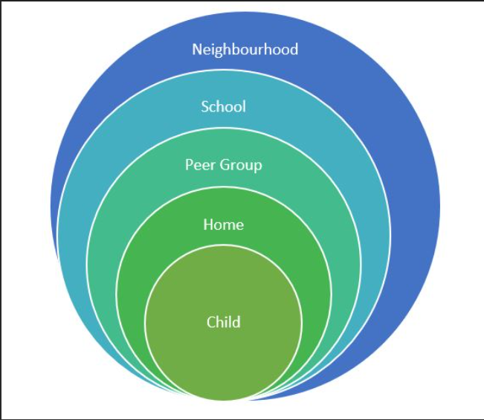
Assessment of risk outside the home
Be aware of risks in your local area –
Drugs, County Lines, gangs, Knife crime, DA, poverty, neglect, robberies, ASB, Exploitation, racism, extremism,
Hotspots (parks, vape shops, takeaways) etc

Slide 77
Responding to a Child who discloses – you should NEVER
Investigate or seek to prove or disprove possible abuse
Make promises about confidentiality or keeping ‘ secrets’
Assume that someone else will take the necessary action
Jump to conclusions, be dismissive or react with shock, anger, horror
Speculate or accuse anyone
Suggest or probe for information
Confront another person (adult or child) allegedly involved
Offer opinions about what is being said or the persons allegedly involved
Forget to record what you have been told
Fail to pass this information on to the correct person

Slide 78
Record Keeping- Principles
Records should be:
Accurate
Based on fact
Record what the child actually said
Jargon free
Abbreviation free
Inclusive of relevant information
Write in permanent ink (Not pencil)
Sign, Date, Time and print your full name
Your current position within the Company
Don’t cross out mistakes, put a line through and correct it.

Slide 79
KCSIE 2024 - Examples of Poor Practice
• failing to act on and refer the early signs of abuse and neglect
• poor record keeping
• failing to listen to the views of the child
• failing to re-assess concerns when situations do not improve
• not sharing information with the right people within and between agencies
• sharing information too slowly, and
• a lack of challenge to those who appear not to be taking action.

Slide 80
Whistle blowing
If you become aware of another adult in school acting inappropriately towards a child then it is your duty to inform the Head Teacher.
If any staff member feels unable to raise an issue with their Head Teacher, or feels that their genuine concerns are not being addressed, other whistleblowing channels are open to them.
General guidance on whistleblowing can be found at:
The ‘NSPCC what you can do to report abuse dedicated helpline’ is available as an alternative route for staff who do not feel able to raise concerns regarding child protection failures internally or have concerns about the way a concern is being handled by their school or college.
Staff can call 0800 028 0285 line is available from 8.00am – 8.00pm Monday – Friday and email help@nspcc.org.uk

Slide 81
An ongoing culture of vigilance
Features of a safer culture:
Open, no secrets
Belief that ‘it could happen here’
Clear procedures for reporting concerns
Support in raising concerns and commitment to take action
Setting acceptable standards of behaviour
Policies and procedures put into practice and monitored
Induction and probationary periods.
Commitment to safeguarding and an ongoing culture of
vigilance

Slide 82
Information Sharing
55. DPA and UK GDPR do not prevent the sharing of information for the purposes of keeping children safe and promoting their welfare. If in any doubt about sharing information, staff should speak to the designated safeguarding lead (or a deputy). Fears about sharing information must not be allowed to stand in the way of the need to safeguard and promote the welfare of children.
KCSIE 2024

Slide 83
The Children’s First Contact Service Referral Form
Google Form, accessible via a link
Children's First Contact Service Referral Form
Telephone number 020 8770 6001/ 6072
cfcs@sutton.gov.uk
Link can also be found on the Sutton LSCP Website
www.suttonlscp.org.uk

Slide 84
Referring a concern to CFCS
The Children’s First Contact Service (CFCS) is the single referral and assessment pathway to access services in the London Borough of Sutton and the referral form can be found on https://www.sutton.gov.uk/cfcs
CFCS is the referral route for the following services:
Statutory Children’s Services;
Targeted Early Help;
Early Help Assessment Tool (EHAT) submission and feedback;
Children with Disabilities (Access Point); and
Parenting Plus.

Slide 85
CFCS SYSTEM
Referrers:
Cases not open to Children’s Social Care and there are identified support needs and/or safeguarding concerns
Contacts/Referrals from:
Statutory/PVI and the public
All contacts from statutory services, Private Voluntary and Independent and the public apart from level 4, require a Early Help Assessment EHAT and consent (Merlins received will not require consent)
*Public does not need to complete a Early Help Assessment
Tier 1 No Additional Needs
No further action/No assessment required
Advice & Information
Telephone:
020 8770 6001 (main number)
Email:
Childrensfirstcontactservice@sutton.gov.uk
Tier 2 Early Help
Assessment: CAF/Early Help Assessment
Consent required
Tier 3 Children with Complex Multiple Needs
Assessment: (Social Work Single Assessment)
Consent required
Tier 4 Children in Acute Need
Assessment: Strategy Meeting/S47
Consent not required
For a list of indicators, please follow the link to:
http://www.londoncp.co.uk/ where the indicators are outlined in the threshold section.

Slide 86
Purpose of children’s social care
Children’s social care exists to support children, young people and families, to protect them by intervening decisively when they are at risk of harm and to provide care for those who need it so that they grow up and thrive with safety, stability and love.

Slide 87
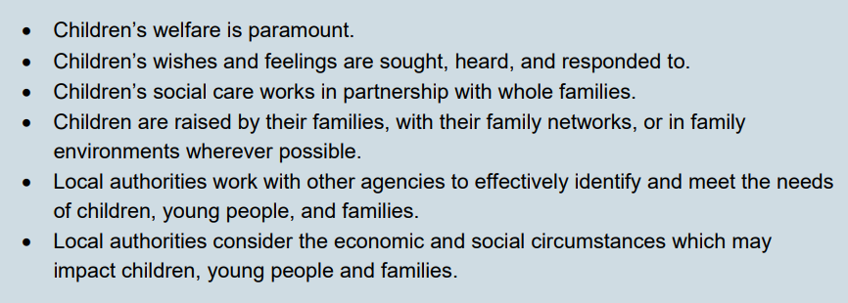
Principles of children’s social care

Slide 88
Children’s Social Care National Framework
Children’s social care has the power to transform lives; wrapping support around children, young people and families can bring about profound and positive changes that help them to flourish.
Every day, local authority children’s social care supports around 400,000 children, and in the last 8 years, on average, around 5 children in every classroom in England were supported by a social worker. These children, young people and families deserve the
highest standards of practice, from compassionate and skilled practitioners, who can support them to address the challenges they face.

Slide 89
Children’s Social Care National Framework
Local authorities provide this support in partnership with other agencies, including the police, health, and education. Local authorities cannot meet the needs of all children, young people and families alone, they need to collaborate with others to draw on the knowledge, skills and expertise of other agencies. For this reason, whilst this guidance is about local authority children’s social care, the responsibilities of all agencies to contribute to effective multi-agency working is reflected as the first enabler to good outcomes.

Slide 90
Worried about a child in your school?
If you are WORRIED about a child in your school and you feel that Children Social Care should do something about it THEN YOU need pass on that WORRY to them.
You need to contextualise that WORRY into words and put it onto the CFCS referral form so when they read it THEY ARE NOW WORRIED about the child and will need to do something about it.
IT IS ALL ABOUT THE INFORMATION ON THE FORM

Slide 91
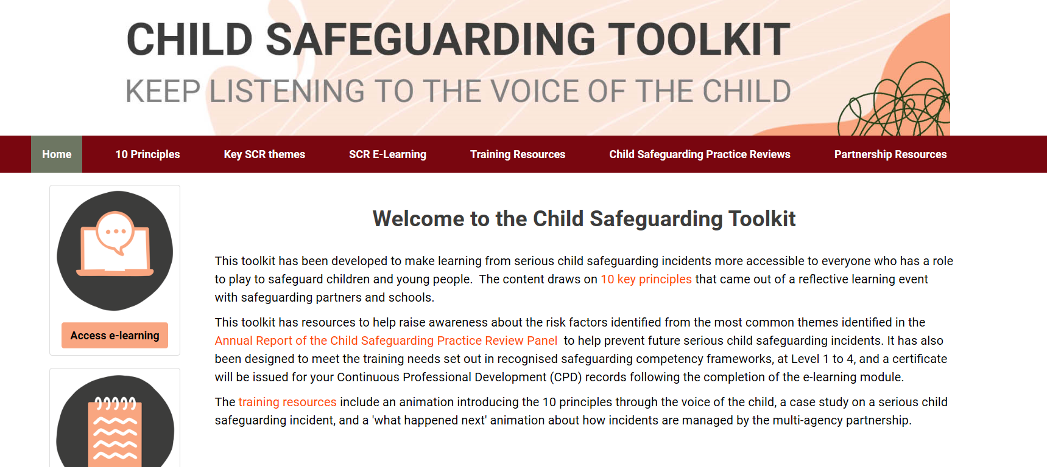
www.childsafeguardingtoolkit.org.uk

Slide 92
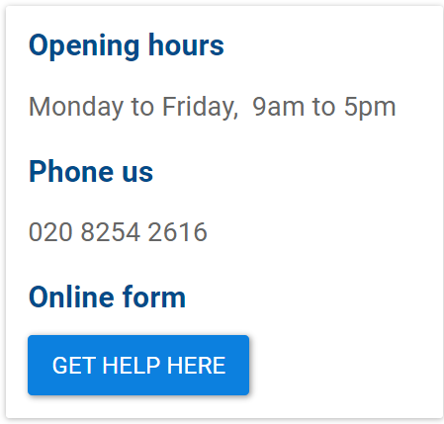
Together for Sutton

Slide 93
At a glance reminders (All Safeguarding concerns)
Always remember the child and look beyond their behaviour and consider why they are behaving like this.
Always listen to what the child is telling you.
Make a record of what the child has said (as soon as possible)
Don’t dismiss what a child tells you.
Be professionally curious if the situation doesn’t look or feel right to you then it probably isn’t right.
If in doubt always seek advice and support.
Share information with the School/Organisation Designated Safeguarding Lead.
Always share with your manager if you have a concern regarding a colleague’s behaviour towards a child.

Slide 94
Key messages for all staff
REMEMBER ‘it could happen here’
Always act in the best interest of the child

Slide 95
Don’t hold onto the RISK

Slide 96
Sutton - Local Authority Safeguarding
CFCS – 0208 770 6001
Out of Hours 0208 770 5000
cfcs@sutton.gov.uk
hayley.cameron@cognus.org.uk
stephen.welding@cognus.org.uk
gillian.bush@cognus.org.uk
mick.bradshaw@cognus.org.uk
Nick.Banham@cognus.org.uk – Early Years Adviser

Slide 97
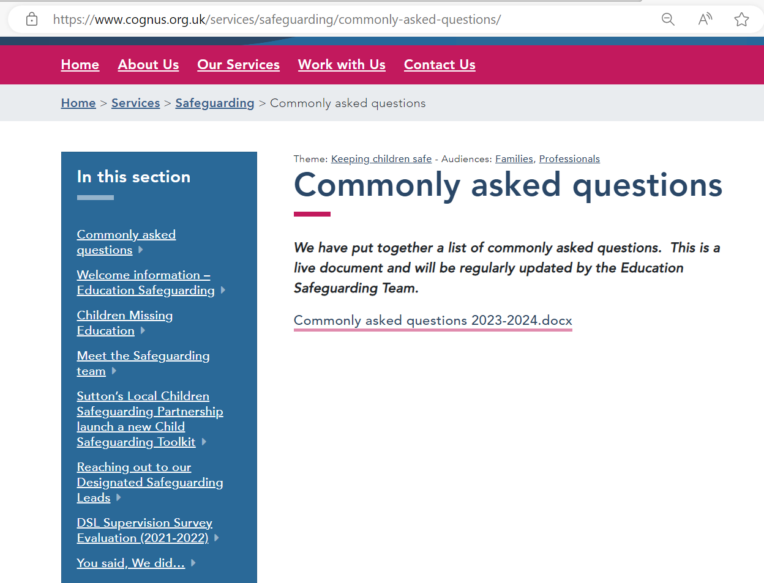
WWW.COGNUS.ORG.UK

Slide 98
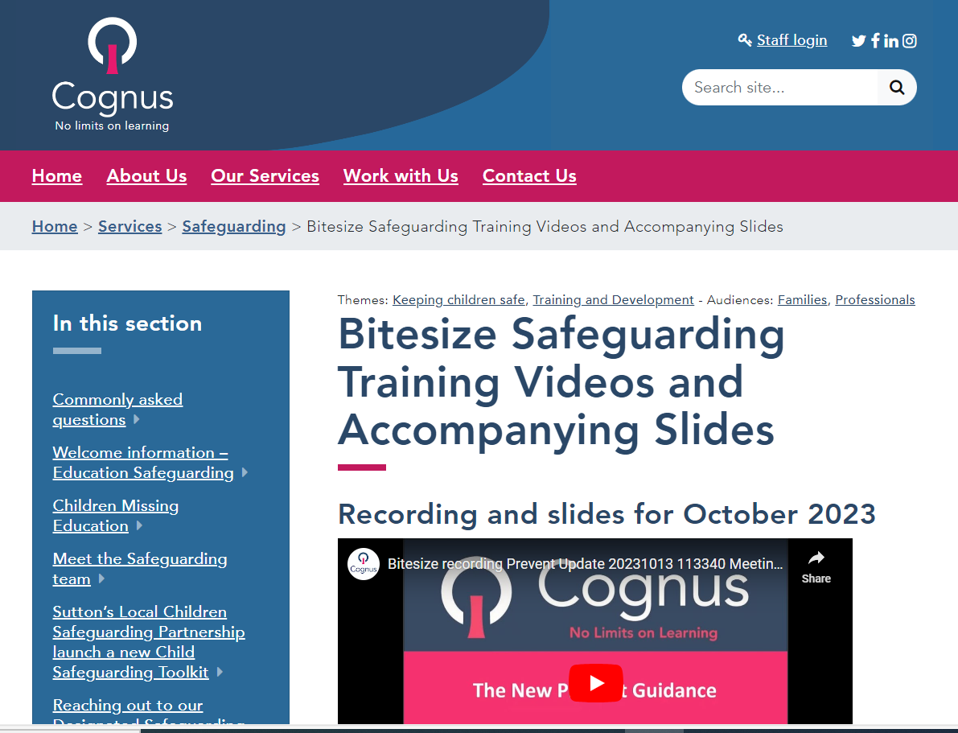
Bitesize training on the Cognus Website

Slide 99
Thank You for Listening
Hayley Cameron: Education Safeguarding Manager
Stephen Welding: Esafety Adviser/Prevent Trainer
Gill Bush: Education Lead, CFCS
Mick Bradshaw: Outdoor Education Adviser

