Slide 1

REVISED LSCP THRESHOLD GUIDANCE 2026
Sutton PSSS, 11 March 2026
Morpheus Patfield, Multi-Agency Partnerships Manager, LSCP and SSAB

Slide 2

Threshold Guidance
Introduction
An update of the revision of the LSCP Threshold Guidance, due for publication on 1 April 2026.
Every LSCP nationally must publish a Threshold Guidance, which sets out “the local criteria for action” in a way “that is transparent, accessible and easily understood by practitioners, children and their families." (WT23, Chapter 2, Paragraph 18). Sutton’s current version is from 2025.
This document is a partnership-developed framework approved by the three statutory Delegated Safeguarding Partners.
It is a tool for professionals and the public to consistently assess concerns about a child's welfare. It sets out the different levels of need and risk, helping professionals decide what level of support a child and family might require—ranging from early community-based help to a formal social work intervention when a child is at risk of significant harm.
The Threshold Guidance supports, but does not dictate to, anyone who makes a referral to the Children’s First Contact Service (CFCS)- the single referral and assessment pathway to access services in the London Borough of Sutton.

Slide 3
Threshold Guidance
Purpose for Change:
Under the DfE’s Families First Partnership Programme (supporting the pending Children’s Wellbeing and Schools Bill), every LSCP nationally must update their threshold guidance, by 1 April 2026:
“Safeguarding partnerships should work together to publish a refreshed threshold document by the end of the transformation year (March 2026) to confirm the changes and remove the need for handovers, building on assessments and plans as needs change. This should set out a broad continuum of Family Help, showing the range of needs for all children that will be supported – with an emphasis on fluidity and prioritising family experience, as opposed to gatekeeping against rigid thresholds.” (FFPP, pp.18-19)
“Central to Family Help is a closer alignment between targeted early help and child in need support and services, to create a seamless support system that promotes early intervention.” (FFPP, p.18)
Notes:
FFP is a large-scale programme, and Threshold is one facet of this. Importantly sets out that “The legislative framework is not changing. Local authorities will continue to have a general duty to provide support and services where children are deemed to be in need (including disabled children)” (p18).

Slide 4
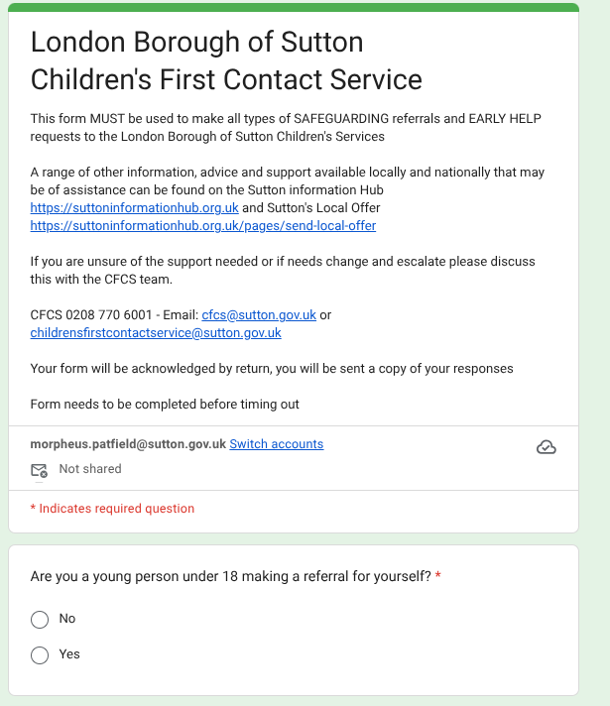
Threshold Guidance for referrals
Notes:
Supports referrals- but does not dictate how they are made/written. The guidance supports the referral mechanism, and outlines the levels of need within which referrals are managed.

Slide 5
Threshold Guidance - revision
Task & Finish Group: Representatives consulted on document in three multi-agency drafting workshops.
Distributed Scrutiny: Harm categories delegated to agency specialists for review.
Overall FFP: Coordinated the workstream via the Families First Partnership Programme And Family Help Project.
Regional Benchmarking: Tested indicators against neighbours and comparable London boroughs.
Pan-London Alignment: Aligned the document with the London-wide continuum of need document
QA&I Subgroup: Provided rigorous scrutiny and endorsement across three review stages.
LSCP Board Approval: Secured broad endorsement from police, health, education, and social care.
Education Working Group: School representatives actively shaped and amended the guidance.
Partnership Executive: Maintained multi-cycle strategic oversight and endorsement.
CFCS Governance Board: Ensured practical alignment with front-door referral processes.
Statutory Sign-off: Final governance authorized collectively by the three Lead Safeguarding Partners.

Slide 6
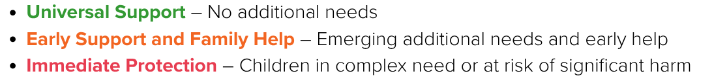
Threshold Guidance - levels and tiers?
All Partnerships nationally have had to revise their Threshold Guidance documents to reflect the change from four rigid tiers to a “Family Help” spectrum.
LEVEL 1 – NO ADDITIONAL NEEDS
LEVEL 2 – EARLY HELP
LEVEL 3 – CHILDREN WITH COMPLEX MULTIPLE NEEDS
LEVEL 4 – CHILDREN IN ACUTE NEED
New, under FFP: The spectrum of need in the thresholds, for mid-level concerns, is illustrated by indicators of concern becoming more serious along a broader spectrum.
Previously: four Levels, across all LSCPs.

Slide 7
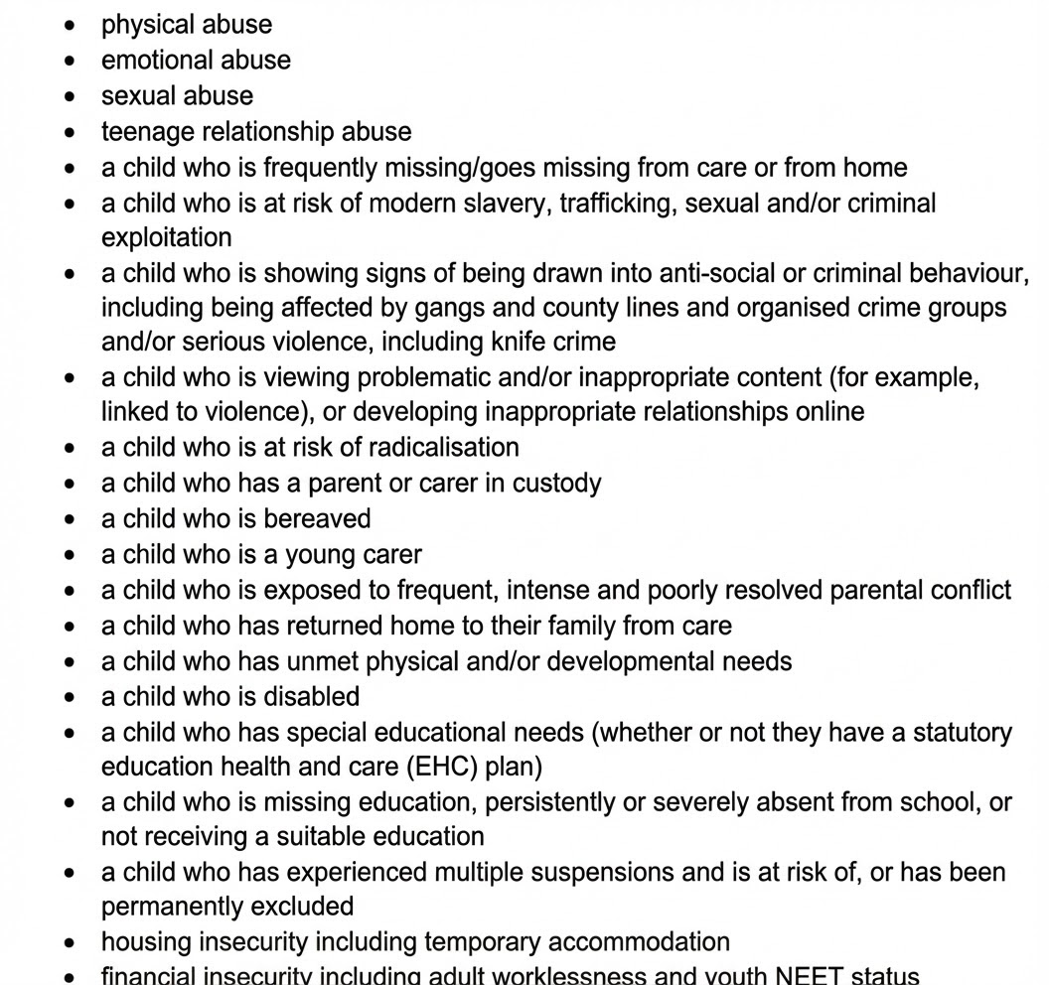
Purpose of document- what does it do?
This document is a partnership framework, and a tool for professionals to consistently assess concerns about a child's welfare. As per WT23, it must be published, and must set out:
The process for early help assessments, and the type and level of early help and targeted early help services to be provided under sections 10 and 11 of the Children Act 2004.
The criteria, including the level of need, for when a case should be referred to local authority children’s social care for assessment and for statutory services under:
section 17 of the Children Act 1989 (children in need, including how this applies for disabled children)
section 47 of the Children Act 1989 (reasonable cause to suspect a child is suffering or likely to suffer significant harm)
section 31 of the Children Act 1989 (care and supervision orders)
section 20 of the Children Act 1989 (duty to accommodate a child)
clear procedures and processes for cases relating to:
the abuse, neglect, and exploitation of children
children managed within the youth secure estate (N/A)
disabled children
Many other factors, outlined in FFP, pp.16-17 —>

Slide 8
Purpose of document- what does it do?
It sets out the different levels of need and risk, helping professionals decide what level of support a child and family requires—ranging from early community-based help to a formal social work intervention when a child is at risk of significant harm.
Statutory duty to refer: Supports referrers to meet obligations under KCSIE, WT23, and S.175 of the Education Act 2002 by outlining the local framework and levels of need for a concern.
A Shared Language: It is a partnership-agreed tool that ensures schools, health workers, police, and social care are all assessing risk and need using the exact same criteria.
A "Spectrum of Need" Map: It helps schools map a child's situation along a spectrum—from Universal Support and Early Family Help, right up to Immediate Protection. When a referral clearly maps to established threshold indicators, relevant services can instantly understand the context and severity of the risk or need, and consider appropriate pathways.
A Tool to Frame Concerns: It provides specific indicators of concern (e.g., around health, attendance, parental conflict) that help staff categorize how serious a situation is becoming.
Information-sharing protocols: Provides LSCP guidance on information-sharing purpose and rationale.
Specific vulnerabilities guidance: Provides local referral guidance on complex issues (e.g. exploitation, children with parents in custody, young carers, domestic abuse, etc).
National research and case reviews (such as those from the Child Safeguarding Practice Review Panel, the DfE's Children’s Social Care National Framework (2023), the Stable Homes, Built on Love strategy, and recent Ofsted thematic reviews of the safeguarding 'front door'—consistently demonstrate that high-quality, detailed referrals lead to significantly better outcomes.
Notes:
The Threshold Guidance is a shared framework that helps us all speak the same language about a child's level of need. It doesn't tell you what specific service to use, but rather helps you clearly articulate why a child needs help so you can make a high-quality, effective referral to the Children's First Contact Service (CFCS).
Sutton is still covered under the (2021) London Multi-Agency Safeguarding Data Sharing Agreement for Safeguarding and Promoting the Welfare of Children (now under revision).

Slide 9

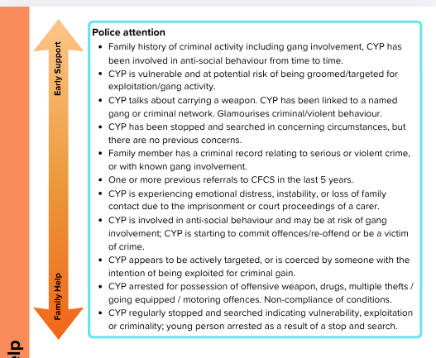
Old vs New Threshold Document
Pan-London continuum of need threshold has kept indicators, but merged the old tiers 2+3
Two levels in one - a spectrum of need for Early Support/Family Help in Sutton

Slide 10
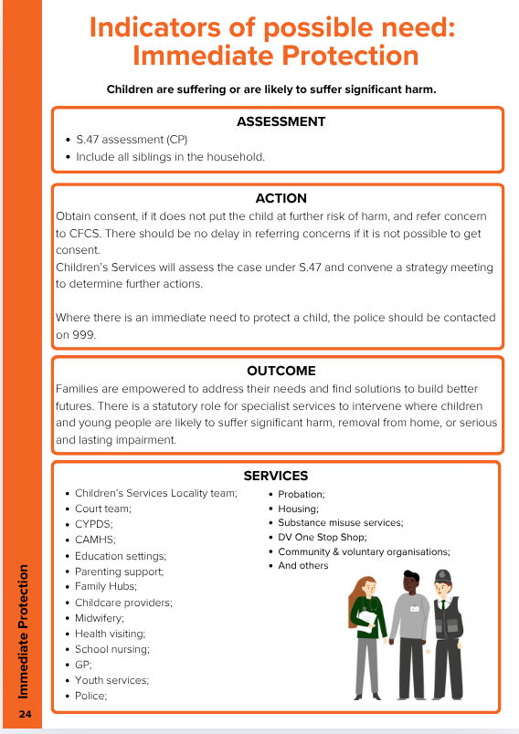
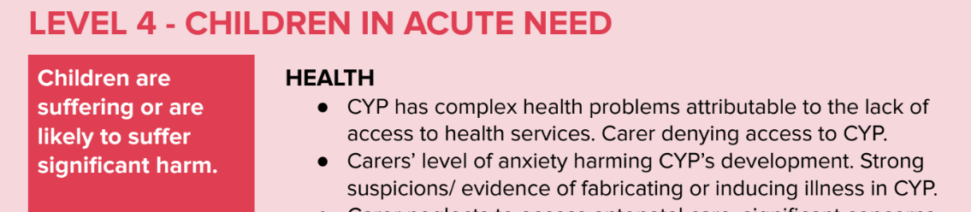
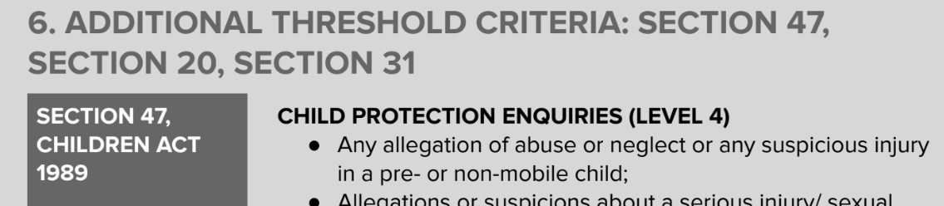
Old vs New Threshold Document
New
Old
Tier 3 is the new tier 4, and an additional threshold considerations section comes after it.
Tier 4 for Immediate Protection, with additional indicators for Child protection etc as an additional section (for S.47, S.20, S.31)

Slide 11
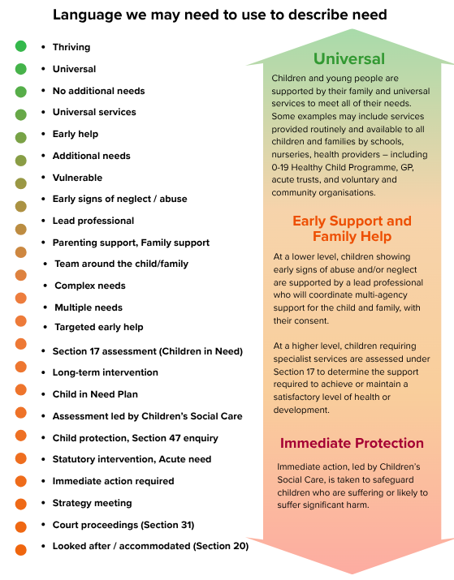
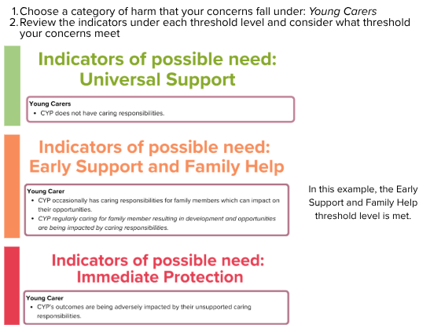
Purpose of document- what does it do?
Notes:
The Threshold Guidance is a shared framework that helps us all speak the same language about a child's level of need. It doesn't tell you what specific service to use, but rather helps you clearly articulate why a child needs help so you can make a high-quality, effective referral to the Children's First Contact Service (CFCS).

Slide 12
Purpose of document- what does it not do?
It does not change how or when referrals are made for children and young people.
It is NOT a Service Directory: The guidance does not list specific services, and does not name every service available to children. Under the Families First Programme, all universal services should be accessible and open to all children regardless of the level of their original concerns.
It is NOT Binding, Prescriptive, or Exhaustive: The Threshold Guidance is not binding nor prescriptive. It does not and cannot name every concern that may arise. The document provides indicative examples rather than a definitive checklist. It cannot account for every situation.
It is NOT a Substitute for Professional Judgement: The guidance supports your decision-making; it does not replace the gut instinct and professional knowledge of school staff who know the child best.
It is NOT an Assessment Tool: While it helps you map the severity of a concern, it does not replace the need for a thorough Early Help Assessment (EHAT) or a statutory social work assessment. It is a guide to assist in decision-making, not the assessment itself.
It is NOT a Rigid "Gatekeeper" to Services: Under the new 2026 framework, we are moving away from rigid "tiers" that keep children out of services. As seen in other progressive safeguarding partnerships, the document is not designed to automatically open or close the door to support based on a strict score. Instead, it promotes fluidity across a spectrum of need.
Sutton LSCP is collectively signed up to comply with the Pan-London Safeguarding Children Procedures, and the shift to the new 'Spectrum of Need' aligns directly with the Pan-London continuum of need threshold.

Slide 13
Next steps
For schools:
Before 1 April 2026: Be aware of the upcoming changes to the LSCP threshold guidance and therefore in the CFCS Referral Form.
Continue to refer to, and liaise with CFCS as before.
To be aware of:
The new Threshold Guidance will be published on 1 April 2026;
Sutton CFCS and Sutton Children’s Services are in the process of transformation under FFPP; teams and services are undergoing restructure to align to the reforms.

Slide 14
Questions?
Contact: suttonlscp@sutton.gov.uk.

