Slide 1


Building Stronger Foundations
Supporting schools to extend and embed inclusive, relational, trauma and attachment aware approaches

Slide 2
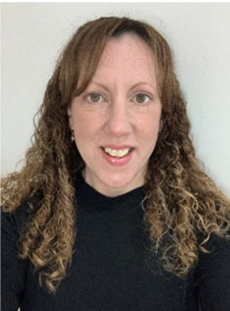
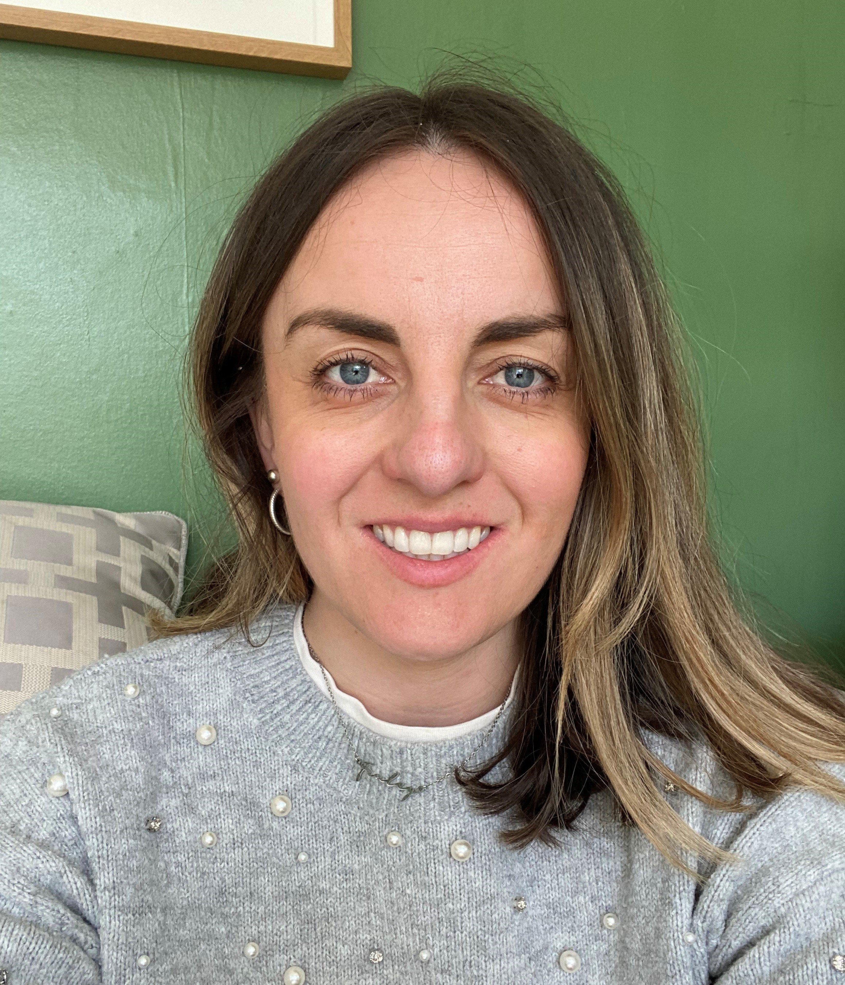
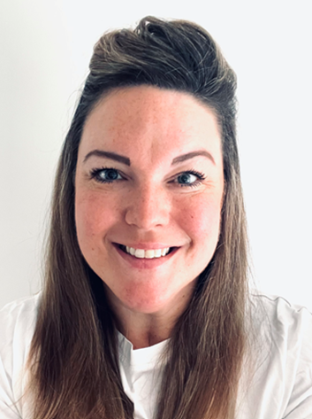
The BSF team
Sara Martin
BSF Lead
Sutton Virtual School Deputy Headteacher
Strategic Lead for children with a social worker & Kinship
Sara.martin@cognus.org.uk
Dr. Kate Payne
Senior Educational Psychologist
Kate.payne@cognus.org.uk
Hannah Miles
Lead advisor for BSF
Extended Duties Education Advisor
Hannah.miles@cognus.org.uk

Slide 3
Key objectives for today's session
To understand what the Building Stronger Foundations programme entails and how it links to the national ARC awards
To have a clear idea of what is involved in taking part
To understand how to complete the audit and become familiar with the Impact and development plan – two key evidence-based documents needed for certification

Slide 4

Part 1: an overview of BSF
Aims of Building Stronger Foundations
Participating schools
Key aspects of the programme
Benefits and impact
What’s involved
The Attachment & Research Community (ARC) and award pathways

Slide 5

Building Stronger Foundations (BSF)
A programme designed by Sutton Virtual School that supports schools to extend and embed inclusive, whole‑school relational approaches. The programme is built to offer flexibility so that it’s tailored to your school.
Builds consistently strong staff–pupil relationships at all levels
Provides practical, evidence‑based relational strategies
Improves outcomes and strengthens school culture and systems
Supports belonging and effective responses to dysregulation
Provides evidence of working in partnership to promote inclusion
Notes:
A programme aimed at supporting schools andsettings to develop a whole-school relationalapproach based on trauma-informed andattachment-aware practice.
The key focus of the programme is to support consistently strong working relationships between staff and pupils, by equipping staff with evidence-based, relational strategies thatsupports their interactions. Research shows that thisapproach leads to better outcomesfor pupils, impacting positively on the whole culture of the school. Relational practice benefits all pupils, not only those who are trauma-experienced, becauseit supports pupils to feel a sense of belonging and helps staff to support dysregulated children, which aids de-escalation.

Slide 6
Participating Settings
Early Years settings
Oaklings preschool ​
Shanklin preschool ​
Sunflowers preschool ​
Lavender preschool at Tweeddale​
Sutton Day Nursery​
St Barnabas preschool
More to join in September 2026
Primary Settings
New this year:
Holy Trinity CofE Junior School
St Mary's Catholic Federation
Beddington Infants' School
Barrow Hedges Primary School
Culvers House Primary School
Wallington Primary Academy
Robin Hood Junior Avenue Primary Academy ​
Dorchester Primary ​
All Saints Carshalton CofE Primary ​
Tweeddale Primary ​
Foresters Primary
Green Wrythe Primary
The Federation of Hackbridge Primary & Spencer Nursery School
The Federation of Thomas Wall Nursery and Robin Hood Infant School
Wood Field Primary School
Stanley Park Infants' School
Stanley Park Junior School
Avenue Primary Academy
Devonshire Primary
Brookfield Primary
Cheam Common Infants’ Academy
Cheam Common Junior
Cheam Fields Primary
Cheam Park Farm Primary
Manor Park Primary
Secondary Settings
Greenshaw High School
Nonsuch High School for Girls ​
Harris Academy Sutton ​​
Carshalton High School for Girls
Sutton Tuition and Reintegration Service
Wallington County Grammar
Carew Academy
Oaks Park High
Wallington High School for Girls
Overton Grange School
St Philomena’s Catholic High School for girls
The Limes College
Cheam High School
Carshalton Boys Sports College

Slide 7
Key aspects of the programme
Led and shaped by you and your school’s priorities
Flexible use of funded EP time for your chosen areas of development (e.g. strategic or systemic, additional staff training, a chosen area of focus such a play times)
Access to refer children under Virtual School remit for funded SaLT and EP assessments
Funded membership to the Attachment & Research Community (ARC) and their nationally recognised award pathways, certified via the Virtual School
Part of a growing network of schools in Sutton and beyond sharing practice and ideas
We offer BSF as a three-year package and beyond so you can plan ahead a longer-term strategy and build on activities each year

Slide 8
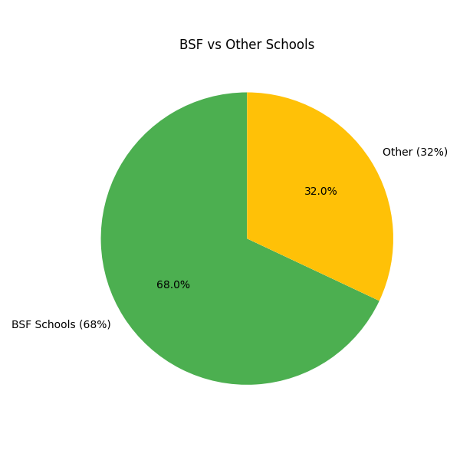
Impact to date
  1,500+ staff have completed training
  Over half of all Sutton schools are in the programme and ARC members
  95% of staff report feeling confident to use relational practice and all schools have reported an improved understanding of how to support pupils using relational approaches
  67% of schools specifically reported an increase in relational and trauma-informed language in staff interactions with pupils
4 Gold award schools
8 Silver award schools working towards Gold
13 Bronze award schools working towards Silver
3 schools applying to be Learning Hubs
Notes:
81% of schools reported improved alternatives to isolation or exclusion
86% reported improved pupil regulation

Slide 9


Impact on pupil outcomes
improved alternatives to isolation/ exclusion
of schools in BSF for 1yr+ reported a reduction in suspensions
reported improved pupil regulation
Reported more inclusive practice
50% of schools who have achieved gold ARC awards reported improved attendance data
Notes:
81% of schools reported there are now improved alternatives to isolation or exclusion in place as a result of BSF activities
86% of schools reported improved pupil regulation, and over half of schools noted pupils self-regulated more quickly
57% reported a reduction in the number of behaviour incidents, and 83% of schools who have been on the programme for a year or more reported a reduction in suspension rates, either across the school or within the CWSW cohort
50% of schools who have achieved gold ARC awards reported improved attendance data
All schools reported development of more inclusive practice

Slide 10
Impact reported by schools
‘The total number of children needing to stay in for detentions/restorative conversations has reduced by 37%’
‘Attendance improved by 2% across the school and persistent absence dropped by 12%’
‘Attainment and progress for all groups of pupils has improved, with significant shifts in achievement for our pupils with trauma or attachment difficulties ’
‘There was a reduction in both suspensions and exclusions this year. Staff feel more confident to relationally de-escalate situations.’
A MAT that adopted relational approaches through BSF across all schools reported ‘enhanced academic performance, positive shifts in emotional screener data, improved attendance rates, reduced suspension data, and compelling pupil and family voice.’
‘Lunchtime behaviour incidents have reduced by 17%.’
Notes:
Recognition of the importance of providing a resource to facilitate meaningful change

Slide 11
Impact reported by schools
‘BSF training has been invaluable; it has raised awareness that the importance of using relational language is essential to being able ‘to connect before correct’. Removals from class have reduced, staff are using the strategies to empathise and de-escalate situations and incorporating the language in restorative justice sessions.’
‘As a result of our journey to become more relational, students experience safer, more predictable environments. There has been a reduction in reactive behaviour and improved staff confidence in using relational strategies to support pupils’ regulation. We have noticed stronger relationships between staff and vulnerable learners, and improved attendance of this cohort.’
‘The support that we’ve had from the Virtual School and EP team has been fantastic. It’s really helped us to impact positively on pupil outcomes, especially for those open to social care.’
‘SLT have a clear vision for Trauma informed and attachment awareness and are actively working on this plan to embed relational practices across the whole community. We’re starting to hear the common language of emotion coaching and staff feel confident in relational practice.’
‘As a result of our involvement in and learning from this project, we’ve seen positive changes across the school: calmer learning environments, improved emotional literacy among staff and students, and stronger relationships built on trust and understanding.’

Slide 12
What is involved?
Audit
Mid-year consultation
Evaluate progress & impact
Consultation meeting
Staff training
Undertake planned activities to address development areas
Plan actions and activities
Notes:
Audit of provision to identify your chosen areas for development
Consultation to map out activities and plan training and EP hours
Staff have training in rel and TI practice*
Lead team undertake activities over the year
mid-year consultation
Staff follow up session/s
At the end of the year, review progress against the audit and complete your dev plan and send toVirtual School so we can report on impact across all schools
Plan year 2 and 3 using further funded package
*Some schools use some of their EP time to facilitate support staff, officestaff and MDS staff training separately due to logistics
Roadmap hand out attached to slides when handing out

Slide 13

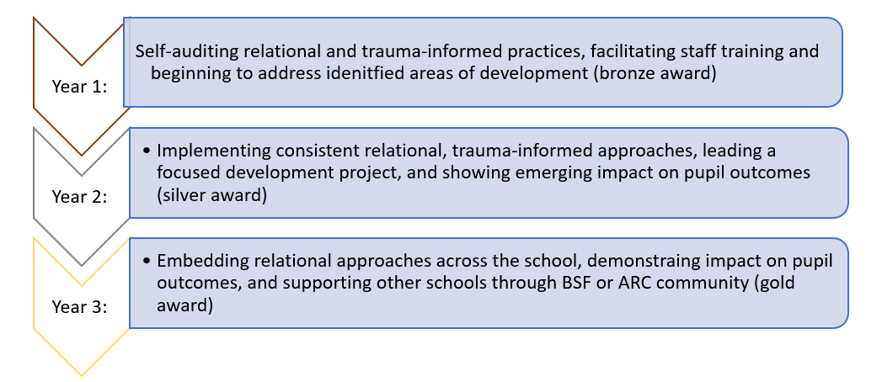
BSF Award pathways and the Attachment & Research Community (ARC)
Bronze award
Silver Award
Gold award

Slide 14
Links to the new Ofsted framework
The BSF programme directly supports schools in meeting these expectations through its focus on inclusive, relational practice, trauma-informed approaches, staff development, and inclusive culture of belonging.
‘Leaders have established a culture in which staff understand the range of barriers that pupils may face to their learning and/or well-being; they quickly and accurately identify pupils facing these barriers’
'Staff have the necessary expertise, confidence and support to adapt behaviour policies and practices appropriately and consistently for pupils with specific needs'
Staff training in evidence-based approaches and strategies to support those needing adaptations or additional support
Support to extend and embed consistent use of relational practice across the setting at all levels
'Pupils feel welcome, valued and respected and that they belong within the school community'
Strategic opportunities to further develop whole-school culture and systems
'Leaders work well with social workers, the virtual school and other professionals to plan and provide multi-agency support for pupils who are known (or previously known) to children’s social care'
‘Having a coherent professional learning programme for all staff that is rooted in a culture of purposeful collaboration'
Explicit evidence from external agencies of inclusive practice and partnership working through the Virtual School and ARC
Inclusive practice that benefits all pupils and especially those who are trauma-experienced is at the heart of BSF

Slide 15

Part 2: the details
The audit
Development & Impact plan
Use of funded EP hours
BSF workshops
Access to referring for funded mini-assessments
Advice and support from the Virtual School

Slide 16
Audit
Complete this together with the Lead Team
Discuss and formulate 3-4 objectives
Incorporate these into school action plans
Leadership
Identifying need and facilitating support
Curriculum
Working in Partnership
Ethos & Inclusive environment
Staff

Slide 17
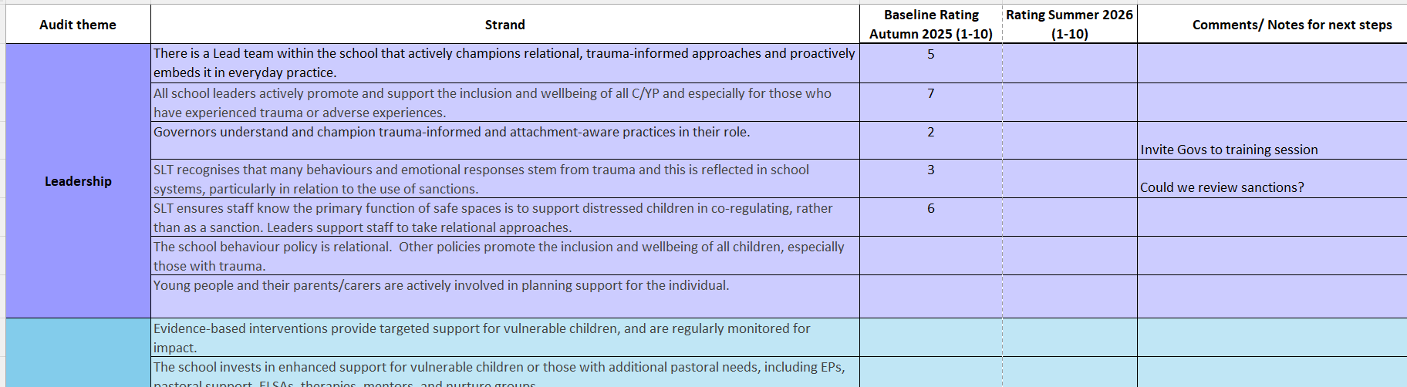
Rate each strand 1-10 and add notes to support formulation of BSF objectives
Please send a copy of the audit to Virtual School by May 2026

Slide 18
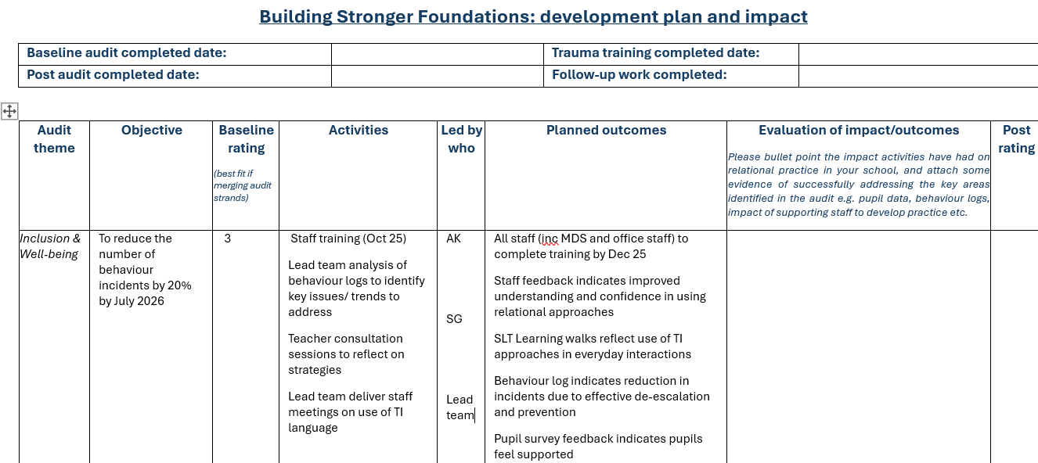
Development & Impact plan
Be clear about your SMART targets and incorporating them into school action plans
Work with SLT to ensure responsibility is shared and all are committed to supporting the development of these areas
Consider a range of feedback

Slide 19

Educational psychology support:
Each school will be allocated an EP
EP and VS will hold an initial consultation to discuss with you your chosen areas of focus, activities and how you'd like to use the funded EP time to support it
Flexibility of how the hours can be used depending on individual school context
Examples include:
Staff training
Pupil focused meetings to explore strategies for specific children
A focus project on reducing suspensions, playtimes etc
Adapting the behaviour policy
Staff supervision sessions
Supportive observations and follow up consultation
Drop-in surgeries
Notes:
KATE
Consultation meeting
Action planning – Development & Impact plan
Use of EP hours (menu and examples (next slide?)

Slide 20
Examples of EP time
Devon and Babcock's relational practice three training sessions:
Developing relationships
Responding calmly to de-escalate
Repairing and restoring.
This allowed for recap of training and review of strategies tried and as a consequence, SLT noticed a change in language used in the classroom.
Staff surgeries: each class teacher/TA could meet with EP/VS to problem solve cases and apply relational practice. Second surgeries took place in summer term to review cases. This enabled staff to apply training to individual cases.
SLT Meetings:
collaboratively developing a future vision for the school and steps to take towards it. This encouraged all of SLT to take some ownership of the programme.
Behaviour Policy Review:
held a meeting to discuss strengths and potential changes. The school SLT made amendments and then a review meeting was held afterwards to plan for dissemination.
Secondary schools invited the EP to meet with HoYs to discuss their role in de-escalating and modelling relational practice to build capacity and extend the lead team.
Some schools asked for:
Emotion coaching
Restorative conversations
Staff wellbeing
Executive functions.
Autism and trauma.
Notes:
Kate

Slide 21
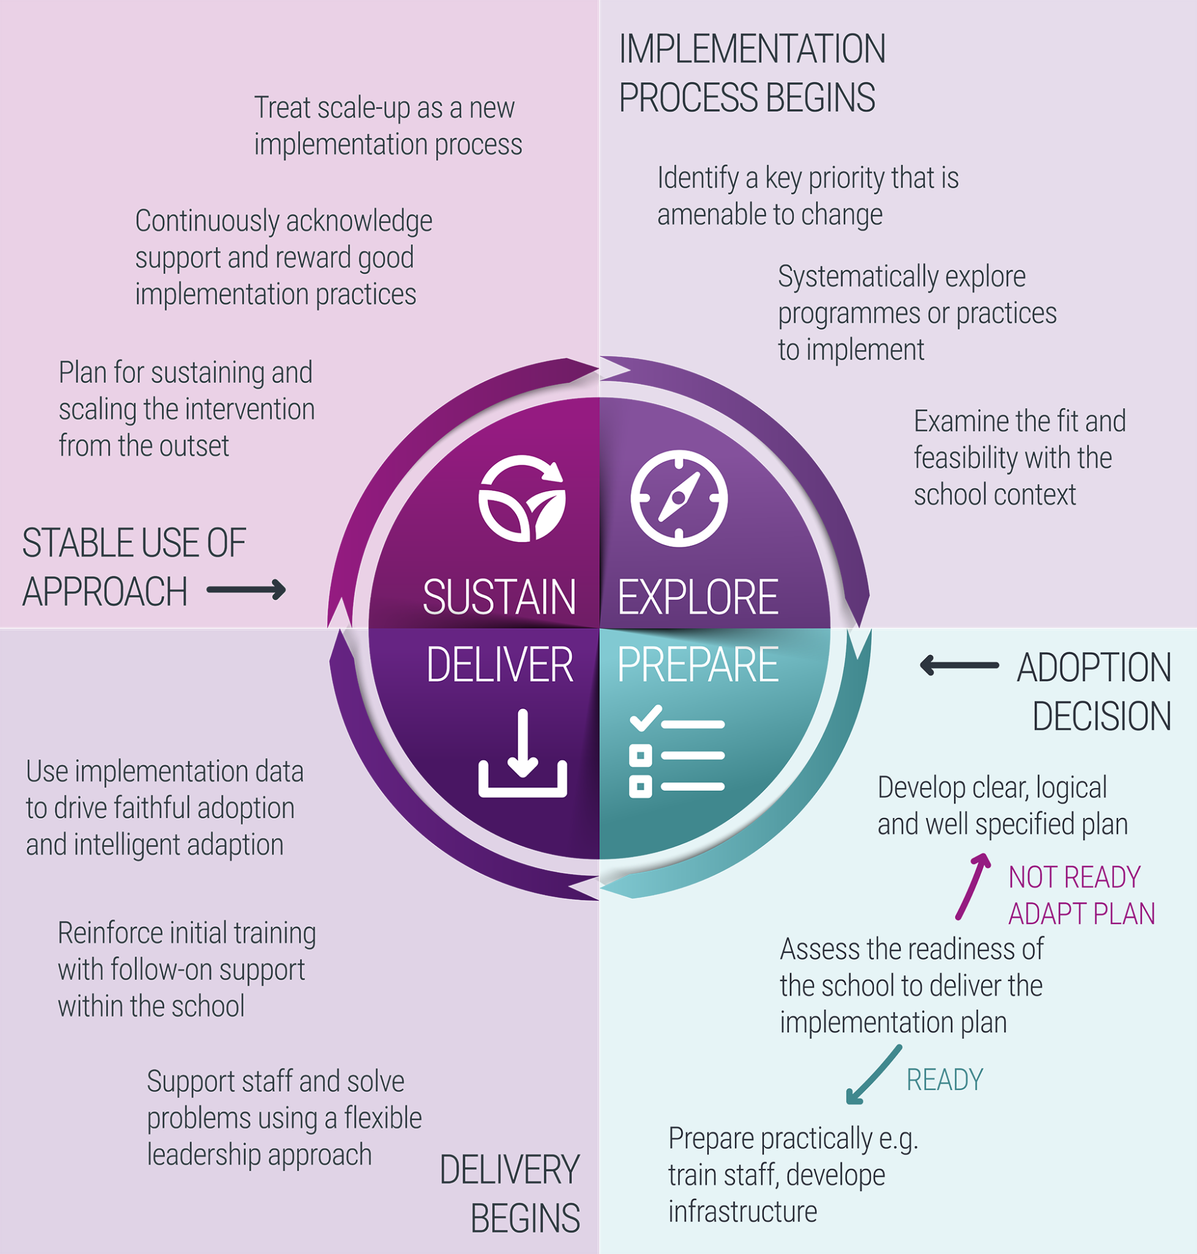
How to make the most of BSF
The lead team taking the lead!
The training is the easy bit – importance of implementation
Allocation of duties in terms of delivery and accountability
Being clear on the outcomes you’re working towards
Reviewing and adjusting at the February consultation
Notes:
Kate

Slide 22
Free workshops for BSF schools
Learning Hub workshops offered through ARC –will be shared
Curriculum workshop: 22nd September 2026 - 3.00pm-5.00pm
Empowering Lead Team: 14th October 2026 – 9.00am - 11am
Relational policy: 3rd December 2026 – 9am – 11am
Governor session: 3rd February 2027 – 6-7pm (this session will be virtual)
Relational practice in SEND: 25th February 2027 – 8.45am-10.45am
Trauma-informed resources to support school-based interventions: 15th March 2027 – 3pm-5pm
Refresher trauma training: 28th April 2027 – 4pm-5pm
Gold award masterclass: 27th January 2027 – 2pm-4pm
End of year network event: 30th June 2027 – 2pm-4pm
BSF workshops are held in-person facilitated by the Educational Psychology team
Focus will be on different aspects of embedding relational practice and support you to address key audit areas
Please invite the relevant staff members to sign up to workshops linked to their role
Building Stronger Foundations Workshops 2026-2027 Sign Up – Fill in form

Slide 23
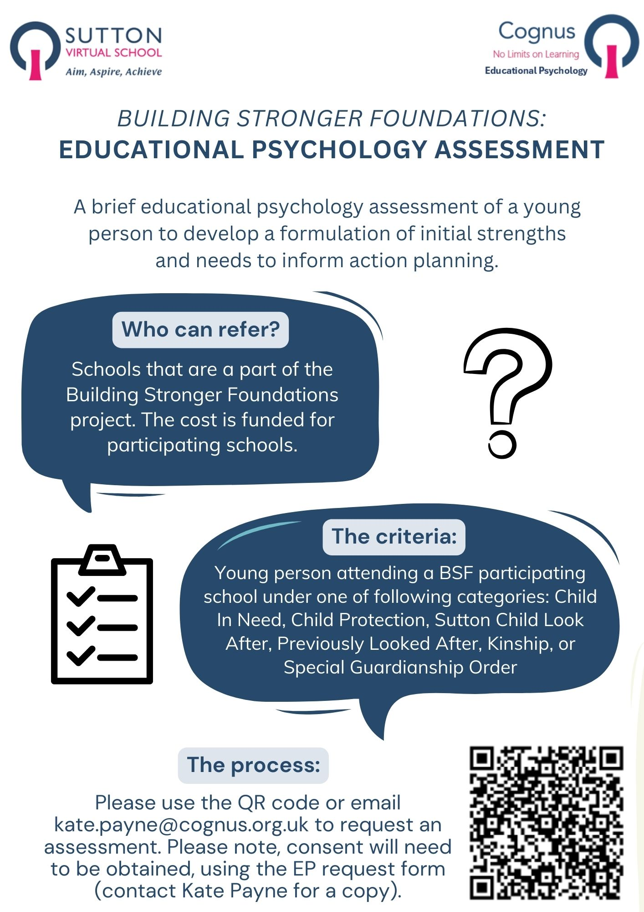
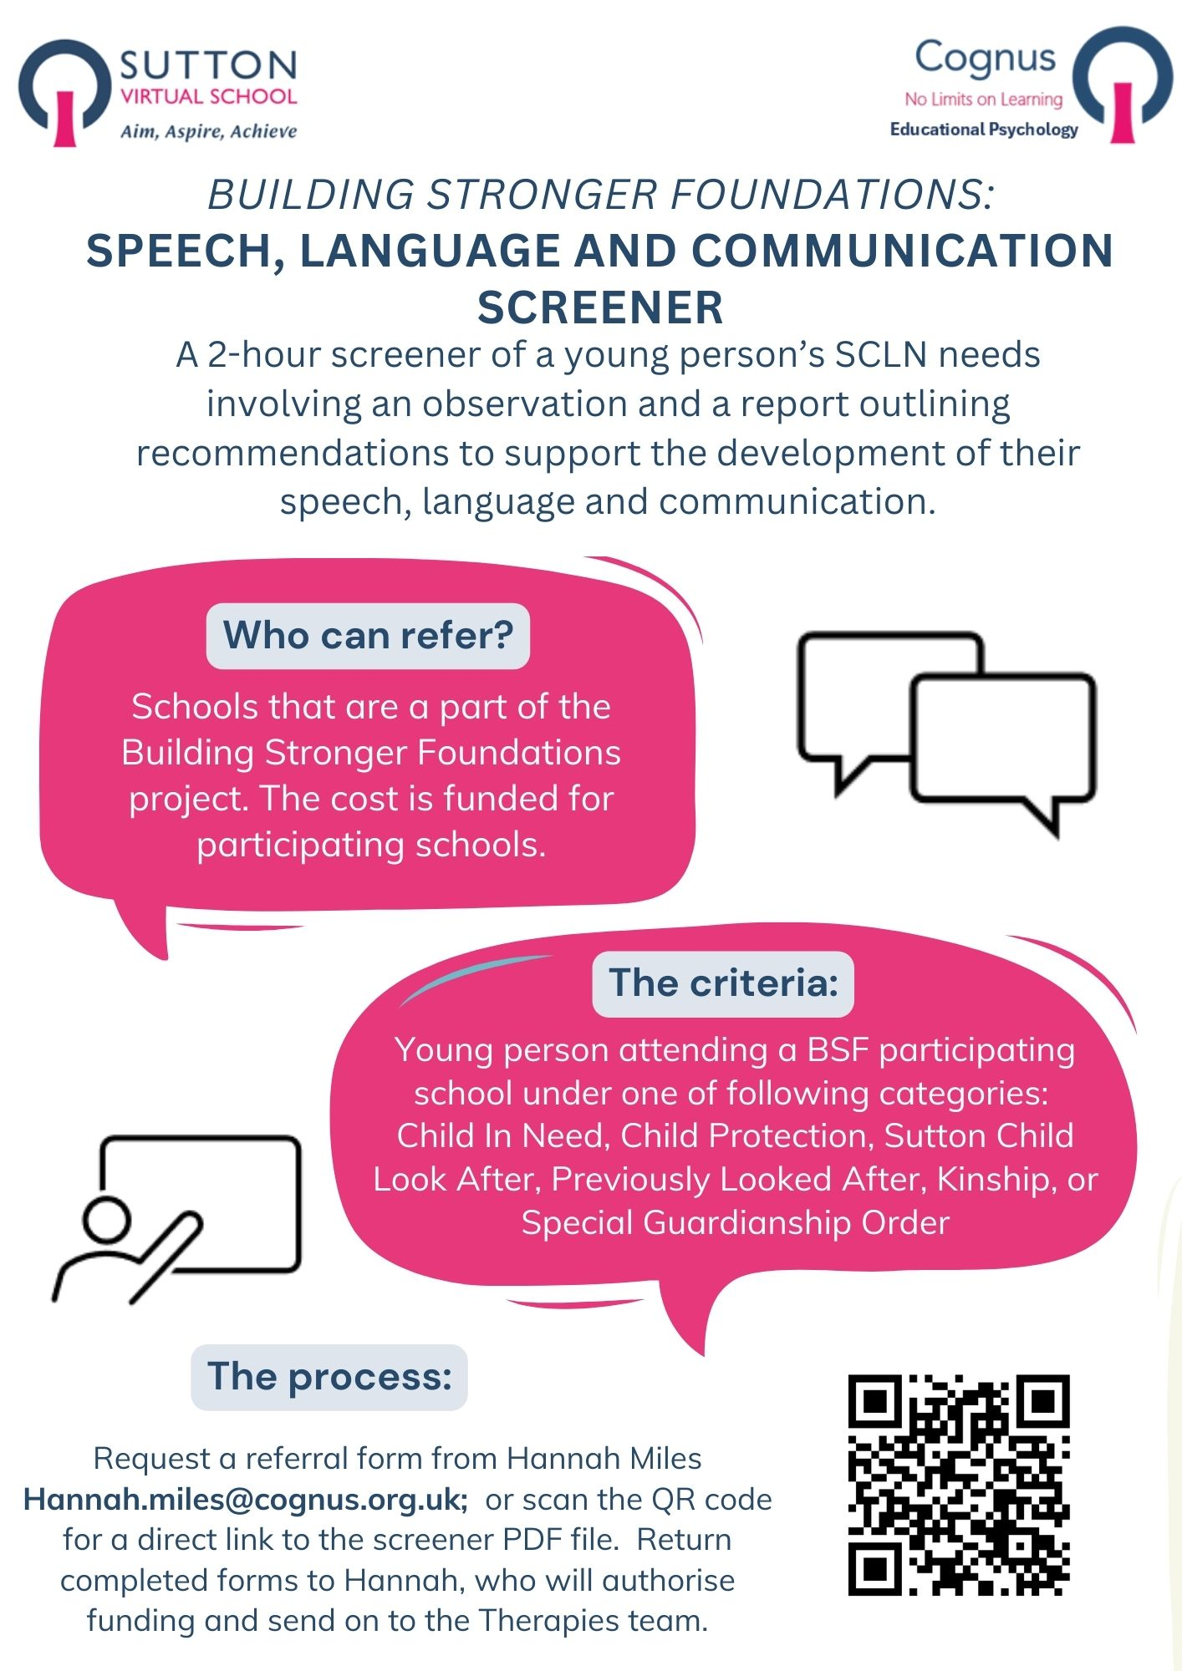
Educational Psychology and SLCN Screeners
For a brief EP assessment email Kate: kate.payne@cognus.org.uk or scan the QR code on the EP flyer
For SLCN screener referral, email Hannah: hannah.miles@cognus.org.uk or scan the QR code on the flyer

Slide 24

Extended Duties Information, Guidance and Support
Advice and support for schools and social workers working with young people under our remit:
Children on a Child in Need plan (CiN)
Children on a Child Protection plan (CPP)
Previous Child Looked After (PCLA)
Kinship & Special Guardians (SGO)
Children who had a social worker in the last 6 years
(ever 6 CWSW)
Contact Hannah at Hannah.miles@cognus.org.uk
Virtual School Consultations
Book a consultation – Cognus
David D'Souza

Slide 25

Questions?

