Slide 1
Gypsy, Roma and Traveller Pupil Lived Experience in School
- Questionnaire Responses

Slide 2
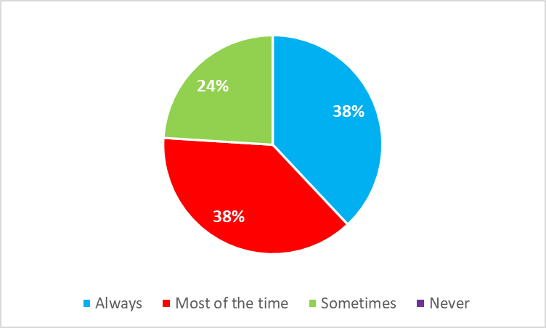
1) I feel welcome in my school.

Slide 3
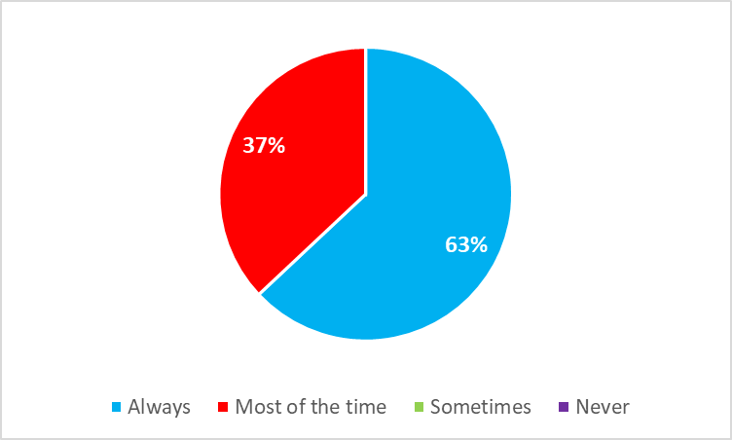
2) I feel safe in school.

Slide 4
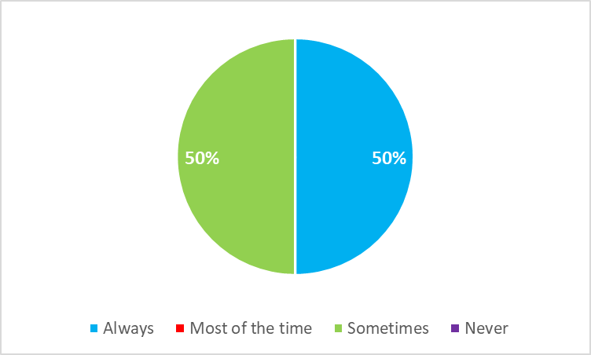
3) Teachers understand and respect my background.

Slide 5
4) Other pupils treat me with respect.

Slide 6
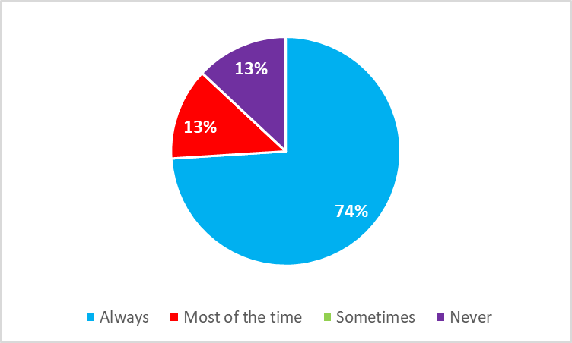
5) I feel comfortable being open about my identity in school.

Slide 7
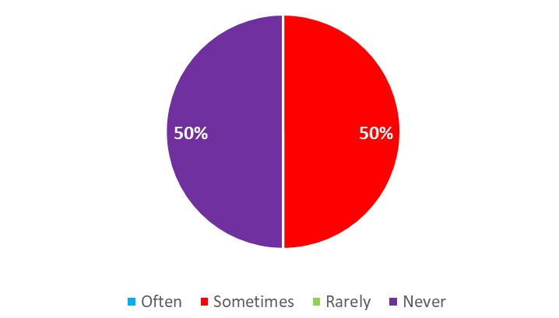
6) My culture, history or community is represented in lessons or school life.

Slide 8
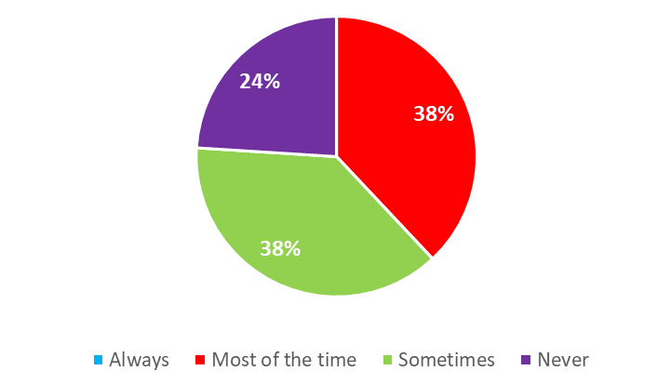
7) School understands things that may affect my education (For example, family responsibilities, travelling, language needs, or cultural traditions).

Slide 9
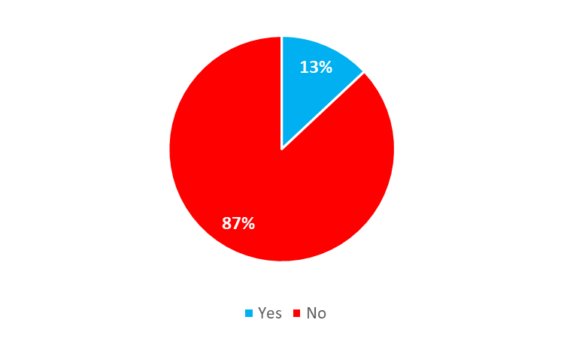
8) Have you ever experienced bullying, racism or discrimination in school linked to being from a Gypsy, Roma or Traveller background?

Slide 10
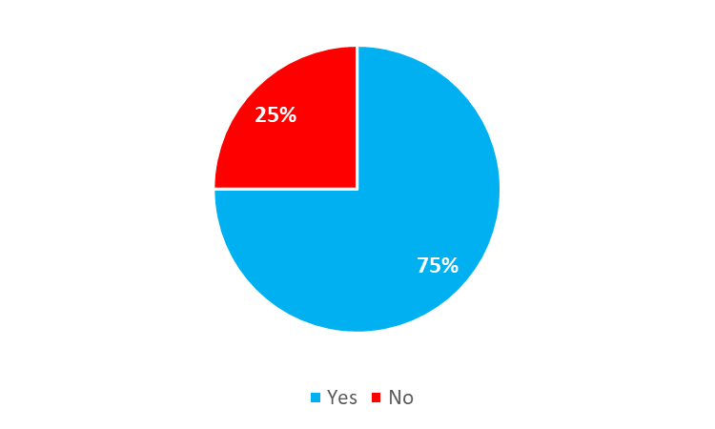
9) If this happened, did you feel able to report it and be taken seriously?

Slide 11
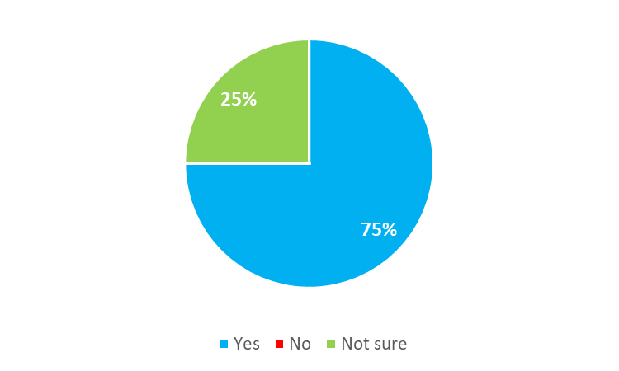
10) Do you know who to go to in school if you need help or support?

Slide 12
11) Tell us what your school does well to support Gypsy, Roma or Traveller pupils.
A few of the responses listed below:
“Support from the Traveller Education Service.”
“Nothing.”
“Not sure.”
“Having Traveller Education support”
“They treat us like everyone else.”
“Nothing really, they treat us like normal students.”
“They help me learn and take care of me.”

Slide 13
12) Tell us what your school could do better to make Gypsy, Roma or Traveller pupils feel welcome and supported.
A few of the responses listed below:
“Maybe they could do something with Travellers like have a club.”
“I don't know”
“Not sure.”
“Include Travellers in History lessons.”
“Have Traveller culture represented in school and lessons.”
“Some learning about Travellers because they are always learning about different cultures except Travellers.”
“Learn about Travellers in lessons.”

